Slide 1
Project 2 Point Cloud Visualization
Alexandre Rodrigues
Matricola: 2039952
Email: alexandre.darocharodrigues@studenti.unipd.it

Slide 2
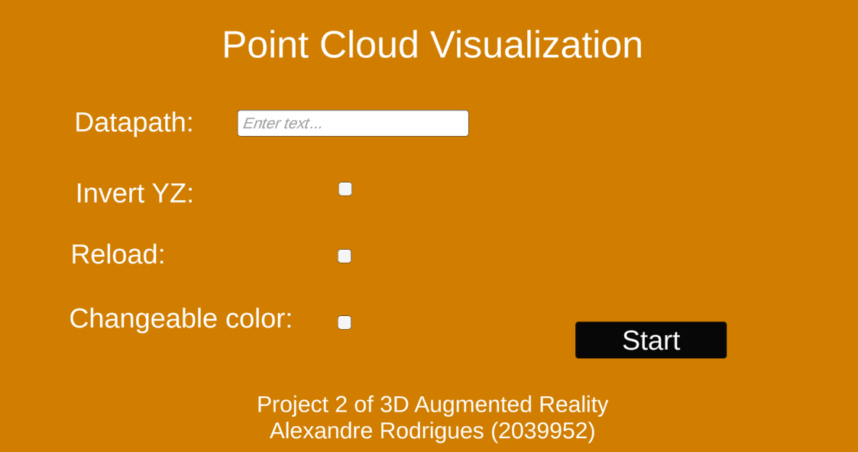
Initial Menu
Datapath
Supports: .txt, .off, .pts.
Invert YZ
Reload
Changeable Color:
Deactivates the VertexColor effect (different colors for some points)
Activates the NeonShader with red as the initial color;
Uses Global References static class to save these parameters for the PCAdv1 scene to read.
Notes:
(based on Lab5)

Slide 3
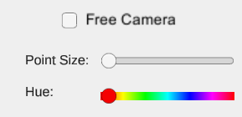
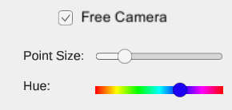
Interface
Free Camera toggle:
Disables CarCameraScript;
Disables the car-like movement of the cube;
Enables the Free Camera script.
Point Size slider:
Varies the size of the points from 1 to 10.
Hue slider:
Varies the hue of the color;
Saturation and value are always 1;
Uses a hue bar texture to improve selection.

Slide 4
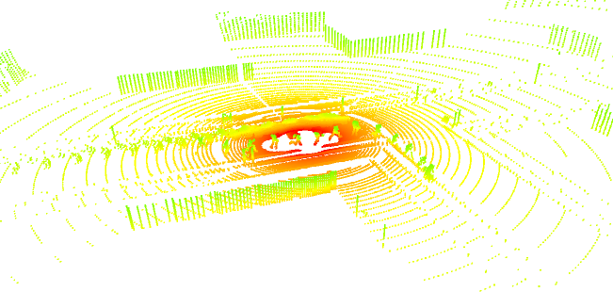
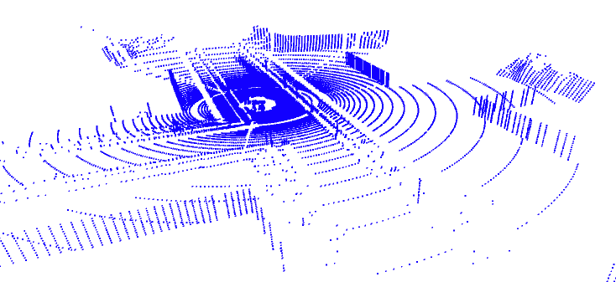

Two Shaders
Added Point Size property in both (only for OpenGL).
VertexColor
NeonShader
Color defined in the material;
Neon effect.
Specific color for each point;

Slide 5

Closer to origin
Shift $y$to be always above the plane:
$$y←y−min$$
To center the point cloud at the origin:
$$x←x−\frac{min+max}{2}$$
$$z←z−\frac{min+max}{2}$$

Slide 6
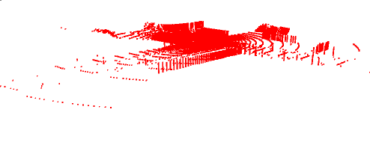
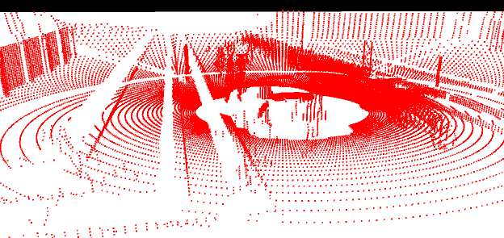
Camera MODES
Free Camera
Standard script from Unity;
Arrow keys to move;
Control key for faster movement;
Mouse right button to rotate.
Follows a very small sliding cube;
Rotates naturally;
All movements are damped.
https://answers.unity.com/questions/900069/camera-turns-to-the-front-when-reversing-car.html
Car-Like Camera

Slide 7
Possible Improvements
Menu to open a LIDAR file;
Workaround to implement Point Size variation in DirectX;
Rendering points as disks to improve close visualization;
Lose dependability on the Asset Manager to allow building an .exe;

Slide 8
Thank You
Alexandre Rodrigues
Matricola: 2039952
Email: alexandre.darocharodrigues@studenti.unipd.it

