Slide 1
Laboratório de Computação e Visualização Científica Visualizing Monte-Carlo sampling of the Ising model phase space
João Amaral (jamaral@ua.pt)
14/3/2022

Slide 2
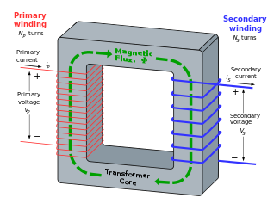
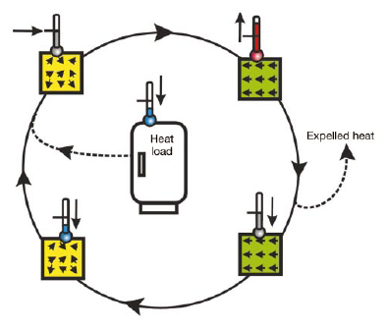
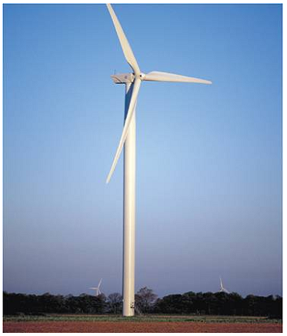
Ferromagnetic materials for energy applications
Ferromagnetic materials have three main applications in energy [1]:
Hard magnets: magnetic motors and generators
Soft magnets: power transformers
Magnetocalorics: power generation and heat management
T
T+ΔT
Q
Q
Absorb heat
T
T-ΔT
A wind turbine can have up to 3 tons of hard ferromagnetic material
All transformers, big and small, employ a “ferrous core” which is a soft ferromagnet
A ferromagnetic material has a phase transition, which can be used for cooling
[1] O. Gutfleisch et al., “Magnetic Materials and Devices for the 21st Century: Stronger, Lighter, and More Energy Efficient”. Adv. Mat. 23, 821, 2011

Slide 3
Modeling the performance of a ferromagnet
For these three major applications, the material’s applicability depends on the temperature at which the ferromagnet transforms into a paramagnet: its Curie temperature (Tc)
A ferromagnet’s Curie temperature establishes its working temperature limit, below which it is useful in motors and transformers. In the case of magnetocalorics, it defines the operational temperature.
Materials currently used for these applications have been found through extensive experimental studies. With modern computational tools, it is possible to computationally search for new ferromagnetic materials for applications: Computational materials design
To predict the Curie temperature of an atomic structure, we need a model that describes magnetic interactions, and their thermodynamic properties.

Slide 4
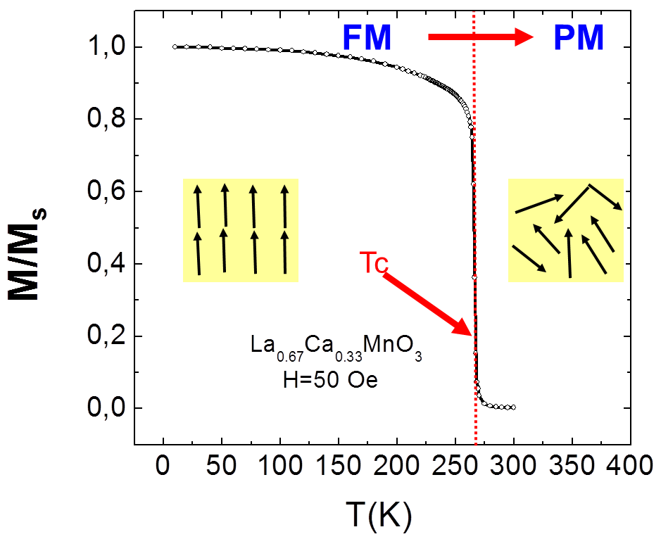
Ferromagnets – a simplified view
(experimental data)
M = 1 (saturation)
M ~ 0 (disordered)
T < Tc
(low entropy)
T > Tc
(high entropy)
If we consider a free energy F = E – T.S, the energy term dominates for low T, while the entropy term dominates for high temperature
Build the simplest model to reproduce this behavior

Slide 5

The Ising model
Magnetic
moment
Sum over
Pairs of spins
Interaction
strength
T > Tc
(high entropy)
T < Tc
(low entropy)
For each spin pair, an interaction energy is defined
If J > 0, the system will be ferromagnetic for T = 0
To model large systems, a lattice should be as large as possible, and use periodic boundary conditions (PBC).
Nearest neighbor interactions should be dominant
Does this work for a VERY small 2x2 lattice with PBC?

Slide 6

2x2 simple square with periodic boundary conditions
The joint density of states, JDOS
3
4
M | E | Ω | Z | F
4 | -8J | 1 | e^{8J/kBT} | -8J
2 | 0 | 4 | 4 | -kB.T.log(4)
0 | 0 | 4 | 4 + 2*e^{-8J/kBT} | -kB.T.log(4 + 2*e^{-8J/kBT})
 | 8J | 2
-2 | 0 | 4 | 4 | -kB.T.log(4)
-4 | -8J | 1 | e^{8J/kBT} | -8J
2
1
2
1
4
3
4
3
1
2
16 total
12 + 2*e^{-8J/kBT}+2*e^{8J/kBT}

Slide 7
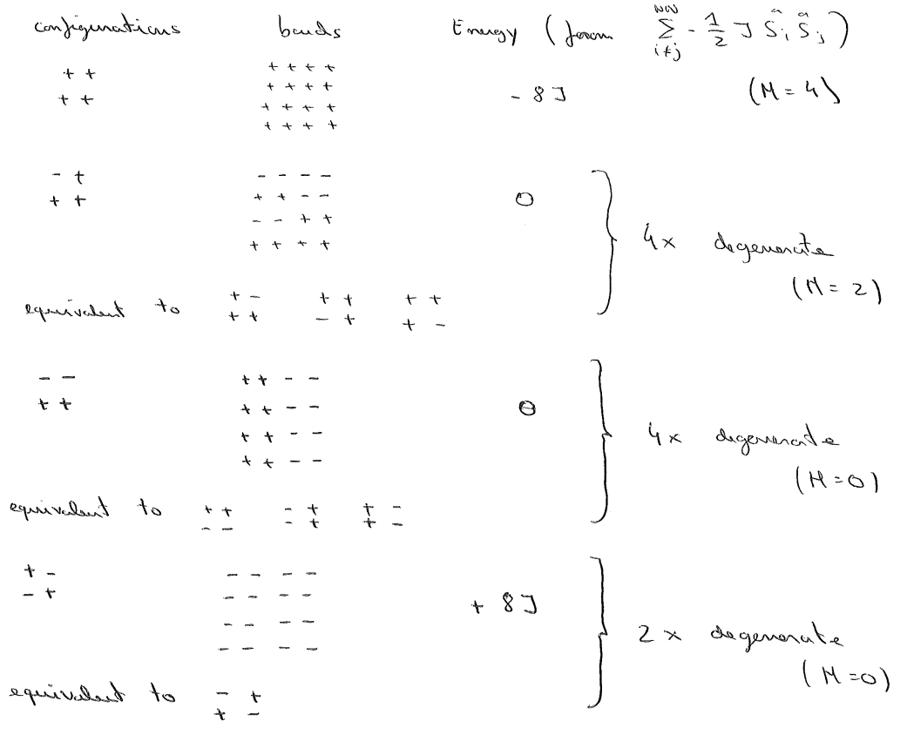
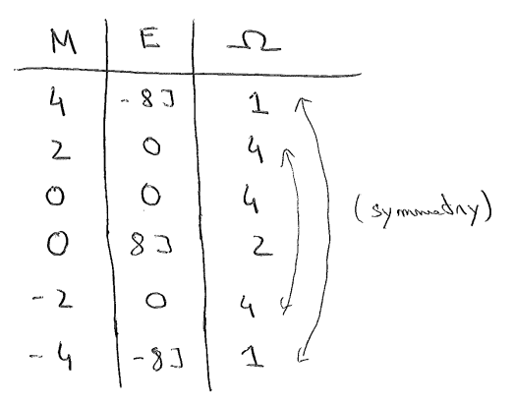
Pen-and-paper JDOS calculation of a 2x2 Ising lattice with periodic boundary conditions
For such a small system, it is possible to explore by hand all possible (2^4 = 16) spin configurations
Energy is estimated from the Hamiltonian formula
Degeneracy is the sum of configurations with the same M and E value
M = 4
M = 2
M = 0
M = 0

Slide 8
Thermodynamic properties from JDOS (2x2)
Low temperature
High temperature
The transition is observed in both calculations of average absolute magnetization and magnetization from free energy minima
Larger system?

Slide 9
Thermodynamic properties from JDOS (4x4)
Low temperature
High temperature
For a 4x4 system of 16 spins, there are ~65k possible spin configurations
Still tractable exactly (in a computer)
Larger system?

Slide 10
Thermodynamic properties from JDOS (16x16)
Low temperature
High temperature
This system has 1E77 possible configurations
The JDOS cannot be computed exactly
The simulations start to behave similarly to a real ferromagnet

Slide 11
Finite size effects
While we were not considering “large” systems, the results appear to be aiming at the right (exact) Tc result for an infinite lattice
So, by having the JDOS (table of possible magnetization, energy and degeneracy) thermodynamic properties can be calculated
Is it easy to estimate the JDOS of larger systems?
Exact solution (Onsager)

Slide 12
Estimating JDOS
It is actually quite difficult, due to the large number of possible configurations when the system size increases:
4x4 (16 spins) : 65x10^3 <- still doable exactly
16x16 (256 spins) : 1E77 configurations <- too big for listing exactly
Even a Monte-Carlo sampling approach is not trivial
If random spin configurations are generated, they will be biased to low magnetization states, as these are the most probable

Slide 13
MC sampling 2x2
M | E | Ω exact | Ω 1E4 samples | Ω 1E5 samples
4 | -8J | 1 | 1.03 | 0.99
2 | 0 | 4 | 3.99 | 4
0 | 0 | 4 | 4.04 | 4
 | 8J | 2 | 1.95 | 1.98
-2 | 0 | 4 | 4.02 | 4.02
-4 | -8J | 1 | 0.97 | 1
For a system with just 16 configurations, over 1E4 samples need to be taken for a good JDOS
Slow energy calculations (global versus local updates)
Sampling is biased in magnetization
For larger systems, this type of sampling will not “see” ordered (high |M| states)
1E5 samples

Slide 14
Random sampling for a 2D 16x16 Ising system
1E5 random samples for this system do not observe |M| values above 20% the possible value
Many configurations are not seen by the random sampling, including two very important configurations (all spins up, and all spins down)
The magnetization range (phase space) is not adequately explored
1E5 samples
Minimum
possible M
Maximum
possible M

Slide 15
Random sampling for a 2D 16x16 Ising system
Much like magnetization, 1E5 random samples for this system is not enough to observe E values near the positive and negative limits
Both energy and magnetization phase space are not adequately sampled
E = -512 all spins parallel
E = 512 all spins anti-parallel (checkerboard)
A JDOS estimated from these histograms would not accurately describe the system
1E5 samples
Minimum
possible E
Maximum
possible E

Slide 16
Random spin configuration sampling of a 2D, simple square with PBC Ising lattice JDOS
First Matlab script: MC_sampling_Ising_2D_SS_no_vis.m
Input: linear system size (L) and sampling repetitions (REP)
Subfunction: function_Energy_Ising_2D_SS(L, S_vector): calculates energy of a spin configuration given by a [-1, 1, 1, -1, …] vector for a system size of L
Main outputs:
All observed E values (E) and M values (M)
Energy histogram (hist_E)
Magnetization histogram (hist_M)
Energy-Magnetization histogram (hist_EM), rows = Energy, columns = Magnetization
Energy value list (E_list)
Magnetization value list (M_list)
The normalized Joint Density of States (JDOS)
Use this script to replicate the histogram figures from the three previous slides [hint: explore Matlab functions hist, histogram and bar]
Plot the Energy-Magnetization histogram of the 2x2, 4x4 and 8x8 lattices [hint: explore contour, surf and bar3]. Is the phase space fully explored with 1E5 samples?

Slide 17
WORK!

Slide 18
Visualizing the magnetization histogram I
The Matlab in-built function “hist” shows a histogram, as it should, but the automatic binning choice is not the best.
L = 2; REP = 10^5
L = 4; REP = 10^5
L = 16; REP = 10^5
M
M
M
“The elements in x are sorted into 10 equally spaced bins along the x-axis between the minimum and maximum values of x.”
This automatic binning does not work well, even for the smallest lattice, the histogram is not centered, with a maximum at the wrong M value

Slide 19
Visualizing the magnetization histogram II
The Matlab in-built function “histogram” works well for small systems, but its simple use is not enough for larger systems
L = 2; REP = 10^5
L = 4; REP = 10^5
L = 16; REP = 10^5
M
M
M
“The histogram function uses an automatic binning algorithm that returns bins with a uniform width, chosen to cover the range of elements in X and reveal the underlying shape of the distribution.”
This automatic binning may not work well, and may need tweaking to accurately show what we want to show
The third plot is the magnetization histogram for L=16 and REP = 10^5, and zooming in for M=0, we can see it is not centered

Slide 20
Visualizing the magnetization histogram III
Instead of letting Matlab choose the binning for the histogram, we can instead use a simple bar plot, and the calculated hist_M
L = 2; REP = 10^5
L = 4; REP = 10^5
L = 16; REP = 10^5
M
M
M
The bar plot forces the x axis binning (or lack of it), preserving the accuracy and symmetry of the data.
This should also be the best approach for plotting the energy histograms

Slide 21
Visualizing the joint energy-magnetization histogram (I)
While looking independently at the magnetization and energy histograms will tell us if the phase space is being accurately sampled, the joint E-M histogram should show this clearly
Now we are dealing with a 3D plot, and that brings added difficulties. Let’s try the Matlab function contour.
L = 16; REP = 10^5
The plots looks nice, using increased plot detail:
contour(-E_list,M_list,hist_EM,100)
Still, the data seems odd, and it would be nice to see this in 3D…

Slide 22
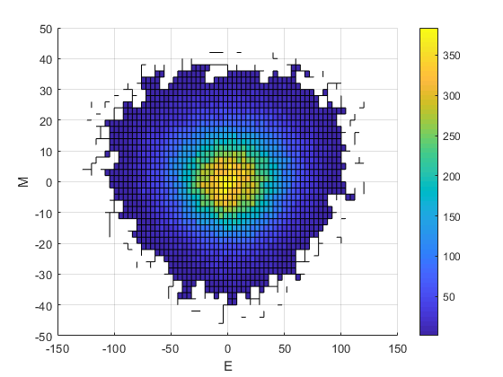
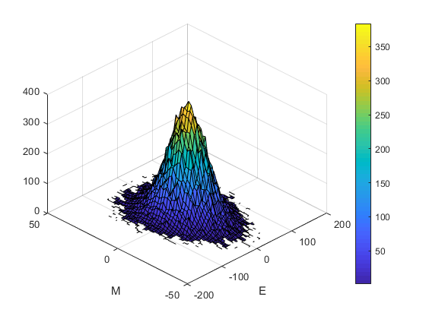
Visualizing the joint energy-magnetization histogram (II)
Now let’s try the Matlab function surf. This is a “real” 3D plot, which allows side views
The plots look colorful and nice, with some tricks:
hist_EM(hist_EM==0)=nan;
Colorbar
View(2)
view(-45,45)
The plot is not centered, and what are those squiggly lines?
L = 16; REP = 10^5

Slide 23
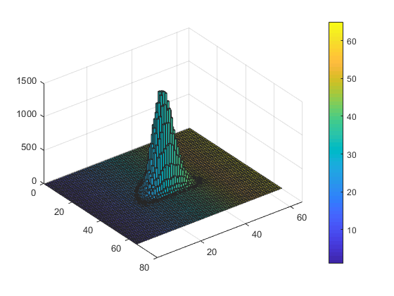
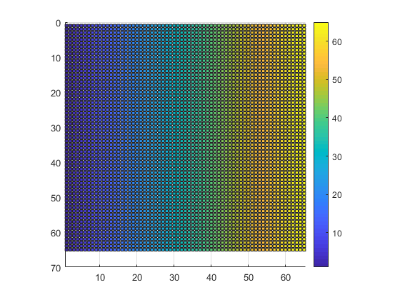
Visualizing the joint energy-magnetization histogram (III)
It seems we still don’t have the kind of plot we want. What about bar3?
L = 8; REP = 10^5
Using bar3 directly will not work
You cannot define the axis tick values via input
The color bar shows the wrong axis
Even with NaNs, the plot color is not good
The 2D (top view) does not show any information

Slide 24
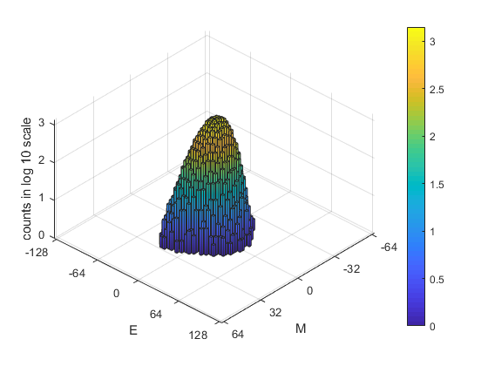
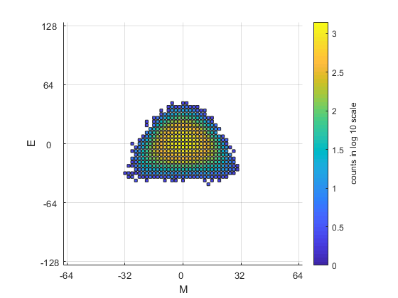
Visualizing the joint energy-magnetization histogram (IV)
The bar plots were the best solution for the 2D histograms, so we dig a little deeper.
These look better, the plots are centered, without any weird artifacts
Tricks:
Log scale for better color visibility
White color for 0 z value
Manually defined scales and tick values
50 lines of code!
L = 8; REP = 10^5

Slide 25
Valuable lessons
Automatic plot types are excellent when they do exactly what you want
For more complex data plots, you will invariably need to start looking “under the hood”
Most of the times, someone else already solved your technical issue, and looking for the solutions online (instead of working them out by yourself) is the pragmatic approach

Slide 26
Numerical convergence and accuracy of random configuration sampling
Using the small 2x2 lattice as an example, we previously saw how the random configuration sampling converged to the correct value for high sampling counts
When we don’t know the exact value, how can we show the method is converging?
M | E | Ω exact | Ω 1E4 samples | Ω 1E5 samples
4 | -8J | 1 | 1.03 | 0.99
2 | 0 | 4 | 3.99 | 4
0 | 0 | 4 | 4.04 | 4
 | 8J | 2 | 1.95 | 1.98
-2 | 0 | 4 | 4.02 | 4.02
-4 | -8J | 1 | 0.97 | 1

Slide 27
Convergence for the 4x4 lattice
We can take as reference the simulation with the highest number of samplings we can reasonably do, and check the trend of deviations
Deviation = abs(JDOS -JDOS[1E7])/JDOS[1E7]
Logarithmic scale is useful as convergence is slow

Slide 28
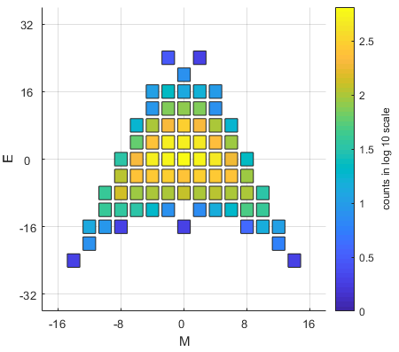
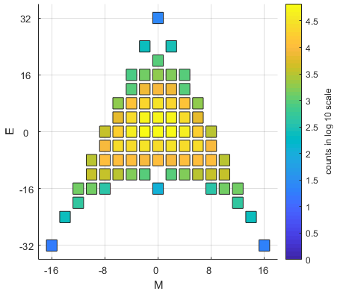
Is the phase space properly sampled?
As we have seen from the simulation of larger systems using this Monte-Carlo approach, the phase space sampling is denser near M=0 and E=0
Only with large sampling it is possible to get data for the following states/configurations
All spins up (M=16,E=-32)
All spins down (M=-16, E=-32)
Checkerboard (M=0, E=32)
This evolution of phase space sampling would be nice to see in a video
L = 4; REP = 10^4
L = 4; REP = 10^6

Slide 29
If a picture is worth a thousand words…
Visualizing the histograms at the end of the sampling run allows us to assess the final result, but a video would allow us to visualize the dynamics of the phase space exploration
Videos can be easily made in Matlab via the ‘getframe’ command
We can start by making simple videos of the 2D magnetization and energy histograms, which highlight the biased sampling of both values
We then move on to making videos of the 3D energy-magnetization histogram

Slide 30
WORK!

Slide 31
Main conclusions
The simple Monte-Carlo approach of generating random spin configurations to explore the phase space works, since
It can sample the whole Energy-Magnetization phase space
It smoothly converges to an accurate value
But…
The number of samples must be larger than the number of possible states, which is not efficient, and makes this approach worse than just listing all the spin configurations/states sequentially
There are, thankfully, much more efficient Monte-Carlo approaches for estimating the JDOS of the Ising model, which we will discuss in the next class

