Slide 1
Laboratório de Computação e Visualização Científica Visualizing Monte-Carlo sampling of the Ising model phase space
João Amaral (jamaral@ua.pt)
21/3/2022

Slide 2
From the last class:
The Ising model is a simple description of a magnetic material, and can be used to estimate the thermodynamic properties of ferromagnets.
These thermodynamic properties can be easily calculated if we have an estimate of the Joint Density of States (JDOS), which is a table of all possible magnetization M and energy E values, together with the degeneracy (number of possible configurations with a given M,E pair).
We have explored a simple Monte-Carlo approach of generating random spin configurations to visualize the phase space of the Ising model. It works, but not in an efficient way. It is worse than making a sequential list of possible states.

Slide 3
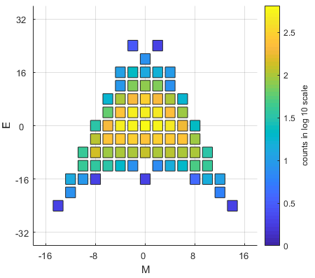
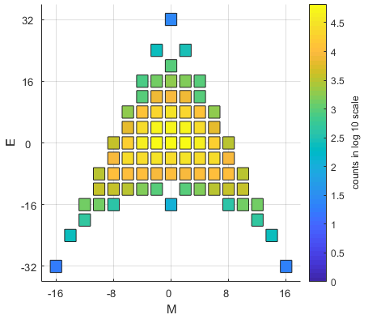
Phase space sampling with random spin configuration sampling
Phase space sampling is denser near M=0 and E=0
Only with large sampling it is possible to get data for the following states/configurations
All spins up (M=16,E=-32)
All spins down (M=-16, E=-32)
Checkerboard (M=0, E=32)
This system has 65536 possible configurations, and 10^6 samples were needed to see the full phase space
L = 4; REP = 10^4
L = 4; REP = 10^6

Slide 4
More efficient Monte-Carlo methods:
These are more advanced methods to better sample the phase space, and so obtain better JDOS estimates:
Wang-Landau
Hüller-Pleimling
Random Path Sampling
and more…
They are naturally more complex than sampling random spin configurations
Visualization helps to better understand their strengths and weaknesses

Slide 5
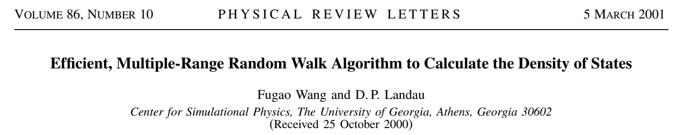
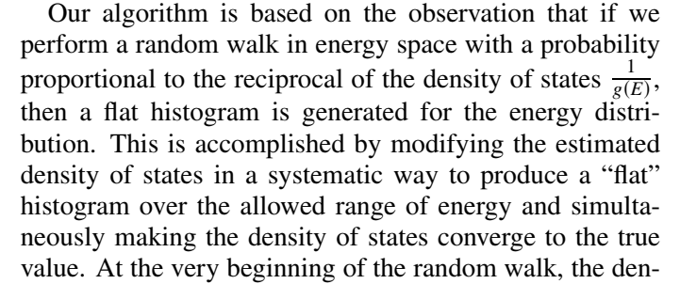
Wang-Landau method [2001]

Slide 6
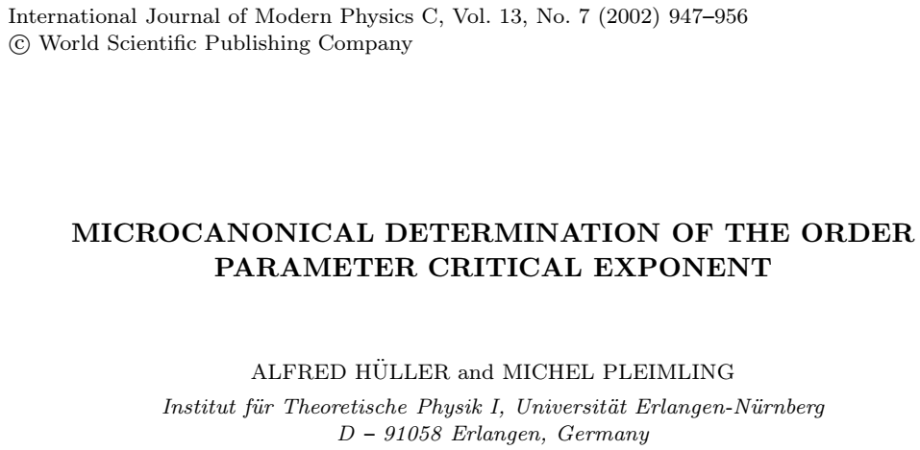
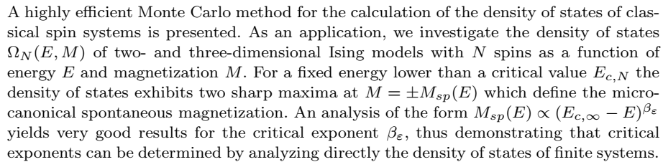
Hüller-Behringer method [2002]

Slide 7
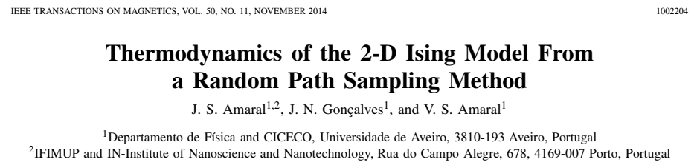
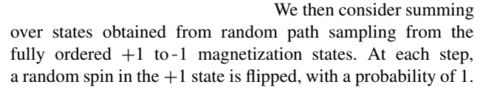

Random Path Sampling [2014]

Slide 8
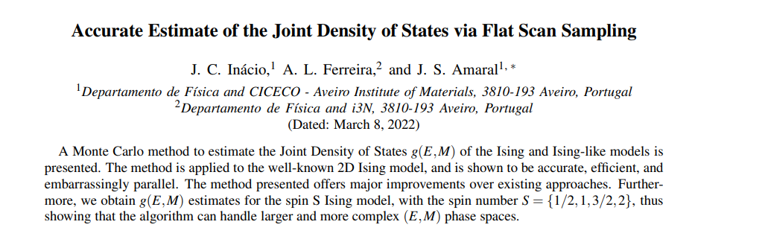
Flat Scan Sampling [2022]
https://arxiv.org/pdf/2203.02718v1.pdf

Slide 9
Random Path Sampling
The method [1] forces a flat-magnetization sampling histogram by sweeping magnetization states from total +1 to -1
Energy calculations are local (fast)
Embarrassingly parallel (each sweep is independent) – not a random walk!
Easy implementation, generalization and parallelization
One full RPS sweep (Ising model)
Flip one random spin:
Local energy update
Flip one random spin (no repetition):
Local energy update
repeat
E = -1/2*J*NN*N_spin
E = -1/2*J*NN*N_spin
[1] J. S. Amaral et al., IEEE Trans. Magn. 50 1002204 (2014)

Slide 10
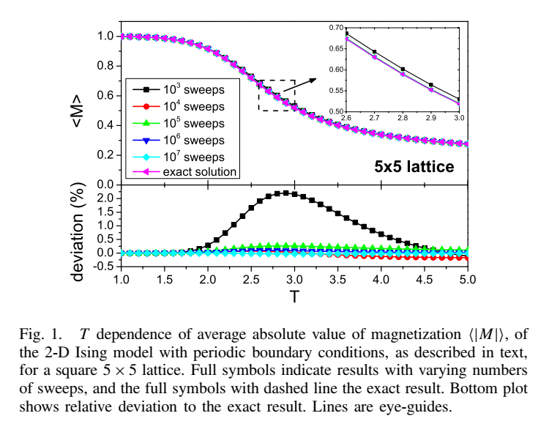
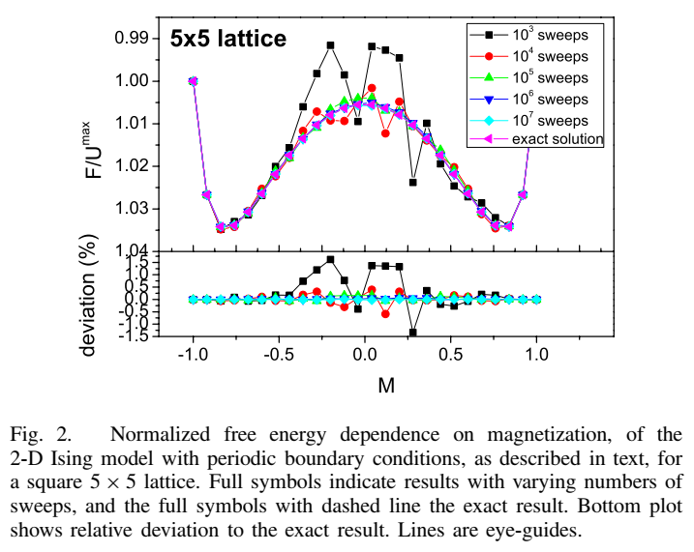
Random Path Sampling: Validation [1]
[1] J. S. Amaral et al., IEEE Trans. Magn. 50 1002204 (2014)

Slide 11
Random Path Sampling: Implementation (I)
The previous random configuration method:
for k = 1:REP
%
S_vector(:,1) = randsample([-1, 1],N_atm,true,[0.5,0.5]);
M(k,1) = sum(S_vector(:,1));
E(k,1) = function_Energy_Ising_2D_SS(L, S_vector);
%
end
The RPS method:
for k = 1:REP % loop through all requested RPS loops
%
S_vector = ones(N_atm, 1); % vector with up spins
SFV(:,1) = randperm(N_atm); % spin flip vector (sequence of spins to flip)
%
for q = 2:N_atm % loop through magnetization values
%
S_vector(SFV(q-1)) = -1; % flip the spin
%
E_new = - S_vector(SFV(q-1)) .* ( ...
S_vector(nnxpos((SFV(q-1)))) + ...
S_vector(nnxneg((SFV(q-1)))) + ...
S_vector(nnypos((SFV(q-1)))) + ...
S_vector(nnyneg((SFV(q-1))))); % energy of bonds to NN
%
E_all(k, q) = E_all(k, q-1) + 2*E_new; % build the energy matrix
%
end
%
end

Slide 12
Random Path Sampling: Implementation (II)
For each RPS sweep, there are N_atm+1 (the number of possible magnetization values) configurations sampled
We can easily benchmark both methods, taking this in mind:
RPS: L = 8, REP = 1E6 (65*1E6 sampled configurations)
RPS time 12.8726 seconds
(E,M) histogram time 43.3236 seconds
RPS + histogram time 56.1962 seconds
MC: L = 8, REP = 1E6 (1E6 sampled configurations)
MC time 35.4572 seconds
(E,M) histogram time 12.5676 seconds
MC + histogram time 48.0247 seconds
The RPS method is ~ 50 times faster, per sampled configuration

Slide 13
Random Path Sampling: Implementation (III)
The differences between both methods are simple in terms of outputs and building the histograms
The main RPS cycle builds an “E_all” matrix, which lists all observed energy values. Each column represents magnetization values between all spins up and all spins down
The magnetization histogram is flat, due to the method itself (by construction)
The sampling of the energy-magnetization phase space should be very different compared to the previous MC method
We should also be able to show how the JDOS estimate converges, and also that it converges to the exact value.
The method itself has a simple concept and implementation, but still has difficulties coping with “large” systems like 8x8 and larger

Slide 14
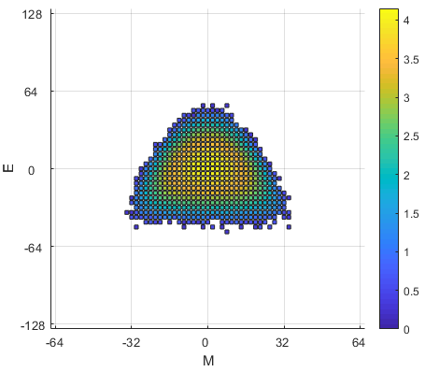
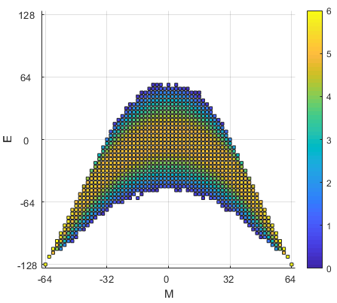
Random Path Sampling: Phase space sampling performance comparison
We can compare the (E,M) sampling histograms for both the simple MC and RPS methods, for the 8x8 system and REP=1E6
The RPS method extends the phase space sampling, but does not sample all possible states
The MC method, as expected, samples the region near E=0,M=0

Slide 15
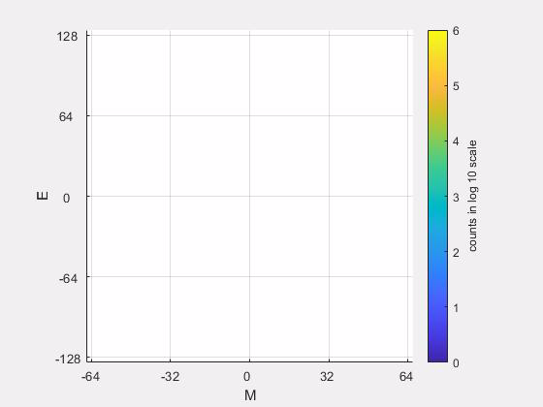
Random Path Sampling: Phase space sampling performance comparison (videos)
The previous result becomes clearer if we compare the phase space sampling throughout
RPS method, L = 8; REP = 10^6
MC method, L = 8; REP = 10^6

Slide 16
Making videos from plots in Matlab
One quick way to make videos in Matlab is by saving plots as video frames, easily done by using getframe:
plot(…)
drawnow()
F(framenumber) = getframe(gcf);
The F variable is then a set of frames that can be easily visualized using matlab
fig = figure;
movie(fig,F,1)
To save this variable to an .avi file, you can use the VideoWriter function in a for cycle:
fig = figure;
v = VideoWriter('video.avi');
open(v);
%
for k = 1:length(F(:))
%
movie(fig,F(k),1)
frame = getframe(gcf);
writeVideo(v,frame);
%
end
%
close(v);

Slide 17
Overview
You have two main Matlab scripts that estimate the JDOS of the 2D Ising model in a square lattice of a linear size L, with periodic boundary conditions. Each script uses a different Monte-Carlo method, one for a simple approach of generating random configurations, and the other for the RPS method
Using the provided scripts and code for making videos, can you reproduce the videos shown in slide 15?

Slide 18
WORK!

Slide 19
The Wang-Landau method
The Wang-Landau method is another MC method that allows to estimate the JDOS of the 2D Ising model. It has its advantages and disadvantages. It is considerably more complex than the two previous approaches, so we will focus on its main points

Slide 20
Wang-Landau method [2001]

Slide 21
The Wang-Landau method in practice
A random walk in phase space, starting in a random configuration
The success ratio of each random walk step is the ratio between the JDOS of the current and target point in E,M phase space.
The JDOS itself starts as a constant number (e.g. 1), which is updated throughout the random walk steps by multiplying its value by the JDOS update weight factor, f
A histogram is built counting both accepted and rejected steps, until it is considered “flat”. When that happens f is updated (ex: starting with value f=2, and when the histogram is flat, f = sqrt(f); the histogram is cleared
The main parameters are the flatness criteria (e.g. p = 0.95), and the lowest limit weight number of the JDOS update (e.g. f = 1 + 10^-8)
D. P. Landau, Shan-Ho Tsai, and M. Exler, "A new approach to Monte Carlo simulations in statistical physics: Wang-Landau sampling," Am. J. Phys. 72, 1294–1302 (2004)
http://stp.clarku.edu/simulations/ising/wanglandau/index.html

Slide 22
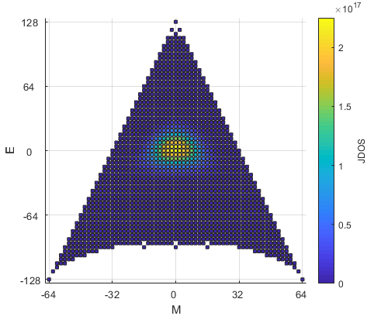
Wang-Landau JDOS estimate for 8x8
WL method, L = 8; p = 0.75; f_min = 1 + 1E-4
As the histogram is cleared throughout the method, the way to visualize the phase space sampling is to look at the JDOS result
This WL run had very rough parameters, and took about 5 hours to run
The phase space is completely sampled, but this does not tell us about the convergence or accuracy of the method
By construction of the method, the phase space should be completely explored when the JDOS is first updated

Slide 23
Convergence and accuracy of the WL method
WL method, L = 4
For the 4x4 lattice we can compare the deviation from the exact result, and see that while the JDOS estimate converges, there will always be a deviation
The WL method (by construction) will sample the full phase space efficiently, but the final JDOS accuracy will depend on the parameters used [1].
[1] C. Zhou and R. N. Bhatt, Understanding and improving the Wang-Landau algorithm, PHYSICAL REVIEW E 72, 025701 (2005)

Slide 24
Conclusions
While simple in construction, the Ising model is rich in physics, together with practical use in the computational materials design of ferromagnets
The thermodynamics of the model can be obtained from the joint density of states (JDOS), which is a list of all possible spin configurations with a given energy and magnetization pair of values, together with their degeneracy
For large system sizes the number of possible configurations is too large to list, so Monte-Carlo (MC) methods can be employed
We have covered three different MC methods to estimate the JDOS of the Ising model: the simple generation of random configurations, the RPS method and Wang-Landau methods
These methods explore the phase space in different ways, and visualization helps to clearly and efficiently show their strengths and weaknesses

Slide 25
What I expect
That you can adequately show via plots and videos how these three Monte-Carlo methods work, and behave differently in terms of
Phase space exploration
Convergence and accuracy
In the process, I hope some of the Matlab plot/video tricks you have learned will be useful for you in the future
The required report for your module 1 evaluation will focus on phase space exploration and convergence/accuracy of the 4x4 Ising lattice with periodic boundary conditions. The exact JDOS solution for that system has been made available.

Slide 26
END

