Slide 1

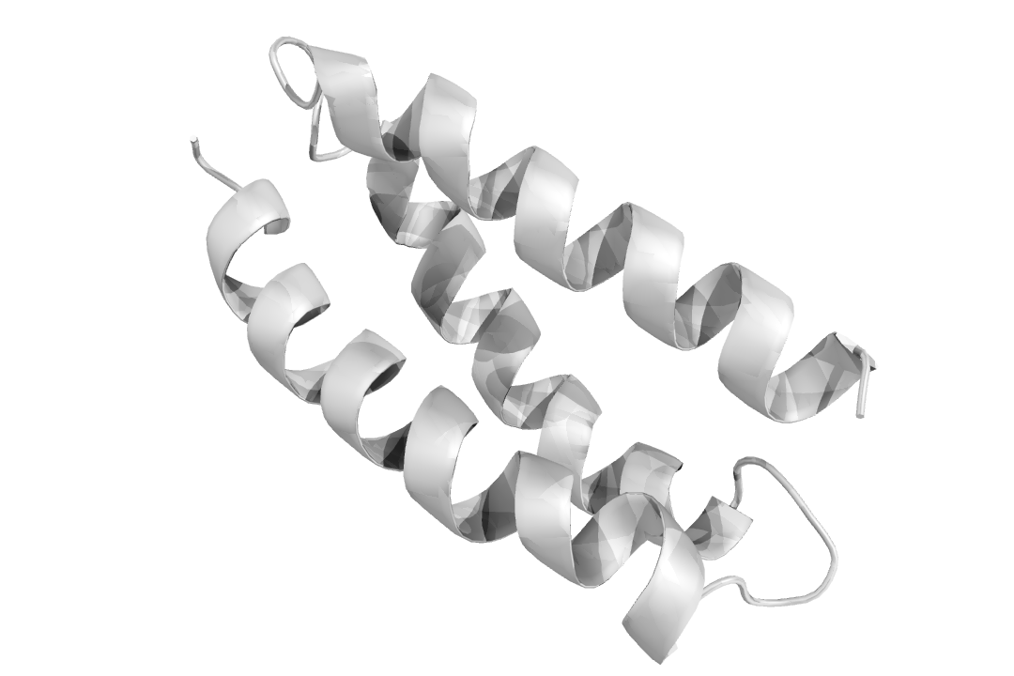
Computational design of peptides
Laboratório de Visualização e Computação Científica
Module 2
José M. S. Pereira
2020-2021
jose.manuel.pereira@ua.pt

Slide 2

Program
Last challenge
Intro
Practical examples
Challenge
30 min
30 min
30 min
90 min
Break

Slide 3
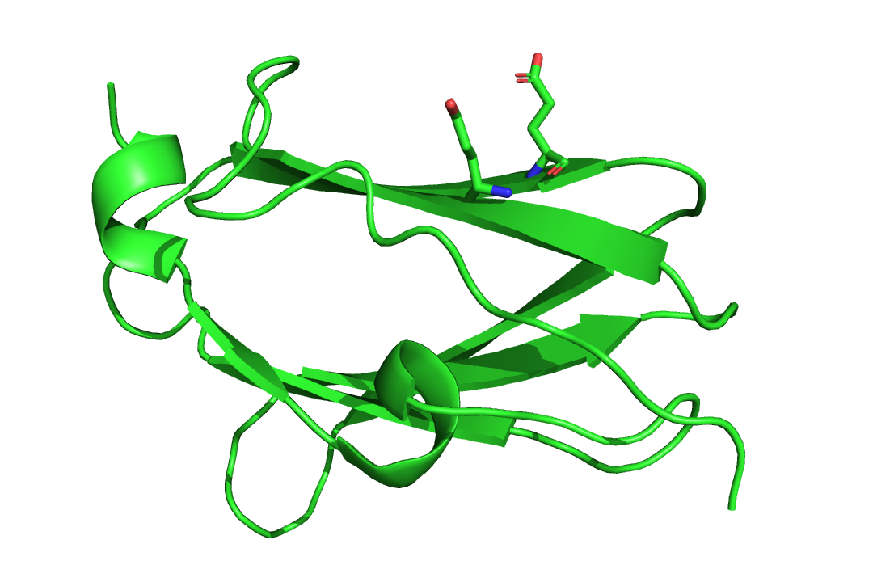
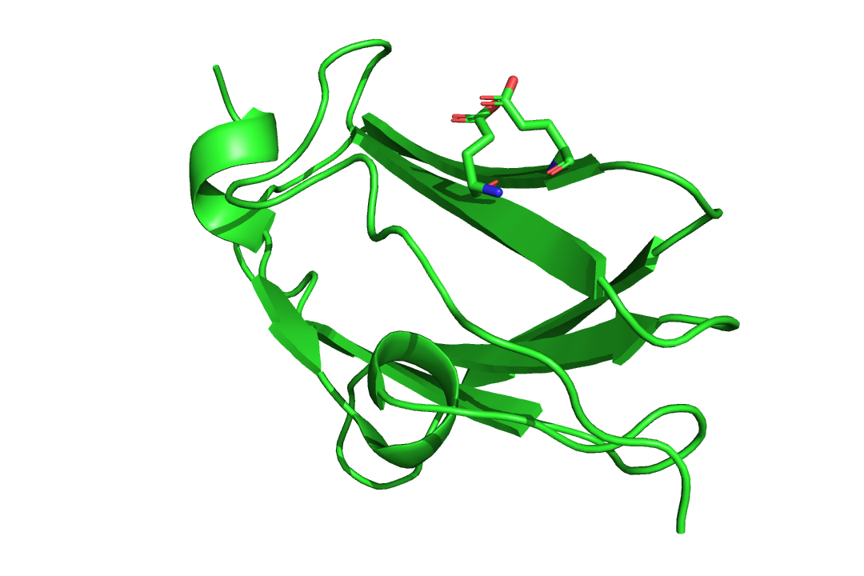

What’s an energy function?
Energy functions measure the energy of a structure.
Less energy = more stable.
Which of these rotamer combinations is more stable?

Slide 4
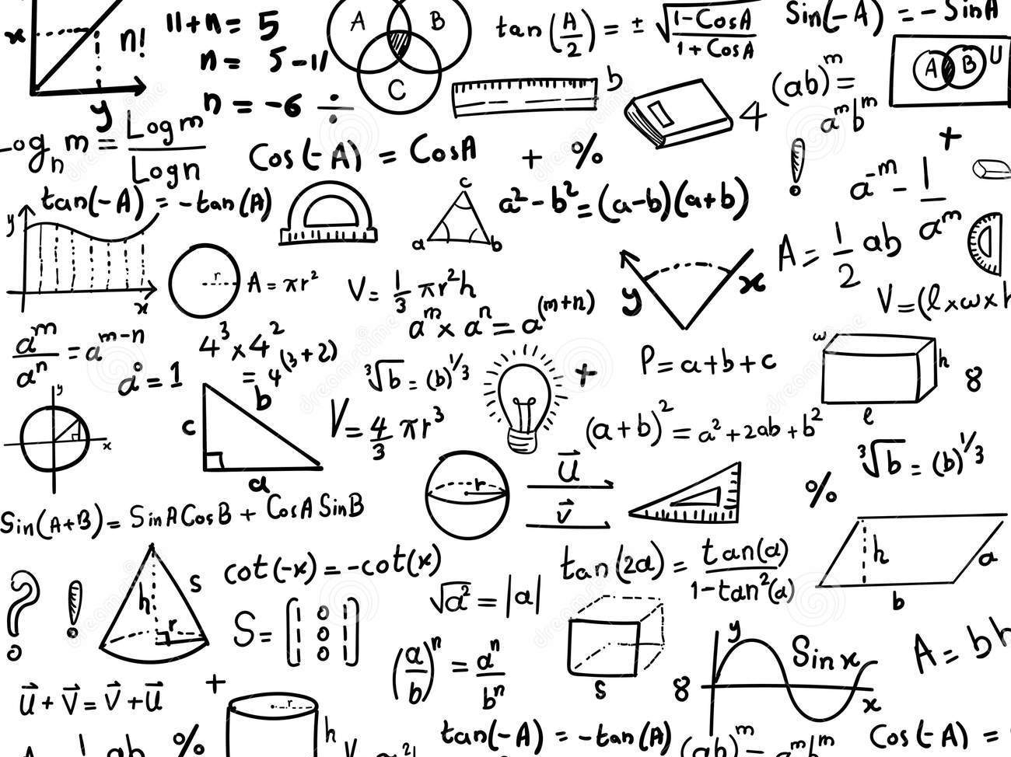

What’s an energy function?
There are many different types of energy functions.
They can be divided based on the measured components:
Physical functions
Statistical functions
Measure the actual bond distances, angles, deformities and clashes, among others, attributing a reward/penalty based on a set of rules.
Measure the likelihood of certain characteristics being real, based on big databases collected from real measurements and experiments.

Slide 5
What’s an energy function?
There are many different types of energy functions.
They can be divided based on the level of detail:
Less accuracy
Faster
More accurate
Slower
Forcefields
DFT
A set of simple functions parametrize where atoms should be in relationship to eachother.
Density Function Theory uses quantum physics to calculate the probable positions of electrons, thus inferring all the characteristics that compose a structure (bonds, angles, etc.)

Slide 6
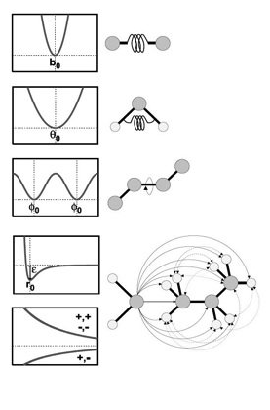
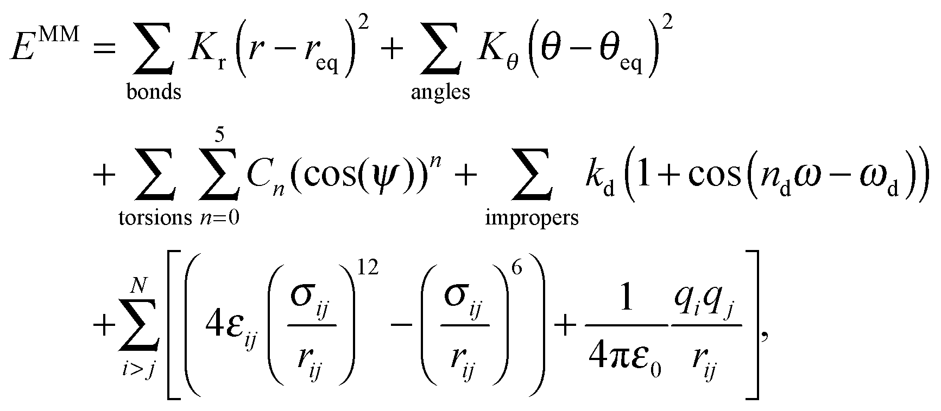
What’s an energy function?
There are many different types of energy functions.
They can be divided based on the level of detail:
Less accuracy
Faster
More accurate
Slower
Forcefields
A set of simple functions parametrize where atoms should be in relationship to eachother.

Slide 7
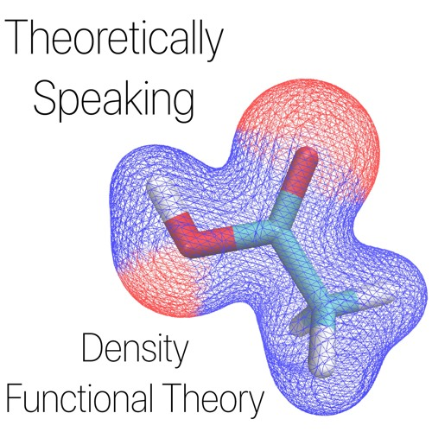
What’s an energy function?
There are many different types of energy functions.
They can be divided based on the level of detail:
Less accuracy
Faster
More accurate
Slower
DFT
Density Function Theory uses quantum physics to calculate the probable positions of electrons, thus inferring all the characteristics that compose a structure (bonds, angles, etc.)

Slide 8
What’s an energy function?
Machine Learning ?
Less accuracy
Faster
More accurate
Slower
Forcefields
DFT
A set of simple functions parametrize where atoms should be in relationship to eachother.
Density Function Theory uses quantum physics to calculate the probable positions of electrons, thus inferring all the characteristics that compose a structure (bonds, angles, etc.)

Slide 9
Ok …
Energy functions can calculate how stable a structure is based on a set of physical rules or on how likely those characteristics are to be found in databases.
There are two major types of energy functions: forcefields use simple equations while DFT uses quantum chemistry.

Slide 10

The challenge
TorchANI was developed by Gao et al.
It’s a machine learning model trained on DFT-level solutions.
https://github.com/aiqm/torchani
An example

Slide 11
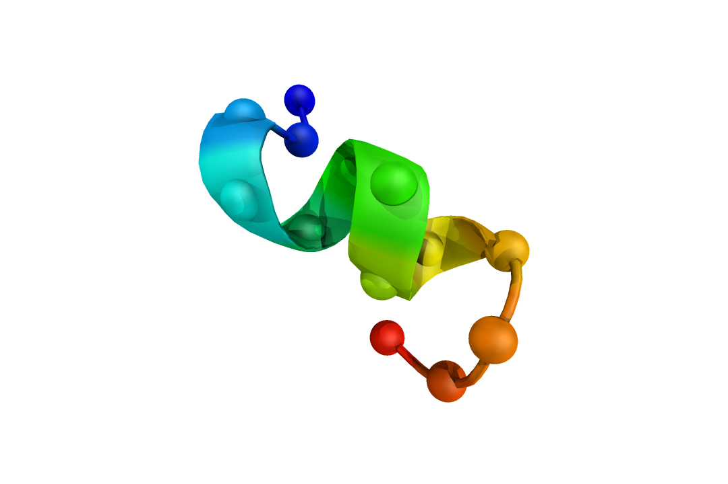
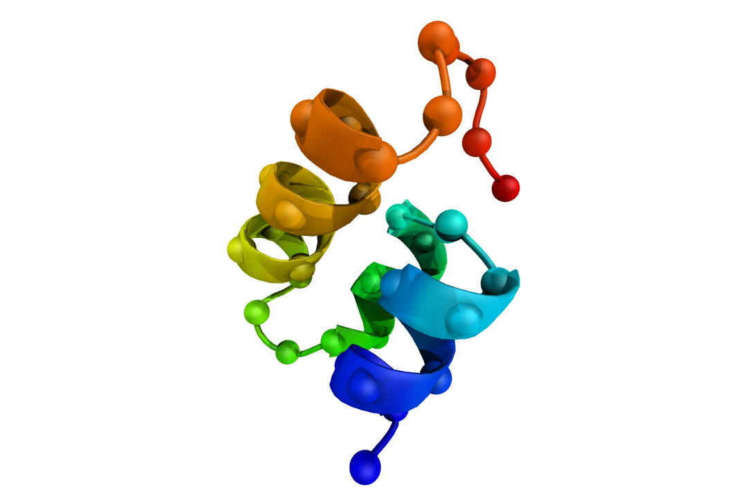
Some practical examples
Measure the energy of a molecule

Slide 12
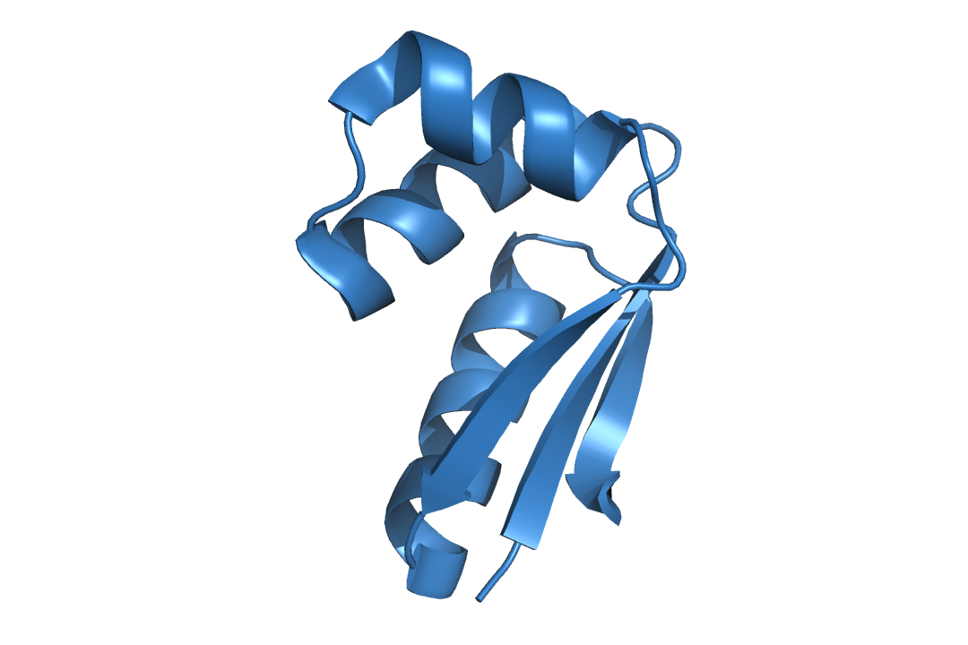
The challenge
Develop a Monte Carlo simulation in order to pack the sidechains of a Molecule

