Slide 1
Final Presentation
Alexander Sahatjian

Slide 2
Problem Statement
Currently most cities in the United States, collect data from various sensors across all the roadways. Most of the data goes unused and is confined to specific intersections or small areas within the cities. This data can be used to improve the efficiency of roadways across America, provide real time traffic conditions to first responders/drivers, and improve the planning of future roadways and public transportation routes. The challenge with smart traffic is aggregation of the various data sources and making meaningful use of all the available data.

Slide 3
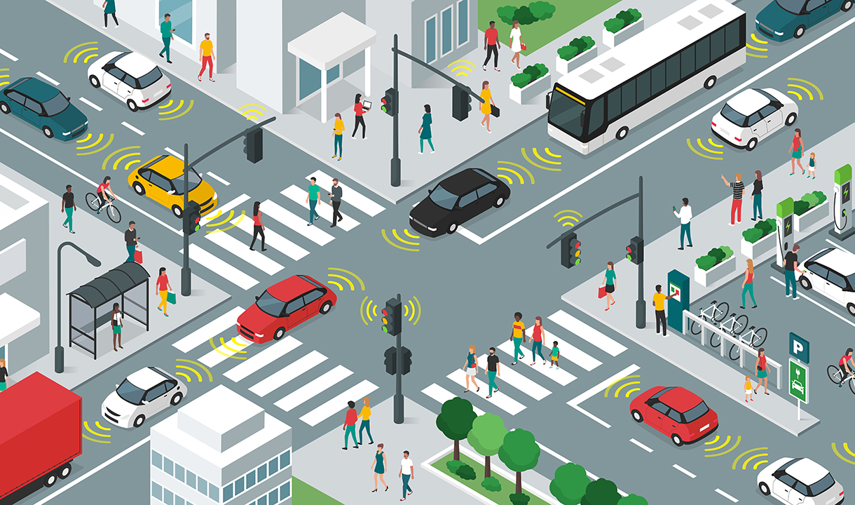
Overview

Slide 4
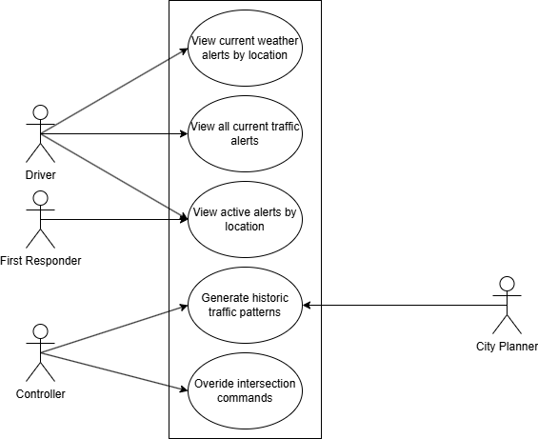
Use Case

Slide 5
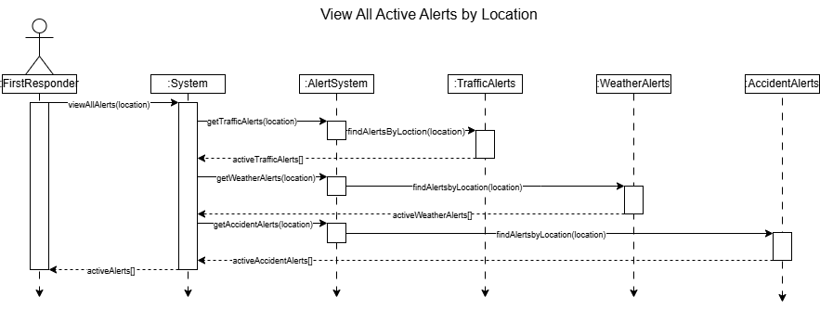
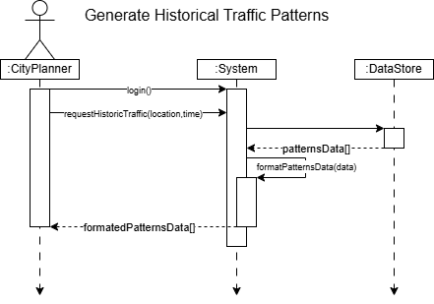
Sequence Diagrams

Slide 6
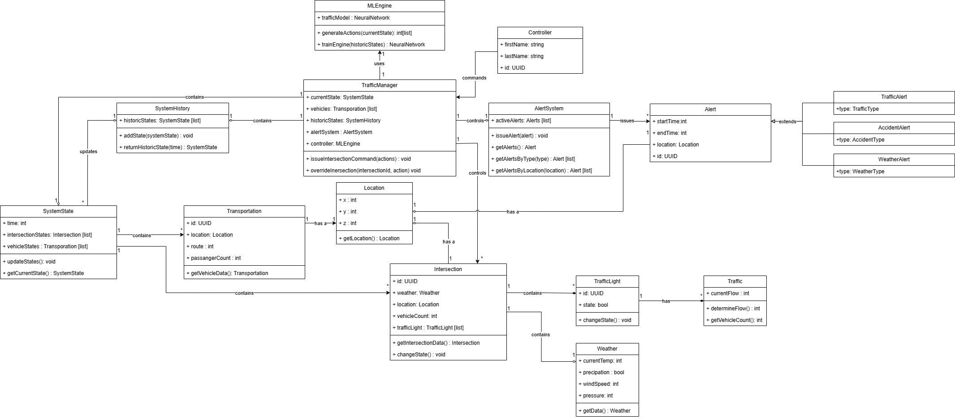
Class Diagram

Slide 7
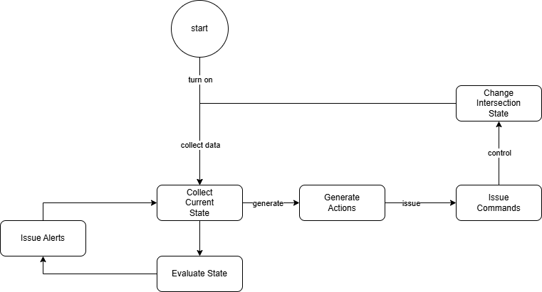
State

Slide 8
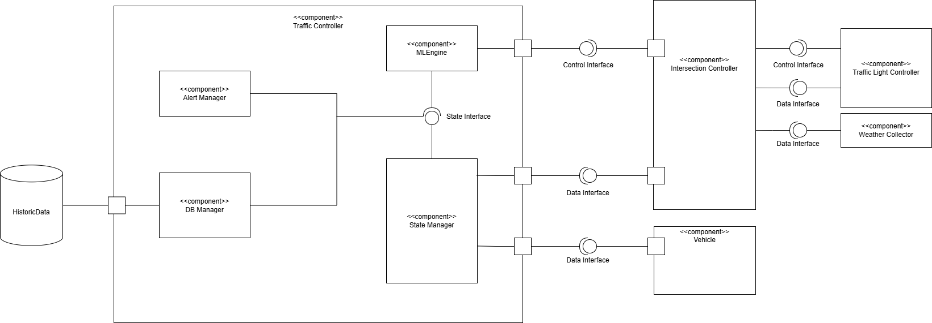
Component

Slide 9
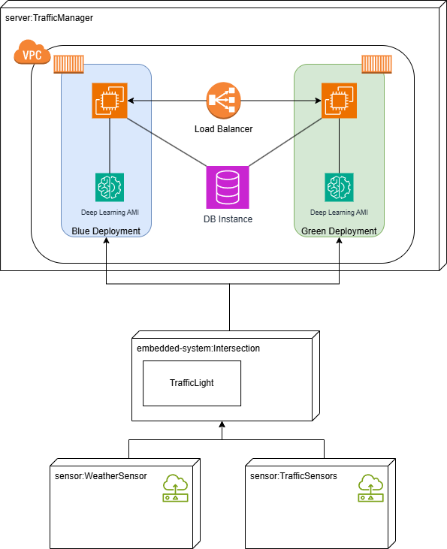
Cloud Deployment

Slide 10
Patterns and Design Principles
GRASP- Controller, Expert
SOLID- Single Responsibility
Distributed Architecture

