Slide 1


Automated prediction of drinking categories in monkeys undergoing chronic alcohol self-administration
Aleksandr Salo
Machine Learning by Dr. Hamerly
Baylor University 2015

Slide 2
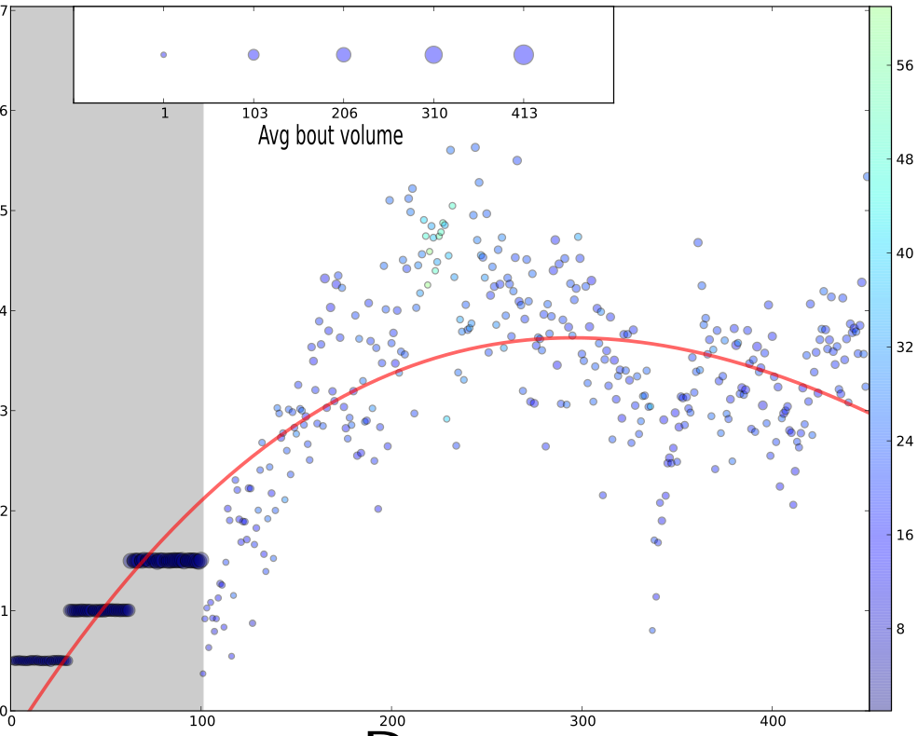
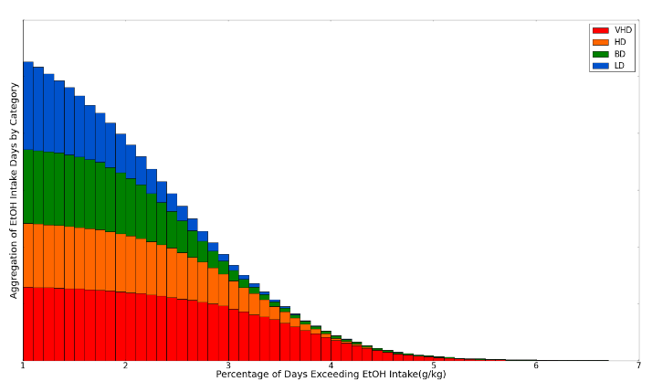

Goal
Classification model:
F(Induction Data) -> Open Access Drinking Category [1]
Daily Ethanol Consumption, g\kg
EtOH Bouts
Classifier?

Slide 3
Approach
Data Analysis
Feature Generation and Filtering
Model Selection
Feature Selection
Validation & Results

Slide 4
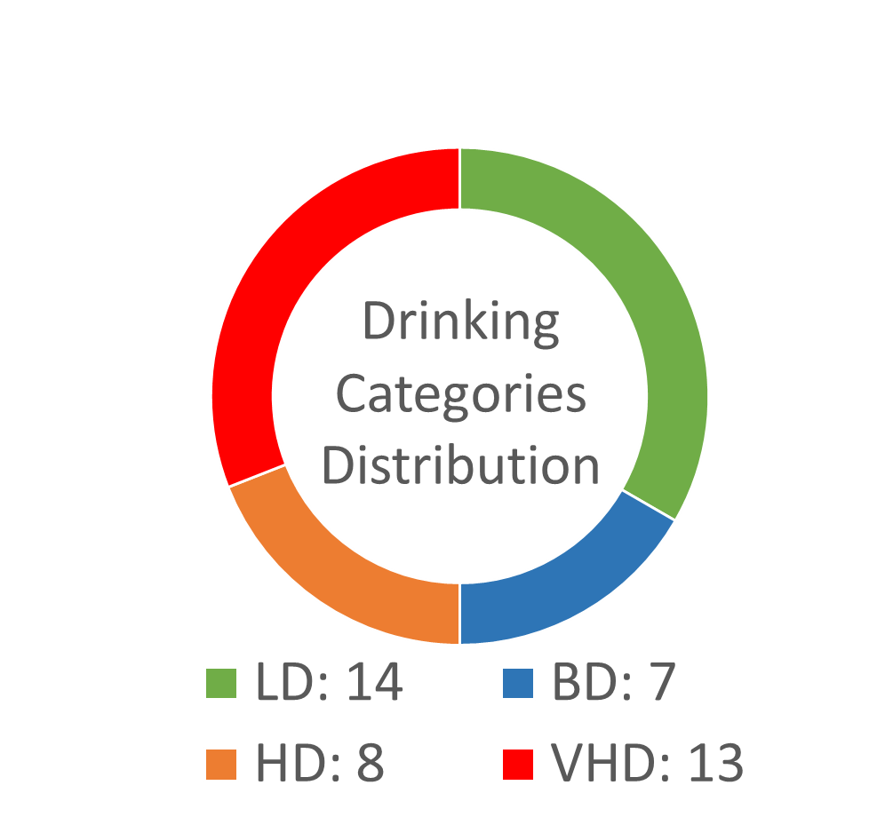
Data Analysis
Data Analysis
Feature Generation and Filtering
Model Selection
Feature Selection
Validation & Results
6 different cohorts (INIA Rhesus)[4]
Natural: Potential Features (n~30)
Gender
Age of intoxication
Derived from induction[4] period:
Latency to first drink (time)
Total number of EtOH bouts
Total number of H2O bouts
Mean length of EtOH drinks^{[i]}
Mean volume of EtOH drinks
Mean bout duration
Seconds it took for monkey to reach day's ethanol allotment
Length of the maximum bout (bout with largest ethanol consumption)
Ethanol consumed during first 10 minutes as a percentage of the daily allotment
42 monkeys (11 females)
Mean age of first intoxication 6.14 (sd=1.64) years
Mean weight 9.30 (sd=1.1) kg
[i] Less than 5 seconds between consumption of EtOH is a continuous drink

Slide 5
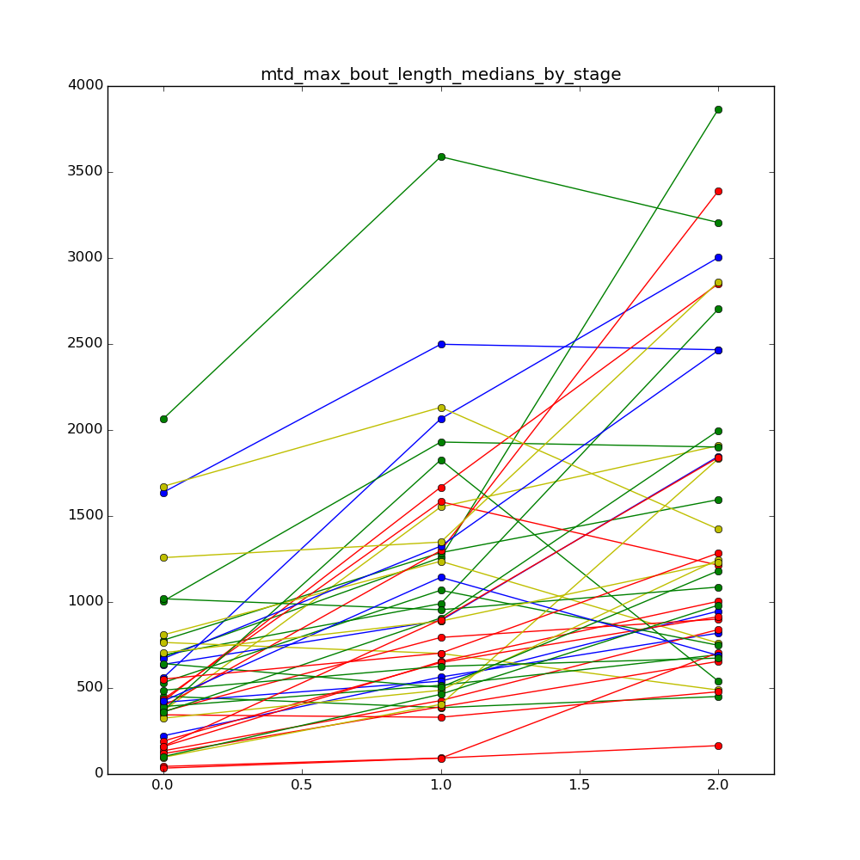

Feature Generation
Data Analysis
Feature Generation and Filtering
Model Selection
Feature Selection
Validation & Results
Max Bout Length
(medians by stage)
$$Rel_{i}^{delta}=\frac{M\left(At_{i}\left[stage_{3}\right]\right)}{M (At_{i}[stage_{1}])}$$
Using 10 first – 10 last days instead
~30 comparable normalized deltas
Max Bout Length, sec
Stage {1, 2, 3}

Slide 6
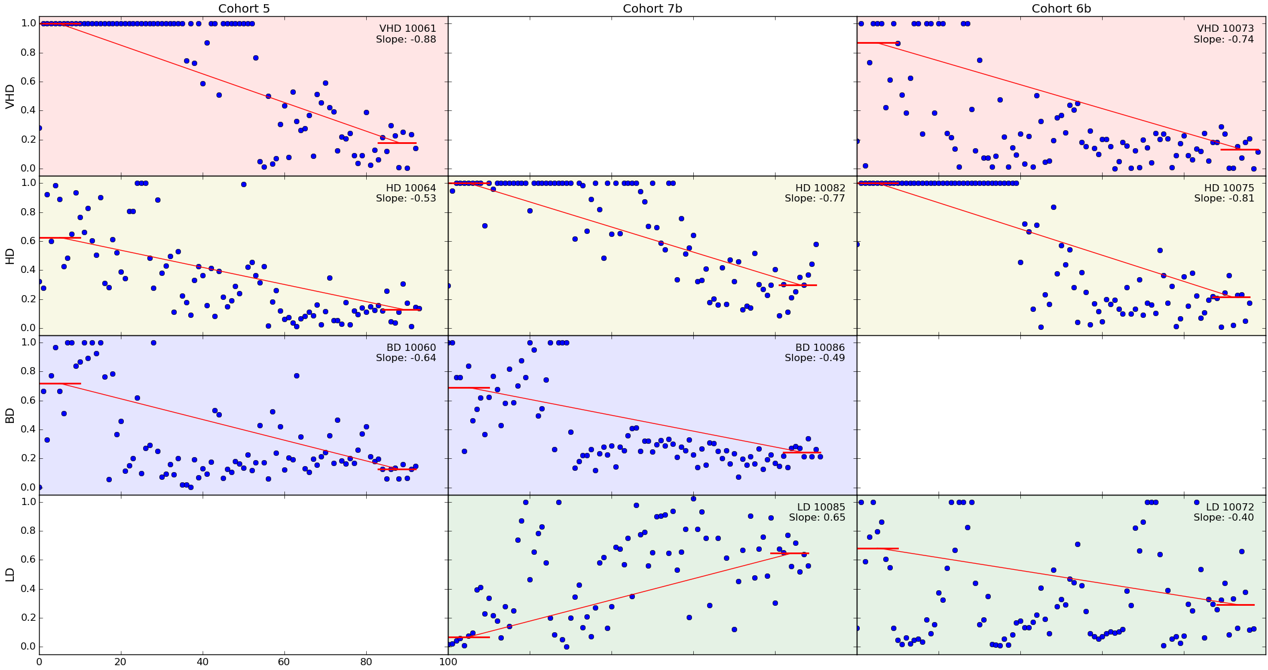
Feature Filtering
Data Analysis
Feature Generation and Filtering
Model Selection
Feature Selection
Validation & Results
Tests for potential features:
~11 significant features
Significance Tests (α=0.05)
Mutual Information Analysis
Typical deltas for EtOH consumed during first 10 minutes by Drinking Category and Cohort.

Slide 7
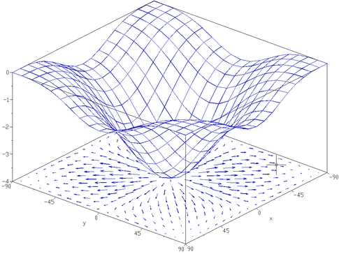
Model Selection
Data Analysis
Feature Generation and Filtering
Model Selection
Feature Selection
Validation & Results
F1
F1
V1
F1
V3
Decision Tree
Average prediction
V1
V3
V1
V3
V4
V5
V4
V5
Optimal Hyperplane
V4
V5
Class 1
Class 2
Class 1
Class 2
Class 1
Class 2
Support Vector Machine
Linear Kernel
C = 3
Class weights
Gradient Boosting Classifier
Max features = 0.4
Max depth = 5
RandomForest Classifier
N_estimators = 20
Max features = 0.4
Bootstrap = True
Accuracy*: .51 (SEM=.08)
Accuracy: .55 (SEM=.1)
Accuracy: .50 (SEM=.11)
*Accuracy was measured with K-Fold Cross Validation (K=14). Detailed performance analysis is in validation section
Sampling with Replacement
Bagging Wrapper
Initial Sample
Accuracy: .61 (SEM=.07)
Unethical and costly to get bigger N

Slide 8
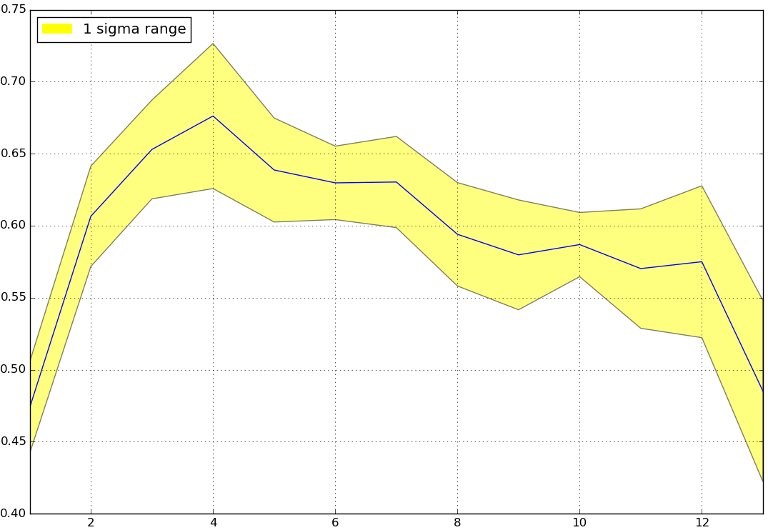
Feature Selection
Data Analysis
Feature Generation and Filtering
Model Selection
Feature Selection
Validation & Results
To fight the curse of dimensionality [3] - "forward selection" [1] filtering method that ranks features by their impact on model performance (measured using 14-fold CV).
20 run avg accuracy
4

Slide 9
Feature Selection (cont)
Data Analysis
Feature Generation and Filtering
Model Selection
Feature Selection
Validation & Results
Then scoped the top-5 features that appeared to be used within the best CV across 20 different runs:

Slide 10
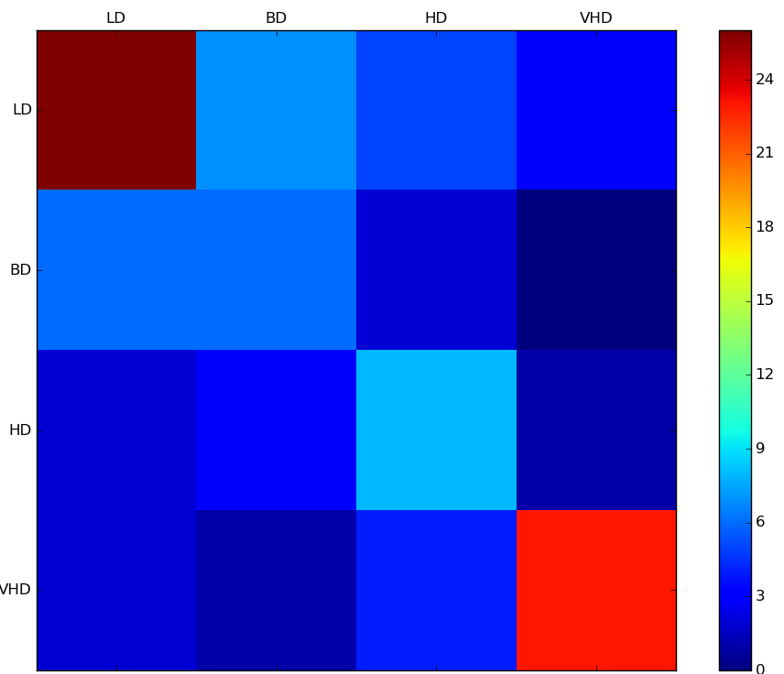
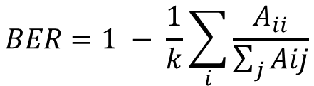
Validation & Results
Data Analysis
Feature Generation and Filtering
Model Selection
Feature Selection
Validation & Results
Predicted Label
Repeated ShuffleSplit & 4-Fold Cross-Validation.
Accuracy: .68 (SEM=.03)
Balanced Error Rate: 0.39
$$BER=1 − \frac{1}{k}\sum_{i}{\frac{A_{ii}}{\sum_{j}{Aij}}}$$
True Label
This is one minus the average recall, treating each class evenly, regardless of its class membership. [7].
BER is employed to compensate for large asymmetry in the data set., i.e. if 95% of data points are non-drinkers, and 5% are drinkers a degenerate classifier that assigns the majority class label to all points will lead to 95% accuracy. Seemingly very good, but is completely uninformative. [6]
Aggregated Confusion Matrix
LD
BD
HD
VHD
26 7 5 3
6 7 2 0
2 3 8 1
2 1 4 23
Base case: Accuracy = 0.33. BER = 0.75 (decrease of 52% in balanced error rate).

Slide 11
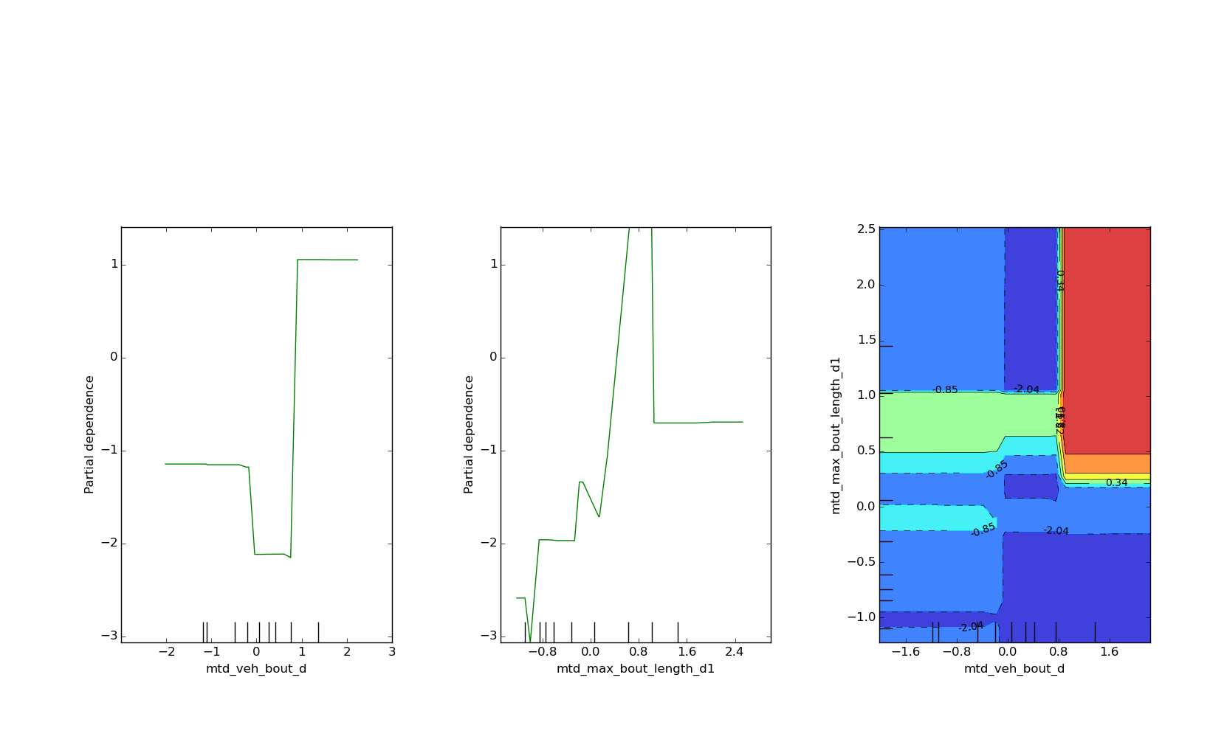
Validation & Results (cont)
Data Analysis
Feature Generation and Filtering
Model Selection
Feature Selection
Validation & Results
Given overall accuracy, our results suggest that there is a linear relationship between the increase of max bout length and chances of becoming VHD. That is, during the induction phase of the NHP model, future heavy drinking animals demonstrate significantly longer ethanol bouts. Moreover, if the animal primate increases the number of H2O bouts (or rather make them shorter) then there is an increase in the probability that they will later be classified as very heavy drinkers (VHD). Cohesively, inverse relationships hold for low drinking animals (LD).
VHD Partial Dependency
Max Bout Length
Max Bout Length
In addition, our approach demonstrates a classification accuracy of 0.81 (SEM=0.05) when only two classes ([LD+BD]&[HD+VHD]) are evaluated.
Number of H2O bouts

Slide 12
References
[1] Ethem Alpaydin. Introduction to machine learning. MIT press, 2014.
[2] Erich J Baker et al. Chronic alcohol self-administration in monkeys shows long-term quantity/frequency categorical stability, 2014.
[3] David Barber. Bayesian reasoning and machine learning. Cambridge University Press, 2012.
[4] James B Daunais et al. Monkey alcohol tissue research resource: banking tissues for alcohol research, 2014.
[5] Jerome H Friedman. Greedy function approximation: a gradient boosting machine. Annals of statistics, pages 1189-1232, 2001.
[6] Andrew Rosenberg. Automatic detection and classification of prosodic events. Columbia University, 2009.
[7] Bjorn Schuller at al. The interspeech 2011 speaker state challenge. In Proceedings INTERSPEECH 2011.
[8] L. Breiman, “Random Forests”, Machine Learning, 45(1), 5-32, 2001.
[9] L. Breiman, “Pasting small votes for classification in large databases and on-line”, Machine Learning, 36(1), 85-103, 1999.

Slide 13
QA

