Slide 1
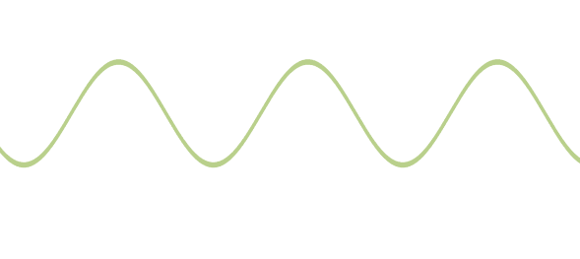
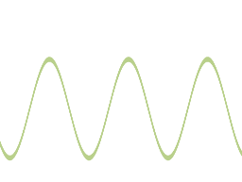
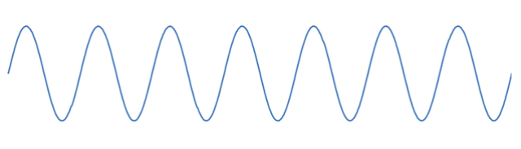
a
d=2 - ok
a
d=2 - ok
a
d=2 - ok
d=2 - ok
d=1 - ok
d=2 – can’t shatter
a
a?
d=2 – ok
d=3 – can’t shatter
a
b
a?
a?
b?
b?
Frequency f
a
Amplitude
ph
phase

