Slide 1

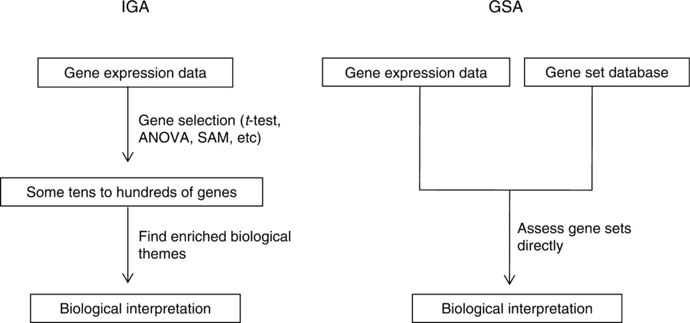
From: Gene-set approach for expression pattern analysis
Brief Bioinform. 2008;9(3):189-197. doi:10.1093/bib/bbn001
Figure Legend:
A schematic diagram comparing gene set analysis (GSA) with individual gene analysis (IGA). IGA is a two-step process which first selects some tens to hundreds of genes by an arbitrarily chosen cutoff and then, from the selected genes, infers the biological meaning of the gene expression data. In contrast, GSA is single-step process which in advance prepares gene sets from diverse sources as a testable hypothesis and then directly infers the biological meaning of gene expression data by applying either a sample or a gene randomization test.
Date of download: 4/19/2017
© The Author 2008. Published by Oxford University Press. For Permissions, please email: journals.permissions@oxfordjournals.org

