Slide 1
Canadian Bioinformatics Workshops
www.bioinformatics.ca

Slide 2

Module #: Title of Module
2

Slide 3

Module 2 Finding over-represented pathways in gene lists
Quaid Morris
Pathway and network analysis of –omic data
June 13-14, 2016

Slide 4
Learning Objectives of Module 2
Be able to select the appropriate enrichment test for your data.
Be able to determine the appropriate background gene list when running Fisher’s Exact Test (aka Hypergeometric test).
Be able to compute a minimum hypergeometric test on a ranked list
Be able to determine when you need a multiple test correction.
Be able to select whether to use a Bonferroni corrected P-value or a false discovery rate.
Be able to explain, in plain language, how you calculate each correction.

Slide 5
Outline
Introduction to enrichment analysis
Hypergeometric Test, aka Fisher’s Exact Test
GSEA and minimum hypergeometric test for ranked lists.
Multiple test corrections:
Bonferroni correction
False Discovery Rate computation using Benjamini-Hochberg procedure

Slide 6
Types of enrichment analysis
Gene list (e.g. expression change > 2-fold)
Answers the question: Are any gene sets surprisingly enriched (or depleted) in my gene list?
Statistical test: Fisher’s Exact Test (aka Hypergeometric test)
Ranked list (e.g. by differential expression)
Answers the question: Are any gene set ranked surprisingly high or low in my ranked list of genes?
Statistical test: minimum hypergeometric test, GSEA (+ others we won’t discuss)

Slide 7
Enrichment Test
Microarray
Experiment
(gene expression table)
Enrichment Table
Spindle 0.00001
Apoptosis 0.00025
ENRICHMENT
TEST
Gene-set
Databases

Slide 8
Gene list enrichment analysis
Given:
Gene list: e.g. RRP6, MRD1, RRP7, RRP43, RRP42 (yeast)
Gene sets or annotations: e.g. Gene ontology, transcription factor binding sites in promoter
Question: Are any of the gene annotations surprisingly enriched in the gene list?
Details:
Where do the gene lists come from?
How to assess “surprisingly” (statistics)
How to correct for repeating the tests

Slide 9
Two-class design for gene lists
Genes Ranked by
Differential Statistic
Selection by Threshold
Expression Matrix
UP
UP
DOWN
DOWN
Class-1
Class-2
E.g.:
Fold change
Log (ratio)
t-test
Significance analysis of microarrays

Slide 10
Time-course design for gene lists
E.g.:
K-means
K-medoids
SOM
Gene
Clusters
Expression Matrix
Each cluster is a separate gene list
t1
t2
t3
…
tn

Slide 11
Example gene list enrichment test
Microarray
Experiment
(gene expression table)
Gene list
(e.g UP-regulated)
Gene-set
Databases
Background
(all genes on the array)

Slide 12
Example gene list enrichment test
Microarray
Experiment
(gene expression table)
Gene list
(e.g UP-regulated)
Gene-set
Gene-set
Databases
Background
(all genes on the array)

Slide 13

Enrichment Test
Random samples
of array genes
The output of an enrichment test is a P-value
The P-value assesses the probability that the overlap is at least as large as observed by random sampling
the array genes.

Slide 14
Recipe for gene list enrichment test
Step 1: Define your gene list and your background list,
Step 2: Select your gene sets to test for enrichment,
Step 3: Run enrichment tests and correct for multiple testing, if necessary,
Step 4: Interpret your enrichments
Step 5: Publish! ;)
Notes:
Consequtive basepairs

Slide 15
Why test enrichment in ranked lists?
Possible problems with gene list test
No “natural” value for the threshold
Different results at different threshold settings
Possible loss of statistical power due to thresholding
No resolution between significant signals with different strengths
Weak signals neglected

Slide 16
Example ranked list enrichment test
Ranked
Gene List
Enrichment Table
Gene-set p-value
Spindle 0.0001
Apoptosis 0.025
GSEA or Min
Hypergeometric
test
Gene-set
Databases

Slide 17
Recipe for ranked list enrichment test
Step 1: Rank your genes,
Step 2: Select your gene sets to test for enrichment,
Step 3: Run enrichment tests and correct for multiple testing, if necessary,
Step 4: Interpret your enrichments
Step 5: Publish! ;)
Notes:
Consequtive basepairs

Slide 18
Outline of theory component
Hypergeometric test for calculating enrichment P-values for gene lists
GSEA and minimum hypergeometric (mHG) test for computing enrichment P-values for ranked lists
Multiple test corrections:
Bonferroni
Benjamini-Hochberg FDR

Slide 19
The hypergeometric test a.k.a., Fisher’s exact test
Gene list
RRP6
MRD1
RRP7
RRP43
RRP42
Null hypothesis: List is a random sample from population
Alternative hypothesis: More black genes than expected
Background population:
500 black genes,
4500 red genes

Slide 20
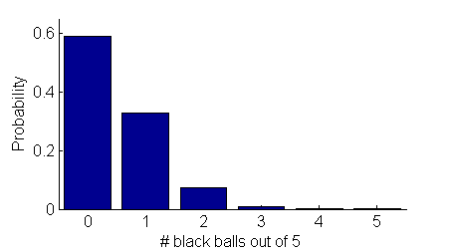
The hypergeometric test a.k.a., Fisher’s exact test
Gene list
Null distribution
RRP6
MRD1
RRP7
RRP43
RRP42
P-value
Answer = 4.6 x 10⁻⁴
Background population:
500 black genes,
4500 red genes

Slide 21
2x2 contingency table for Fisher’s Exact Test
Gene list
 | In gene list | Not in gene list
In gene set | 4 | 496
Not in gene set | 1 | 4499
RRP6
MRD1
RRP7
RRP43
RRP42
Background population:
500 black genes,
4500 red genes

Slide 22
Important details
To test for under-enrichment of “black”, test for over-enrichment of “red”.
Need to choose “background population” appropriately, e.g., if only portion of the total gene complement is queried (or available for annotation), only use that population as background.
To test for enrichment of more than one independent types of annotation (red vs black and circle vs square), apply Fisher’s exact test separately for each type. ***More on this later***

Slide 23
Other enrichment tests
UP
Gene list
Fisher’s Exact Test,
Binomial and Chi-squared.
ENRICHMENT
TEST
DOWN
Ranked list (semi-quantitative)
Minimum hypergeometric test,
GSEA,
Wilcoxon ranksum,
Mann-Whitney U,
Kolmogorov-Smirnov
UP
DOWN

Slide 24
Minimum hypergeometric test (mHG)
Steps
Calculate P-value at multiple thresholds
Correct for multiple testing (or compute empirical P-values using permutations)
Eden E, Lipson D, Yogev S, Yakhini Z. Discovering motifs in ranked lists of DNA sequences. PLoS Comput Biol. 2007 Mar 23;3(3):e39

Slide 25
GSEA/mHG: Method
GSEA/mHG score calculation
gene-set
Where are the gene-set genes located in the ranked list?
Is there distribution random, or is there an enrichment in either end?

Slide 26
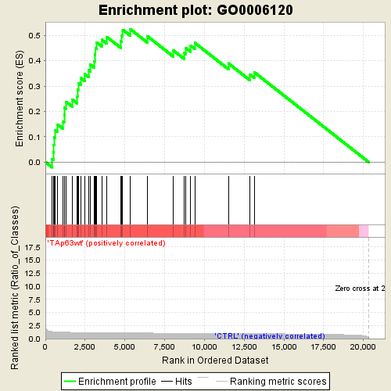
GSEA/mHG: Method
GSEA/mHG score calculation
gene-set
1
101
401
Gene rank
ES score
Every present gene (thick red vertical bar) gives a positive contribution,
Every absent gene (black vertical bar) gives a negative contribution
Warning: the alignment here between bars and plot is a little off
For mHG, ES score = -log P of hypergeometric test at that threshold

Slide 27
GSEA/mHG: Method
GSEA/mHG score calculation
gene-set
1
101
401
Gene rank
ES score
1. Maximum (or minimum) ES score is the final ES score for the gene set
2. Can define “leading edge subset” as all those genes ranked as least as high as the enriched set.

Slide 28
Going from ES score → P-value
Two options
For GSEA and mHG, can compute empirical P-values using permutations (see following slides)
For mHG, you have another option, you can use a multiple test correction.

Slide 29
Permutation-based P-values
Empirical p-value estimation (for every gene-set)
Generate null-hypothesis distribution from randomized data (see permutation settings)
Distribution of (max) ES scores from
N permutations (e.g. 2000)
Counts
ES Score

Slide 30
Permutation-based P-values
Estimate empirical p-value by comparing observed max ES score to null-hypothesis distribution from randomized data (for every gene-set)
Distribution of ES scores from
N permutations (e.g. 2000)
Counts
Real ES score
ES Score

Slide 31
Permutation-based P-values
Estimate empirical p-value by comparing observed max ES score to null-hypothesis distribution from randomized data (for every gene-set)
Distribution of ES scores from
N permutations (e.g. 2000)
Counts
Randomized with ES score ≥ real: 4 / 2,000
--> Empirical p-value = 0.002
Real ES score
ES Score

Slide 32
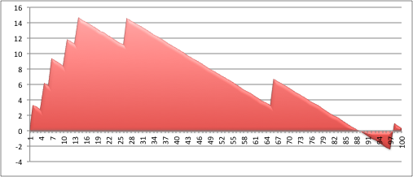
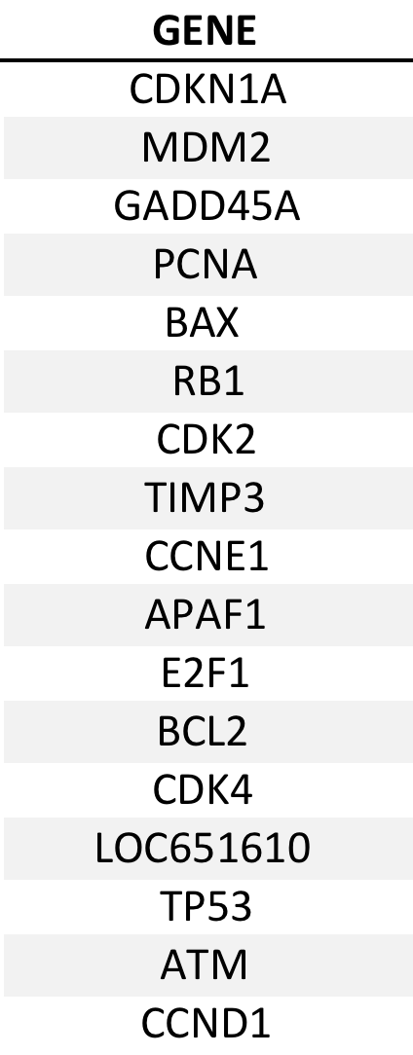
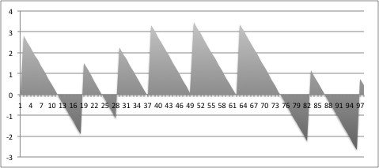
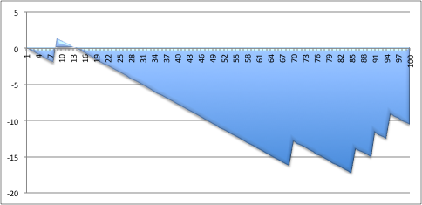
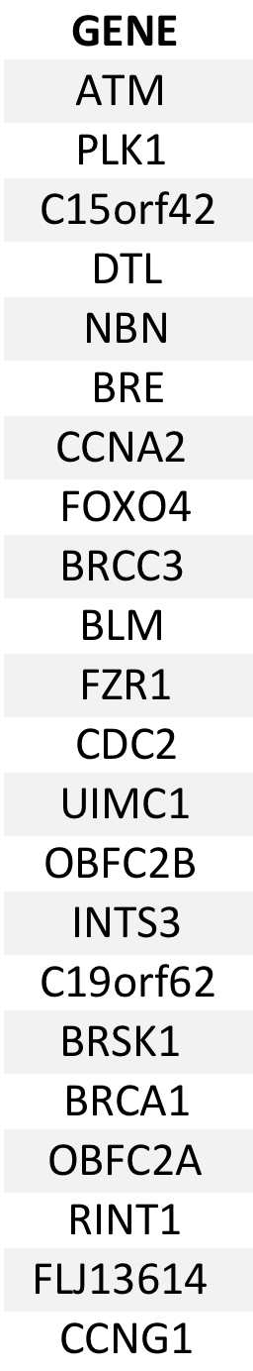
More GSEA examples
Ranked
gene list
UP in treated
+
+
+
+
+
Gene-set 1 (n=17)
Enriched in treated
+
+
Enrichment Score
Gene-set 2
Not enriched
+
-
Gene-set 3 (n=22)
Depleted in treated
DOWN in treated
+
Enrichment Score
Notes:
How is the running sum calculated.
We have 2 variables N and G.
N represents the # of genes in our ranked list, let’s say 20000 genes and G is the number of genes in the gene-set.
If the gene I is in the gene-set,…..
If the gene I is not in the gene-set…
The running sum of X is calculated until we reach the last gene in the ranked list
Thus, if a gene is in the gene-set , the running sum increases a lot and if not the running sum decreases just a little bit (this is because in the 20000 gene list, we have much more genes that are not in the gene-set (containing) 50 genes than otherwise)
We plot this running sum and the enrichment score corresponds to the maximum deviation from zero. We can have a positive enrichment score if the genes in the gene-set are at the top of the list (thus up-regulated in the treated sample versus the control) and a negative enrichment score if the genes are more at the bottom of the list, corresponding to down-regulated genes.

Slide 33
Multiple test corrections

Slide 34
How to win the P-value lottery, part 1
Random draws
Expect a random draw with observed enrichment once every 1 / P-value draws
… 7,834 draws later …
Background population:
500 black genes,
4500 red genes
Notes:
Whenever you do multiple tests, need to correct the p-values
Remind audience of p-value definition
Motivating example: Do 20 tests at a p-value of 0.05, expect one false positive

Slide 35
How to win the P-value lottery, part 2 Keep the gene list the same, evaluate different annotations
Observed draw
Different annotation
RRP6
MRD1
RRP7
RRP43
RRP42
RRP6
MRD1
RRP7
RRP43
RRP42
Notes:
Use different annotations. “evaluate different annotations”

Slide 36
Simple P-value correction: Bonferroni
If M = # of annotations tested:
Corrected P-value = M x original P-value
Corrected P-value is greater than or equal to the probability that one or more of the observed enrichments could be due to random draws. The jargon for this correction is “controlling for the Family-Wise Error Rate (FWER)”

Slide 37
Bonferroni correction caveats
Bonferroni correction is very stringent and can “wash away” real enrichments leading to false negatives,
Often one is willing to accept a less stringent condition, the “false discovery rate” (FDR), which leads to a gentler correction when there are real enrichments.

Slide 38
False discovery rate (FDR)
FDR is the expected proportion of the observed enrichments due to random chance.
Compare to Bonferroni correction which is a bound on the probability that any one of the observed enrichments could be due to random chance.
Typically FDR corrections are calculated using the Benjamini-Hochberg procedure.
FDR threshold is often called the “q-value”

Slide 39
Benjamini-Hochberg example I
(Nominal)
P-value
Rank
Category
1
2
3
4
5
…
52
53
Transcriptional regulation
Transcription factor
Initiation of transcription
Nuclear localization
Chromatin modification
…
Cytoplasmic localization
Translation
0.001
0.002
0.003
0.0031
0.005
…
0.97
0.99
Sort P-values of all tests in increasing order

Slide 40
Benjamini-Hochberg example II
(Nominal)
P-value
Rank
Category
Adjusted P-value
1
2
3
4
5
…
52
53
Transcriptional regulation
Transcription factor
Initiation of transcription
Nuclear localization
Chromatin modification
…
Cytoplasmic localization
Translation
0.001
0.002
0.003
0.0031
0.005
…
0.97
0.99
0.001 x 53/1 = 0.053
0.002 x 53/2 = 0.053
0.003 x 53/3 = 0.053
0.0031 x 53/4 = 0.040
0.005 x 53/5 = 0.053
…
0.985 x 53/52 = 1.004
0.99 x 53/53 = 0.99
Adjusted P-value is “nominal” P-value times # of tests divided by the rank of the P-value in sorted list
Adjusted P-value = P-value X [# of tests] / Rank

Slide 41
Benjamini-Hochberg example III
(Nominal)
P-value
FDR /
Q-value
Rank
Category
Adjusted P-value
1
2
3
4
5
…
52
53
Transcriptional regulation
Transcription factor
Initiation of transcription
Nuclear localization
Chromatin modification
…
Cytoplasmic localization
Translation
0.001
0.002
0.003
0.0031
0.005
…
0.97
0.99
0.001 x 53/1 = 0.053
0.002 x 53/2 = 0.053
0.003 x 53/3 = 0.053
0.0031 x 53/4 = 0.040
0.005 x 53/5 = 0.053
…
0.985 x 53/52 = 1.004
0.99 x 53/53 = 0.99
0.040
0.040
0.040
0.040
0.053
…
0.99
0.99
Q-value (or FDR) corresponding to a nominal P-value is the smallest adjusted P-value assigned to P-values with the same or larger ranks.

Slide 42
Benjamini-Hochberg example III
P-value threshold for FDR < 0.05
FDR /
Q-value
(Nominal)
P-value
Rank
Category
Adjusted P-value
1
2
3
4
5
…
52
53
Transcriptional regulation
Transcription factor
Initiation of transcription
Nuclear localization
Chromatin modification
…
Cytoplasmic localization
Translation
0.001
0.002
0.003
0.0031
0.005
…
0.97
0.99
0.001 x 53/1 = 0.053
0.002 x 53/2 = 0.053
0.003 x 53/3 = 0.053
0.0031 x 53/4 = 0.040
0.005 x 53/5 = 0.053
…
0.985 x 53/52 = 1.004
0.99 x 53/53 = 0.99
0.040
0.040
0.040
0.040
0.053
…
0.99
0.99
Red: non-significant
Green: significant at FDR < 0.05
P-value threshold is highest ranking P-value for which corresponding Q-value is below desired significance threshold

Slide 43
Reducing multiple test correction stringency
The correction to the P-value threshold α depends on the # of tests that you do, so, no matter what, the more tests you do, the more sensitive the test needs to be
Can control the stringency by reducing the number of tests: e.g. use GO slim; restrict testing to the appropriate GO annotations; or filter gene sets by size.

Slide 44
Summary
Enrichment analysis:
Statistical tests
Gene list: Fisher’s Exact Test
Ranked list: mHG, GSEA, also see Wilcoxon ranksum, Mann-Whitney U-test, Kolmogorov-Smirnov test
Multiple test correction
Bonferroni: stringent, controls probability of at least one false positive*
FDR: more forgiving, controls expected proportion of false positives* -- typically uses Benjamini-Hochberg
* Type 1 error, aka probability that observed enrichment if no association

Slide 45
Learning Objectives of Module 2
Be able to select the appropriate enrichment test for your data.
Be able to determine the appropriate background gene list when running Fisher’s Exact Test (aka Hypergeometric test).
Be able to compute a minimum hypergeometric test on a ranked list
Be able to determine when you need a multiple test correction.
Be able to select whether to use a Bonferroni corrected P-value or a false discovery rate.
Be able to explain, in plain language, how you calculate each correction.

Slide 46
We are on a Coffee Break & Networking Session

