Slide 1
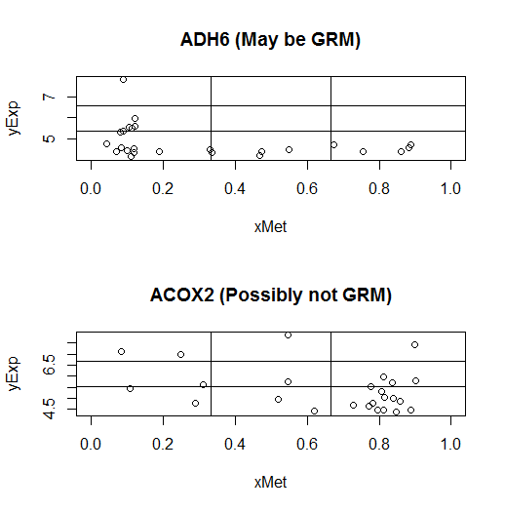
☺ | 😐 | ☹
☺ | 😐 | 😐
☺ | ☺ | ☺
Permitted, indistinct and forbidden regions
To score an L shape on a grid
L-shape (GRM) vs non L-shape

