Slide 1
Microarray Data Analysis
Statistical methods to detect differentially expressed genes

Slide 2
Outline
The class comparison problem
Statistical tests
  Calculation of p-values
  Permutations tests
  The volcano plot
Multiple testing
Extensions
Examples

Slide 3
Class comparison: Identifying differentially expressed genes
Identify genes whose expression is significantly associated with different conditions
  Treatment, cell type,... (qualitative covariates)
  Dose, time, ... (quantitative covariate)
  Survival, infection time,... !
Estimate effects/differences between groups probably using log-ratios, i.e. the difference on log scale:
log(X)-log(Y) [=log(X/Y)]

Slide 4
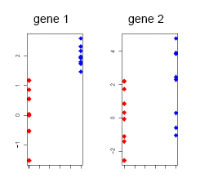
What is a “significant change”?
Depends on the variability within groups, which may be different from gene to gene.
To assess the statistical significance of differences, conduct a statistical test for each gene.

Slide 5
Different settings for statistical tests
Indirect comparisons: 2 groups, 2 samples, unpaired
  E.g. 10 individuals: 5 suffer diabetes, 5 healthy
  One sample fro each individual
  Typically: Two sample t-test or similar
Direct comparisons: Two groups, two samples, paired
  E.g. 6 individuals with brain stroke.
  Two samples from each: one from healthy (region 1) and one from affected (region 2).
  Typically: One sample t-test (also called paired t-test) or similar, based on the individual differences between conditions.

Slide 6
Different ways to do the experiment
An experiment use cDNA arrays (“two-colour”) or affy (“one-colour).
Depending on the technology used allocation of conditions to slides changes.
Type of chip Experiment | cDNA (2-col) | Affy (1-col)
10 indiv. Diab (5) Heal (5) | Reference design. (5) Diab/Ref (5) Heal/Ref | Comparison design. (5) Diab vs (5) Heal
6 indiv. Region 1 Region 2 | 6 slides 1 individual per slide (6) reg1/reg2 | 12 slides (6) Paired differences

Slide 7
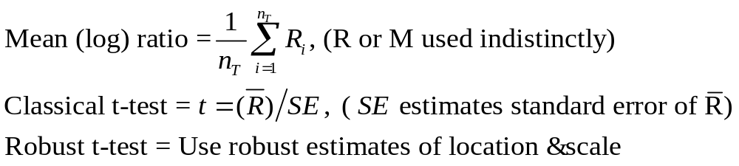
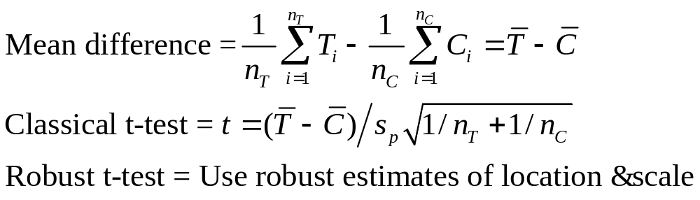
“Natural” measures of discrepancy
For Direct comparisons in two colour or paired-one colour.
For Indirect comparisons in two colour or
Direct comparisons in one colour.

Slide 8
Some issues in gene selection
Gene expression values have peculiarities that have to be dealt with.
Some related with small sample sizes
  Variance unstability
  Non-normality of the data
Other related to big number of variables
  Multiple testing

Slide 9
Variance unstability
Can we trust average effect sizes (average difference of means) alone?
Can we trust the t-statistic alone?
Here is evidence that the answer is no.
Gene | M1 | M2 | M3 | M4 | M5 | M6 | Mean | SD | t
A | 2.5 | 2.7 | 2.5 | 2.8 | 3.2 | 2 | 2.61 | 0.40 | 16.10
B | 0.01 | 0.05 | -0.05 | 0.01 | 0 | 0 | 0.003 | 0.03 | 0.25
C | 2.5 | 2.7 | 2.5 | 1.8 | 20 | 1 | 5.08 | 7.34 | 1.69
D | 0.5 | 0 | 0.2 | 0.1 | -0.3 | 0.3 | 0.13 | 0.27 | 1.19
E | 0.1 | 0.11 | 0.1 | 0.1 | 0.11 | 0.09 | 0.10 | 0.01 | 33.09
M may be assumed to be the log-Fold change in a paired experiment
Courtesy of Y.H. Yang

Slide 10
Variance unstability (1): outliers
Can we trust average effect sizes (average difference of means) alone?
Can we trust the t statistic alone?
Here is evidence that the answer is no.
Gene | M1 | M2 | M3 | M4 | M5 | M6 | Mean | SD | t
A | 2.5 | 2.7 | 2.5 | 2.8 | 3.2 | 2 | 2.61 | 0.40 | 16.10
B | 0.01 | 0.05 | -0.05 | 0.01 | 0 | 0 | 0.003 | 0.03 | 0.25
C | 2.5 | 2.7 | 2.5 | 1.8 | 20 | 1 | 5.08 | 7.34 | 1.69
D | 0.5 | 0 | 0.2 | 0.1 | -0.3 | 0.3 | 0.13 | 0.27 | 1.19
E | 0.1 | 0.11 | 0.1 | 0.1 | 0.11 | 0.09 | 0.10 | 0.01 | 33.09
Averages can be driven by outliers.
Courtesy of Y.H. Yang

Slide 11
Variance unstability (2): tiny variances
Can we trust average effect sizes (average difference of means) alone?
Can we trust the t statistic alone?
Here is evidence that the answer is no.
Gene | M1 | M2 | M3 | M4 | M5 | M6 | Mean | SD | t
A | 2.5 | 2.7 | 2.5 | 2.8 | 3.2 | 2 | 2.61 | 0.40 | 16.10
B | 0.01 | 0.05 | -0.05 | 0.01 | 0 | 0 | 0.003 | 0.03 | 0.25
C | 2.5 | 2.7 | 2.5 | 1.8 | 20 | 1 | 5.08 | 7.34 | 1.69
D | 0.5 | 0 | 0.2 | 0.1 | -0.3 | 0.3 | 0.13 | 0.27 | 1.19
E | 0.1 | 0.11 | 0.1 | 0.1 | 0.11 | 0.09 | 0.10 | 0.01 | 33.09
t’s can be driven by tiny variances.
Courtesy of Y.H. Yang

Slide 12
Solutions: Adapt t-tests
Let
  R_{g} mean observed log ratio
  SE_{g} standard error of R_{g} estimated from data on gene g.
  SE standard error of R_{g} estimated from data across all genes.
Global t-test: t=R_{g}/SE
Gene-specific t-test t=R_{g}/SE_{g}

Slide 13
Some pro’s and con’s of t-test
Test | Pro’s | Con’s
Global t-test: t=R_{g}/SE | Yields stable variance estimate | Assumes variance homogeneity → biased if false
Gene-specific: t=R_{g}/SE_{g} | Robust to variance heterogeneity | Low power Yields unstable variance estimates (due to few data)

Slide 14
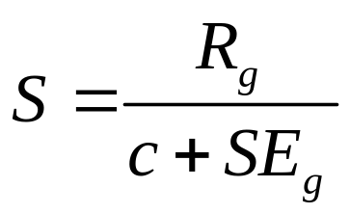
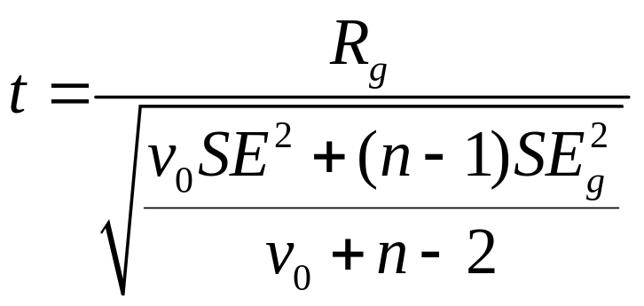
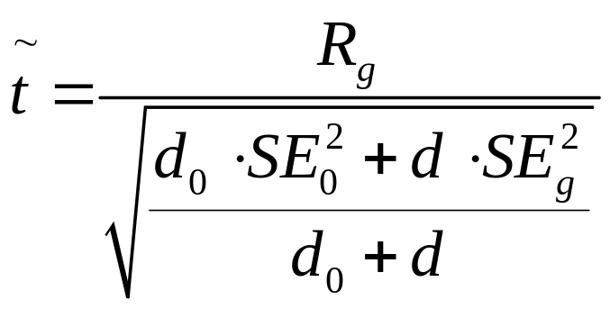
T-tests extensions
SAM
(Tibshirani, 2001)
Regularized-t
(Baldi, 2001)
EB-moderated t
(Smyth, 2003)

Slide 15
Up to here…: Can we generate a list of candidate genes?
With the tools we have, the reasonable steps to generate a list of candidate genes may be:
Gene 1: M₁₁, M₁₂, …., M_{1k}
Gene 2: M₂₁, M₂₂, …., M_{2k}
…………….
Gene G: M_{G1}, M_{G2}, …., M_{Gk}
For every gene, calculate
S_{i}=t(M_{i1}, M_{i2}, …., M_{ik}),
e.g. t-statistics, S, B,…
?
Statistics of interest
S₁, S₂, …., S_{G}
A list of candidate
DE genes
We need an idea of how significant are these values →We’d like to assign them p-values

Slide 16
Nominal p-values
After a test statistic is computed, it is convenient to convert it to a p-value:
The probability that a test statistic, say S(X), takes values equal or greater than the observed value, say X^{0,} under the assumption that the null hypothesis is true
p=P{S(X)>=S(X⁰)|H₀ true}

Slide 17
Significance testing
Test of significance at the α level:
  Reject the null hypothesis if your p-value is smaller than the significance level
  It has advantages but not free from criticisms
Genes with p-values falling below a prescribed level may be regarded as significant

Slide 18
Hypothesis testing overview for a single gene
 |  | Reported decision
 |  | H₀ is Accepted (gene not Selected) | H₀ is Rejected (gene is Selected)
State of the nature ("Truth") | H₀ is true (Not Affected) | TN , prob: β | FP, P[Rej H₀|H₀]<= α Type I error | Specificity TN/[TN+FP]
 | H₀ is false (Affected) | FN, prob: 1-β Type II error | TP, prob: 1-α | Sensitiviy TP/[TP+FN]
 |  | Negative predictive value TN/[TN+FN] | Positive predictive value TP/[TP+FP]

Slide 19
Calculation of p-values
Standard methods for calculating p-values:
  (i) Refer to a statistical distribution table (Normal, t, F, …) or
  (ii) Perform a permutation analysis

Slide 20
(i) Tabulated p-values
Tabulated p-values can be obtained for standard test statistics (e.g.the t-test)
They often rely on the assumption of normally distributed errors in the data
This assumption can be checked (approximately) using a
  Histogram
  Q-Q plot
Notes:
One of the things we want to do with our t-statistics is roughly speaking, to identify the extreme ones.
It is natural to rank them, but how extreme is extreme? Since the sample sizes here are not too small ( two samples of 8 each gives 16 terms in the difference of the means), approximate normality is not an unreasonable expectation for the null marginal distribution.
Converting ranked t’s into a normal q-q plot is a great way to see the extremes: they are the ones that are “off the line”, at one end or another. This technique is particularly helpful when we have thousands of values. Of course we can’t expect all differentially expressed genes to stand out as extremes: many will be masked by more extreme random variation, which is a big problem in this context.

Slide 21
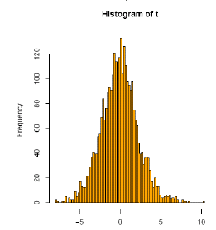
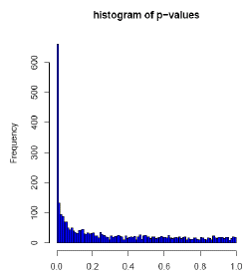
Example (1)
Golub data, 27 ALL vs 11 AML samples, 3051 genes
A t-test yields 1045 genes with p< 0.05

Slide 22
(ii) Permutations tests
Based on data shuffling. No assumptions
  Random interchange of labels between samples
  Estimate p-values for each comparison (gene) by using the permutation distribution of the t-statistics
Repeat for every possible permutation, b=1…B
  Permute the n data points for the gene (x). The first n1 are referred to as “treatments”, the second n2 as “controls”
  For each gene, calculate the corresponding two sample
  t-statistic, tb
After all the B permutations are done put
p = #{b: |tb| ≥ |tobserved|}/B

Slide 23
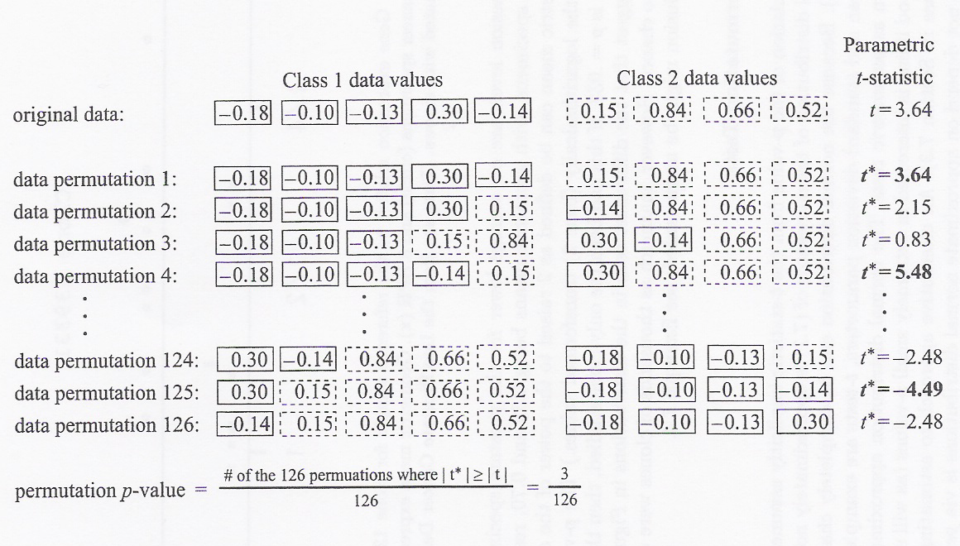
Permutation tests (2)

Slide 24
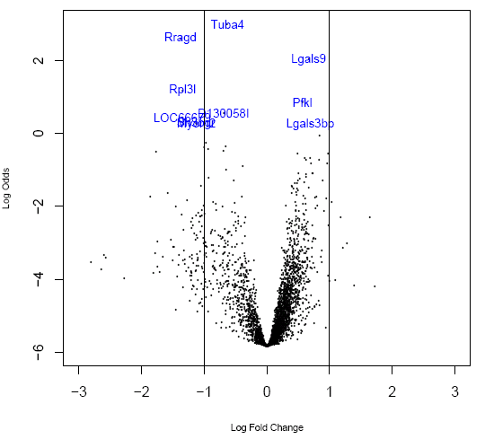
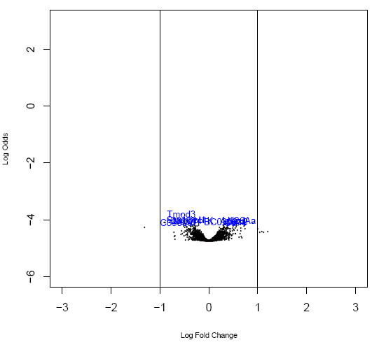
The volcano plot: fold change vs log(odds)¹
Significant change detected
No change detected
1: log(odds) is proportional to “-log (p-value)”

Slide 25
Multiple testing

Slide 26
How far can we trust the decision?
The test: "Reject H₀ if p-val ≤ α"
  is said to control the type I error because, under a certain set of assumptions,
  the probability of falsely rejecting H₀ is less than a fixed small threshold
    P[Reject H₀|H₀ true]=P[FP] ≤ α
  Nothing is warranted about P[FN]→
    “Optimal” tests are built trying to minimize this probability
    In practical situations it is often high

Slide 27
What if we wish to test more than one gene at once? (1)
Consider more than one test at once
  Two tests each at 5% level. Now probability of getting a false positive is 1 – 0.95*0.95 = 0.0975
  Three tests → 1 – 0.95³ =0.1426
  n tests → 1 – 0.95^{n}
  Converge towards 1 as n increases
Small p-values don’t necessarily imply significance!!! → We are not controlling the probability of type I error anymore

Slide 28
What if we wish to test more than one gene at once? (2): a simulation
Simulation of this process for 6,000 genes with 8 treatments and 8 controls
All the gene expression values were simulated i.i.d from a N (0,1) distribution, i.e. NOTHING is differentially expressed in our simulation
The number of genes falsely rejected will be on the average of (6000 · α), i.e. if we wanted to reject all genes with a p-value of less than 1% we would falsely reject around 60 genes
See example

Slide 29
Multiple testing: Counting errors
 |  | Decision reported
 |  | H₀ is accepted (Genes not Selected) |  | H₀ is Rejected (Genes Selected) |  | Total
State of the nature ("Truth") | H₀ is true (Not Affected) | m_{o}-αm0 | (U) | αm₀ | (V) | m_{o}
 | H₀ is false (Affected) | (m-m_{o})- (m_{α} −αm₀₎ | (T) | m_{α} −αm₀ | (S) | m-m_{o}
Total |  | m-m_{α} | (m-R) | M_{α} | (R) | m
V = # Type I errors [false positives]
T = # Type II errors [false negatives]
All these quantities could be known if m₀ was known

Slide 30
How does type I error control extend to multiple testing situations?
Selecting genes with a p-value less than α doesn’t control for P[FP] anymore
What can be done?
  Extend the idea of type I error
    FWER and FDR are two such extensions
  Look for procedures that control the probability for these extended error types
    Mainly adjust raw p-values
Notes:
For strong control of the FWER at some level α, there are procedures which will take m unadjusted p-values and modify them separately, so-called single step procedures, the Bonferroni adjustment or correction being the simplest and most well known. Another is due to Sidák.
Other, more powerful procedures, adjust sequentially, from the smallest to the largest, or vice versa. These are the step-up and step-down methods, and we’ll meet a number of these, usually variations on single-step procedures.

Slide 31
Two main error rate extensions
Family Wise Error Rate (FWER)
  FWER is probability of at least one false positive
    FWER= Pr(# of false discoveries >0) = Pr(V>0)
False Discovery Rate (FDR)
  FDR is expected value of proportion of false positives among rejected null hypotheses
    FDR = E[V/R; R>0] = E[V/R | R>0]·P[R>0]

Slide 32
FDR and FWER controlling procedures
FWER
  Bonferroni (adj Pvalue = min{n*Pvalue,1})
  Holm (1979)
  Hochberg (1986)
  Westfall & Young (1993) maxT and minP
FDR
  Benjamini & Hochberg (1995)
  Benjamini & Yekutieli (2001)
Notes:
As we will see, there is a bewildering variety of multiple testing procedures.
How can we choose which to use?
There is no simple answer here, but each can be judged according to a number of criteria:
Interpretation: does the procedure answer a relevant question for you?
Type of control: strong, exact or weak?
Validity: are the assumptions under which the procedure applies clear and definitely or plausibly true, or are they unclear and most probably not true?
Computability: are the procedure’s calculations straightforward to calculate accurately, or is there possibly numerical or simulation uncertainty, or discreteness?

Slide 33
Difference between controlling
FWER or FDR
FWER→ Controls for no (0) false positives
  gives many fewer genes (false positives),
  but you are likely to miss many
  adequate if goal is to identify few genes that differ between two groups
FDR→ Controls the proportion of false positives
  if you can tolerate more false positives
  you will get many fewer false negatives
  adequate if goal is to pursue the study e.g. to determine functional relationships among genes

Slide 34
Steps to generate a list of candidate genes revisited (2)
Gene 1: M₁₁, M₁₂, …., M_{1k}
Gene 2: M₂₁, M₂₂, …., M_{2k}
…………….
Gene G: M_{G1}, M_{G2}, …., M_{Gk}
For every gene, calculate
S_{i}=t(M_{i1}, M_{i2}, …., M_{ik}),
e.g. t-statistics, S, B,…
Statistics of interest
S₁, S₂, …., S_{G}
Assumption on the
null distribution:
data normality
Nominal p-values
P₁, P₂, …, P_{G}
A list of candidate
DE genes
Select genes with
adjusted P-values
smaller than α
Adjusted p-values
aP₁, aP₂, …, aP_{G}

Slide 35
Example (1b)
Golub data, 27 ALL vs 11 AML samples, 3051 genes
Bonferroni adjustment: 98 genes with p_{adj}< 0.05 (p_{raw} < 0.000016)

Slide 36
Example (2)
Se the examples of testing in the case study found in this link
http://www.ub.edu/stat/docencia/bioinformatica/microarrays/ADM/labs/Virtaneva2002/Ejemplo_AML8.R

Slide 37
Extensions
Some issues we have not dealt with
  Replicates within and between slides
  Several effects: use a linear model
  ANOVA: are the effects equal?
  Time series: selecting genes for trends
Different solutions have been suggested for each problem
Still many open questions

