Slide 1
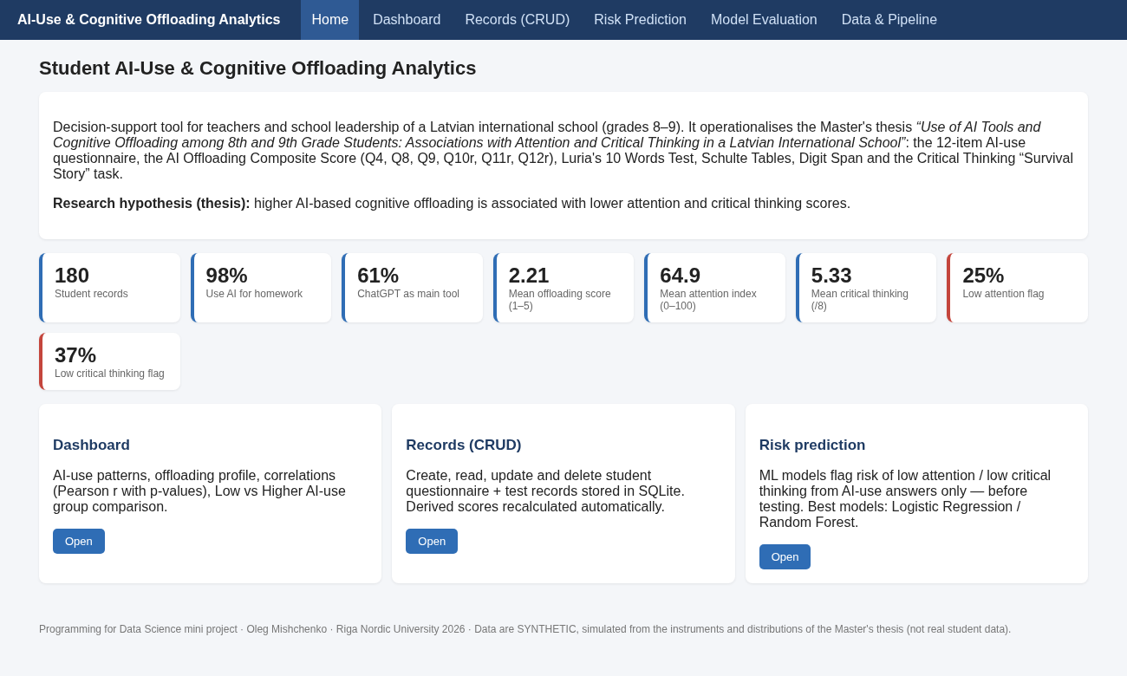
STUDENT AI-USE & COGNITIVE OFFLOADING ANALYTICS
A data-science system for attention and critical-thinking risk screening, grades 8–9
App home page
Oleg Mishchenko
Programming for Data Science · Riga Nordic University · 2026
Supervisor: Amit Joshi
OLEG MISHCHENKO
PROGRAMMING FOR DATA SCIENCE · RIGA NORDIC UNIVERSITY
PAGE
1 / 15
Notes:
The project turns my Master's thesis on AI tools and cognitive offloading into a working analytics application.
[Supervisor name to verify: Amit Joshi]

Slide 2
PROBLEM STATEMENT
100%
−0.35 to −0.68
of students in the thesis sample use AI tools such as ChatGPT and Gemini for homework
correlation between AI reliance and critical thinking in the literature
+51%
42%
higher risk of concentration problems with more than 2 h/day of screen time
of Latvian students are distracted by devices in class (OECD average 30%)
The gap: schools have no student-level data or tools, and the thesis sample (n = 12) was too small to test the hypothesis.
OLEG MISHCHENKO
PROGRAMMING FOR DATA SCIENCE · RIGA NORDIC UNIVERSITY
PAGE
2 / 15
Notes:
The open question is whether AI is a support or a substitute for thinking, and nobody measures this at school level.

Slide 3
OBJECTIVES
Main objective: build a web system that operationalises the thesis methodology and predicts at-risk students.
Model the instruments: 12-item questionnaire, Luria, Schulte, Digit Span, Critical Thinking task
ML: predict low attention and low critical thinking from questionnaire answers only
Automatic AI Offloading Composite (Q4, Q8, Q9, reversed Q10–Q12)
CRUD, dashboard and REST API for teachers
Statistics that mirror thesis Tables 4.3, 4.7 and 4.8
Target: F1 ≥ 0.60, AUC ≥ 0.75
Achieved: 0.76 / 0.96 and 0.65 / 0.75
OLEG MISHCHENKO
PROGRAMMING FOR DATA SCIENCE · RIGA NORDIC UNIVERSITY
PAGE
3 / 15
Notes:
One main objective and five specific ones. The measurable target for the models was F1 of at least 0.60 and ROC-AUC of at least 0.75 for the at-risk class; both models met it.

Slide 4
LITERATURE REVIEW
Study | Finding
Gerlich 2025 (n = 655) | AI use ↔ offloading +0.72; ↔ critical thinking −0.68
Tian & Zhang 2025 (n = 580) | AI dependence ↔ CT −0.35; fatigue mediates
Risko & Gilbert 2016 | Offloading: performance up, retention down
Leonhardt et al. 2025 (33 studies) | > 2 h screen time → +51% concentration risk
Sina et al. 2024 (I.Family, 8,673) | Smartphone hours → higher impulsivity
OECD PISA 2022 | Latvia: 42% digital distraction in class
Gap: no studies on Baltic lower-secondary students, and no operational tools for teachers.
OLEG MISHCHENKO
PROGRAMMING FOR DATA SCIENCE · RIGA NORDIC UNIVERSITY
PAGE
4 / 15
Notes:
Adult and university studies consistently link heavy AI reliance to weaker critical thinking, and screen exposure to attention problems. None of them covers Baltic grade 8–9 students or gives teachers a tool.

Slide 5
METHODOLOGY
01
EXTRACT
02
GENERATE
03
DERIVE
Instruments and hypothesis from the thesis
Synthetic, thesis-calibrated data: N = 180, seed 2026, about 3% missing
Load into SQLite; offloading score, attention index, CT total, risk flags
04
ANALYSE
05
MODEL
06
DELIVER
Pearson / Spearman, Welch t-test, Cohen's d
LR vs Random Forest; stratified 75/25 + 5-fold CV; select by F1 of at-risk class
Flask web app, tests, documentation
OLEG MISHCHENKO
PROGRAMMING FOR DATA SCIENCE · RIGA NORDIC UNIVERSITY
PAGE
5 / 15
Notes:
Development was iterative, in seven work packages. The pipeline runs from the thesis instruments to a synthetic dataset, the database with derived indicators, statistics, two classifiers and the web app.

Slide 6
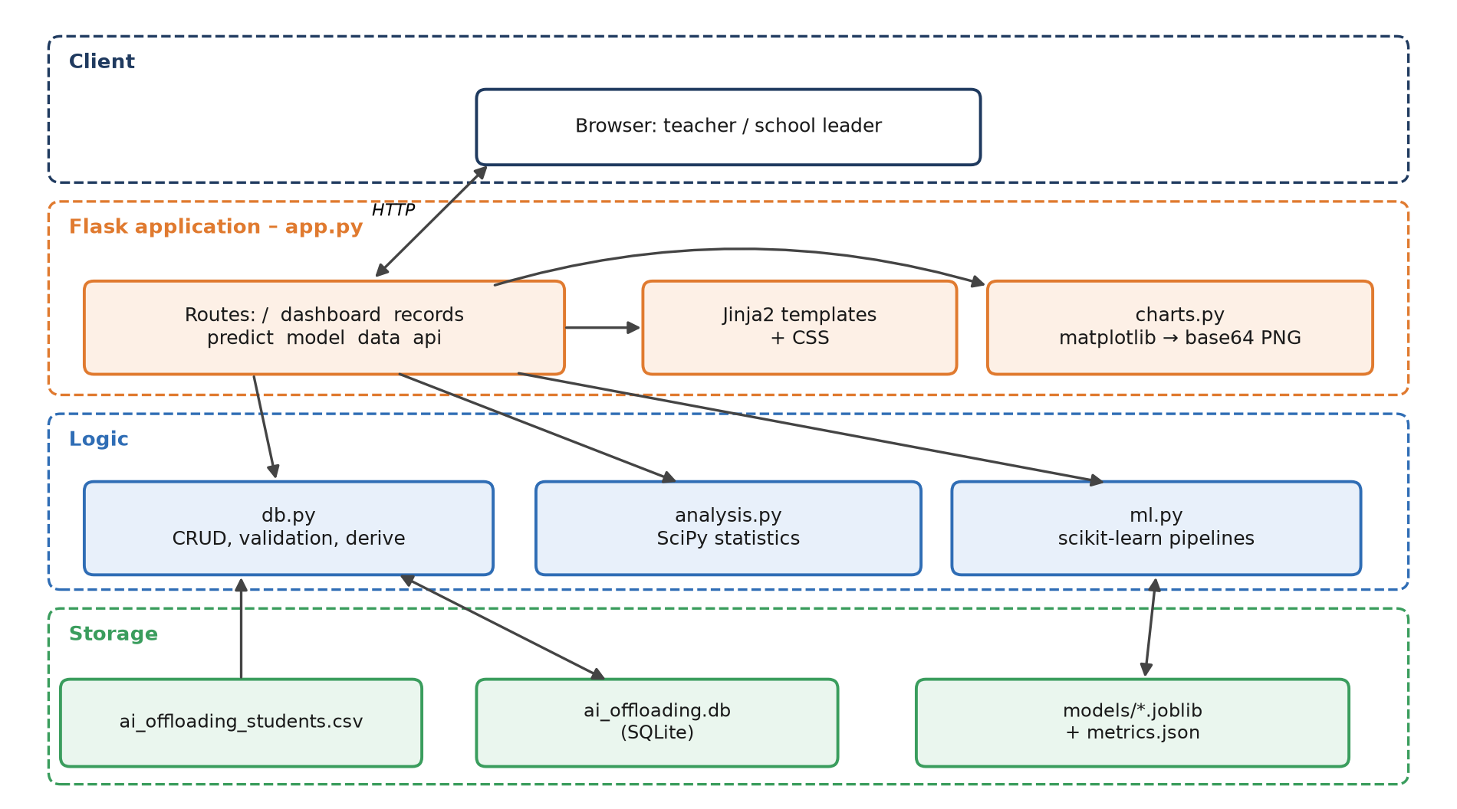
ARCHITECTURE
Client: browser for teachers and school leaders
Flask app: routes, Jinja2 templates, matplotlib charts
Logic: db.py (CRUD, derive), analysis.py (SciPy), ml.py (scikit-learn)
Storage: SQLite DB, CSV source, joblib models
OLEG MISHCHENKO
PROGRAMMING FOR DATA SCIENCE · RIGA NORDIC UNIVERSITY
PAGE
6 / 15
Notes:
Three tiers. Teachers add records, the indicators are recomputed, and the models can be retrained from the UI.

Slide 7
TECHNOLOGY STACK
FRONTEND
HTML5, Jinja2, CSS3
BACKEND
Python 3.13, Flask 3.1, REST API
DATABASE
SQLite 3
DATA SCIENCE
pandas, NumPy, SciPy, scikit-learn, matplotlib, joblib
QUALITY
unittest (8 tests), fixed seeds
DEPLOYMENT
Local; gunicorn, Docker or Render ready
OLEG MISHCHENKO
PROGRAMMING FOR DATA SCIENCE · RIGA NORDIC UNIVERSITY
PAGE
7 / 15
Notes:
A deliberately lightweight Python stack: Flask and SQLite for the app, the standard scientific Python libraries for analysis and machine learning, and unittest for the 8 automated tests.

Slide 8
DATASET
180
synthetic students (grade 8: 97 / grade 9: 83; 104 male / 76 female)
Calibration | Thesis n = 12 | Simulated
ChatGPT main tool | 67% | 61%
Luria Trial 1 mean | 6.8 | 6.8
CT total (/8) | 5.6 | 5.3
Offloading score (1–5) | 2.00 | 2.21
24 + 7
raw and derived attributes: questionnaire, screen time, sleep, Luria, Schulte, Digit Span, CT
Real thesis data (n = 12) are kept as a reference table. Cleaning: reverse coding, partial composites, range validation.
≈ 3%
missing values; median/mode imputation inside the pipeline
OLEG MISHCHENKO
PROGRAMMING FOR DATA SCIENCE · RIGA NORDIC UNIVERSITY
PAGE
8 / 15
Notes:
The data are synthetic because n = 12 is too small for ML and data on minors cannot be published.

Slide 9
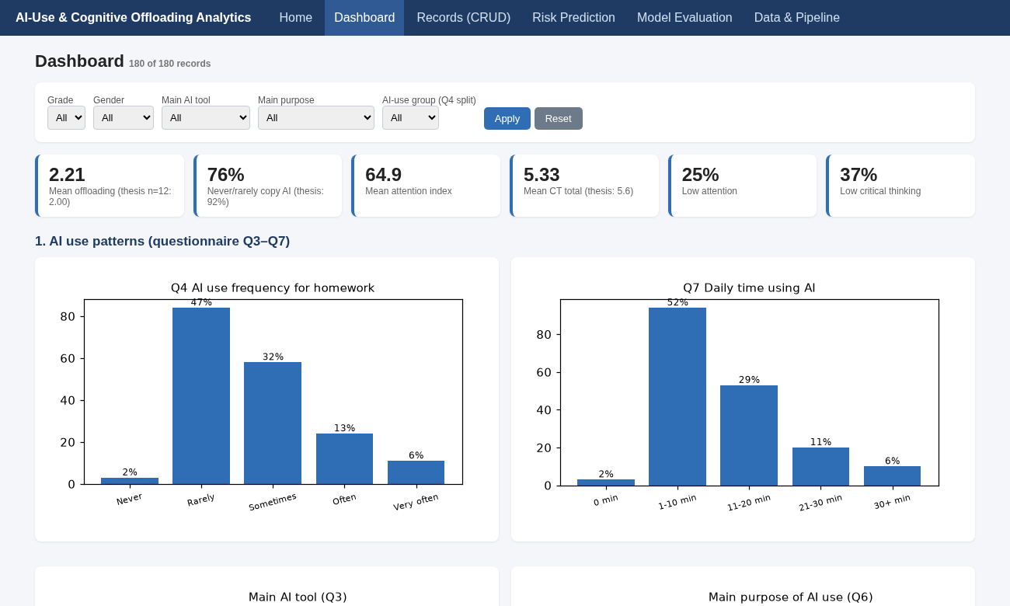
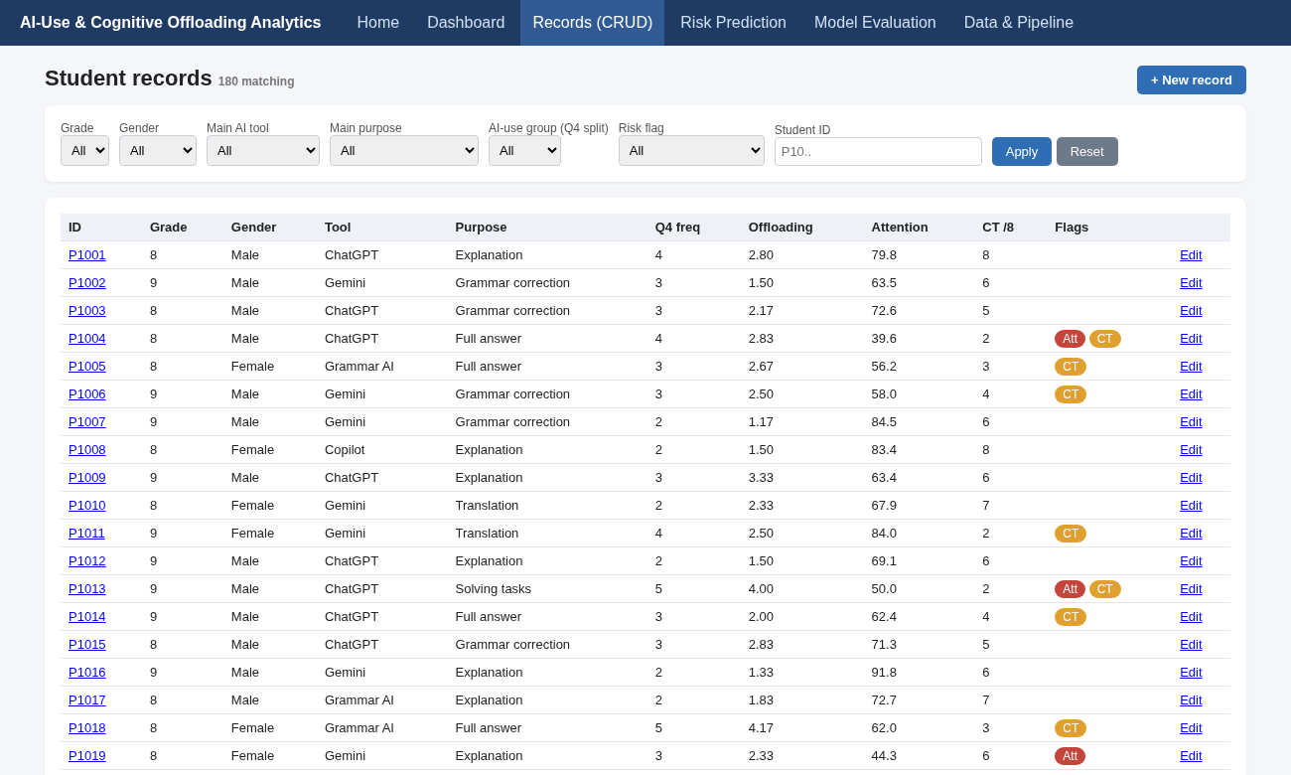
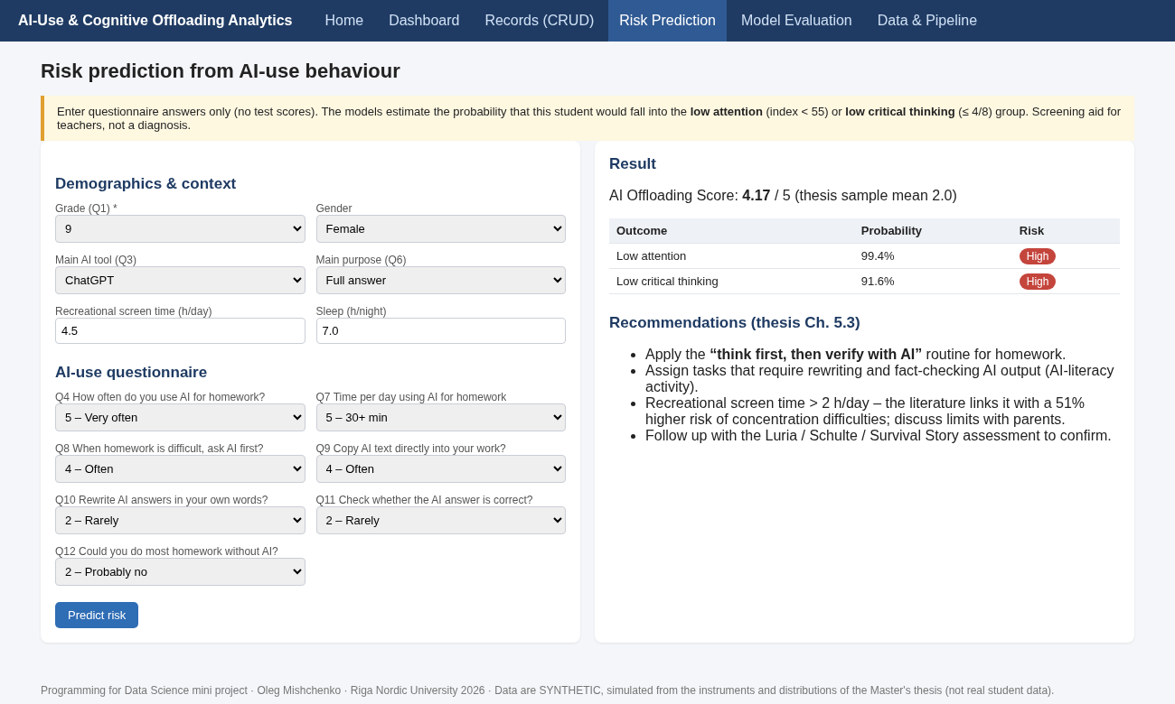
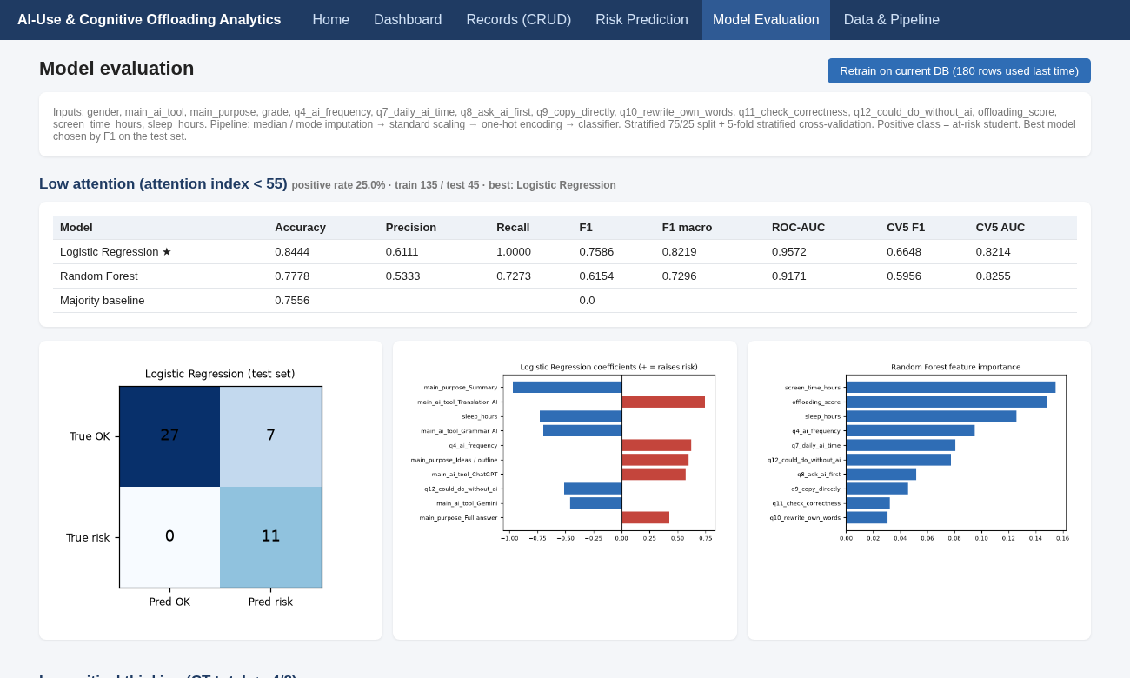
SYSTEM MODULES
DASHBOARD
RECORDS
RISK PREDICTION
MODEL EVALUATION
5 filters, 14 charts, correlation and group tables, CSV export
CRUD with validation, search, risk badges
Answers → probabilities → recommendations ("think first, then verify with AI")
Metrics, confusion matrices, coefficients, retrain
DATA & PIPELINE: missing values, statistics, thesis reference table · JSON API for records and predictions
OLEG MISHCHENKO
PROGRAMMING FOR DATA SCIENCE · RIGA NORDIC UNIVERSITY
PAGE
9 / 15
Notes:
Five modules plus the API. The dashboard is for cohort analysis, Records for data entry, Risk Prediction for students who only completed the questionnaire, and Model Evaluation for transparency and retraining.

Slide 10
GANTT CHART
WK 1
WK 2
WK 3
WK 4
WK 5
WK 6
WK 7
WP1 Requirements
WP2 Dataset
WP3 Preprocessing
WP4 Models
WP5 Frontend
WP6 Testing
WP7 Docs, video, ZIP
Milestones (◆): data ready (wk 3) · app feature-complete (wk 5) · submission (wk 7). WP4 and WP5 run in parallel.
OLEG MISHCHENKO
PROGRAMMING FOR DATA SCIENCE · RIGA NORDIC UNIVERSITY
PAGE
10 / 15
Notes:
About seven weeks in total. Requirements, dataset and preprocessing run in sequence; model development and the frontend run in parallel in weeks 4 and 5; then testing and the documentation, video and ZIP.

Slide 11
SWOT ANALYSIS
STRENGTHS
WEAKNESSES
Based on thesis and validated tests
interpretable
screening from questionnaire only
lightweight, tested
Synthetic data
self-report bias
non-clinical cut-offs
no login yet
OPPORTUNITIES
THREATS
Real follow-up study with 40–50+ students
longitudinal tracking
transfer to HR and teams
EU AI-literacy policy
GDPR and minors
stigmatising labels
AI tools change fast
confounding by ability
OLEG MISHCHENKO
PROGRAMMING FOR DATA SCIENCE · RIGA NORDIC UNIVERSITY
PAGE
11 / 15
Notes:
The main weakness is the synthetic data: the results demonstrate the method, not real effects. The biggest opportunity is the real follow-up study with 40 to 50 or more students that the thesis recommends.

Slide 12
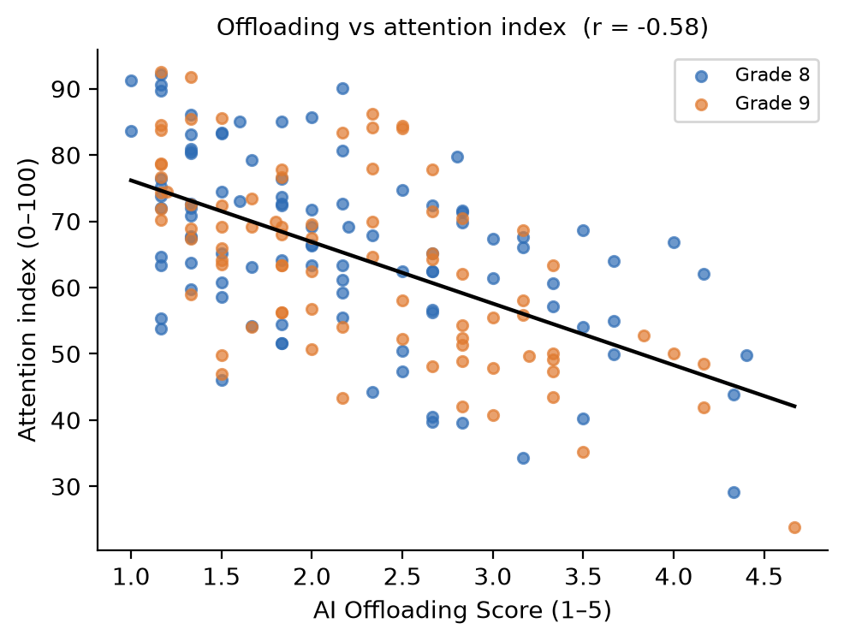
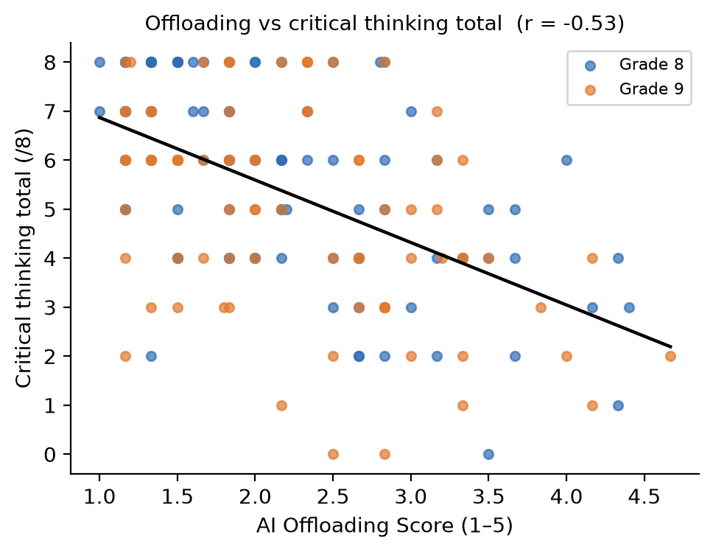
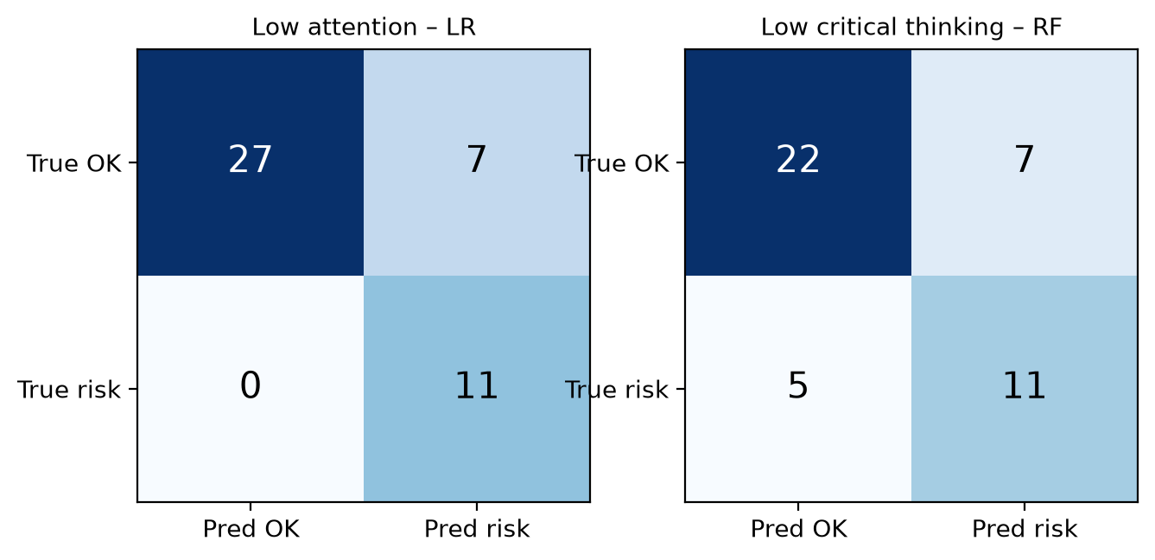
RESULTS & ANALYSIS
r = −0.58
offloading ↔ attention index
r = −0.53
offloading ↔ critical thinking (p < 0.001; critical r 0.146, vs 0.576 at n = 12)
F1 0.76 · AUC 0.96
Higher vs Low AI use: attention 59.5 vs 70.8 (d = −0.90), CT 4.6 vs 6.1 (d = −0.74)
low attention (LR), recall 1.00; CV F1 0.66
F1 0.65 · AUC 0.75
low CT (RF); CV F1 0.68; both above baseline
Top predictors: offloading score, Q12 independence, Q11 checking, screen time, sleep
OLEG MISHCHENKO
PROGRAMMING FOR DATA SCIENCE · RIGA NORDIC UNIVERSITY
PAGE
12 / 15
Notes:
How students use AI matters as much as how often. The thesis's own n = 12 result is within sampling noise.

Slide 13
FUTURE SCOPE
Real, consented data from the next cohort (40–50+ students) and a longitudinal design
SHAP explanations, gradient boosting, mediation analysis (AI → offloading → CT)
Digital Schulte and Digit Span tests with reaction times
Authentication, RBAC, PostgreSQL, Docker and cloud deployment, Moodle integration
Transfer to organisations: AI-reliance screening of teams
OLEG MISHCHENKO
PROGRAMMING FOR DATA SCIENCE · RIGA NORDIC UNIVERSITY
PAGE
13 / 15
Notes:
The first priority is replacing the synthetic data with real, consented data. After that come explainability per student, digital versions of the tests, and production features such as login and Moodle integration.

Slide 14
CONCLUSION
01
The thesis methodology now runs as a reproducible pipeline and web tool: data model, database, CRUD, statistics, ML and dashboard
02
At an adequate sample size, the hypothesised negative link between offloading and cognition is detectable
03
Questionnaire-only screening reaches useful accuracy, as an advisory aid and not a diagnosis
04
Ready for the real follow-up study recommended by the thesis
DEMO: live app or recorded video (Google Drive link, "Anyone with the link")
OLEG MISHCHENKO
PROGRAMMING FOR DATA SCIENCE · RIGA NORDIC UNIVERSITY
PAGE
14 / 15
Notes:
Summary of what was achieved. Then switch to the live demo or the recorded video.
Demo script: 1) Home: KPIs and synthetic-data note. 2) Dashboard: Grade 9 + Higher AI use, charts, correlation and t-test tables. 3) Records: filter Low critical thinking, open, edit, create, delete. 4) Risk Prediction: reflective profile (Low risk), then ?demo=high (High risk). 5) Model Evaluation: metrics, confusion matrix, Retrain. 6) Data & Pipeline: missing values, statistics, thesis n = 12 table, CSV export.
[Add the Google Drive video link before submission.]

Slide 15
REFERENCES
1. Gerlich, M. (2025). AI tools in society: impacts on cognitive offloading and the future of critical thinking. Societies, 15(1), 6.
2. Tian, X., & Zhang, J. (2025). AI dependence, cognitive fatigue, and critical thinking.
3. Risko, E. F., & Gilbert, S. J. (2016). Cognitive offloading. Trends in Cognitive Sciences, 20(9).
4. Leonhardt, M., et al. (2025). Screen time and concentration difficulties.
5. Sina, E., et al. (2024). Digital media use and cognition in European children (I.Family).
6. OECD (2023). PISA 2022 Results, Vol. I.
7. Zhai, C., Wibowo, S., & Li, L. D. (2024). Over-reliance on AI dialogue systems. Smart Learning Environments, 11.
8. Mishchenko, O. (2026). Master's thesis, Riga Nordic University.
9. Pedregosa, F., et al. (2011). Scikit-learn. JMLR, 12. Flask, pandas and SciPy documentation.
OLEG MISHCHENKO
PROGRAMMING FOR DATA SCIENCE · RIGA NORDIC UNIVERSITY
PAGE
15 / 15
Notes:
Full reference list with all 24 sources is in the report, section 25.

