Slide 1
HASHEDIN BY DELOITTE · CAMPUS PM HIRING 2026 · CASE 14
RuleForge: agentic rule generation for CloudGuard Labs
AI drafts the evidence. SMEs decide. Every finding stays provable.
MVP · AWS only · 100% SME sign-off
Alex Shajan
IIM Shillong · 2025PGP280
1

Slide 2
1 · PROBLEM
Rule coverage grows with SME hours, but the rate of cloud change keeps rising
6
3–5
6–10
100
cloud security SMEs write every rule by hand
SME-days to research, write and validate one rule
rules a week at most, if SMEs did nothing else
AWS announcements in 13 days (14–26 Oct 2026)
CASE
CASE
DERIVED
AWS WHAT'S NEW FEED
Problem statement
CloudGuard's detection coverage is capped by the hours of 6 people, while AWS alone ships an API model update about every 2 days. Gaps stay open for months, competitors close them faster, and the know-how sits with 1–2 people.
2

Slide 3
1 · PROBLEM
Four root causes sit behind the slow rule output
1
2
3
4
Manual end to end
Validation is the heavy step
Knowledge is tacit
No change detection
Research, writing, validation and documentation are all done by hand, in sequence, for every rule.
Each rule must be tested against real cloud configurations before it ships, which means building test resources.
Rule logic and judgement live with 1–2 people. Nothing is captured in a way another person or system can reuse.
New services and API changes are found only when an SME happens to notice them.
CASE
CASE + HYPOTHESIS
CASE
CASE
3

Slide 4
1 · PROBLEM
Doing nothing costs coverage, credibility and breach exposure
Cost area | Evidence | What it means for CloudGuard
Competitive coverage | Prowler (open source): 567 AWS checks. Wiz: 1,400+ rules (2024) | "Several hundred" rules is behind even free tools
Customer breach risk | Avg breach $4.44M global, $10.22M US (2025). Cloud misconfiguration: 12% of breaches (2024) | Each month a gap stays open is unprotected exposure
Trust in alerts | 73% of security teams name false positives their #1 detection challenge | A noisy AI rule damages credibility fast
Talent | 4.8M global security workforce gap; cloud security is #2 skills gap (30%) | Hiring more SMEs is not a realistic fix
SME capacity | 3–5 SME-days per rule × 6 SMEs | Expensive specialist time goes to repetitive work
4

Slide 5
1 · PROBLEM
AWS changes alone already use up the whole SME team
11
33–55
54
~309
AWS changes in 13 days that need a new or updated rule
SME-days to build those 11 rules at 3–5 days each
SME-days the whole team has in those 9 working days (6 × 9)
AWS rule candidates a year, vs 312–520 rules of capacity at 100% use
GOLDEN DATASET
DERIVED
DERIVED
DERIVED
What this costs CloudGuard and its customers
The AWS feed alone needs 61–100% of total SME capacity, before Azure, GCP, the 31 CIS v6.0 → v7.0 changes, maintenance or false-positive fixes. The backlog is structural: it grows every week, and each open gap is unprotected exposure for customers and a coverage loss against tools like Prowler (567 AWS checks).
5

Slide 6
2 · USERS & WORKFLOW
Five personas, and each one needs something different from the system
1
2
3
4
5
Cloud security SME
Detection engineer
Customer success & sales
Compliance / audit customer
Applied-AI pod engineer
Authors and validates rules today
Ships and maintains the rule pipeline
Fields coverage and accuracy questions
Relies on rule provenance
2–3 engineers, new team
NEEDS
NEEDS
NEEDS
NEEDS
NEEDS
Less grunt work; keeps control and credit
AI rules in the same format, CI and tests
A defensible coverage story
Every finding traceable to a named source
Clear evals, observability, rollback
WINS WITH RULEFORGE
WINS WITH RULEFORGE
WINS WITH RULEFORGE
WINS WITH RULEFORGE
WINS WITH RULEFORGE
Approves an evidence pack instead of building from zero
Rules arrive tested and versioned
"New AWS changes covered in days"
Provenance card + audit evidence
Golden-set gate and kill switch
6

Slide 7
2 · USERS & WORKFLOW
Today an SME carries every step; tomorrow the SME reviews the evidence
TODAY · 3–5 SME-DAYS PER RULE
SME notices change
Research docs + CIS
Write rule
Build test resources
Validate in real account
Write citation + metadata
Ship
PROPOSED · SME TIME ON REVIEW ONLY
Watcher detects
Research agent cites
Author agent drafts
Test harness validates
Critic checks edges
SME reviews pack
Staged release
Friction today | Why it happens | Value once fixed
Changes found late | No automated monitoring | Gaps flagged within a day of the announcement
Research + test building | Manual, repeated per rule | SME time moves to judgement and edge cases
Knowledge in 1–2 heads | Reasoning never written down | Every rule carries its sources, tests and rationale
7

Slide 8
3 · SOLUTION
RuleForge: the AI drafts the evidence, and humans decide
Grounded
Verified
Governed
Every claim in a draft quotes a source span (CIS, AWS docs, CVE). No citation means automatic rejection.
A deterministic test harness decides pass/fail by deploying compliant and non-compliant resources in a sandbox. The LLM never grades itself.
Risk-tiered human sign-off, shadow mode before customers see anything, and a kill switch for every AI-drafted rule.
What changes for the SME: instead of 3–5 days building a rule from nothing, they review one screen with the sources, the rule, the test results and the critic's concerns, then approve, edit or reject with a reason code.
8

Slide 9
3 · SOLUTION
End-to-end architecture: code orchestrates, agents only where judgement is needed
Sources
AWS What's New · botocore diffs · CIS releases · CVEs
Watcher
Ingest, dedupe vs library, rank by customer footprint
Research agent
Retrieves docs; outputs quoted spans + URLs
Author agent
Few-shot from existing SME rules; JSON schema output
Test harness
Terraform fixtures in sandbox; deterministic pass/fail
Eval gate
Golden set runs on every model or prompt change
Customer
Findings + provenance; FP reports
Scan engine
Existing CloudGuard product (separate)
Staged release
Shadow → canary → GA, flag-gated
SME decision
Approve / edit / reject + reason code
Critic agent
Edge cases, overlaps with existing rules
LLM agent
Deterministic
Human
False-positive report sends the rule back to SME review
Cross-cutting: OpenTelemetry tracing per candidate · token + sandbox cost per run · versioned prompts, model and rules · immutable audit log
9

Slide 10
3 · SOLUTION
RuleForge plugs into CloudGuard's existing stack and stays off the scan path
System | How RuleForge uses it | Access
Rule library (Git, house format) | Few-shot examples and dedupe; drafts arrive as pull requests with the evidence pack | Read + open PRs
CI/CD pipeline | Schema checks, golden-set gate and existing rule tests run on every draft PR | Same pipeline as SME rules
Sandbox AWS Organization (new) | Terraform fixtures per run; standing accounts for root- and org-level rules that cannot be spun up | Isolated, no customer data
Retrieval index (new) | CIS text, AWS docs, botocore models and existing rules, chunked with source URLs | Read-only
Scan telemetry | Aggregated resource counts to rank candidates by customer footprint | Aggregated, read-only
Feature flags, Jira, SSO | Flag per AI-drafted rule and kill switch; SME review queue; reviewer identity | Role-based
Audit + evidence store (new) | Prompt, model version, citations, test results and approver for every rule | Append-only
10

Slide 11
3 · SOLUTION
How the agents are prompted and orchestrated to reason reliably
Workflow, not a free-roaming agent. Code fixes the order of steps; each LLM call has one job.
Structured outputs. Every agent returns JSON against a schema; invalid output is rejected and retried.
Citation grounding. Research output must quote the source span it relies on.
Few-shot from house rules. The existing several hundred SME-written rules are the examples.
LLM never grades itself. Pass/fail comes from the sandbox test harness.
Least privilege (OWASP LLM06). Agents read docs and write drafts; no production credentials.
Ingested text is untrusted (OWASP LLM01). Web content is passed as data, never as instructions.
MODEL TIERING (EXAMPLE PROVIDER)
Stage | Model tier | Input / output $ per 1M tokens
Watcher triage | Small (Haiku 5.5) | $0.10 / $0.50
Research, Author | Mid (Sonnet 5.5) | $2 / $10
Critic (all rules) | Mid; large (Opus 5.5) on T3 | $2 / $10 · $4 / $20
Estimated cost per rule: under $1 in tokens
Research + Author (~40k in / 5k out, mid) ≈ $0.13 · Critic on T3 (~20k / 2k, large) ≈ $0.12 · Watcher share ≈ $0.02. SME time and sandbox spend dominate. The pilot replaces these assumptions with logged tokens.
11

Slide 12
3 · FEASIBILITY
Build on a hosted LLM API, and use open source as reference data
Option | What the facts say | Cost | Time to value | Control / IP | Verdict
Buy a rule set | Case: no budget to license a large third-party rule set | High | Fast | Low | Rejected
Adopt open source (Prowler, Checkov, Cloud Custodian) | Prowler 567 AWS checks (Apache-2.0); Checkov 750+ IaC policies; different formats | Free | Medium | Medium | Use as reference + golden data
Build on hosted LLM API | Pay per token; fits a 2–3 engineer pod; no ML ops needed | Low, variable | Fast | High | Recommended
Fine-tune / self-host model | Needs ML ops and GPU budget the pod does not have | High fixed | Slow | High | Revisit in V2
Scalability: candidates run in parallel and independently, so throughput scales with workers. The main running cost is sandbox cloud resources rather than tokens, so fixtures are torn down after every run. Non-urgent backlog work can use batch processing.
12

Slide 13
4 · MVP & ROADMAP
MVP: AWS only, simple settings, every rule signed off by an SME
IN THE MVP
OUT OF THE MVP
AWS only
2–3 service families with simple, checkable settings: storage, logging, encryption
Sources: CIS AWS Foundations v7.0.0, AWS docs, AWS What's New
Watcher, Research, Author, Test harness and Critic agents + shadow mode
Review in pull requests with the evidence pack attached (prototype shows the V1 console)
CIS v6.0 → v7.0 drift remapping (31 items, metadata only)
100% SME sign-off on every rule, whatever its tier
Azure and GCP
IAM privilege-escalation and multi-resource attack-path rules
CVE and threat-intel driven rules
Any auto-approval, even for low-risk rules
Customer-facing AI features
13

Slide 14
4 · MVP & ROADMAP
Roadmap: prove it on AWS in 12 weeks, then widen scope and autonomy
MVP · months 0–3
V1 · months 3–6
V2 · months 6–12
12-week pilot
Widen coverage
New rule classes
Wk 1–3: backtest on golden set (hide SME rules, regenerate)
Wk 4–8: live drafts, all in shadow mode
Wk 9–12: canary customers, go/no-go
Azure and GCP
Maintenance agent for API deprecations and future CIS releases
Purpose-built review console
T1 rules auto-ship with random SME audits
CVE and threat-intel driven rules
Attack-path rules across resources
Natural-language custom rules for customers
Auditor provenance portal
14

Slide 15
4 · MVP & ROADMAP
KPIs tie model quality to the business case
Layer | KPI | Baseline | Target
Business | Validated rules per week | 6–10 max (derived) | ≥ 20 / week (~3×)
Business | Days from provider change to rule shipped | "Months" (case) | ≤ 14 days
Quality | Citation accuracy on golden set | n/a | 100% (hard gate)
Quality | Rule accuracy (all gates passed) | n/a | ≥ 80%
Quality | False-positive reports per rule after release | n/a | ≤ SME-rule rate
Technical | Triage recall on 'needs rule' class | n/a | ≥ 95%
Ops | SME minutes per rule · cost per rule · p95 pipeline latency | 3–5 SME-days | ≤ 120 SME-min · < $1 tokens
Business case
Today ~4 SME-days per rule. If review takes ~0.5 day, each rule frees ~3.5 SME-days.
~300 AWS rules a year × 3.5 = ~1,050 SME-days, about 4.7 SME-years
Cost: a 2–3 engineer pod, under $1 of tokens per rule, plus sandbox spend
Freed SME time exceeds pod size, and coverage grows ~3× without hiring.
15
Notes:
Business case in SME-days avoids picking an uncertain salary figure. Citation accuracy is the only hard target set in advance.

Slide 16
5 · PRODUCTION READINESS
Production readiness: versioned, observable, and reversible in one click
1
Environments & promotion
2
Observability
Dev: sandbox AWS Organization (per-run + standing accounts)
Staging: shadow mode on opted-in tenants
Prod: canary, then GA
Golden set is the CI gate at every promotion
OpenTelemetry trace per candidate, end to end
Tokens and cost per stage; sandbox spend
p95 latency, errors, queue depth, SME backlog age
Shadow: every finding diffed against Prowler
3
Reliability
4
Rollback
Retries with backoff; fallback model
Idempotent runs; fixtures torn down after each run
Pipeline isolated from the customer scan engine
Pinned model versions
Every AI-drafted rule behind a feature flag
Global kill switch: back to SME-only rules
Prompt, model and rule versioned together
Weekly golden-set regression run
16

Slide 17
5 · GOVERNANCE
Security, compliance and responsible AI are designed in, not bolted on
Secure the agents
Comply
Govern once live
Prompt injection (LLM01): ingested docs treated as data
Excessive agency (LLM06): read-only tools, no prod credentials
Sandbox accounts isolated from customer data
Red-team with poisoned doc pages
NIST AI RMF: Govern · Map · Measure · Manage
ISO/IEC 42001: certifiable AI management system
EU AI Act: GPAI rules from 2 Aug 2025; most rules from 2 Aug 2026
CIS licence: confirm vendor terms for commercial use
Shadow mode uses config metadata only, opt-in
Rule review board owns tier policy
Immutable audit trail of every decision
Monthly model and prompt review
"AI-drafted, SME-approved" disclosed on findings
17

Slide 18
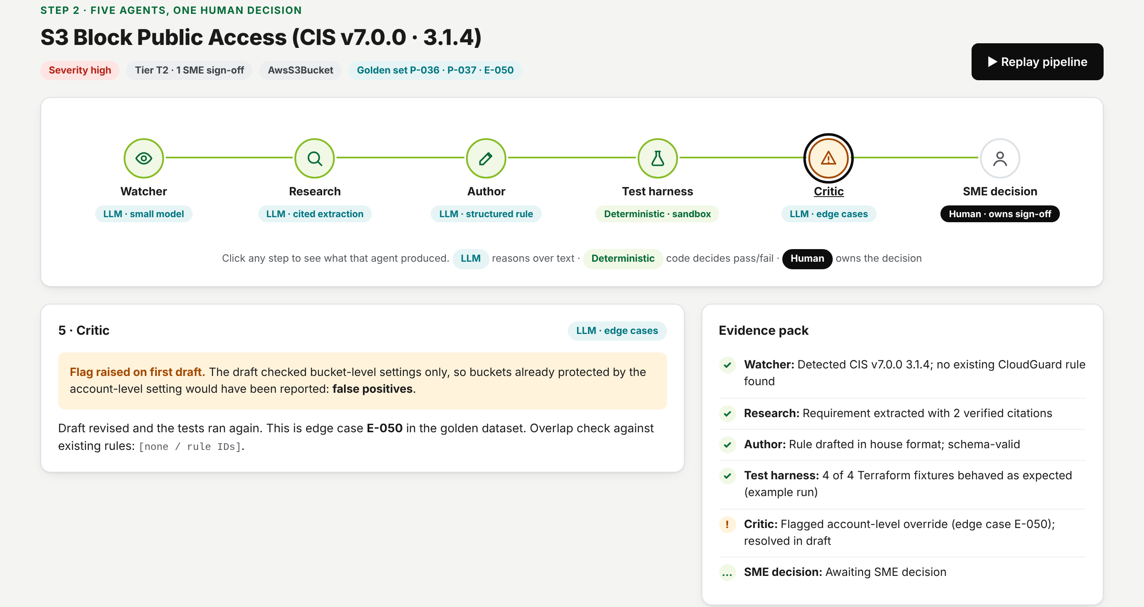
6 · PROTOTYPE
One workbench shows all five agents and the human decision
1 Detect
2 Draft & verify
3 Publish
4 Monitor
1
Pipeline rail
Watcher → Research → Author → Test harness → Critic → SME
2
Colour-coded steps
LLM, deterministic or human: the LLM never grades itself
3
Critic flag
Caught the account-level override edge case (E-050)
4
Evidence pack
Citations, rule, 4 sandbox tests in one list
5
SME decision
Approve / edit / reject; reject needs a reason code
Source: RuleForge clickable prototype (RuleForge_Wireframes_v3.html, step 2); data from golden dataset rows P-036, P-037, E-050
18

Slide 19
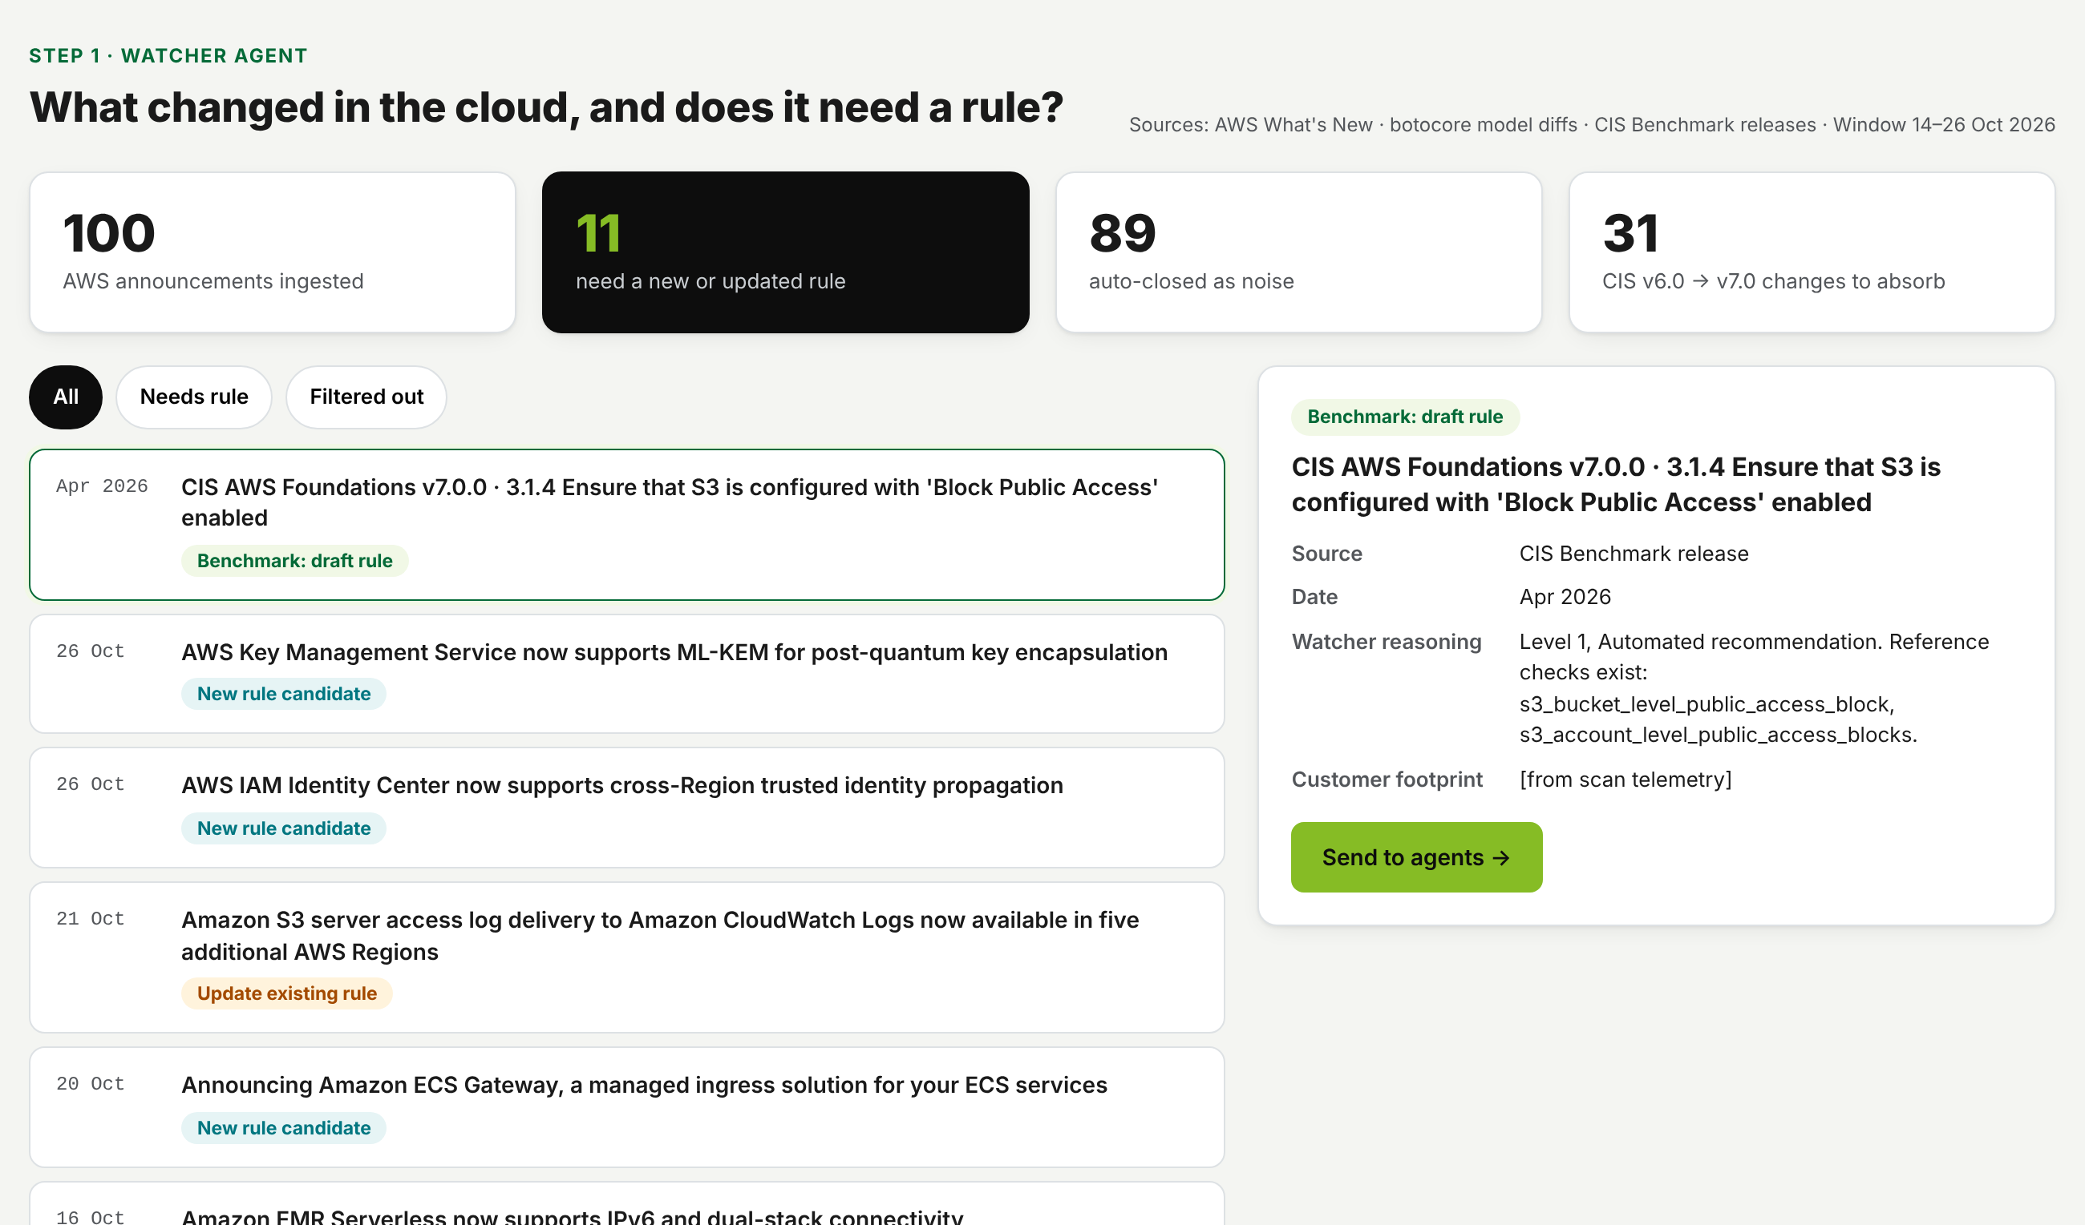
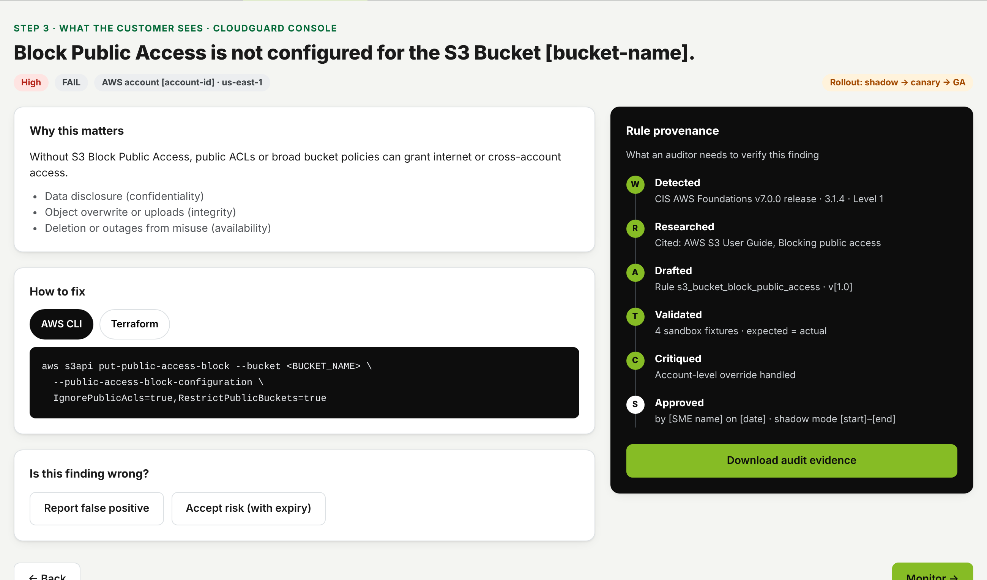
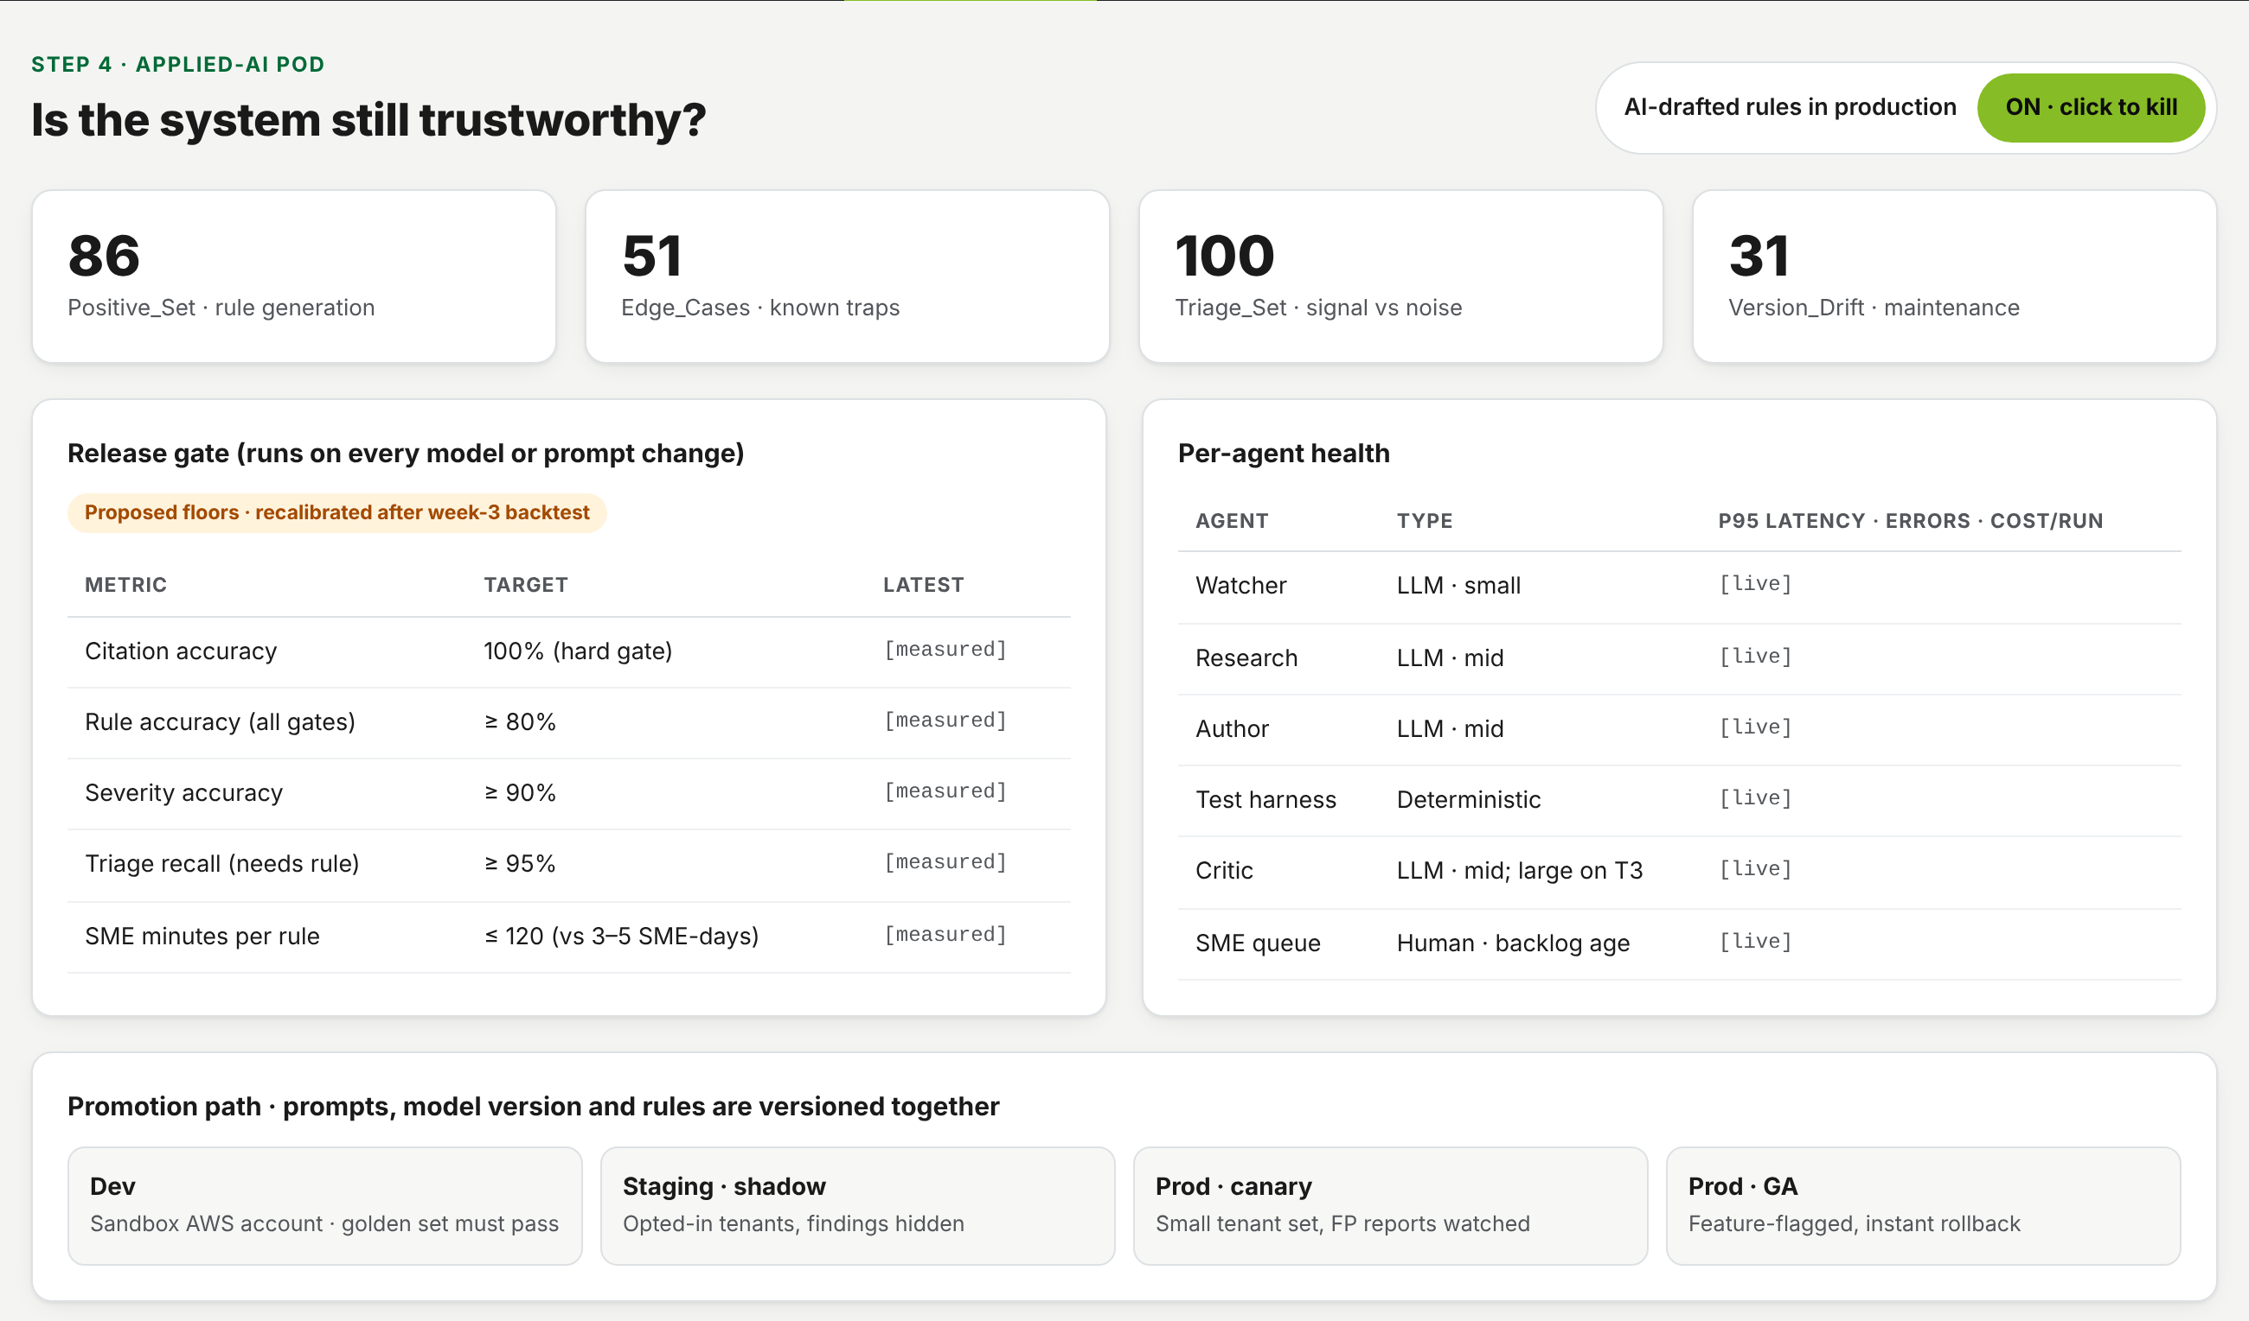
6 · PROTOTYPE
Detect, publish and monitor complete one linear journey
Step 1 · Detect
Step 3 · Publish
Step 4 · Monitor
Watcher inbox: 100 real AWS announcements; 11 need a rule, the rest are filtered as noise
Customer finding with CLI/Terraform fix; provenance timeline mirrors the six pipeline steps
Golden-set release gate, per-agent health, kill switch
19

Slide 20
7 · GOLDEN DATASET
The golden dataset is real public data, built to test every agent
86
Positive_Set
ID | CIS | Expected check | Severity | Tier
P-007 | 2.5 | iam_root_mfa_enabled | critical | T3
P-036 | 3.1.4 | s3_bucket_level_public_access_block | high | T2
P-076 | 6.2 | ec2_networkacl_allow_ingress_tcp_port_22 | medium | T2
P-079 | 6.3 | ec2_securitygroup_allow_ingress_from_internet_to_tcp_port_22 | high | T3
Rule generation vs Prowler reference
51
Edge_Cases
Traps a naive generator falls into
100
Triage_Set
Used three ways
Signal vs noise: 11 need a rule
Before launch: backtest. Hide the reference rules and regenerate them.
In CI: regression gate on every model or prompt change.
Go/no-go: the Eval_Scorecard sheet computes rule, severity and citation accuracy, plus triage precision and recall. 26 of 86 rows are tier T3.
Known limits: ground truth is Prowler's reading of CIS (3.1.4 checks 2 of 4 BPA settings); triage labels are draft until SME review.
31
Version_Drift
CIS v6.0 → v7.0 maintenance
20

Slide 21
8 · RISKS
The main risks have specific, testable mitigations
Risk | Impact | Mitigation | How we know it works
Hallucinated or wrong rule | False positives or misses; trust loss | Citation gate, sandbox tests, critic, shadow mode | Golden-set rule accuracy; FP reports
Prompt injection via ingested docs | Agent manipulated | Docs as untrusted data; no prod credentials | Red-team suite with poisoned pages
SMEs rubber-stamp AI drafts | Errors slip through review | Seed known-flawed 'canary' drafts in the queue | Canary catch rate
SME resistance | Low adoption | SMEs own approvals and credit; time freed for research | Review throughput; SME feedback
Model or prompt drift | Silent quality drop | Pinned versions; weekly golden-set regression | Regression delta
Customer data exposure in shadow mode | Privacy breach | Config metadata only, opt-in tenants | Data-access audit
Triage auto-closes a real change | Coverage gap stays open | Weekly random audit of auto-closed items; SME override | Triage recall on audited sample
Sandbox cost runaway | Cloud bill spike | Per-run budget, resource tags, nightly sweeper | Sandbox spend per rule
21

Slide 22
NEXT STEPS
The ask: fund the 12-week AWS pilot with a clear go/no-go
1
2
3
Approve the pilot
Agree the gates
Validate with SMEs
2–3 engineer pod + SME reviewer time, AWS only
Citation accuracy 100%; floors of ≥80% rule accuracy and ≥95% triage recall, recalibrated after the week-3 backtest
Interview 2–3 SMEs to confirm where the 3–5 days really go
Don't automate the SME. Automate everything around the SME.
22
Notes:
End on the decision you want from the panel.

Slide 23
APPENDIX
Sources
IBM Cost of a Data Breach Report 2025 (via CyberScoop, ASIS) and 2024 (via 10guards; IBM India newsroom)
botocore release cadence: releasealert.dev/github/boto/botocore
Prowler check counts: pypi.org/project/prowler-cloud/5.9.2 · Prowler repo and compliance mappings (Apache-2.0)
Wiz rule count: Contrary Research (2024) · Google–Wiz acquisition close: TechCrunch, 11 Mar 2026
SANS 2025 Detection & Response Survey (via Stamus Networks, sponsor)
ISC2 Cybersecurity Workforce Study 2024
CIS AWS Foundations Benchmark v7.0.0: CIS Benchmarks April 2026 update
Checkov 750+ policies: Qburst (2024) · Cloud Custodian: CNCF project
OWASP Top 10 for LLM Applications 2025 · NIST AI RMF · ISO/IEC 42001
EU AI Act timeline: European Commission AI Act Service Desk
Anthropic Claude API pricing (Oct 2026)
AWS What's New RSS feed, retrieved 27 Oct 2026 (triage set)
23
Notes:
Every number in the deck traces to one of these.

Slide 24
LINKS
See the work: design, prototype and code
1
2
3
Figma design
Clickable prototype
GitHub repository
All 12 screens: the MVP journey plus proposed V1 and V2 features
tinyurl.com/tc9nc223
Detect → Draft & verify → Publish → Monitor, in any browser
alexshajan.github.io/Ruleforge_HashedIn
Deck, prototype, golden dataset, Figma SVGs and README
github.com/alexshajan/Ruleforge_HashedIn
Alex Shajan · IIM Shillong · 2025PGP280
24
Notes:
Links. Figma: https://tinyurl.com/tc9nc223 . Prototype: https://alexshajan.github.io/Ruleforge_HashedIn/RuleForge_Wireframes_v3.html (needs GitHub Pages on the repo, branch main). Repo: https://github.com/alexshajan/Ruleforge_HashedIn .

