Slide 1


Data Quality Assessment
Alejandro Silva Zamora

Slide 2
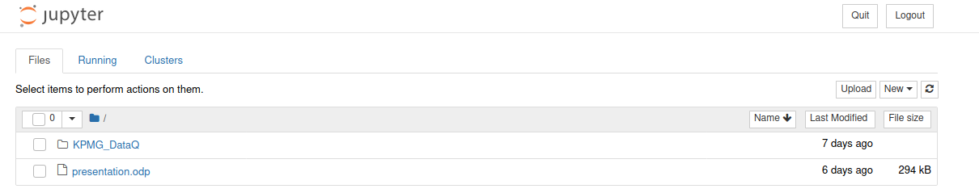
Analysis of the data using Python Programming
Using a virtual environment for Python and Jupyter notebook program was created to semi-automatically analyze the data and save time next time the Data is updated or data with similar format is provided. This will also aid in the subsequent Analysis of the data

Slide 3
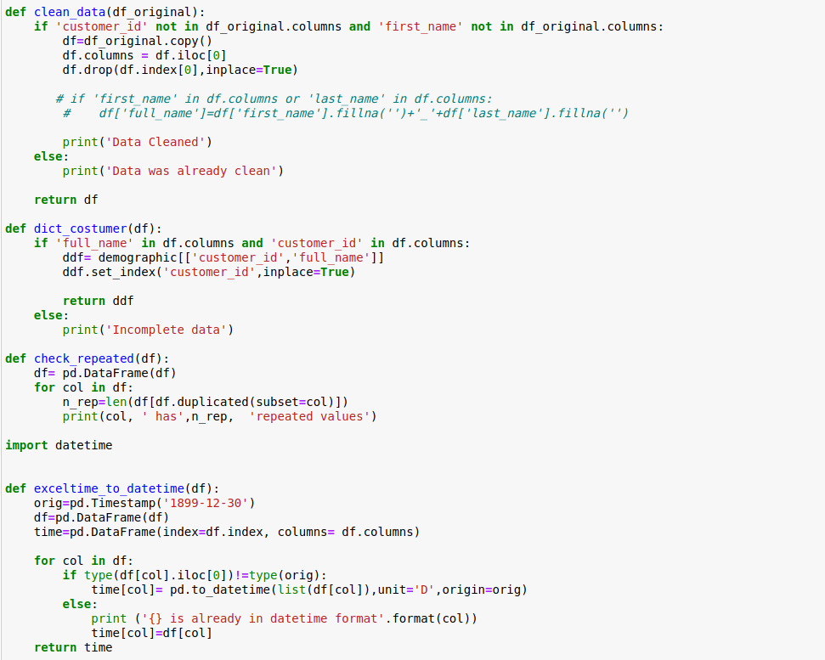
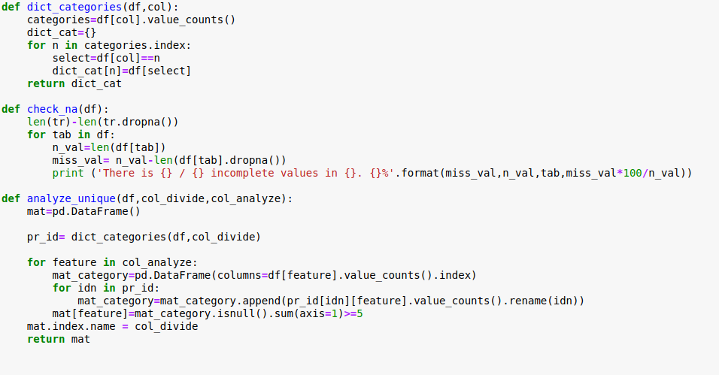
List of Python Functions created for the Assessment
All code can be found at the git repository:
https://github.com/alexsilza898/InsideSherpa/tree/master/KPMG/DataQ

Slide 4
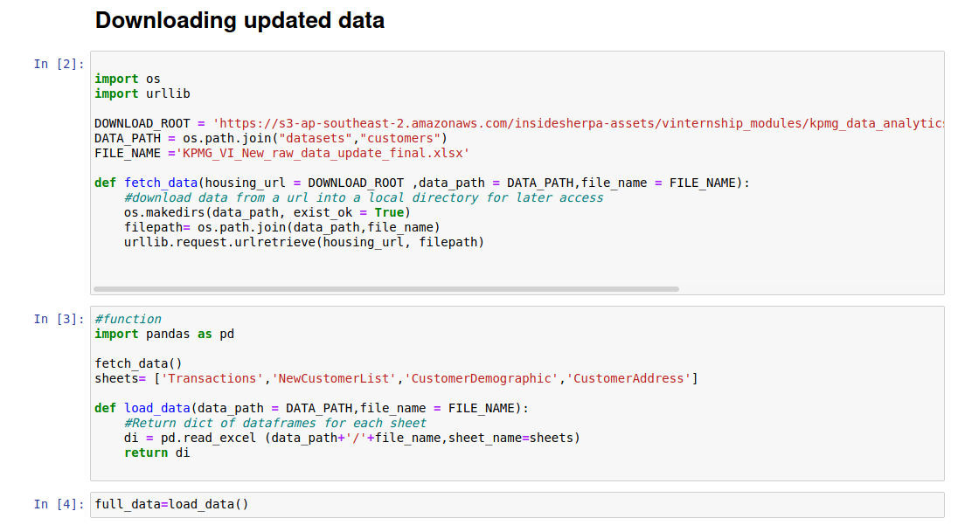
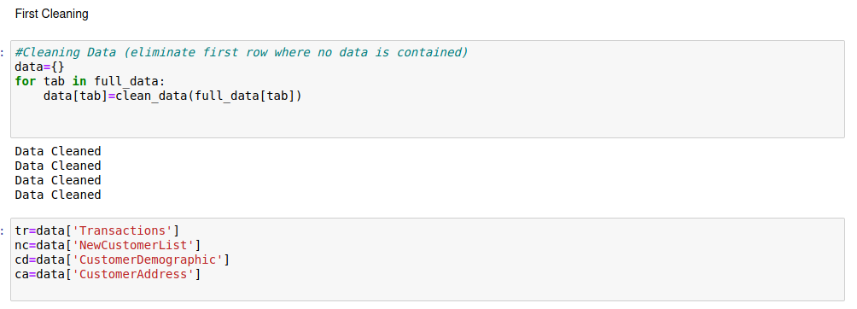
Obtaining and cleaning updated Data
We define a function to download the updated data from the server where it is hosted and get it ready to be utilized by the rest of the program.
This functions can be run anytime we want to update the data
Since the data contains row which are not part of the data we run the clean_data() function we created for this.
We assign shortnames to each tag for easy view of the data if required.

Slide 5
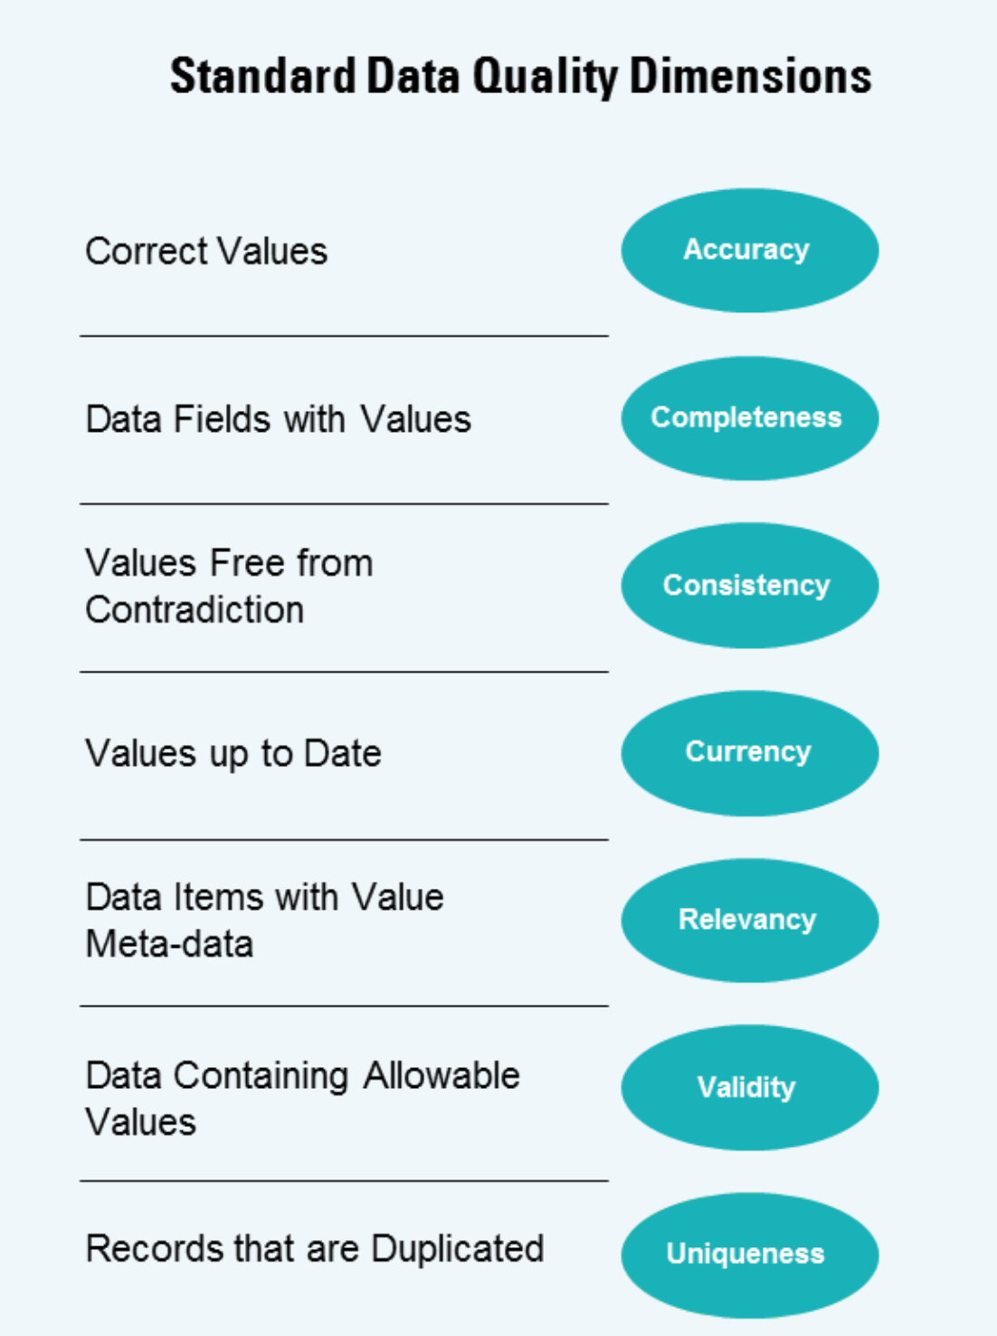
Getting Started
Following the Data Quality Framework we identify what we can do with the information provided
Since we are using a function to update the data we can assume the data is current. We will assume the dates not being recent to the actual date is due to this being a practice exercise instead of having any trouble with the server or data.

Slide 6
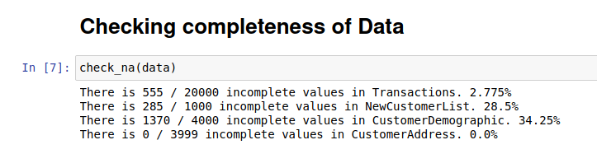
Completeness
This is a feature that we are able to analyze for all tabs at the same time so we use the function "check_na()" we programmed on the whole data.
We can see Transactions and Customer Address have a very low incompleteness ratio. We can analyze NewCustomer and CustomerDemographic to see if we find any obvious problem.

Slide 7
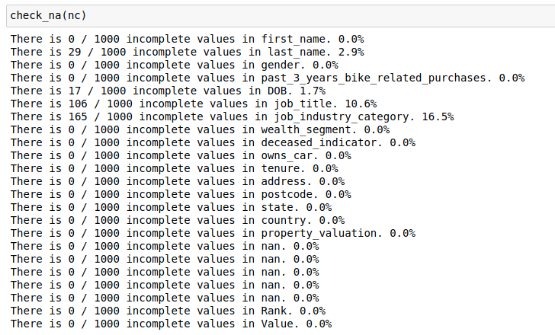
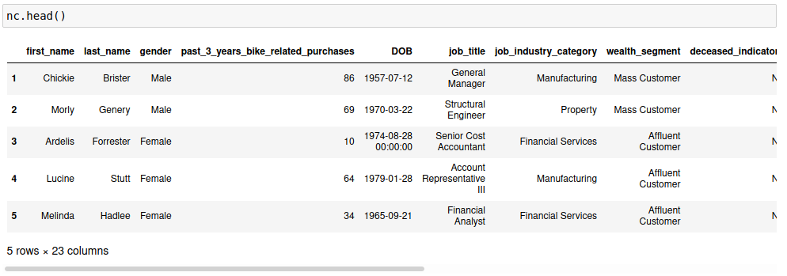
Completeness – New Customers
Running check_na() on the NewCustomers data we see job_industry_category, job_title and last_name have the highest na ratio, however we dont see any obvious reason for this other than an incomplete sample

Slide 8
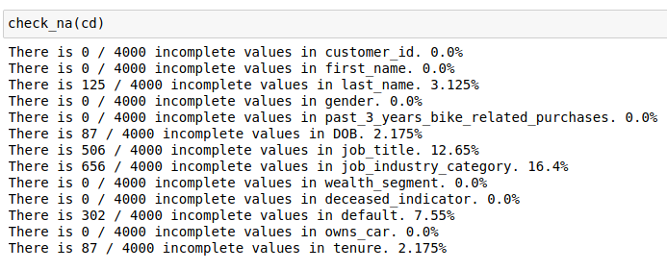
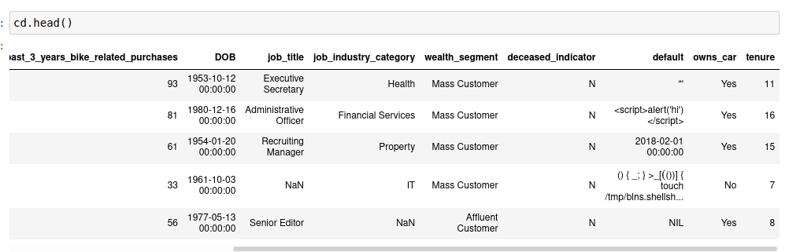
Completeness – Customer Demographic
Running check_na() on the CustomerDemographic data we see job_industry_category, job_title and default have the highest na ratio, with a quick look at the data we see the default column was corrupted, we need to check back with the team if this column is important and try to get the relevant data.

Slide 9
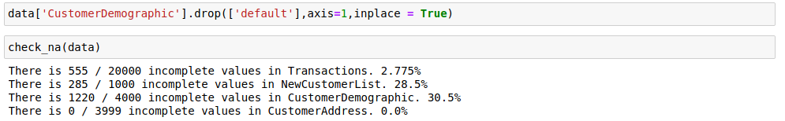
Completeness – Customer Demographic
Once we drop the "default" column the na ratio for CustomerDemographic goes down from the initial 34.5% to 30.5%

Slide 10

Transactions
From now on we will analyze every tab individually and compare to the rest of the tabs when required.
Transaction Uniqueness

Slide 11
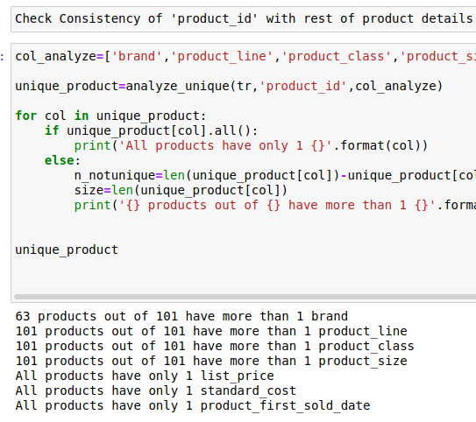
Transactions - Consistency
Analyzing the details of the product_id everytime it is in a Transaction we notice it has different values for almost all of the description of the product, suggesting the product_id is not unique
This is a big problem and we need to get back to the client to solve this issue

Slide 12
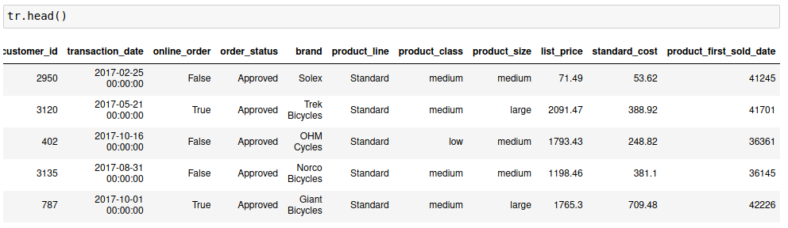
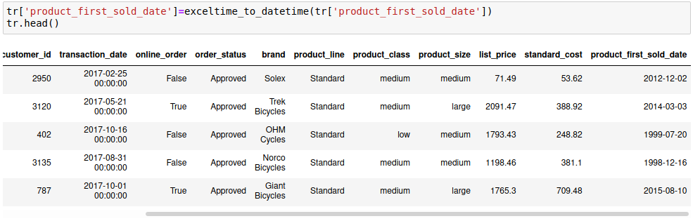
Transactions - Consistency
Analyzing the Transactions we find that the dates provided for product_first_sold_date are integers. These is not consistent with the date format for transaction_date
We can apply the date format in Excel to the column or the function exceltime_to_datetime() in Python and this will give us a logical date but it would be good to check back with the customer if this is what we were meant to do

Slide 13
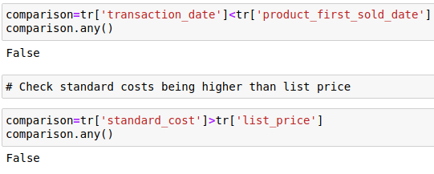
Transactions - Validity
In the transactions Tab, the only columns that may have non valid inputs are the dates and the costs. We check that no product was sold before the first sold date or sold at a loss (this could be possible in certain scenarios but does not appear to happen in our data)

Slide 14
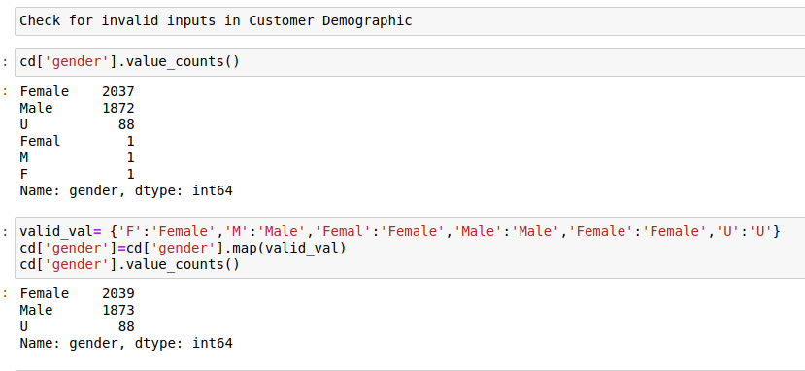
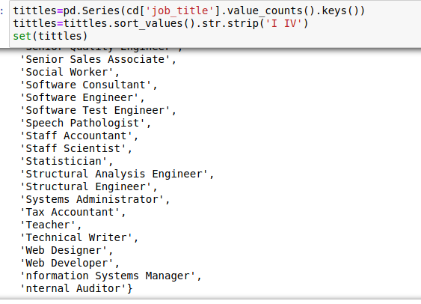
Customer Demographic - Validity
In the Customer Demographic Tab, We already know that there was an error in "default". Now we check the Validity of DOB ,job_title, and gender.
At gender we seem to have 3 main options, Male, Female and U which may be option a 3rd inclusive option. There's some invalid inputs such as M,F,Femal which can easily be corrected via code.
Appart from some small, non common spelling errors, there job_title seems to have no trouble.

Slide 15
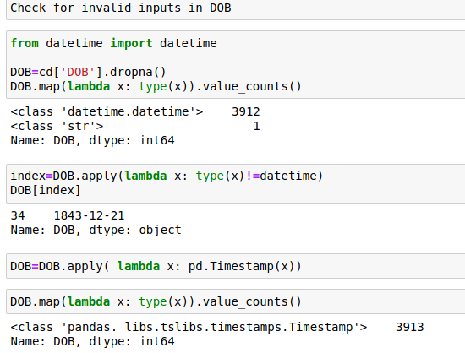
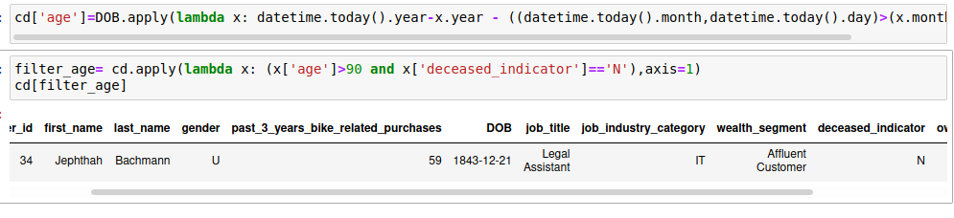
Customer Demographic - Validity
For DOB we can check invalid inputs. For starters we notice not all of the data has the same format, even after dismissing empty values(Nan). We fix it by converting all values to a more manipulable format.
We filter anyone who's older than 90 and have N in deceased_indicator. Jeanne Calment was the oldest person to ever live and he lived to be 122 years. Jepthan wants to beat his record with 177.

Slide 16
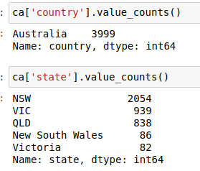
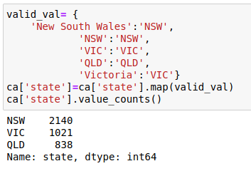
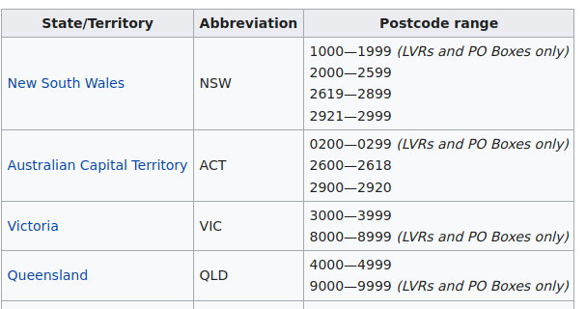
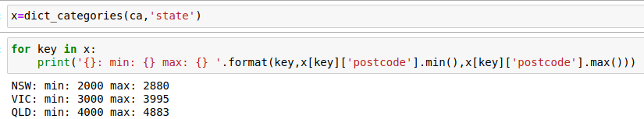
Customer Adress - Validity
We check the country of the Adresses, all data appear to be from Australia. Then we see if all states are actually Australian States and notice they are, although there are some some states which are not correctly abreviated. We fix this with simple code.
We filter the data by state and check the postcodes actually correspond to the actual state in Australia.

