Slide 1
Housing Prices Predictions – Project 2
by Alex Simon

Slide 2
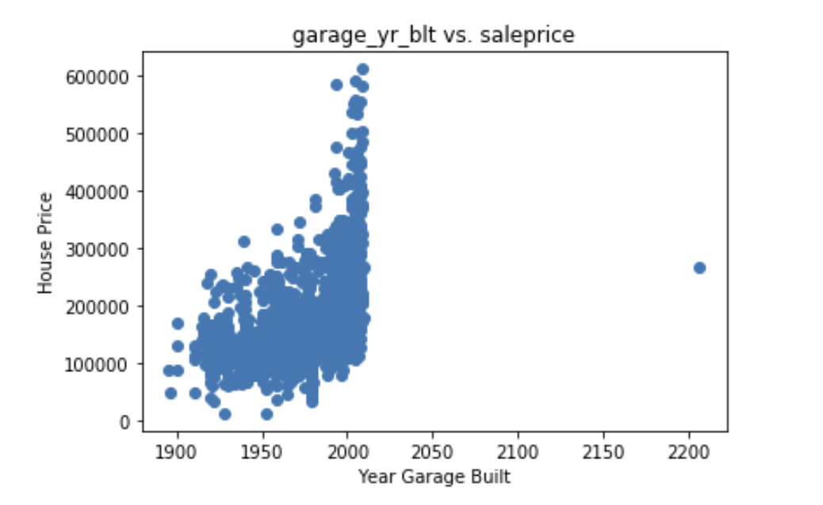
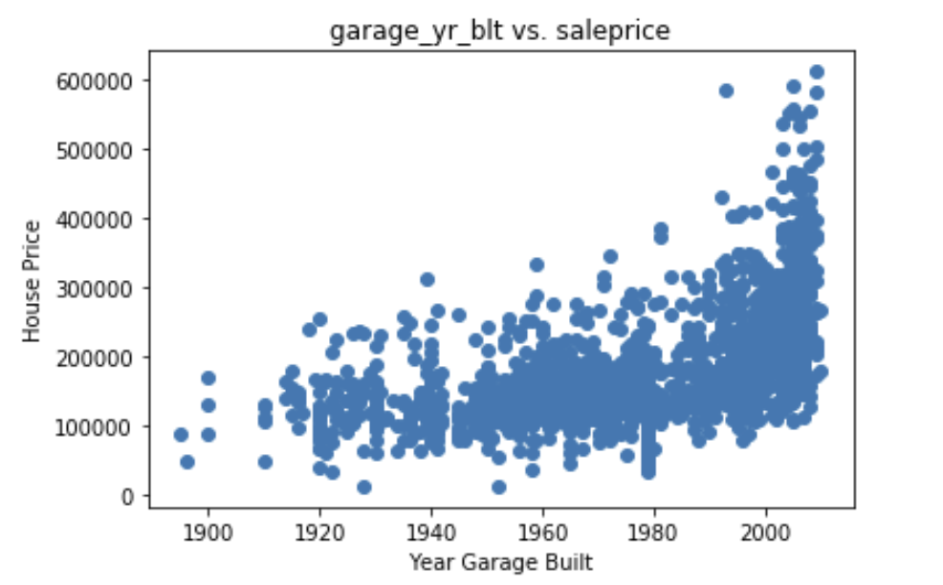
Cleaning and EDA:
81 columns in total
Most of them have little or no correlation to the price of the house
Some columns (e.g. Year Garage Built) were pretty well correlated to price, minus some outliers, which I removed to increase the correlations for a linear regression

Slide 3
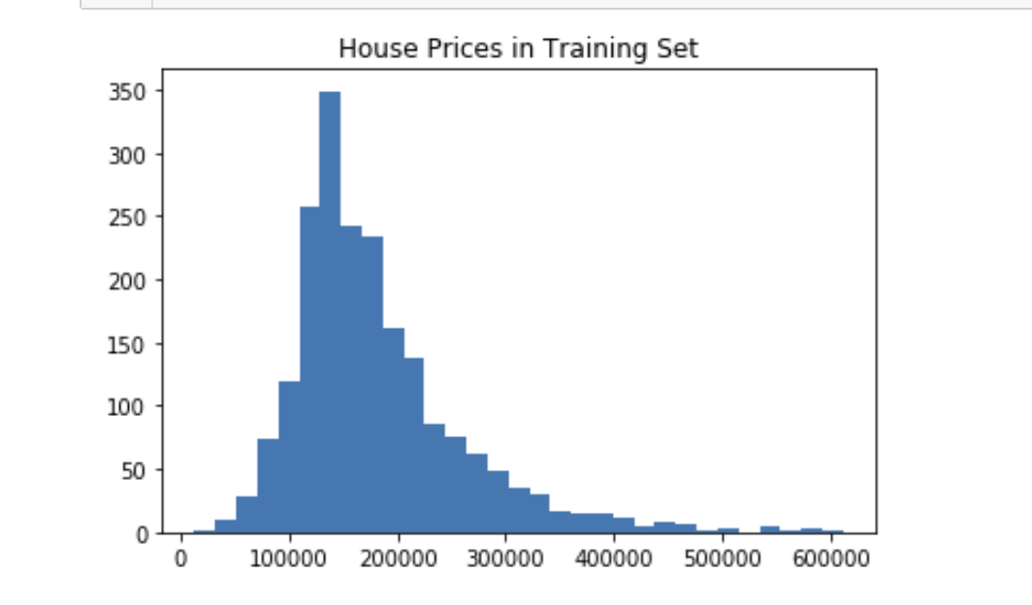
Prices are very skewed, which means I’ll want to use a log transformation later on.

Slide 4
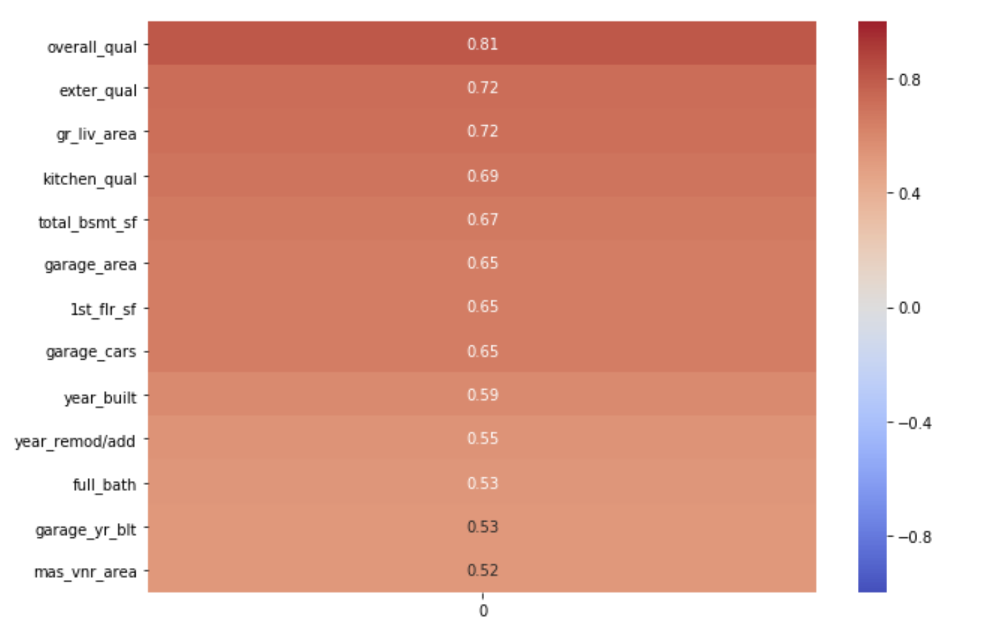
Cleaning and EDA:
5 numerical columns with null values, which I replaced with each column’s mean value ('mas_vnr_area', 'total_bsmt_sf', 'garage_yr_blt', 'garage_cars', 'garage_area’)
Replaced categorical columns with numbers (poor >> excellent : 1 >> 5) and checked them against the prices, and a couple correlated very well.
In total I used 13 columns as my predictors for X
Highest:
r = 0.81
Lowest:
r = 0.52

Slide 5
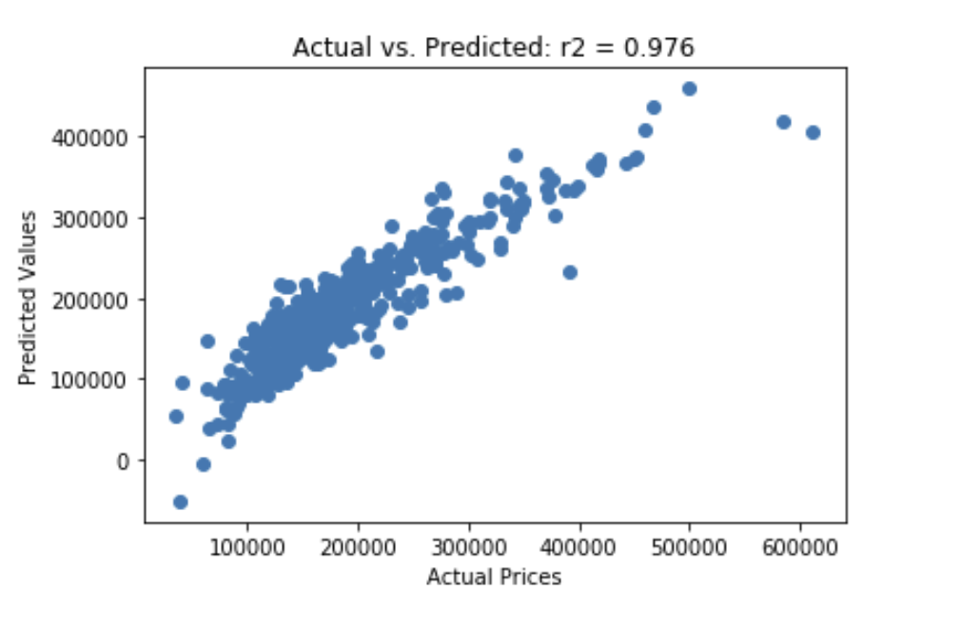
Modeling
Started with a simple linear regression
Cross-Val mean of scores: 0.85
According to OLS, r2 = 0.976
RMSE = 31,451.85

Slide 6
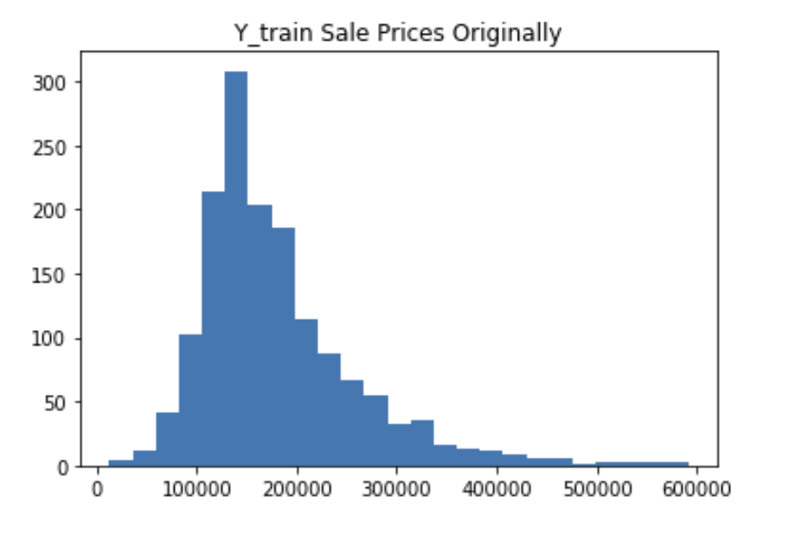
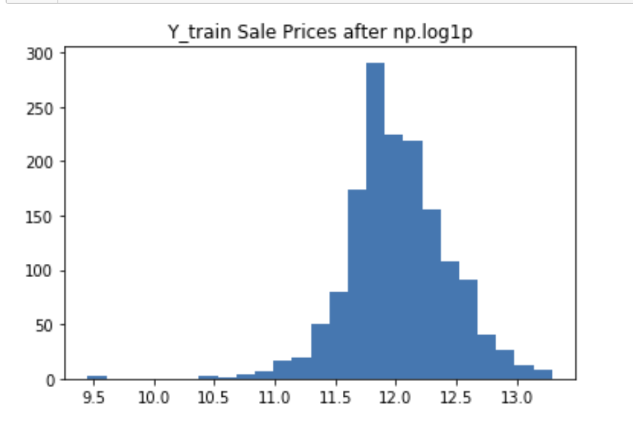
Applied a log transformation to normalize the distribution of sale prices
NEW STATS:
Cross-Val mean of scores: 0.85 (stayed the same)
However, the new RMSE = 27,118.68

Slide 7


