Slide 1

ECE 484 - Advanced Digital Systems Design Lecture 13 – Register Transfer Methodology
HQ U.S. Air Force Academy
I n t e g r i t y - S e r v i c e - E x c e l l e n c e
Capt Michael Tanner Room 2F46A 333-6766
Notes:
Write on board:
ECE 315
Day 1 – Admin
Section Marcher
Introductions
Syllabus

Slide 2
Lesson Outline
Introduction
Overview of FSMD
FSMD Design of a Repetitive-Addition Multiplier
Timing and Performance Analysis of FSMD
Synthesis Guidelines

Slide 3
Introduction

Slide 4
Introduction
How to realize an algorithm in hardware?
Two characteristics of an algorithm:
Use of variables (symbolic memory location) Example: n = n + 1 (when programming in C)
Sequential execution (execution order is important)

Slide 5
Dataflow Implementation
“Dataflow” implementation in VHDL
Convert the algorithm in to combinational circuit
No memory elements
The sequence is embedded into the “flow of data”
Problems with dataflow implementation:
Can only be applied to trivial algorithm
Not flexible
Can we just share one adder in a time-multiplexing fashion to save hardware resources
What happen if input size is not fixed (i.e., size is determined by an external input)

Slide 6
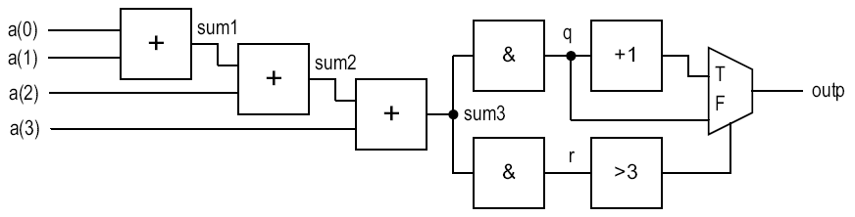
Dataflow Example
Algorithm:
Sum 4 numbers
Divide the result by 8
Round the final result
size = 4;
sum = 0;
for i in (0 downto size-1) do
sum = sum + a(i);
q = sum / 8;
r = sum rem 8;
if (r > 3)
q = q+1;
outp = q;
sum <= 0;
sum0 <= a(0);
sum1 <= sum0 + a(1);
sum2 <= sum1 + a(2);
sum3 <= sum2 + a(3);
q <= "000" & sum3(8 downto 3);
r <= "00000" & sum3(2 downto 0);
outp <= q + 1 when (r > 3) else
q;

Slide 7
Register Transfer Methodology
Realized algorithm in hardware
Use register to store intermediate data and imitate variable
Use a datapath to realize all register operations
Use a control path (FSM) to specify the order of register operation
The system is specified as sequence of data manipulation/transfer among registers
Realized by FSM with a datapath (FSMD)

Slide 8
Overview of FSMD

Slide 9



Overview of FSMD
Basic form:
Interpretation:
At the rising edge of the clock, the output of registers $r_{src1}$, $r_{src2}$, etc. are available
Outputs are passed to a combinational circuit that performs $f(…)$
At the next rising edge of the clock, result is stored into $r_{dest}$
$$r_{dest}←f(r_{src1},r_{src2},…,r_{srcn})$$
$$r←1 \\ r←r \\ r_{0}←r_{1} \\ n←n−1 \\ y←a⊕b⊕c⊕d \\ s←a^{2}+b^{2}$$

Slide 10
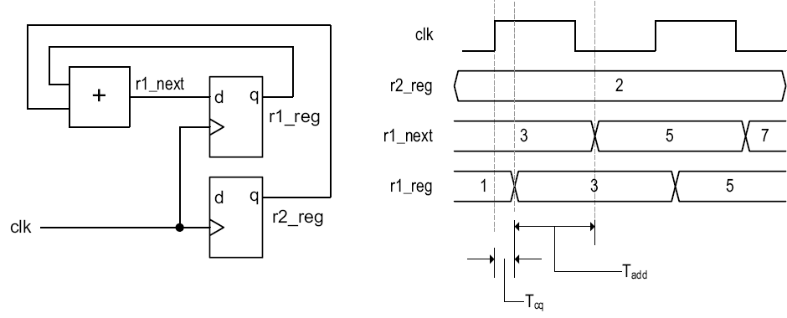

Implementation Example Single RT Operation
$$r_{1}←r_{1}+r_{2}$$

Slide 11
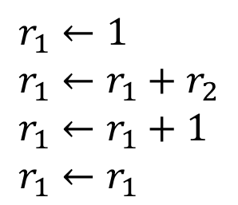
Implementation Example Multiple RT Operations
$$r_{1}←1 \\ r_{1}←r_{1}+r_{2} \\ r_{1}←r_{1}+1 \\ r_{1}←r_{1}$$

Slide 12
FSM as a Control Path
FSM is a good to control RT operation
State transition is on clock-by-clock basis
FSM can enforce order of execution
FSM allows branches on execution sequence
Normally represented in an extended ASM chart known as ASMD (ASM with datapath) chart
Note: New value or $r_{1}$ is only available when the FSM exits $s_{1}$ state.

Slide 13
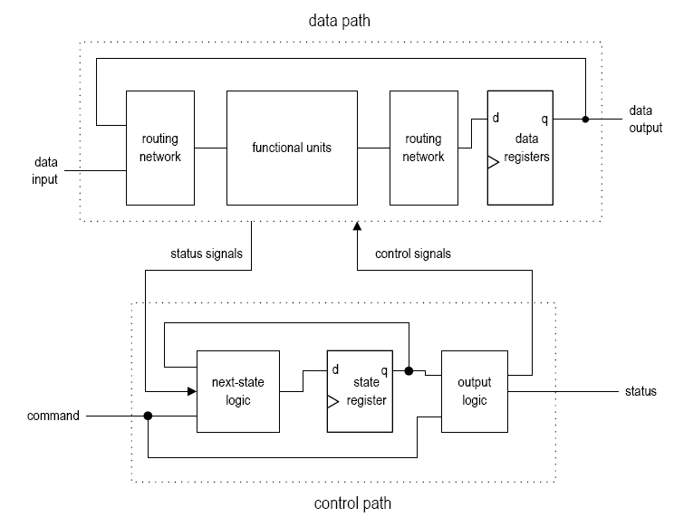
Basic Block Diagram of FSMD

Slide 14
FSMD Design of a Repetitive-Addition Multiplier

Slide 15
FSMD Design Repetitive-Addition Multiplier
Basic algorithm: 7*5 = 7+7+7+7+7
Pseudo code:
ASMD-Friendly Code:
if ((a_in = 0) or (b_in = 0)) then
r = 0;
else
a = a_in;
n = b_in;
r = 0;
while (n != 0)
r = r + a;
n = n - 1;
return r;
if ((a_in = 0) or (b_in = 0)) then
r = 0;
else
a = a_in;
n = b_in;
r = 0;
op: r = r + a;
n = n-1;
if (n = 0)
goto stop;
else
goto op;
stop: return r;

Slide 16
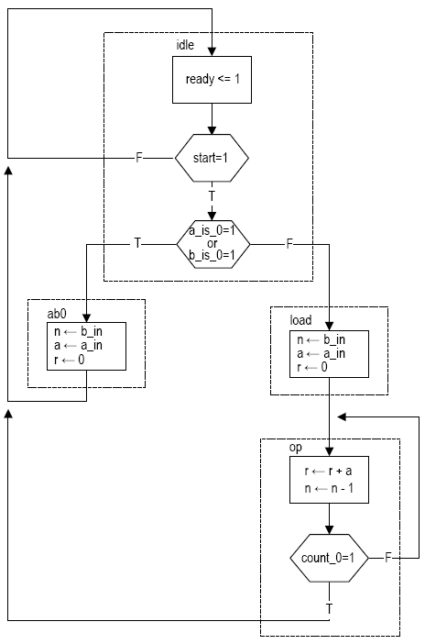
FSMD Design Repetitive-Addition Multiplier
Input:
a_in, b_in: 8-bit unsigned
clk, reset
start: command
Output:
r: 16-bit unsigned
ready: status
ASMD chart
Default RT operation: keep the previous value
Note the parallel execution in op state
if ((a_in = 0) or (b_in = 0)) then
r = 0;
else
a = a_in;
n = b_in;
r = 0;
op: r = r + a;
n = n-1;
if (n = 0)
goto stop;
else
goto op;
stop: return r;

Slide 17
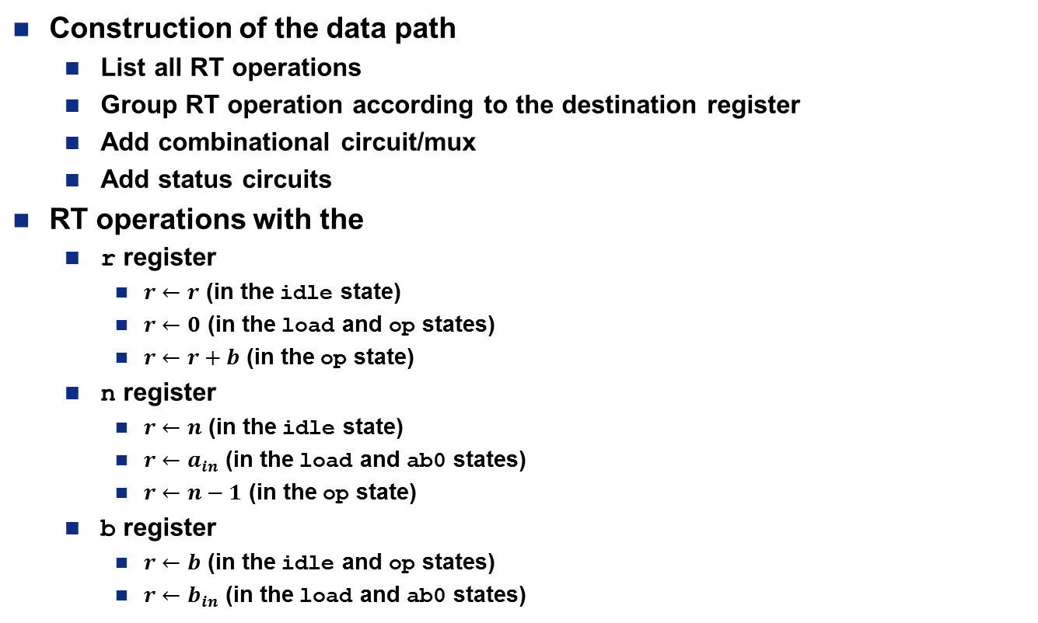
FSMD Design Repetitive-Addition Multiplier
Construction of the data path
List all RT operations
Group RT operation according to the destination register
Add combinational circuit/mux
Add status circuits
RT operations with the
r register
$r←r$ (in the idle state)
$r←0$ (in the load and op states)
$r←r+b$ (in the op state)
n register
$r←n$ (in the idle state)
$r←a_{in}$ (in the load and ab0 states)
$r←n−1$ (in the op state)
b register
$r←b$ (in the idle and op states)
$r←b_{in}$ (in the load and ab0 states)

Slide 18
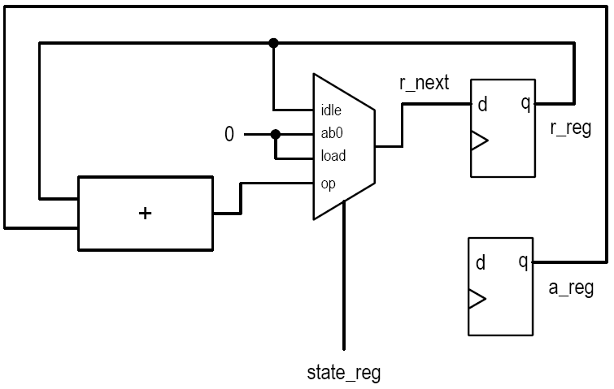
FSMD Design Repetitive-Addition Multiplier
Circuit associated with r register:

Slide 19
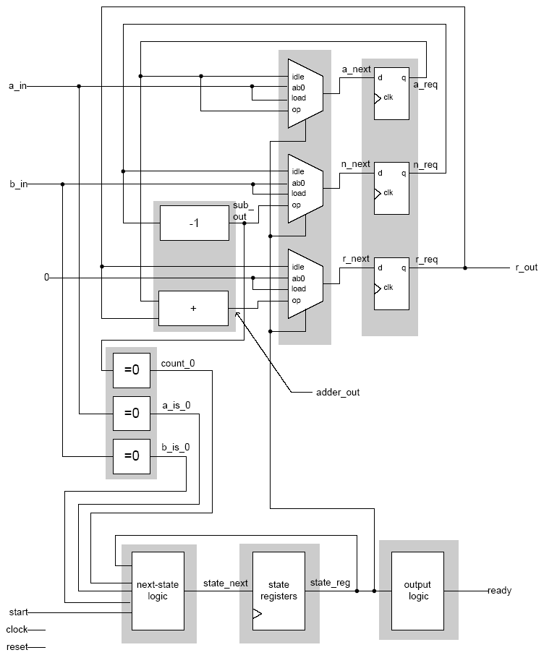
FSMD Design Repetitive-Addition Multiplier
VHDL Code
multiplier.vhd
Various code segments can be combined
Should always separate registers from combinational logic
May be a good idea to isolate the main functional units

Slide 20
Timing and Performance Analysis of FSMD

Slide 21
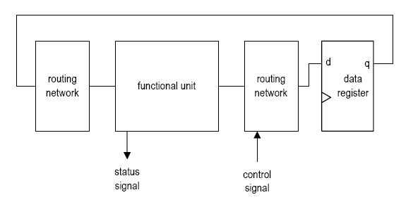
Timing and Performance Analysis of FSMD
Maximal clock rate
More difficult to analyze because of two interactive loops
The boundary of the clock rate can be found
Best-case scenario:
Control signals needed at late stage
Status signal available at early stage

Slide 22
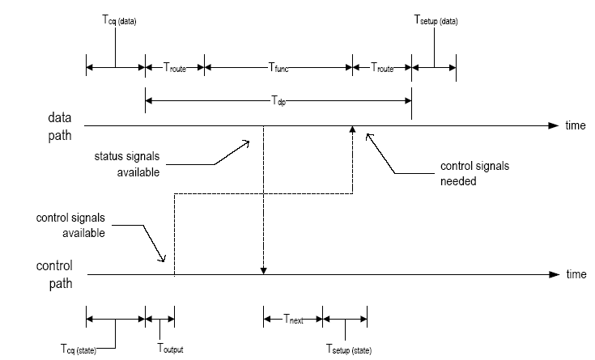

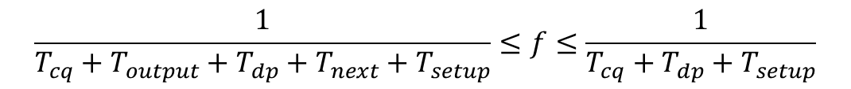
Timing and Performance Analysis of FSMD
$$T_{c}=T_{cq\left(data\right)}+T_{dp}+T_{setup\left(data\right)}$$
$$T_{cq}+T_{dp}+T_{setup}≤T_{C}≤T_{cq}+T_{output}+T_{dp}+T_{next}+T_{setup}$$
$$\frac{1}{T_{cq}+T_{output}+T_{dp}+T_{next}+T_{setup}}≤f≤\frac{1}{T_{cq}+T_{dp}+T_{setup}}$$

Slide 23
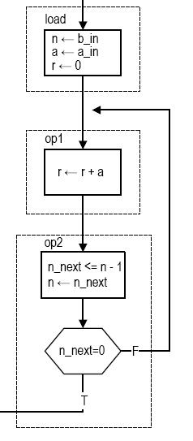
Timing and Performance Analysis of FSMD
Performance of FSMD
Tc: Clock period
K: # clock cycles to compete the computation
Total time = K * Tc
K determined by algorithm, input patterns, etc.
Example:
8-bit input
Best: b=0, K=2
Worst: b=255, K=2 + 255*2
N-bit input:
Worst: K=2+2*(2^{n}-1)

Slide 24
Synthesis Guidelines

Slide 25
Synthesis Guidelines
As with any sequential circuit, the registers of the FSMD should be separated from the combinational circuits.
Be aware that an RT operation exhibits a delayed-store behavior. Use of a register in a decision box should be carefully examined.
The variables used in Boolean expressions of a pseudo algorithm normally correspond to the next values of the registers used in an ASMD.
The function units are normally the most dominant components in a FSMD design. To exercise more control, we may need to isolate them from the rest of the code.
Separate the control path from the code if FSM optimization is needed later.

Slide 26
Lesson Outline
Introduction
Overview of FSMD
FSMD Design of a Repetitive-Addition Multiplier
Timing and Performance Analysis of FSMD
Synthesis Guidelines

