Slide 1

ECE 484 - Advanced Digital Systems Design Lecture 1 – Intro to Digital System Design
HQ U.S. Air Force Academy
I n t e g r i t y - S e r v i c e - E x c e l l e n c e
Capt Michael Tanner Room 2F46A 333-6766
Notes:
Write on board:
ECE 315
Day 1 – Admin
Section Marcher
Introductions
Syllabus

Slide 2
Lesson Outline
Why digital systems?
Instructor/Course Introduction
Methods of implementing digital systems
Custom digital device technologies
Abstraction
Digital system implementation
Design goals

Slide 3
Why Digital Systems?

Slide 4
Why Digital Systems?
Advantages
Reproducibility of information
Flexibility and functionality: easier to store, transmit and manipulate information
Economy: cheaper device and easier to design
Digital circuitry replaces many analog systems:
Audio recording: from tape to music CD to MP3 (MPEG Layer 3) player
Image processing: from silver-halide film to digital camera
Telephone switching networks
Control of mechanical system: e.g., “fly-by-wire”

Slide 5
Why Digital Systems?
Fly-By-Wire Digital System

Slide 6
Instructor/Course Intro

Slide 7


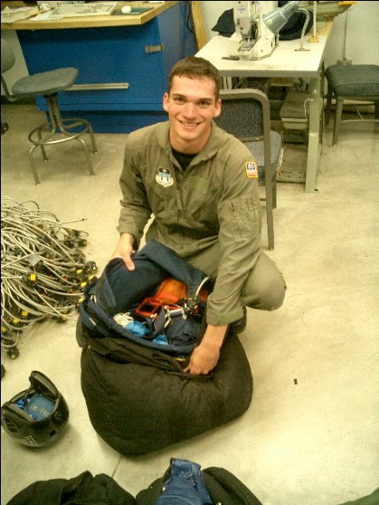

About me…
Chicago, IL
Education:
BS Computer Engineering, Computer Science, USAFA
MS Computer Engineering, AF Institute of Technology
Previous assignments:
Wright-Patterson AFB, OH; AFIT
Eglin AFB, FL; Munitions Directorate, AF Research Labs

Slide 8

The Family
Katie and Eliza

Slide 9
Information Sheet
Section
Name (First Last)
Hobbies/Activities/Jobs
Something interesting about you

Slide 10
Extra Instruction (EI)
Capt Michael Tanner
2F46A
333-6766
M1
T1
M2
T2
M3
T3
ECE 484
M4
T4
ECE 484
Available
M5
T5 ECE 315
Sometimes Available
M6
T6
Always Unavailable
M7
T7

Slide 11
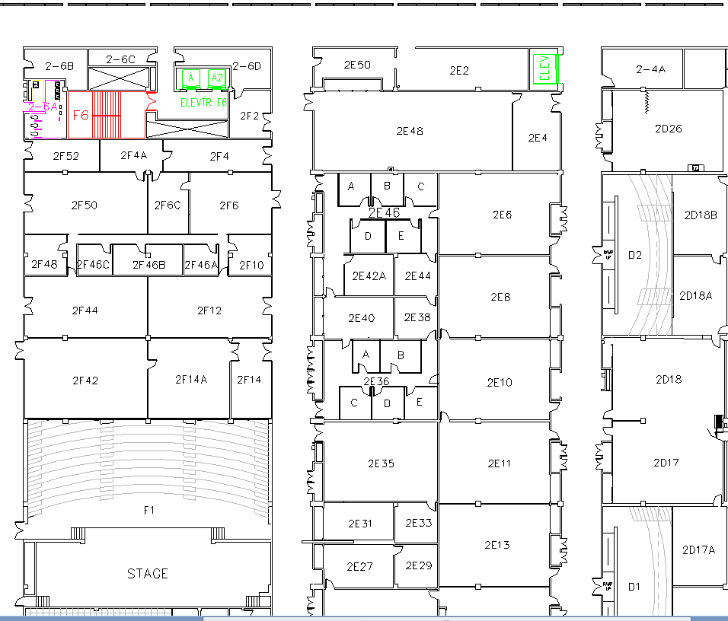
West (Terrazzo) Side

Slide 12

Rules
Be prepared for class (reading/homework)
Pay attention in lecture (1st hour)
Be productive during 2nd hour of application

Slide 13
Course Materials
Website: https://eis.usafa.edu/academics/eleccompengineering/ECE484/default.aspx [1]
Textbook:
RTL Hardware Design Using VHDL
Pong P. Chu

Slide 14
Methods of implementing digital systems

Slide 15
Digital Implementation Methods
General-purpose hardware with custom software
General purpose processor
Performance-oriented processor (e.g., Core i7)
Cost-oriented processor (e.g., PIC microcontroller)
Special purpose processor
DSP processor (multiplication-addition)
Network processor (buffering and routing)
Graphics engine (3D rendering)
Custom software on a custom processor (known as hardware-software co-design)
Custom hardware
Note: A complex project may use more than one of these!

Slide 16
Digital Implementation Methods
General Purpose Hardware
Custom Software
Custom Hardware
Custom Software
Custom Hardware
Increasing Development Time
Increasing Performance
Increasing Cost
Increasing Power Consumption

Slide 17
Custom digital device technologies

Slide 18
Custom Digital Device Technologies
Where customization is done:
In a fab (fabrication facility): ASIC (Application Specific IC)
In the “field”: non-ASIC
Six device technology classifications:
Full-custom ASIC
Standard cell ASIC
Gate array ASIC
Complex field programmable logic device
Simple field programmable logic device
Off-the-shelf SSI (Small Scaled IC)/MSI (Medium Scaled IC) components

Slide 19
Full-custom ASIC
All aspects (e.g., size of a transistor) of a circuit are tailored for a particular application.
Circuit fully optimized
Design extremely complex and involved
Only feasible for small components
Masks needed for all layers
Full-Custom ASIC
Standard-Cell ASIC
Gate-Array ASIC
Complex PLDs
Simple PLDs
SSI/MSI

Slide 20
Standard-Cell ASIC
Circuit made of a set of pre-defined logic, known as standard cells
Basic logic gates
1-bit adder,
D FF
etc.
Layout of a cell is pre-determined, but layout of the complete circuit is customized
Masks needed for all layers
Full-Custom ASIC
Standard-Cell ASIC
Gate-Array ASIC
Complex PLDs
Simple PLDs
SSI/MSI

Slide 21
Gate array ASIC
Circuit is built from an array of a single type of cell (known as base cell)
Base cells are pre-arranged and placed in fixed positions, aligned as one- or two-dimensional array
More sophisticated components (macro cells) can be constructed from base cells
Masks needed only for metal layers (connection wires)
Full-Custom ASIC
Standard-Cell ASIC
Gate-Array ASIC
Complex PLDs
Simple PLDs
SSI/MSI

Slide 22
Complex Field Programmable Device
Device consists of an array of generic logic cells and general interconnect structure
Logic cells and interconnect can be “programmed” by utilizing semiconductor fuses or switches
Customization is done “in the field” vs. fab
Two categories:
CPLD (Complex Programmable Logic Device)
FPGA (Field Programmable Gate Array)
No custom mask needed
Full-Custom ASIC
Standard-Cell ASIC
Gate-Array ASIC
Complex PLDs
Simple PLDs
SSI/MSI

Slide 23
Simple Field Programmable Device
Programmable device with simple internal structure
PROM (Programmable Read Only Memory)
PAL (Programmable Array Logic)
etc.
No custom mask needed
Replaced by CPLD/FPGA
Full-Custom ASIC
Standard-Cell ASIC
Gate-Array ASIC
Complex PLDs
Simple PLDs
SSI/MSI

Slide 24
SSI/MSI components
Small parts with fixed, limited functionality
7400 TTL series (more than 100 parts)
etc.
Resource is consumed by package but not silicon:
Power
Board area
Manufacturing cost
etc.
No longer a viable option
Full-Custom ASIC
Standard-Cell ASIC
Gate-Array ASIC
Complex PLDs
Simple PLDs
SSI/MSI

Slide 25
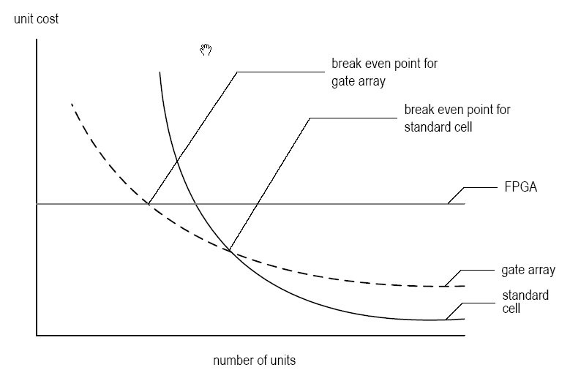
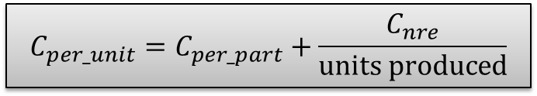
Types of Cost
NRE (Non-Recurrent Engineering) cost: one-time, per-design cost
Part cost: per-unit cost
Time-to-market cost: loss of revenue
$$C_{per_unit}=C_{per_part}+\frac{C_{nre}}{units produced}$$

Slide 26
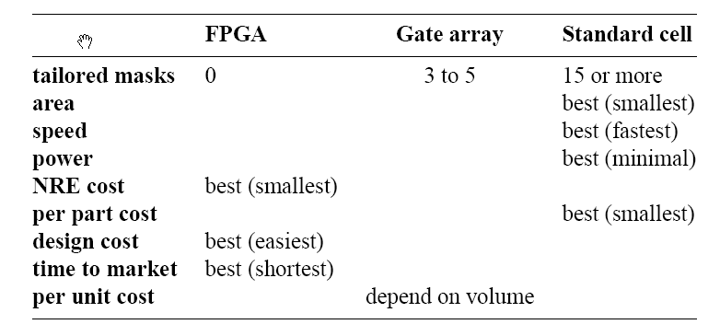
Technology Summary
Trade-off between optimal use of hardware resource and design effort/cost
No single best technology

Slide 27
Abstraction

Slide 28
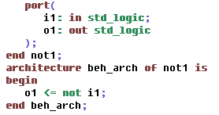
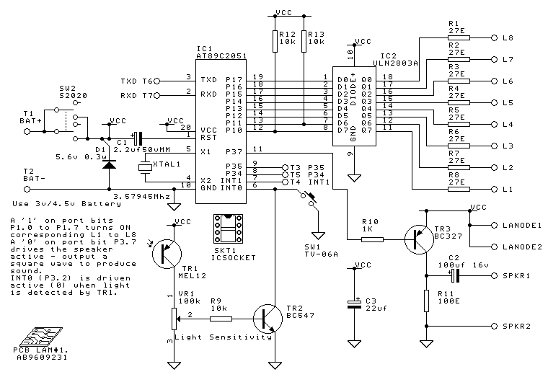
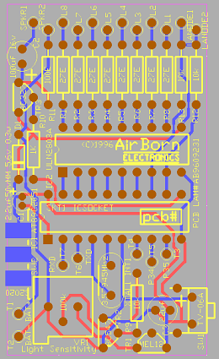
Digital System Views
Behavioral view:
Describe functionalities and I/O behavior
Treat the system as a black box
Structural view:
Describe the internal implementation (components and interconnections)
Essentially block diagram
Physical view:
Add more info to structural view: component size, component locations, routing wires
E.g., layout of a print circuit board

Slide 29
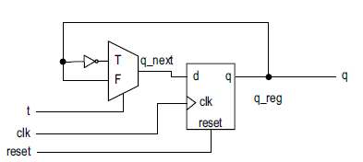
Register-Transfer Abstraction
Contains higher-level components (register, adder, mux, etc.) – think of datapaths in ECE 281/382
Based on clock “tick” event
Described as a finite state machine
Later on: a design methodology in which the system operation is described by how the data is manipulated and moved among registers

Slide 30
Digital system implementation

Slide 31
Digital System Implementation
Synthesis
Maps a higher-level description to lower-level components (RT, gate, technology map levels)
Results in structural view
Physical Design
Generates netlist based on synthesis
Floor Plan – layout based on RT/processor level
Place & Route – gate level
Circuit Extraction – Compute propagation delays (Cp/R)
Power/Clock Networks
Etc.

Slide 32
Digital System Implementation
Verification – Checking whether a design meets the functional and timing goals
Simulation
Formal verification
Hardware emulation
Testing – Process of detecting physical defects of a die or package that occurred during manufacturing

Slide 33
Design goals

Slide 34
Design Goals
Design for Efficiency
Synthesis cannot convert bad designs into good ones
Know what hardware your HDL will create
Design for Large
Design a large module
Design to be incorporated into a larger system
Design to facilitate the overall development process
Design for Portability
Device independent
Software independent
Design reuse

Slide 35
Lesson Outline
Why digital systems?
Instructor/Course Introduction
Methods of implementing digital systems
Custom digital device technologies
Abstraction
Digital system implementation
Design goals

