Slide 1

ECE 484 - Advanced Digital Systems Design Lecture 2 – HDL Overview
HQ U.S. Air Force Academy
I n t e g r i t y - S e r v i c e - E x c e l l e n c e
Capt Michael Tanner Room 2F46A 333-6766
Notes:
Write on board:
ECE 315
Day 1 – Admin
Section Marcher
Introductions
Syllabus

Slide 2
Lesson Outline
Overview of HDLs
Basic VHDL concepts via an example
HDL Synthesis

Slide 3
Overview of HDLs

Slide 4
Programming Language (PL)
Can we use C or Java as HDL?
A computer programming language
Semantics (“meaning”)
Syntax (“grammar”)
Develop of a language
Study the characteristics of the underlying processes
Develop syntactic constructs and their associated semantics to model and express these characteristics.

Slide 5
HDL vs. Traditional PL
Traditional PL
Modeled after a sequential process
Operations performed in a sequential order
Help human's thinking process to develop an algorithm step by step
Resemble the operation of a basic computer model
HDL
Characteristics of digital hardware
Connections of parts
Concurrent operations
Concept of propagation delay and timing
Characteristics cannot be captured by traditional PLs
Require new languages: HDL

Slide 6
HDL vs. Traditional PL
Structural Connections
Timing
Parallel nature

Slide 7
Modern Use of HDLs
Formal documentation
Input to simulator
Input to a synthesizer

Slide 8
Characteristics of an HDL
Capture characteristics of a digital circuit:
Entity – basic building block (e.g., 7400 chips)
Connectivity – Connection of entities (e.g., wires)
Concurrency – parallel operations
Timing – schedule/order of multiple operations
Must be able to describe a circuit in
Gate level and RT level
structural view and behavioral view (not physical)

Slide 9
Highlights of modern HDLs
Encapsulate the concepts of entity, connectivity, concurrency, and timing
Incorporate propagation delay and timing information
Consist of constructs for structural implementation
Incorporate constructs for behavioral description (sequential execution of traditional PL)
Describe the operations and structures in gate level and RT level.
Consist of constructs to support hierarchical design process

Slide 10
Industry Standard HDLs
VHDL
DoD initiative in 1980s
Transferred to IEEE to standardize
First released in 1987
Similar to Ada
Heavily used in FPGA industry
New versions: 1993, 2001, 2008
Verilog
Developed by industry
Released in early 1980s
Similar to C
Heavily used in ASIC industry
New versions: 1995, 2001, 2005
SystemVerilog is a superset of Verilog 2005
Syntax and “appearance” of VHDL/Verilog are very different but,
their capabilities and scopes are quite similar.

Slide 11
Basic VHDL concepts via an example

Slide 12
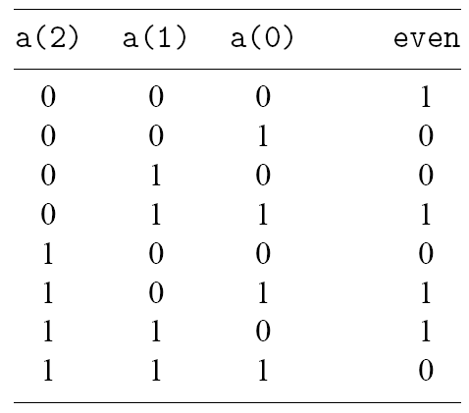
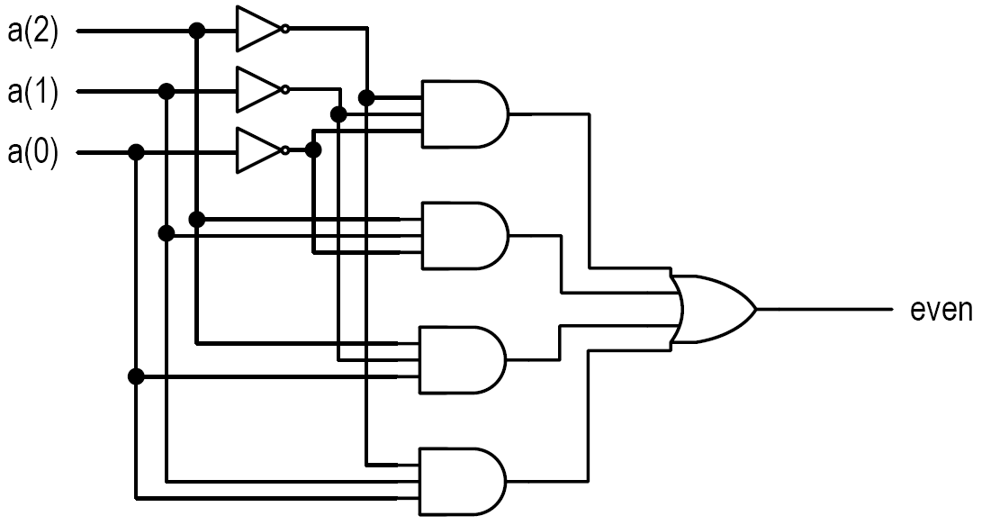
Even Parity Detection Circuit
Inputs: a(2 downto 0)
Output: even
$$even=\overline{a_{2}}∙\overline{a_{1}}∙\overline{a_{0}}+\overline{a_{2}}∙a_{1}∙a_{0}+a_{2}∙\overline{a_{1}}∙a_{0}+a_{2}∙a_{1}∙\overline{a_{0}}$$

Slide 13
Even Parity Detection Circuit
library ieee;
use ieee.std_logic_1164.all;
entity even_detector is
port(
a: in std_logic_vector(2 downto 0);
even: out std_logic
);
end even_detector;
architecture sop_arch of even_detector is
signal p1, p2, p3, p4 : std_logic;
begin
even <= (p1 or p2) or (p3 or p4) after 20 ns;
p1 <= (not a(2)) and (not a(1)) and (not a(0)) after 15 ns;
p2 <= (not a(2)) and a(1) and a(0) after 12 ns;
p3 <= a(2) and (not a(1)) and a(0) after 12 ns;
p4 <= a(2) and a(1) and (not a(0)) after 12 ns;
end sop_arch;
Library (extensions) to include for code
Similar to #include in C
This library defines std_logic and std_logic_vector
Entity declaration
Defines I/O ports
Black box description of the circuit
Architecture body
Declares signals (i.e., wires)
Concurrent statements contain timing information
The body can be thought of as a collection of parts
What’s the difference between this and a C program?

Slide 14
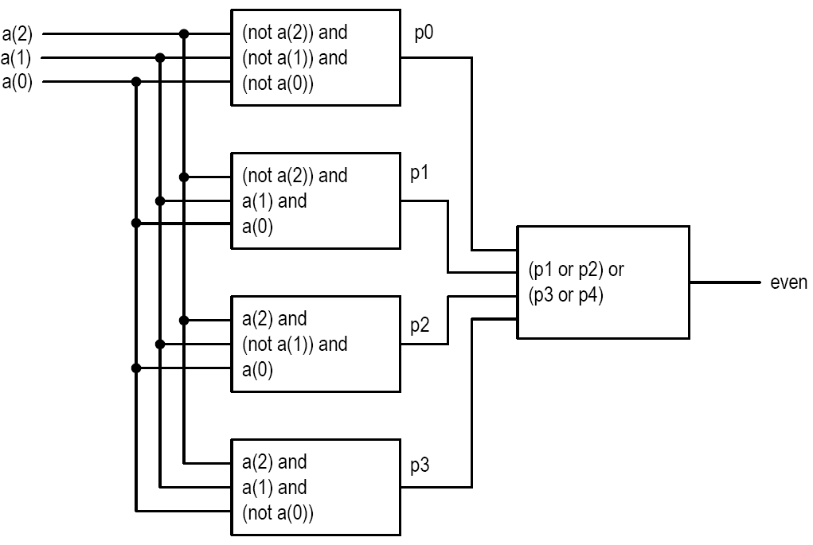
VHDL Conceptual Diagram
p0
p1
p2
p2
$$even=\overline{a_{2}}∙\overline{a_{1}}∙\overline{a_{0}}+\overline{a_{2}}∙a_{1}∙a_{0}+a_{2}∙\overline{a_{1}}∙a_{0}+a_{2}∙a_{1}∙\overline{a_{0}}$$

Slide 15
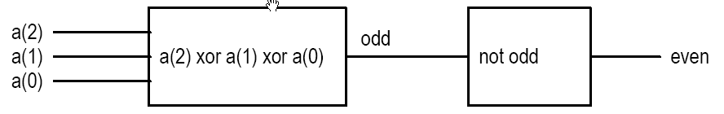
Alternative Implementation
Same entity declaration
VHDL now contains two architecture bodies (sop_arch is in the “…”)
Implicit δ-delay (delta delay)
library ieee;
use ieee.std_logic_1164.all;
...
architecture xor_arch of even_detector is
signal odd : std_logic;
begin
even <= not odd;
odd <= a(2) xor a(1) xor a(0);
end xor_arch;

Slide 16
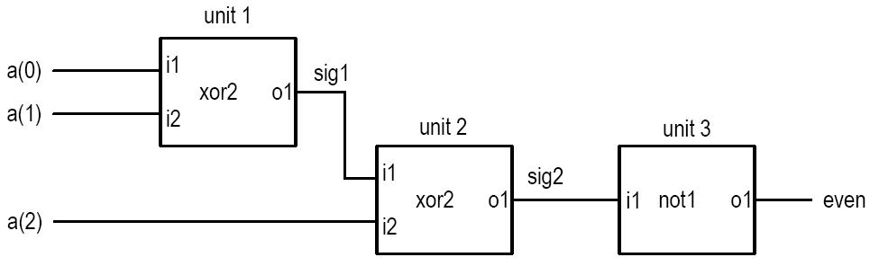
Structural Description
Circuit is constructed by smaller parts
Specify the types of parts and connections
Textual description of a schematic
Done by using “component in VHDL
First declared (made known)
Then instantiated (used)

Slide 17
Even Detector Structural Description
architecture str_arch of even_detector is
component xor2
port(i1, i2: in std_logic;
o1: out std_logic);
end component;
component not1
port(i1: in std_logic;
o1: out std_logic);
end component;
signal sig1, sig2: std_logic;
begin
unit1: xor2
port map (i1 => a(0), i2 => a(1), o1 => sig1);
unit2: xor2
port map (i1 => a(2), i2 => sig1, o1 => sig2);
unit3: not1
port map (i1 => sig2, o1 => even);
end str_arch;
Note: xor2 and not1 must be defined in an imported library (e.g. work or UNISIM).

Slide 18
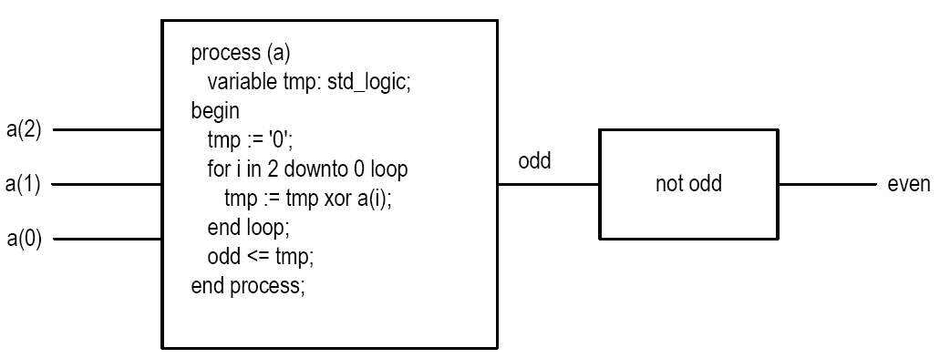
Even Detector Behavioral Description
architecture beh1_arch of even_detector is
signal odd: std_logic;
begin
even <= not odd;
process (a)
variable tmp: std_logic;
begin
tmp := '0';
for i in 2 downto 0 loop
tmp := tmp xor a(i);
end loop;
odd <= tmp;
end process;
end beh1_arch;
VHDL “process”: A language construct to encapsulate sequential statements
The entire process is a concurrent statement
( … ) contains the sensitivity list (i.e., when the process is called)
Note: “behavioral” in VHDL is anything that is not structural.

Slide 19
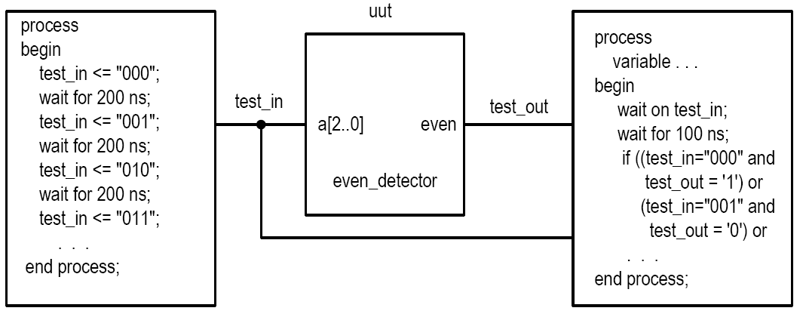
Testbench
A virtual experiment to test functionality of an architecture
Input stimuli, monitor output
Note: See Listing 2.7 (page 35) for example testbench code.

Slide 20
VHDL Configuration
Multiple architecture bodies can be associated with an entity declaration
VHDL configuration specifies the binding
VHDL 1993 provides a shortcut (Lesson 6)
configuration demo_config of even_detector_testbench is
for tb_arch
for uut: even_detector
use entity work.even_detector(sop_arch);
end for;
end for;
end demo_config;

Slide 21
HDL Synthesis

Slide 22
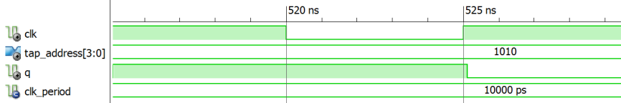
Simulation of VHDL Code
Design realized in a virtual environment (simulation software)
All VHDL language constructs can be realized in simulation
Simulation is executed by sampling circuit using small time steps (user configurable)

Slide 23
HDL Synthesis
Design realized by hardware components
Many VHDL constructs cannot be synthesized (e.g. file operation, floating-point data type, division)
Only small subset can be used for synthesis
Syntactically correct code ≠ Synthesizable code
Synthesizable code ≠ Efficient code
Synthesis software only performs transformation and local optimization

Slide 24
HDL Synthesis
The course focuses on hardware, not VHDL (i.e., the “H”, not “L” of HDL)
Emphasis on coding for synthesis:
Code accurately describing the underlying hardware structure
Code providing adequate info to guide synthesis software to generate efficient implementation
 | System Model | RTL Model
NAND Equivalents | 40,000 | 1200
Ports | 546 | 146
Clock Cycles | N/A | 8
Registers | 0 | 19
Synthesis of Dot Product of Two Vectors

Slide 25
Lesson Outline
Overview of HDLs
Basic VHDL concepts via an example
HDL Synthesis

