Slide 1

ECE 484 - Advanced Digital Systems Design Lecture 9 – PicoBlaze and HW/SW Partitioning
HQ U.S. Air Force Academy
I n t e g r i t y - S e r v i c e - E x c e l l e n c e
Capt Michael Tanner Room 2F46A 333-6766
Notes:
Write on board:
ECE 315
Day 1 – Admin
Section Marcher
Introductions
Syllabus

Slide 2
Lesson Outline
Software on an FPGA
PicoBlaze Overview
HW and SW Partitioning

Slide 3
Software on an FPGA

Slide 4
Software on an FPGA
Types of CPUs
Hard Core CPU – CPU is custom built/fabricated on the same die as the FPGA.
Soft Core CPU – CPU is built with CLBs and other standard FPGA components
Xilinx
PicoBlaze (8-bit Soft-Core CPU)
MicroBlaze (32-bit Soft-Core CPU)
PowerPC (32-bit Hard/Soft-Core CPU)
ARM (32-bit Hard/Soft-Core CPU)
Altera
Nios II (32-bit Soft-Core CPU)
Connect CPU to your custom hardware through I/O (memory mapped or port mapped)

Slide 5
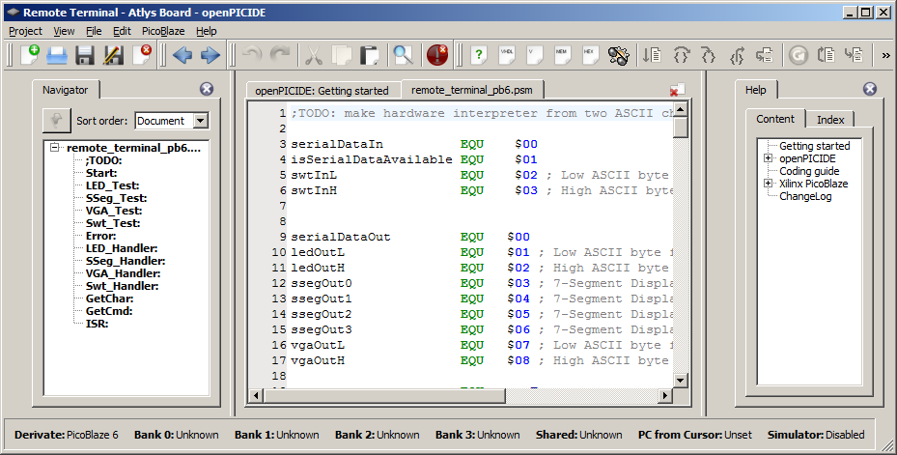
Software Development
Write/Test/Debug software on PC using vendor-provided development tools.
HDL Simulation to test software and hardware interfaces
Compile/Assemble code and store in program memory accessible from FPGA
openPICIDE

Slide 6
PicoBlaze Overview

Slide 7
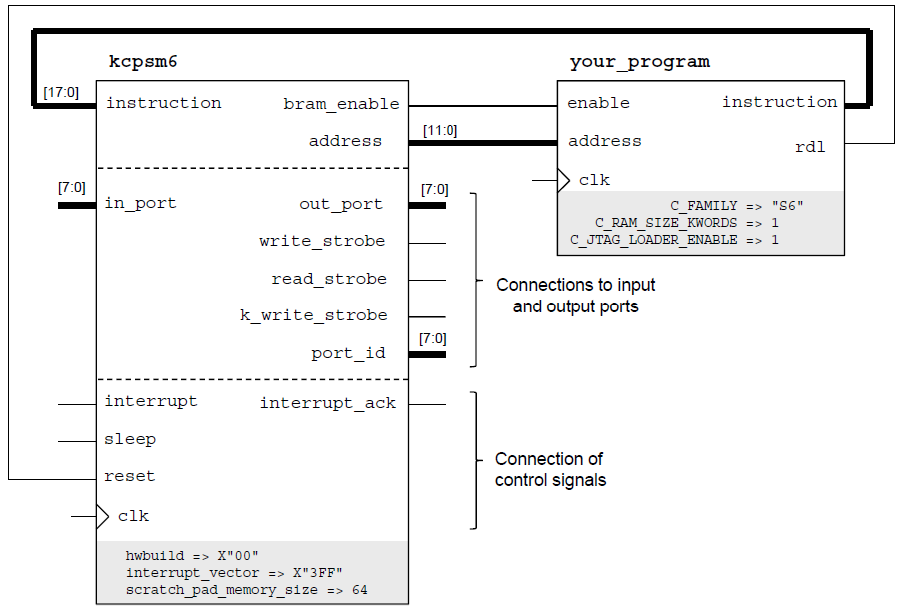
PicoBlaze Overview
8-Bit Xilinx Microprocessor
26 Spartan-6 Slices – Can use lots of them in a single design!
Up to 4096 instructions (configurable)
105 MHz on Spartan 6 (-2)
52 – 119 MIPS
Can go to “sleep”

Slide 8
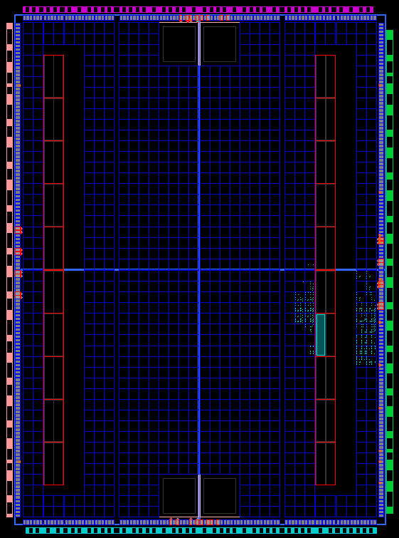
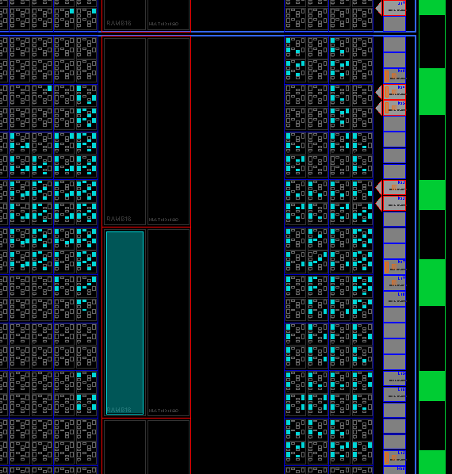
PicoBlaze on Spartan 3E-500
Less than 1% Utilization

Slide 9
PicoBlaze Feature Set KCPSM6
16 General Purpose registers (s0 through sF)
All instructions under all conditions execute in exactly 2 clock cycles
8-bit ALU
load, add, subtract, xor, and, compare, test, etc.
zero and carry flags
reset returns processor to initial state except for register contents
64, 128, or 256 byte general purpose memory (fetch/store register contents)
Capable of handling a single external interrupt

Slide 10
PicoBlaze Feature Set KCPSM6
The next few slides are extracted from the manual
Read the manual! Some “goodies” include:
Sample VHDL code for input/output ports
Detailed port descriptions
Detailed description of assembly instructions
Example assembly code

Slide 11
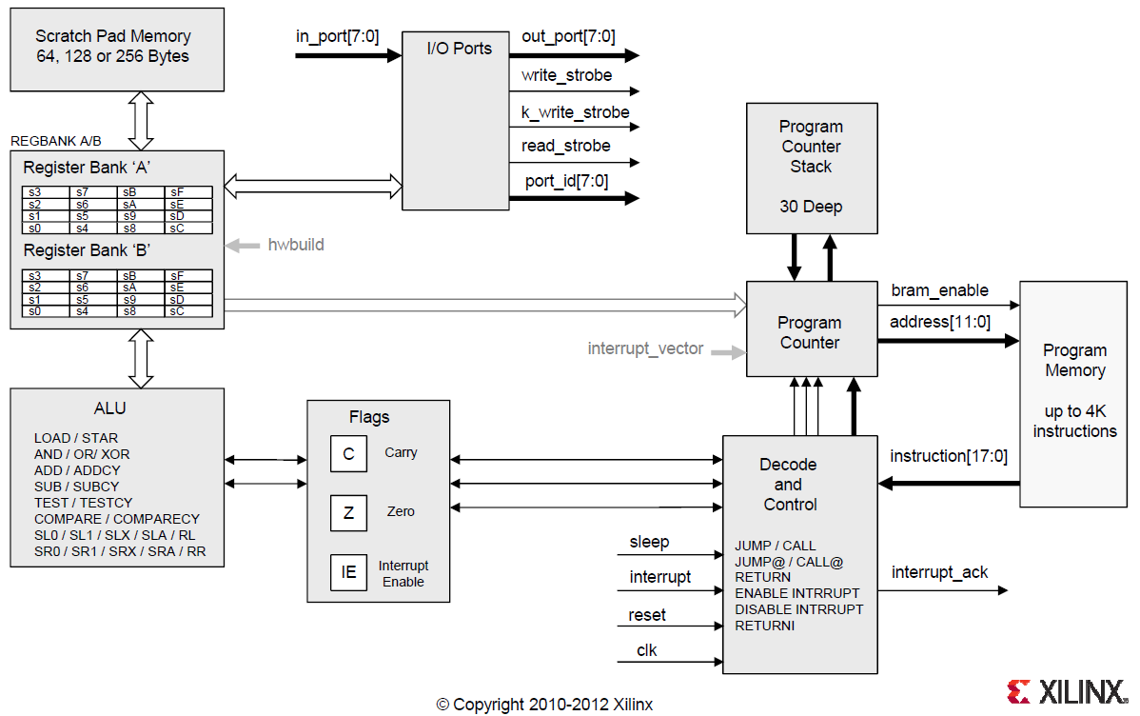
PicoBlaze Architecture KCPSM6

Slide 12
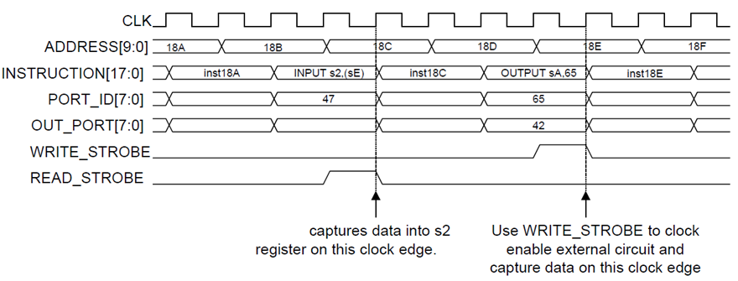
Read and Write Strobes KCPSM6
256 input ports, 256 output ports
read_strobe – high for one clock cycle after data read in
write_strobe – high for one clock cycle after data written out

Slide 13
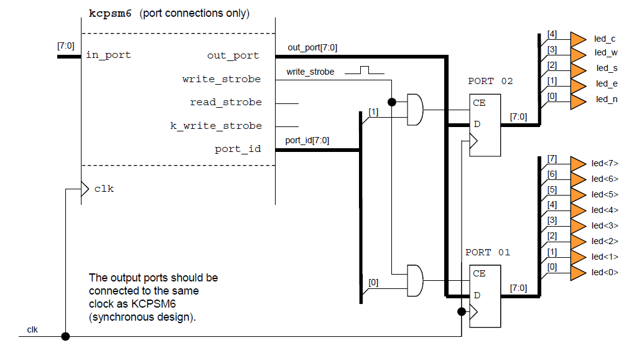
Design of Output Ports KCPSM6

Slide 14
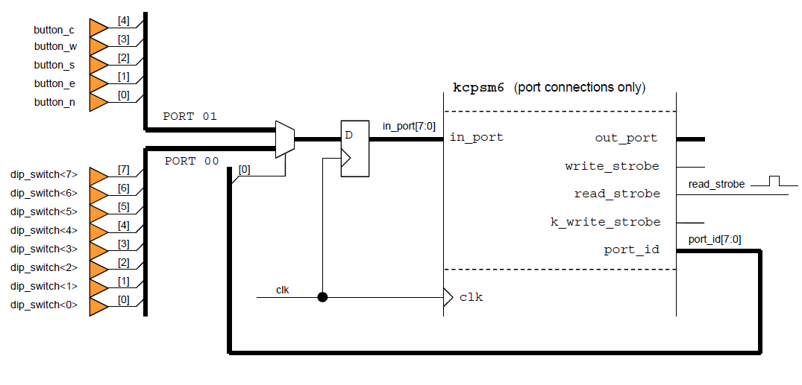
Design of Input Ports KCPSM6

Slide 15
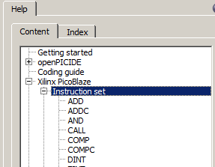
Assembly Instructions
ADD, ADDC
AND
CALL
COMP
IN
JUMP [C, NC, Z, NZ]
LOAD
OR
OUT
RET [C, NC, Z, NZ]
RETI [ENABLE, DISABLE]
STORE
SUB, SUBC
TEST
openPICIDE provides a complete list of available instructions

Slide 16
PicoBlaze Example
switches_port EQU $AF ; input
led_port EQU $07 ; output
temp EQU s0 ; temporary register
Main: IN temp, switches_port
OUT temp, led_port
JUMP Main ; labels are case sensitive
ISR: RETI ENABLE
ORG 0x3FF
JUMP ISR
How do we simulate the software? Hardware?

Slide 17
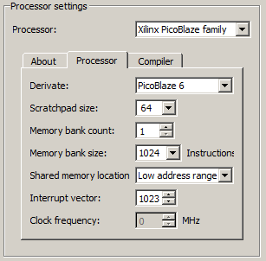
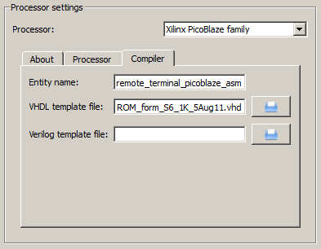

openPICIDE Configuration
Enable Simulator
Compile to VHDL
Check Syntax

Slide 18
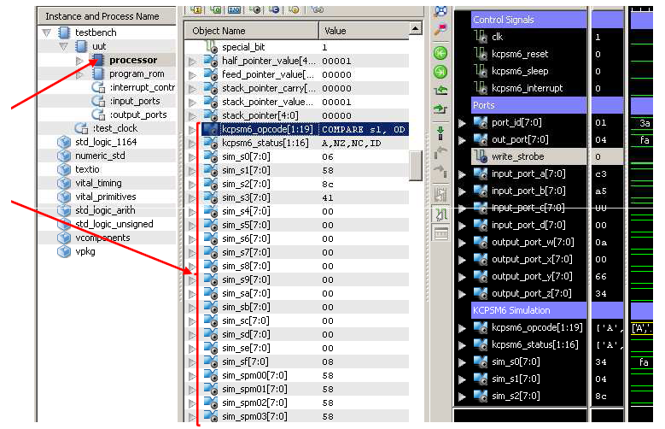
Hardware Simulation
In hardware simulation, you can even view the opcode in plain text!

Slide 19
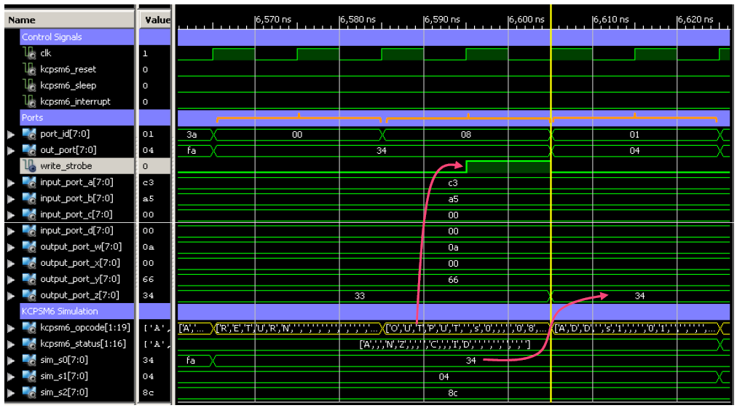
Hardware Simulation

Slide 20
PicoBlaze Development Process
Software: Write assembly code in openPICIDE
Simulate code to verify it works correctly, in software
Generate VHDL ROM file for hardware design
Hardware: Implement design using VHDL
Instantiate the KCPSM6 module
Instantiate your generated ROM module
Connect signals, as needed
Input/Output ports
Between the ROM and KCPSM6
Iterate through this process a few times. Start simple!

Slide 21
HW and SW Partitioning

Slide 22
Dividing Between HW and SW
Partitioning – Grouping of specific sets of instructions in an application and then mapping those groups to either hardware or software.
Profile – collect run-time information on an application during execution for a given set of inputs.
Type of information collected
Execution time
Resource usage (CPU cycles, memory, hardware, etc.)
Variety of tools available
gprof – Unix command-line tool
time – Unix command-line tool
tic/toc – MATLAB command-line tool

Slide 23
Decomposition Steps
Decompose the problem and draw a hierarchy of components
If possible, profile a pure software implementation
Group components into individual functions
Find the “bottleneck” functions and attempt to parallelize
Divide components into hardware and software implementation categories
Hardware (expensive to develop/test, great area/power/speed)
Hard area/power/speed requirements
Inherently parallel problem
Software (cheap to develop/test, poor area/power/speed)
Sequential algorithms
Non-time critical complex state machines
Anything not implemented in hardware!

Slide 24
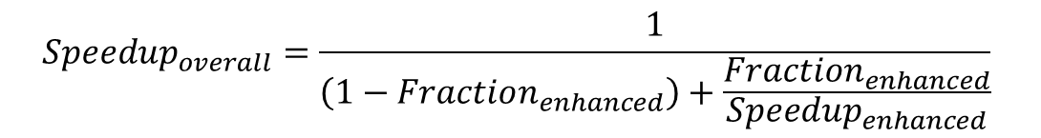
Amdahl’s Law
Important equation for computer architecture
Applies law of diminishing returns to the usefulness of a single architecture feature
$$Speedup_{overall}=\frac{1}{\left(1−Fraction_{enhanced}\right)+\frac{Fraction_{enhanced}}{Speedup_{enhanced}}}$$
Example 1: Suppose an enhancement that makes a portion of Machine A runs 500 times faster than the original. The portion makes up 20% of the machine. What is the overall speedup?
Example 2: After benchmarking a certain computer algorithm, you find that a certain for loop takes 80% of the execution time. You calculate that a hardware implementation of this loop will execute 100 times faster. How much faster will this algorithm run with the hardware accelerator?
Example 3: If a given part of an algorithm takes up 80% of the execution time, what is the theoretical maximum speedup you can achieve with a hardware accelerator?

Slide 25
Decomposing a Problem Asteroids Game
Asteroids Game
VGA Controller
Rendering Engine
PS/2 Controller
Game Logic
Graphical Output
Input Processing
Game State
Timer Subsystem
Collision Detection
State Propagation

Slide 26
Lesson Outline
Software on an FPGA
PicoBlaze Overview
HW and SW Partitioning

