Slide 1

ECE 484 - Advanced Digital Systems Design Lecture 10 – FPGA Design for Area, Power, or Speed
HQ U.S. Air Force Academy
I n t e g r i t y - S e r v i c e - E x c e l l e n c e
Capt Michael Tanner Room 2F46A 333-6766
Notes:
Write on board:
ECE 315
Day 1 – Admin
Section Marcher
Introductions
Syllabus

Slide 2

Documentation
Most of the images and notes in this presentation are taken from:
Xilinx University Program [1]
Xilinx Online FPGA Design Training [2]

Slide 3
Lesson Outline
Xilinx FPGA Architecture
Optimizing for Area
Optimizing for Power
Optimizing for Speed

Slide 4
Xilinx FPGA Architecture

Slide 5
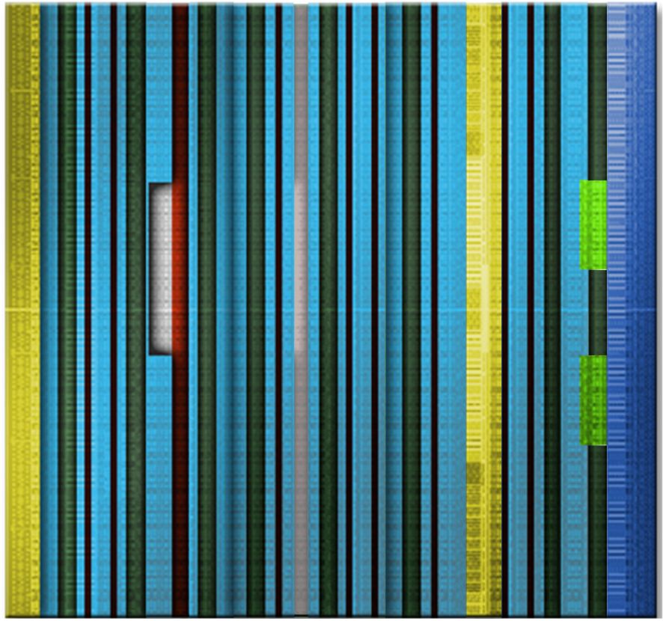
Xilinx FPGA Architecture Overview
Modern FPGA’s contain hardware-dedicated resources to for commonly used functions.
Improves performance
Reduces area and power use
7-Series Architecture Features
Logic (“FPGA Fabric”)
Interconnect
Block/Distributed RAM
SelectIO/CMT
DSP Slices
Serial Transceiver
SelectIO
& CMT
SelectIO
& CMT
Serial Transceiver
DSP
Logic
BRAM
Clock Buffers and Routing
PCI Express

Slide 6
Xilinx FPGA Architecture CLB Structure
Two side-by-side slices per CLB
Slice_M are memory-capable
Slice_L are logic and carry only
Four 6-input LUTs per slice
Consistent with previous architectures
Single LUT in Slice_M can be a 32-bit shift register or 64 x 1 RAM (Distributed RAM)
Two flip-flops per LUT
Excellent for heavily pipelined designs
CLB
SLICE
LUT
SLICE
LUT

Slide 7
Xilinx FPGA Architecture Slice Structure
Local routing provides connection between slices in the same CLB, and it provides routing to neighboring CLBs
Carry logic runs vertically, between slices and CLBs
Other resources on slice:
LUTs
MUXs with dedicated routing
Carry Logic
Sequential Elements
Slice 0
LUT
PRE
Carry
D
Q
CE
CLR
LUT
Carry
D
PRE
CE
Q
CLR
Interconnect

Slide 8
Xilinx FPGA Architecture Block RAM
Synchronous read and write capability
True dual-port memory
Built-in FIFO logic
Supports initial values and parity bits
Situated next to embedded multiplier for fast multiply-accumulate operations
36K/18K block RAM
32k x 1 to 512 x 72 in one 36K block
64-bit error correction coding per 36K block
Adjacent blocks combine to 64K x 1 without extra logic
ADDRA
Port A
36
36
DIA
DOA
4
WEA
CLKA
36 Kb Memory Array
36
ADDRB
36
4
DIB
DOB
WEB
CLKB
Port B

Slide 9
Xilinx FPGA Architecture Distributed RAM
Synchronous write
Asynchronous read – but can be made into synchronous read
RAM/ROM are initialized during configuration – data can be written to RAM after configuration
Emulated dual-port RAM
One read/write port
One read-only port
Implemented using LUTs
RAM16X1S
D
LUT
WE
WCLK
A0
O
A1
A2
A3
RAM32X1S
RAM16X1D
D
D
WE
WE
Slice
WCLK
WCLK
A0
O
A0
SPO
LUT
A1
A1
A2
A2
A3
A3
A4
DPRA0
DPO
DPRA1
LUT
DPRA2
DPRA3

Slide 10
Xilinx 7-Series Architecture Input/Output Blocks (SelectIO)
Extension of logic layer functionality
Wider input/output SERDES
Addition of independent ODELAY
Phaser, IO FIFO, IO PLL
Supports dozens of IO standards
Single (PCI, CMOS, TTL, I2C, etc.)
Differential (TMDS, Display Port, etc.)
Tri-state buffers
Double Data Rate
Registered I/O
Various Voltage levels
IOB
Reg
Input
DDR MUX
Reg
OCK1
Reg
ICK1
OCK2
3-state
Reg
ICK2
Reg
DDR MUX
OCK1
PAD
Reg
OCK2
Output

Slide 11
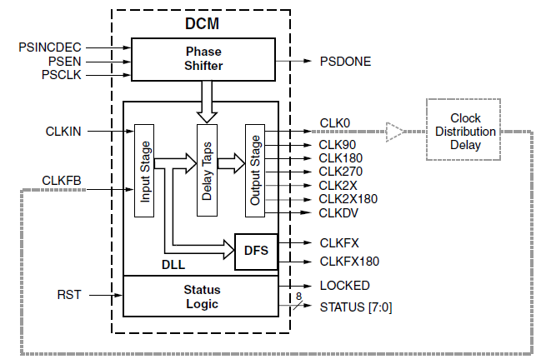
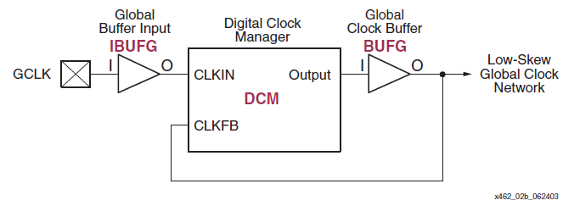
Xilinx FPGA Architecture CMT/DCM
Former: Digital Clock Manager (DCM)
Current: Clock Management Tile (CMT)
Purpose:
Reduce clock skew through feedback (PLL/DLL)
Generate new frequencies that are a multiple/divisor of current frequency (e.g. clk*4/8)
Phase shift clock
Dedicated routing to all flip flops in within clock region to minimize clock skew

Slide 12
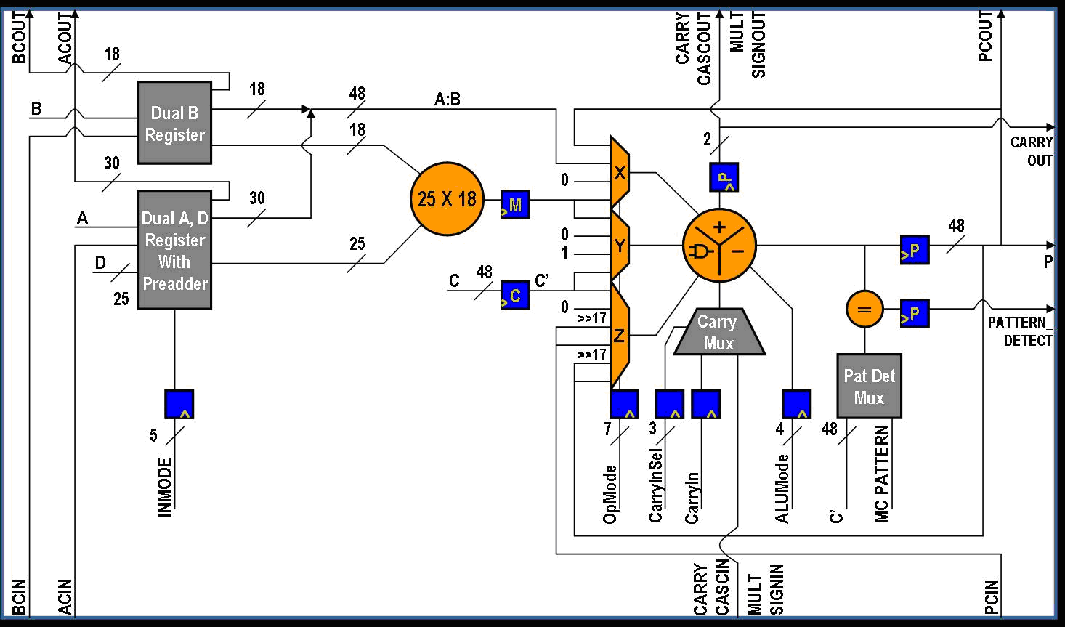
Xilinx FPGA Architecture DSP Slice
7-Series Architecture DSP Slice Features:
25x18 multiplier
25-bit pre-adder
Flexible pipeline
Cascade in and out
Carry in and out
96-bit MACC
SIMD support
48-bit ALU
Pattern detect
17-bit shifter
Dynamic operation (cycle by cycle)

Slide 13
Xilinx FPGA Architecture Other Features
High-Speed Analog-to-Digital Converters
17 External
Analog Inputs
XADC
ADC Results
Status Registers
ADC 1
Control Registers
Define XADC Operation
Initialize with Attributes
GTX Transceivers
MUX
On-Chip Sensors
ADC 2
PCI Express Block
DRP
On-Chip Sensors Supplies ±1%
Temperature ±4°C
2 x 12 Bits
1 MSPS
JTAG
Arbitrator
Transaction Layer
Data Link Layer
Physical Layer
Interconnect
Dynamic Reconfiguration Port
Configuration module
High-Speed Serial I/O Transceivers

Slide 14
Optimizing for Area

Slide 15
Optimizing for Area
Use RTL design methodology
Use dedicated hardware when available (e.g., block RAM, multipliers, DSP, SERDES I/O, etc.)
Pay attention to synthesizer messages (e.g., could not infer block/distributed RAM due to a coding style mistake)
“Optimize for Area” during synthesis and implementation
Resource Sharing
Use IOB’s registers
Combine LUTs
Do not preserve hierarchy (do this last and only if needed)
“Optimize for Area” when using CoreGen tools
Use resets only when necessary, use synchronous resets
http://www.xilinx.com/itp/xilinx10/isehelp/ise_c_xst_area_reduction_strategies.htm

Slide 16
Optimizing for Power

Slide 17

Optimizing for Power
Minimize your dynamic power (see below equation)
Turn off parts of FPGA that aren’t in use
Block RAM
Use the Chip Enable signals for flip-flops
Use Xilinx tools to estimate power usage for various settings
“Optimize for Power” during synthesis and implementation
“Optimize for Power” when using CoreGen tools
Use resets only when necessary, use synchronous resets
$$P_{dynamic}=nCV^{2}f$$
n = number of toggling nodes
C = capacitance
V = voltage swing
f = toggle frequency
http://www.xilinx.com/support/documentation/white_papers/wp285.pdf

Slide 18
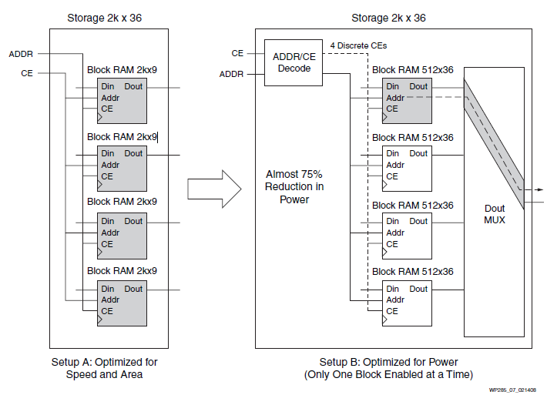
Optimizing for Power

Slide 19
Optimizing for Speed

Slide 20
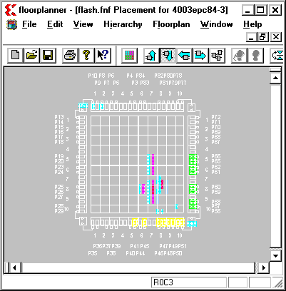
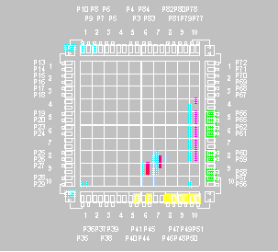
Optimizing for Speed Use Global Timing Constraints
Without global timing constraints
Logic tends to be grouped to improve internal timing at the expense of I/O timing
With global timing constraints
All timing paths are evaluated
I/O paths are improved (CLBs are place closer to I/O pins)

Slide 21
Optimizing for Speed Logic Levels and Delay
Enter your timing constraints into the Xilinx Constraints File
Over-constraining does not help you, but it will take longer to implement (if it can implement)
Review the timing reports after synthesis and implementation to see details (max clock speed, longest path, etc.)
Path endpoints are:
I/O Pads
Synchronous elements (FFs, Latches, RAMs, DSP slices, SRLs, etc.)
NOT: LUTs, Nets, or any other asynchronous element
Global timing constraints will cover 90% of the timing constraints you need to deal with.
You can specify net-specific constraints, but that is beyond the scope of this class

Slide 22
Optimizing for Speed Timing Constraints
The combination of the interconnect and the LUT forms a logic level
Lower speed grade devices operate slower (longer LUT delays)
50/50 rule is typically used – 50% of delay is from LUT, 50% from routing delay
Make your designs parallel - cascading logic (e.g., priority multiplexer) significantly slows down your design
Pipeline your design to reduce longest path and therefore increase maximum clock speed.
1.4
LUT4
I3
1.5
LUT4
LUT2
I2
O
I3
1.9
I1
1.6
I1
I2
O
I0
O
I0
I1
0.5
I0
0.5
1.8
LUT3
0.5
I2
2.1
I1
O
I0
0.5

Slide 23
Optimizing for Speed PERIOD constraint
The PERIOD constraint covers paths between synchronous elements on a single clock domain
In this example, there is one clock signal (CLK)
There are five synchronous elements (all FFs) attach to the clock which means there are five path endpoints, in this case
There are three delay paths constrained between those five FFs
ADATA
FLOP1
FLOP2
FLOP3
D
Q
D
Q
D
Q
OUT1
CLK
BUFG
FLOP4
FLOP5
D
Q
D
Q
OUT2
BUS [7..0]
CDATA
NET "clk" PERIOD = 20 ns;

Slide 24
Optimizing for Speed OFFSET IN/OUT constraints
The OFFSET IN constraint covers paths from input pads to synchronous elements
The OFFSET OUT constraint covers paths from synchronous elements to input pads
OFFSET IN
OFFSET OUT
ADATA
FLOP
FLOP
FLOP
D
Q
D
Q
D
Q
OUT1
CLK
BUFG
FLOP
FLOP
D
Q
D
Q
OUT2
BUS [7..0]
CDATA
= Combinatorial Logic
OFFSET = IN 10 ns BEFORE "clk";
OFFSET = OUT 10 ns BEFORE "clk";

Slide 25
Lesson Outline
Xilinx FPGA Architecture
Optimizing for Area
Optimizing for Power
Optimizing for Speed

