Slide 1

ECE 484 - Advanced Digital Systems Design Lecture 3 – Basic Language Constructs of VHDL
HQ U.S. Air Force Academy
I n t e g r i t y - S e r v i c e - E x c e l l e n c e
Capt Michael Tanner Room 2F46A 333-6766
Notes:
Write on board:
ECE 315
Day 1 – Admin
Section Marcher
Introductions
Syllabus

Slide 2
Lesson Outline
Basic VHDL Program
Lexical Elements and Program Format
VHDL Objects
Data Types and Operators
Synthesis Guidelines

Slide 3
Basic VHDL Program

Slide 4
Design Unit
Building blocks in a VHDL program
Each design unit is analyzed and stored independently
Types of design unit:
entity declaration
architecture body
package declaration
package body
configuration

Slide 5
Entity Declaration
Simplified syntax
Mode:
in: flow into the circuit
out: flow out of the circuit
inout: bi-directional flow
entity entity_name is
port(
port_names : mode data_type;
port_names : mode data_type;
...
port_names : mode data_type
);
end entity_name;
entity even_detector is
port(
a : in std_logic_vector(2 downto 0);
even : out std_logic;
);
end even_detector;

Slide 6
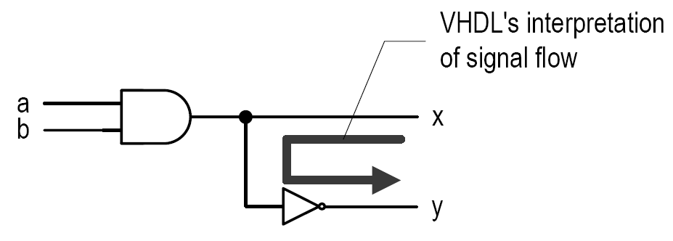
Common Mistake with Mode
entity mode_demo is
port(
a, b: in std_logic;
x, y : out std_logic;
);
end mode_demo;
architecture wrong of mode_demo is
begin
x <= a and b;
y <= not x;
end wrong;
...
architecture correct of entity_name is
signal x_i : std_logic;
begin
x_i <= a and b;
x <= x_i;
y <= not x_i;
end correct;

Slide 7
Architecture Body
Simplified syntax
An entity declaration can be associated with multiple architecture bodies
architecture arch_name of entity_name is
declarations;
begin
concurrent statement;
concurrent statement;
concurrent statement;
...
end arch_name;
architecture sop_arch of even_detector is
signal p1, p2, p3, p4 : std_logic;
begin
even <= (p1 or p2) or (p3 or p4);
p1 <= (not a(2)) and (not a(1)) and (not a(0));
p2 <= (not a(2)) and a(1) and a(0);
p3 <= a(2) and (not a(1)) and a(0);
p4 <= a(2) and a(1) and (not a(0));
end sop_arch;

Slide 8
Other Design Units
Package declaration/body - collection of commonly used items:
Data Types
Subprograms
Components
Configuration – specify which architecture body is to be bound with the entity declaration
VHDL Library – A place to store the analyzed design units
Normally mapped to a folder on host computer
Default library: “work”
Library “IEEE” is used for many IEEE packages
1 library ieee;
2 use ieee.std_logic_1164.all;
Invoke library named IEEE
Make std_logic_1164 visible to all design units in current file

Slide 9
Processing of VHDL Code
Analysis
Performed on “design unit” basis
Check the syntax and translate the unit into an intermediate form
Store design unit in a library
Elaboration
Bind architecture body with entity
Substitute the instantiated components with architecture description
Create a “flattened”' description
Execution
Simulation or synthesis

Slide 10
Lexical Elements and Program Format

Slide 11
Lexical Elements
Basic syntactical units in a VHDL program
Types of elements:
Comments
Identifiers
Reserved words
Numbers
Characters
Strings

Slide 12
Comments
Starts with --
Comments for the remainder of the line
Added for program clarity and documentation
VHDL 2008 supports C-style block commenting /* ... */
--*******************************************
-- Example to show the caveot of the out mode
--*******************************************
architecture correct of entity_name is
signal x_i : std_logic; -- Internal signal
begin
x_i <= a and b;
x <= x_i; -- Connect the internal signal to the output
y <= not x_i;
end correct;

Slide 13
Identifier
Identifier is the name of an object
Basic rules:
Can only contain alphabetic letters, decimal digits and underscore
The first character must be a letter
The last character cannot be an underscore
Two successive underscores are not allowed
Valid: A10, next_state, NextState
Invalid: sig#3, _X10, 7segment, X10_, hi_ _there
VHDL is case insensitive: {nextstate, NextState, NEXTSTATE, nEXTsTATE} are all the same

Slide 14
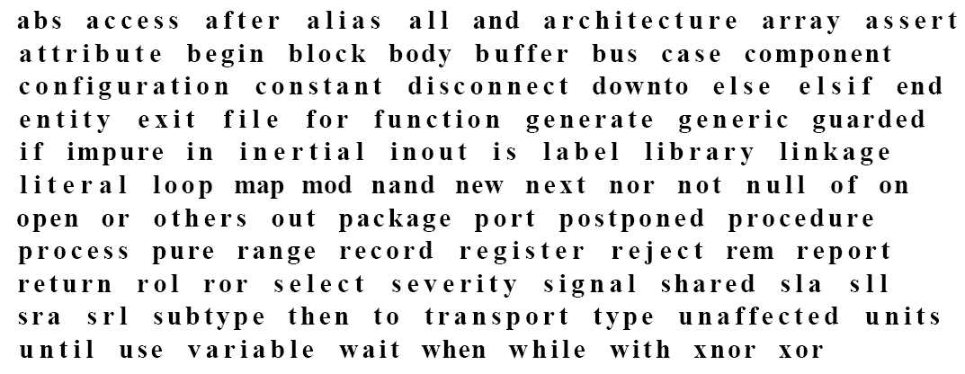
Reserved Words

Slide 15
Numbers, Characters, and Strings
Number:
Integer: 0, 1234, 98E7
Real: 0.0, 1.23456 or 9.87E6
Base 2: 2#101101#
Character:
‘A’, ‘Z’, ‘1’
Strings
“Hello”, “101101”
Note:
0 and ‘0’ are different
2#101101# and “101101” are different

Slide 16
Program Format
VHDL is “free-format”: blank space, tab, new-line (i.e., “white space”) can be freely inserted
The following are the same:
architecture correct of entity_name is
signal x_i : std_logic;
begin
x_i <= a and b;
x <= x_i;
y <= not x_i;
end correct;
architecture correct of entity_name is signal x_i : std_logic; begin x_i <= a and b; x <= x_i; y <= not x_i; end correct;

Slide 17
VHDL Objects

Slide 18
Objects
A named item that hold a value of specific data type
Four kinds of objects
Signal
Variable
Constant
File (cannot be synthesized)
Related construct
Alias

Slide 19
Signal
Declared in the architecture body's declaration section
Signal declaration: signal sig1, sig2, ... : data_type;
Signal assignment: signal_name <= projected_waveform;
Ports in entity declaration are considered as signals
Can be interpreted as wires or “wires with memory” (e.g., FFs, latches etc.)

Slide 20
Variable
Declared and used inside a process
Variable declaration: variable var1, var2, ... : data_type;
Variable assignment: variable_name := value_expression;
Contains no “timing info” (immediate assignment)
Used as in traditional PL: a “symbolic memory location” where a value can be stored and modified
No direct hardware counterpart

Slide 21
Constant
Value cannot be changed
Constant declaration: constant const_name, ... : data_type := value_expression;
Used to enhance readability
constant BUS_WIDTH : integer := 32;
constant BUS_BYTDL : integer := BUS_WIDTH / 8;

Slide 22
Constant Example: Avoid Hard Literals
architecture beh1_arch of even_detector is
signal odd : std_logic;
begin
...
tmp := '0';
for i in 2 downto 0 loop
tmp := tmp xor a(i);
end loop;
Versus
architecture beh1_arch of even_detector is
signal odd : std_logic;
constant BUS_WIDTH : integer := 3;
begin
...
tmp := '0';
for i in (BUS_WIDTH-1) downto 0 loop
tmp := tmp xor a(i);
end loop;
...

Slide 23
Alias
Not an object
Alternative name for an object
Used to enhance readability
signal word : std_logic_vector(15 downto 0);
alias op : std_logic_vector(6 downto 0) is word(15 downto 9);
alias reg1 : std_logic_vector(2 downto 0) is word(8 downto 6);
alias reg2 : std_logic_vector(2 downto 0) is word(5 downto 3);
alias reg3 : std_logic_vector(2 downto 0) is word(2 downto 0);

Slide 24
Data Types and Operators

Slide 25
Data Types and Operators
Standard VHDL
IEEE1164_std_logic package
IEEE numeric_std package

Slide 26
Data Type
Definition of data type
A set of values that an object can assume.
A set of operations that can be performed on objects of this data type.
VHDL is a strongly-typed language
an object can only be assigned with a value of its type
Error: int_var := char_var;
Correct: int_var := to_integer(char_var);
only the operations defined with the data type can be performed on the object

Slide 27
Data Types in Standard VHDL
integer:
Minimal range: -(2^31-1) to 2^31-1
Two subtypes: natural, positive
boolean: (false, true)
bit: ('0', '1')
Not capable enough
bit_vector: a one-dimensional array of bit

Slide 28
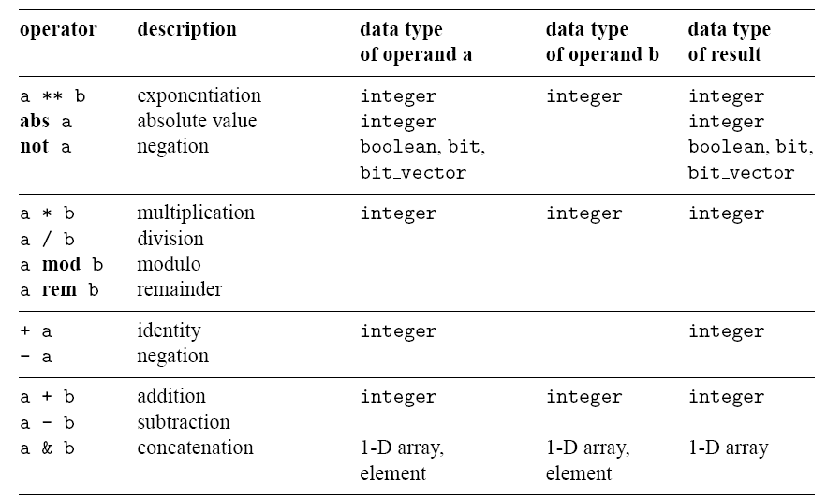
Operators in Standard VHDL

Slide 29
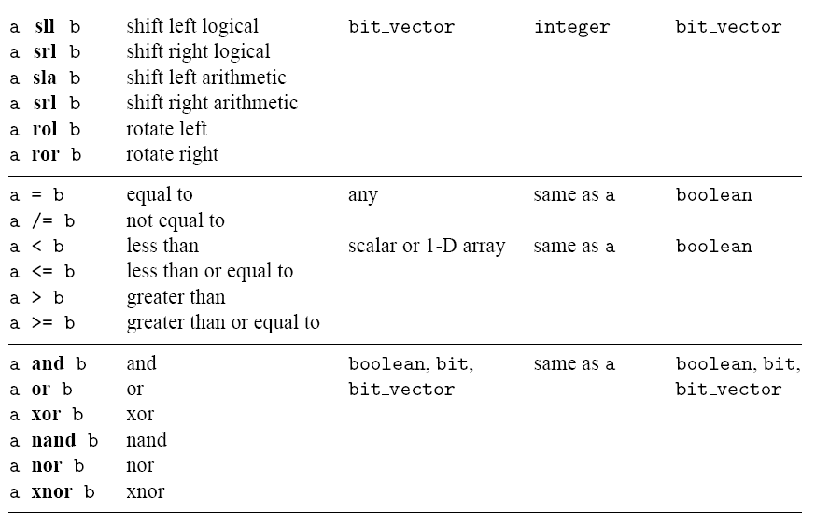
Operators in Standard VHDL

Slide 30
IEEE std_logic_1164 package
What’s wrong with bit?
New data type: std_logic, std_logic_vector
std_logic: 9 values: ('U', 'X', '0', '1', 'Z', 'W', 'L', 'H', '-')
'0', '1': forcing logic 0' and forcing logic 1
'Z': high-impedance, as in a tri-state buffer.
'L' , 'H': weak logic 0 and weak logic 1, as in wired logic
'X', 'W': “unknown” and “weak unknown”
'U': for uninitialized
'-': don't-care.

Slide 31
IEEE std_logic_1164 package
std_logic_vector
an array of elements with std_logic data type
Implies a bus
Example declaration signal a: in std_logic_vector(7 downto 0);
Another form (less desired) signal a: in std_logic_vector(0 to 7);
Need to invoke package to use the data type:
library ieee;
use ieee.std_logic_1164.all;

Slide 32
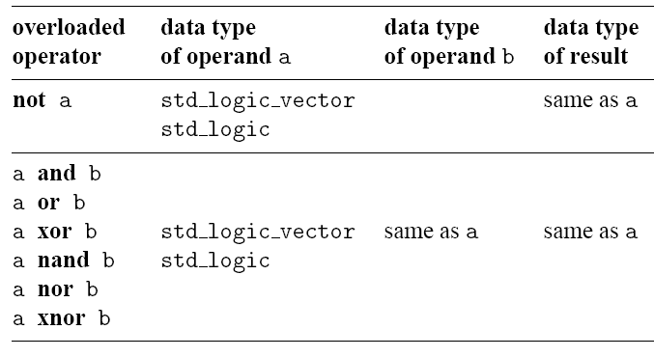
IEEE std_logic_1164 package: Overloaded Operators
Which standard VHDL operators can be applied to std_logic and std_logic_vector?
Overloading: same operator of different data types
Overloaded operators in std_logic_1164 package

Slide 33
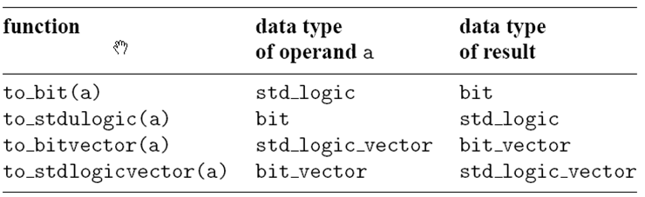
IEEE std_logic_1164 package: Conversion Functions
Provides functions to convert between data types
signal s1, s2, s3 : std_logic_vector(7 downto 0);
signal b1, b2: bit_vector(7 downto 0);
s1 <= to_stdlogicvector(b1);
b2 <= to_bitvector(s1 and s2);
s3 <= to_stdlogicvector(b1) or s2;
s3 <= to_stdlogicvector(b1 or to_bitvector(s2));

Slide 34
Array Data Type Operators
Relational operators for array
operands must have the same element type but their lengths may differ
Two arrays are compared element by element, form the left most element
All following returns true
"011"="011", "011">"010", "011">"00010", "0110">"011“
Concatenation operator (&)
y <= "00" & a(7 downto 2);
y <= a(7) & a(7) & a(7 downto 2);
y <= a(1 downto 0) & a(7 downto 2);

Slide 35
Array Aggregate
Aggregate is a VHDL construct to assign a value to an array-typed object
a <= "10100000";
a <= (7 => '1', 6 => '0', 0 => '0', 1 => '0',
5 => '1', 4 => '0', 3 => '0', 2 =>'1');
a <= (7|5 => '1', 6|4|3|2|1|0 => '0');
a <= (7|5 => '1', others => '0');
a <= "00000000"
a <= (others => '0');

Slide 36
IEEE numeric_std package
How to infer arithmetic operators?
In standard VHDL:
signal a, b, sum: integer;
. . .
sum <= a + b;
What’s wrong with integer data type?

Slide 37
IEEE numeric_std package
IEEE numeric_std package: define integer as a an array of elements of std_logic
Two new data types: unsigned, signed
The array interpreted as an unsigned or signed binary number
signal x, y: signed(15 downto 0);
Need invoke package to use the data type
library ieee;
use ieee.std_logic_1164.all;
use ieee.numeric_std.all;

Slide 38
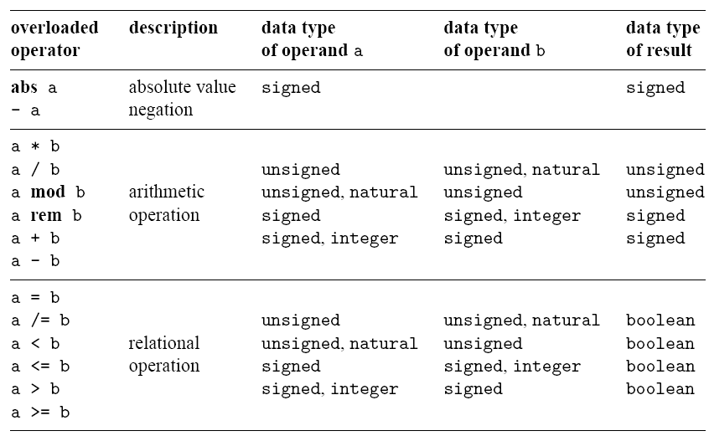
IEEE numeric_std package: Overloaded Operators

Slide 39
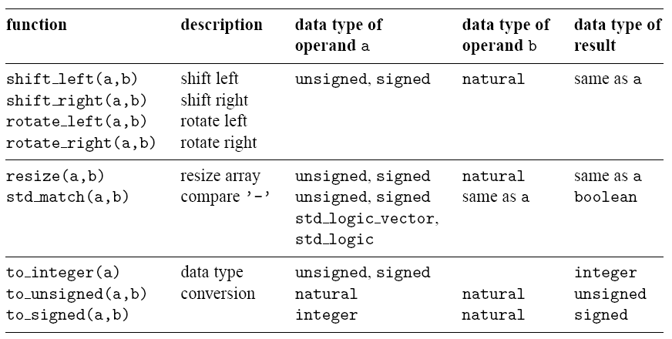
IEEE numeric_std package: New Functions

Slide 40
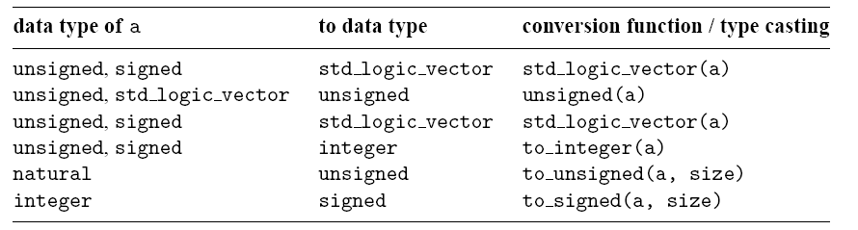
IEEE numeric_std package: Type Conversion
std_logic_vector, unsigned, signed are defined as an array of element of std_logic
They considered as three different data types in VHDL
Type conversion between data types:
type conversion function
Type casting (for “closely related” data types)

Slide 41
Casting vs. Conversion
Type casting (language primitive) is available between related types
bit, std_logic
bit_vector, std_logic_vector, unsigned, signed
integer, natural, positive
Conversion functions (library add-ons) must be used when type casting is not available.
Best Reference: C:\Xilinx\xx.x\ISE_DS\ISE\vhdl\src.

Slide 42
Non-IEEE Package
Packages by Synopsys
std_logic_arith
Similar to numeric_std
New data types: unsigned, signed
Details are different
std_logic_unsigned/std_logic_signed
Treat std_logic_vector as unsigned and signed numbers
Overload std_logic_vector with arith operations
Vendors typically store these packages in the IEEE library
Only one type (unsigned/signed) can be used per VHDL file
unsigned/signed defeat the motivation behind strong typing
Inconsistent implementation between vendors
numeric_std is preferred (required in this class)

Slide 43
Synthesis Guidelines

Slide 44
Guidelines for General VHDL
Use the std_logic_vector and std_logic instead of bit_vector and bit data types
Use the numeric_std package and the unsigned and signed data types for synthensizing arithmetic operations
Only use downto in array specification (e.g., unsigned, signed, std_logic_vector)
Use parentheses to clarify the intended order of operations
Don’t use user-defined types unless there is a compelling reason
Don’t use immediate assignment (i.e., :=) to assign an initial value to a signal
Use operands with identical lengths for the relational operators

Slide 45
Guidelines for VHDL Formatting
Include an information header for each file
Be consistent with the use of case
Use proper spaces, blank lines, and indentations to make the code clear
Add necessary comments
Use symbolic constant names to replace hard literals in VHDL code
Use meaningful names for the identifiers
Use a suffix to indicate a signal’s special property:
_n for active low signals
_i for internal signals (tied to an output signal to make it readable)
Keep the line width within 72 characters so code can be displayed and printed properly by various editors and printers without wrapping

Slide 46
Lesson Outline
Basic VHDL Program
Lexical Elements and Program Format
VHDL Objects
Data Types and Operators
Synthesis Guidelines

