Slide 1

ECE 484 - Advanced Digital Systems Design Lecture 11 – Timing Analysis
HQ U.S. Air Force Academy
I n t e g r i t y - S e r v i c e - E x c e l l e n c e
Capt Michael Tanner Room 2F46A 333-6766
Notes:
Write on board:
ECE 315
Day 1 – Admin
Section Marcher
Introductions
Syllabus

Slide 2
Lesson Outline
Combinational Timing Considerations
Sequential Timing Analysis
Synthesis Guidelines

Slide 3
Combinational Timing Considerations

Slide 4
Combinational Timing Considerations
Propagation delay
Synthesis with timing constraint
Hazards
Delay-sensitive design

Slide 5
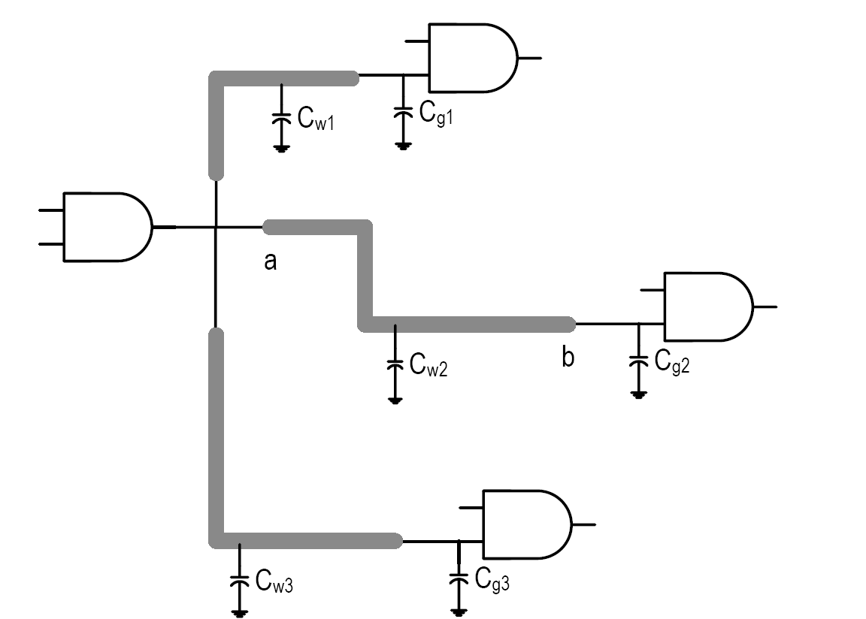

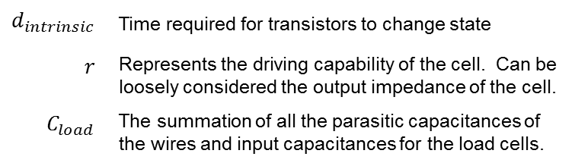
Propagation Delay Overview
Delay – time required to propagate a signal from an input port to a output port
Cell level delay – most accurate
The impact of wire becomes more dominant
$$delay=d_{intrinsic}+r∙C_{load}$$
$$d_{intrinsic}$$ | Time required for transistors to change state
$$r$$ | Represents the driving capability of the cell. Can be loosely considered the output impedance of the cell.
$$C_{load}$$ | The summation of all the parasitic capacitances of the wires and input capacitances for the load cells.

Slide 6
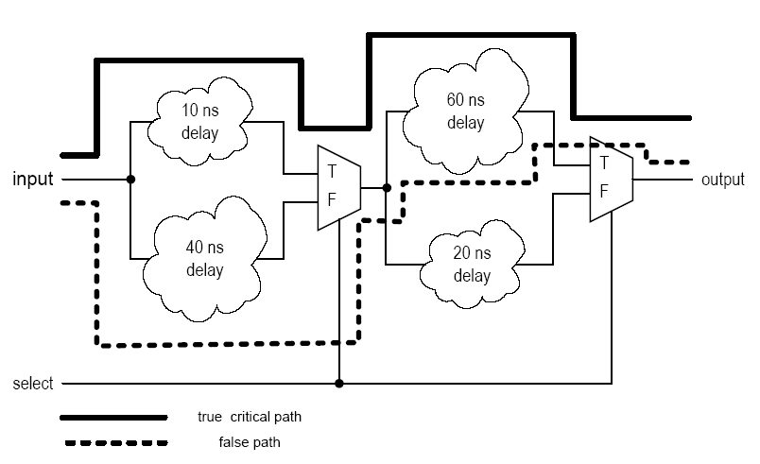
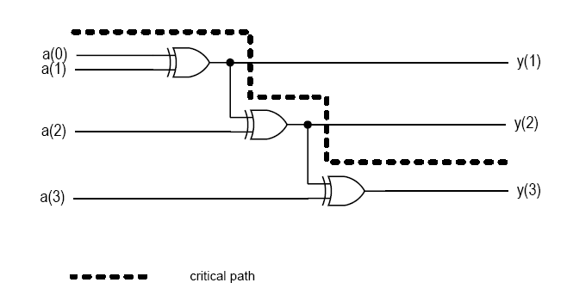
Propagation Delay System Delay
System Delay – the longest path (input to output) in the system
False path – a path along which a signal cannot actually propagate
Difficult if the design is mainly “random” logic
Critical path can be identified if many complex operators (such as adders or multipliers) are used in the design.

Slide 7
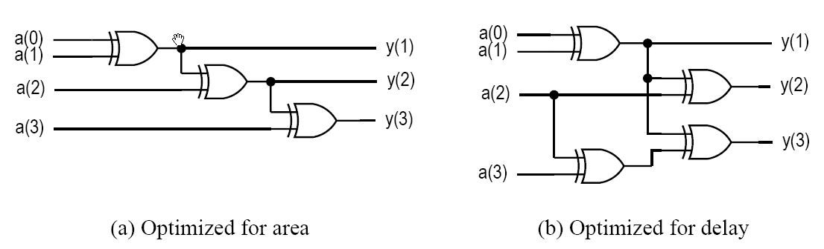
Synthesis with Timing Constraint
Multi-level synthesis is flexible
It is possible to reduce by delay by adding extra logic
Synthesis with timing constraint:
Obtain the minimal-area implementation
Identify the critical path
Reduce the delay by adding extra logic
Repeat 2 & 3 until meeting the constraint

Slide 8
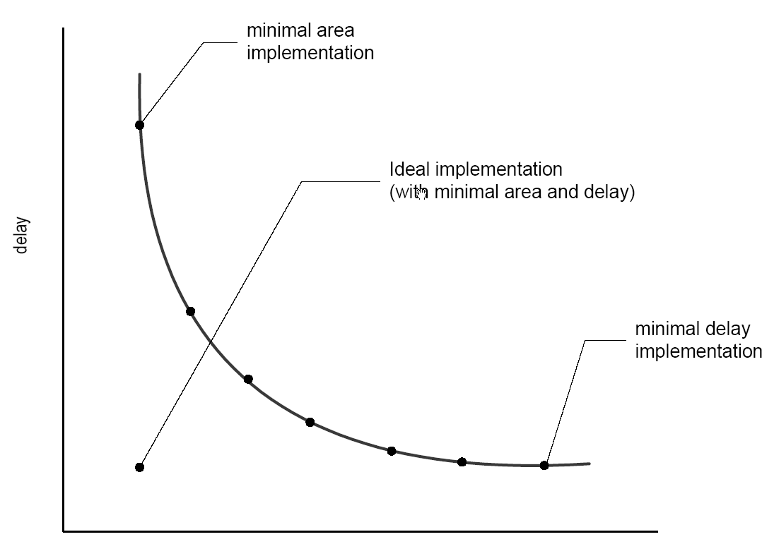
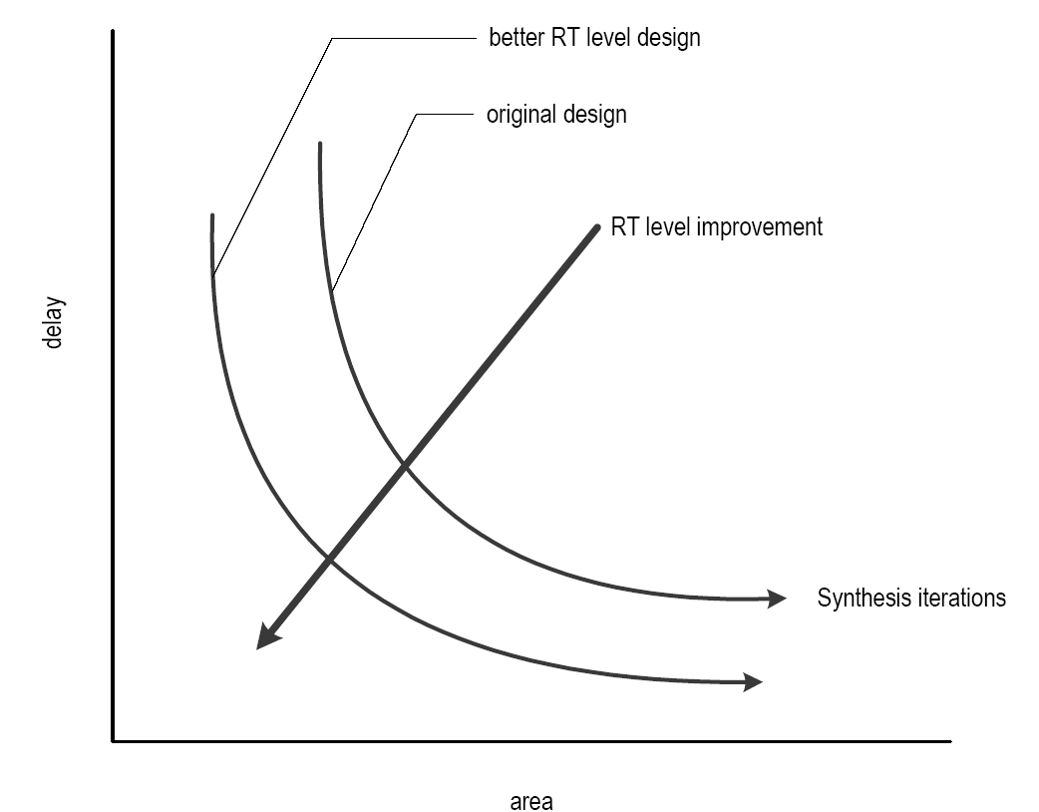
Synthesis with Timing Constraint
Area-Delay Trade-Off Curve
Writing better RTL code

Slide 9
Timing Hazards
Propagation delay – time to obtain a stable output
Hazards – the fluctuation occurring during the transient period
Static hazard – glitch when the signal should be stable
Dynamic hazard – a glitch in transition
Due to the multiple converging paths of an output port

Slide 10
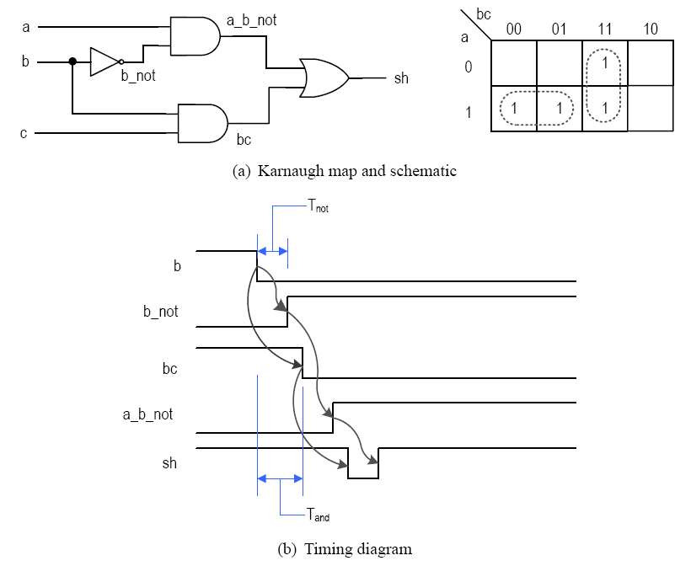
Timing Hazards Static Hazard
a = c = 1

Slide 11
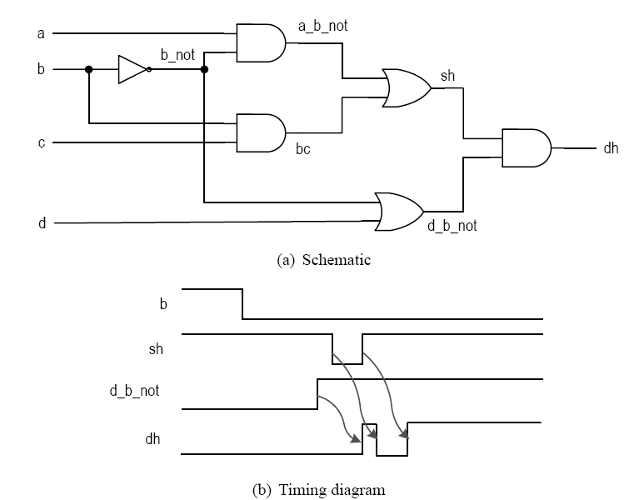
Timing Hazards Dynamic Hazard
a = c = d = 1

Slide 12
Timing Hazards Dealing With Hazards
Some hazards can be eliminated in theory (e.g., use redundant K-map terms)
Eliminating glitches is very difficult in reality, and almost impossible for synthesis
Multiple inputs can change simultaneously (e.g., 1111 → 0000 in a counter)
During logic synthesis, the logic expressions will be rearranged and optimized.
During technology mapping, generic gates will be re-mapped
During placement & routing, wire delays may change
How to deal with it?
Ignore glitches in the transient period and retrieve the data after the signal is stabilized
Synchronous Design! – but now we have to deal with setup and hold time constraints

Slide 13
Sequential Timing Analysis

Slide 14
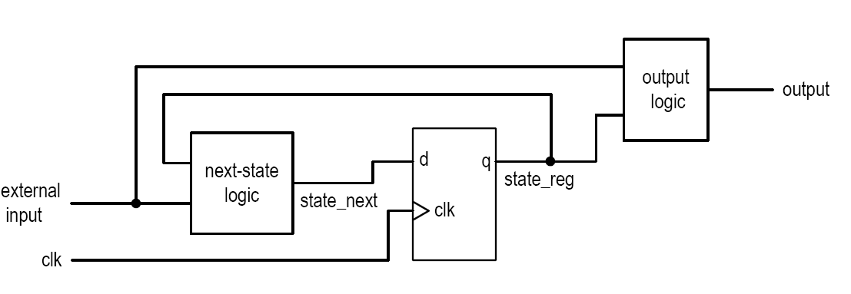
Sequential Timing Analysis
Combinational Circuit – characterized by propagation delay
Sequential Circuit
Has to satisfy setup/hold time constraints
Characterized by maximal clock rate (e.g., 200 MHz Counter, 3.4 GHz Intel Core i7)
Embedded in clock rate
Setup time
clock-to-Q delay of a register
Propagation delay of next-state logic

Slide 15
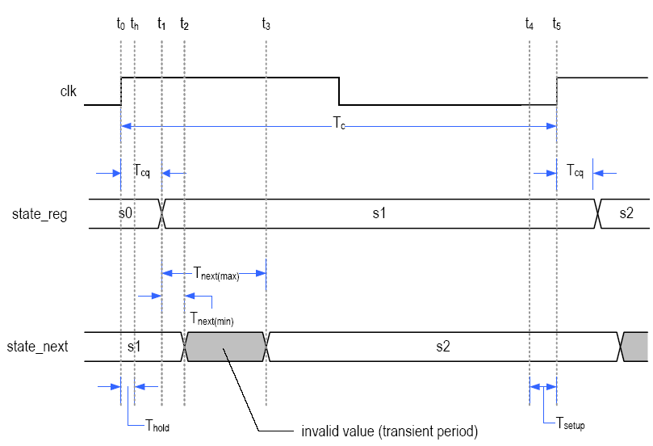
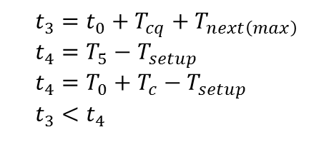
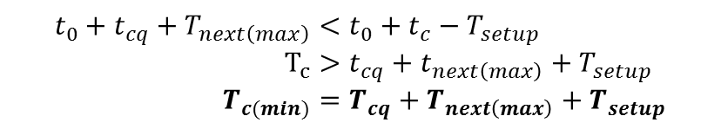
Sequential Timing Analysis Setup Time Violation
$$t_{3}=t_{0}+T_{cq}+T_{next\left(max\right)} \\ t_{4}=T_{5}−T_{setup} \\ t_{4}=T_{0}+T_{c}−T_{setup} \\ t_{3}<t_{4}$$
$$t_{0}+t_{cq}+T_{next\left(max\right)}<t_{0}+t_{c}−T_{setup} \\ T_{c}>t_{cq}+t_{next\left(max\right)}+T_{setup} \\ T_{c(min)}=T_{cq}+T_{next\left(max\right)}+T_{setup}$$
To Avoid Setup Time Violation

Slide 16
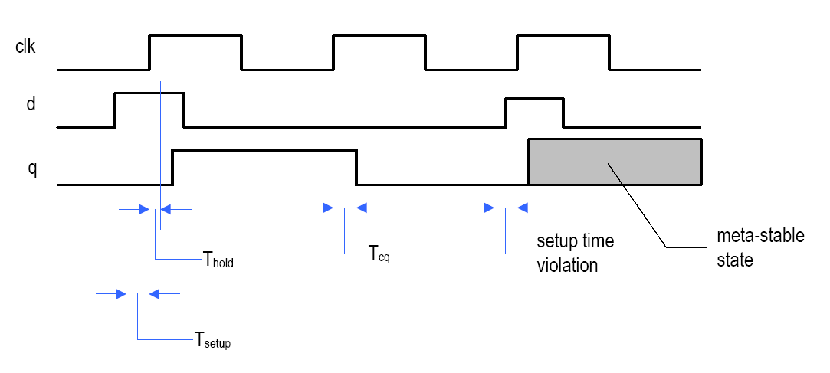
Sequential Timing Analysis Setup Time Violation - Consequences

Slide 17
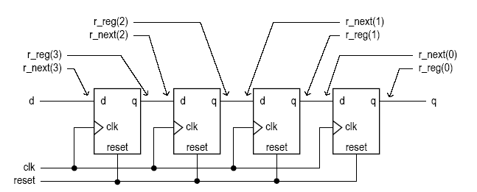
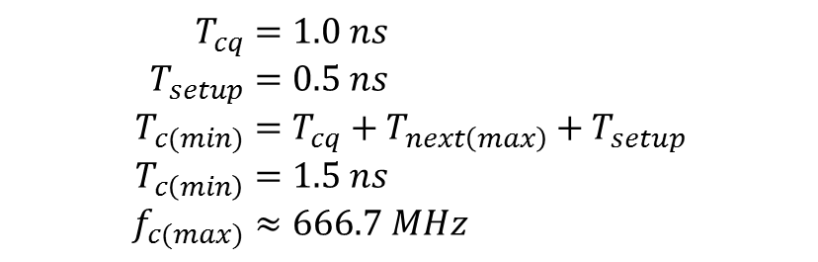
Sequential Timing Analysis Shift Register Example
$$T_{cq}=1.0 ns \\ T_{setup}=0.5 ns \\ T_{c(min)}=T_{cq}+T_{next\left(max\right)}+T_{setup} \\ T_{c\left(min\right)}=1.5 ns \\ f_{c(max)}≈666.7 MHz$$

Slide 18
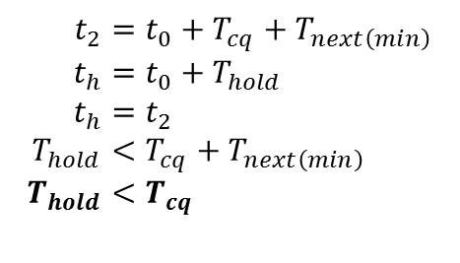
Sequential Timing Analysis Hold Time Violation
$$t_{2}=t_{0}+T_{cq}+T_{next\left(min\right)} \\ t_{h}=t_{0}+T_{hold} \\ t_{h}=t_{2} \\ T_{hold}<T_{cq}+T_{next\left(min\right)} \\ T_{hold}<T_{cq}$$
To Avoid Hold Time Violation
$∴$ We do not need to worry about hold time requirement unless the clock edge does not arrive at all Flip Flops at the same time.

Slide 19

Sequential Timing Analysis Output Delay
$$T_{co}=T_{cq}+T_{output}$$

Slide 20
Synthesis Guidelines

Slide 21
Synthesis Guidelines
Strictly follow the synchronous design methodology (i.e., all registers in a system should be synchronized by a common clock signal).
Isolate the memory components from the VHDL description and code them in a separate segment. One-segment coding style is not advisable.
The memory components should be coded clearly so that a predesigned cell can be inferred from the device library.
Avoid synthesizing a memory component from scratch.
Asynchronous reset, if used, should be only for system initialization. It should not be used to clear the registers during regular operation.
Unless there is a compelling reason, a variable should not be used to infer a memory component.

Slide 22
Lesson Outline
Combinational Timing Considerations
Sequential Timing Analysis
Synthesis Guidelines

