Slide 1

ECE 484 - Advanced Digital Systems Design Lecture 4 – Combinational Circuits in VHDL
HQ U.S. Air Force Academy
I n t e g r i t y - S e r v i c e - E x c e l l e n c e
Capt Michael Tanner Room 2F46A 333-6766
Notes:
Write on board:
ECE 315
Day 1 – Admin
Section Marcher
Introductions
Syllabus

Slide 2
Lesson Outline
Combinational vs. Sequential Circuits
Simple Signal Assignment
Conditional Signal Assignment
Selected Signal Assignment
Conditional vs. Selected Signal Assignment
Synthesis Guidelines

Slide 3
Combinational vs. Sequential Circuits

Slide 4
Combinational vs. Sequential Circuits
Combinational circuit:
No internal state
Output is a function of inputs only
No latches/FFs or closed feedback loop
Sequential circuit:
With internal state
Output is a function of inputs and internal state
Sequential circuit to be discussed later

Slide 5
Simple Signal Assignment

Slide 6
Simple Signal Assignment
Simple signal assignment is a special case of conditional signal assignment
Syntax: signal_name <= projected_waveform; y <= a + b + 1 after 10 ns;
Timing info ignored in synthesis and δ-delay is used: signal_name <= value_expression;

Slide 7
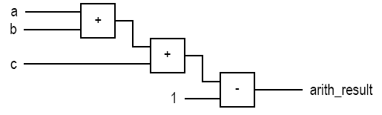
Simple Signal Assignment
Example simple signal assignments
status <= '1';
even <= (p1 and p2) or (p3 and p4);
arith_out <= a + b + c - 1;
Implementation of last statement:

Slide 8
BAD: Simple Assignment with Closed Feedback Loop
A signal appears in both sides of a concurrent assignment statement q <= ((not q) and (not en)) or (d and en);
Syntactically correct
Forms a closed feedback loop (i.e., infinite loop)
Should be avoided

Slide 9
Conditional Signal Assignment

Slide 10
Conditional Signal Assignment
Syntax
Examples
Conceptual implementation
signal_name
<= value_expr_1 when boolean_expr_1 else
value_expr_2 when boolean_expr_2 else
value_expr_3 when boolean_expr_3 else
. . .
value_expr_n

Slide 11
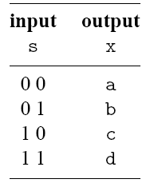
Example: 4-to-1 Multiplexer
library ieee;
use ieee.std_logic_1164.all;
entity mux4 is
port(
a,b,c,d: in std_logic_vector(7 downto 0);
s: in std_logic_vector(1 downto 0);
x: out std_logic_vector(7 downto 0)
);
end mux4;
architecture cond_arch of mux4 is
Begin
x <= a when (s="00") else
b when (s="01") else
c when (s="10") else
d;
end cond_arch;

Slide 12
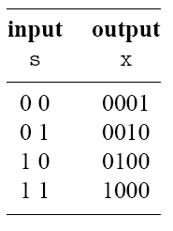
Example: 2-to-2² Binary Decoder
library ieee;
use ieee.std_logic_1164.all;
entity decoder4 is
port(
s: in std_logic_vector(1 downto 0);
x: out std_logic_vector(3 downto 0)
);
end decoder4;
architecture cond_arch of decoder4 is
begin
x <= "0001" when (s="00") else
"0010" when (s="01") else
"0100" when (s="10") else
"1000";
end cond_arch;

Slide 13
Conceptual Implementation
Syntax:
signal_name
<= value_expr_1 when boolean_expr_1 else
value_expr_2 when boolean_expr_2 else
value_expr_3 when boolean_expr_3 else
. . .
value_expr_n
Evaluation in ascending order
Achieved by “priority-routing network”
Top value expression has a “higher priority”

Slide 14
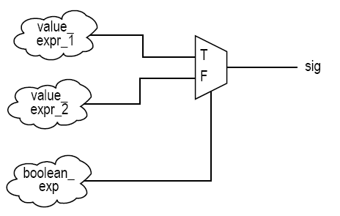
2-to-1 Mux Implementation
signal_name <= value_expr_1 when boolean_expr_1 else
value_expr_2

Slide 15
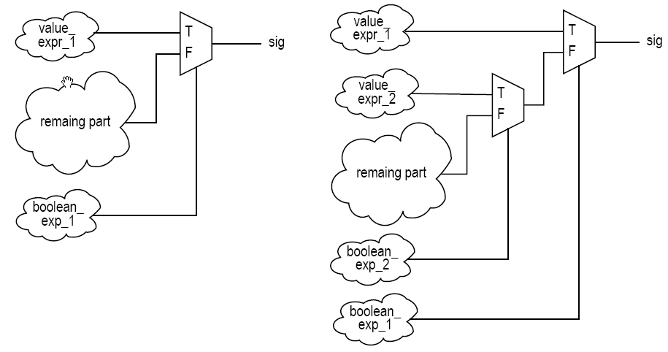
Cascaded Mux Implementation
signal_name <= value_expr_1 when boolean_expr_1 else
value_expr_2 when boolean_expr_2 else
value_expr_3 when boolean_expr_3 else
value_expr_4

Slide 16
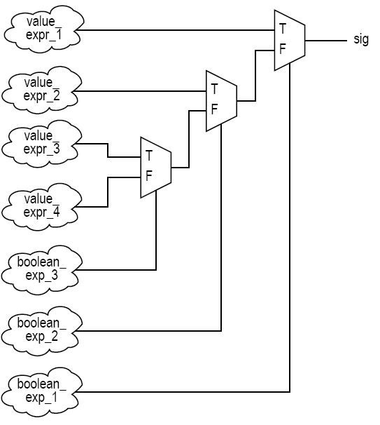
Cascaded Mux Implementation

Slide 17
Selected Signal Assignment

Slide 18
Selected Signal Assignment
Syntax
Examples
Conceptual implementation
select_expression
Discrete type or 1-D array
With finite possible values
choice_i
A value of the data type
Choices must be
mutually exclusive
all inclusive
others can be used as last choice_i
with select_expression select
sig_name <= expr_1 when choice_1,
expr_2 when choice_2,
expr_3 when choice_3,
. . .
expr_n when choice_n;

Slide 19
Example: 4-to-1 Multiplexer
architecture sel_arch of mux4 is
begin
with s select
x <= a when "00",
b when "01",
c when "10",
d when others;
end sel_arch;
Question: Can ‘when “11”’ be used to replace the ‘when others’ statement?

Slide 20
Example: 2-to-2² Decoder
architecture sel_arch of mux4 is
begin
with s select
x <= "0001" when "00",
"0010" when "01",
"0100" when "10",
“1000" when others;
end sel_arch;

Slide 21
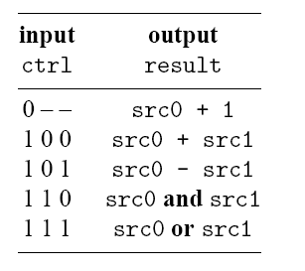
Example: Simple ALU
architecture sel_arch of simple_alu is
signal sum: std_logic_vector(7 downto 0);
signal diff: std_logic_vector(7 downto 0);
signal inc: std_logic_vector(7 downto 0);
begin
inc <= std_logic_vector(
signed(src0) + 1 );
sum <= std_logic_vector(
signed(src0) + signed(src1) );
diff <= std_logic_vector(
signed(src0) - signed(src1) );
with ctrl select
result <= inc when "000"|"001"|"010"|"011",
sum when "100",
diff when "101",
src0 and src1 when "110",
src0 or src1 when others; -- "111“
end sel_arch;
Question: Can “0--” be used to replace the first statement?

Slide 22
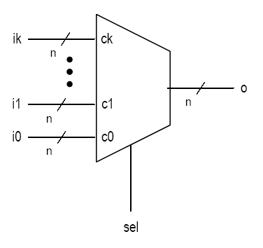
Conceptual Implementation
Achieved by a multiplexing circuit
Abstract (k+1)-to-1 multiplexer
sel is with a data type of (k+1) values: c0, c1, c2, . . . , ck
select_expression is with a data type of 5 values: c0, c1, c2, c3, c4
with select_expression select
sig <= value_expr_0 when c0,
value_expr_1 when c1,
value_expr_n when others;

Slide 23
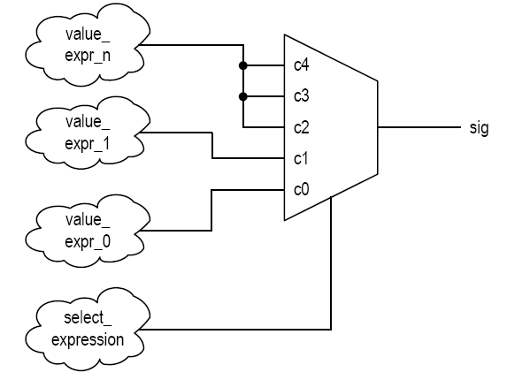
Conceptual Implementation

Slide 24
Conditional vs. Selected Signal Assignment

Slide 25
Conditional vs. Selected Signal Assignment
Conversion between conditional vs. selected signal assignment
Comparison

Slide 26
Conversion: Selected → Conditional
with sel select
sig <= value_expr_0 when c0,
value_expr_1 when c1|c3|c5,
value_expr_2 when c2|c4,
value_expr_n when others;
sig <=
value_expr_0 when (sel=c0) else
value_expr_1 when (sel=c1) or (sel=c3) or (sel=c5) else
value_expr_2 when (sel=c2) or (sel=c4) else value_expr_n;

Slide 27
Conversion: Conditional → Selected
sig <= value_expr_0 when bool_expr_0 else
value_expr_1 when bool_expr_1 else
value_expr_2 when bool_expr_2 else
value_expr_n;
sel(2) <= '1' when bool_exp_0 else '0';
sel(1) <= '1' when bool_exp_1 else '0';
sel(0) <= '1' when bool_exp_2 else '0';
with sel select
sig <= value_expr_0 when "100"|"101"|"110"|"111",
value_expr_1 when "010"|"011",
value_expr_2 when "001",
value_expr_n when others,

Slide 28
Conditional vs. Selected Comparison
Selected signal assignment:
Good match for a circuit described by a functional table
Example: binary decoder, multiplexer
Less effective if input pattern is given a preferential treatment
Conditional signal assignment:
good match for a circuit a circuit that needs to give preferential treatment for certain conditions or to prioritize the operations
Example: priority encoder
May “over-specify” for a functional table based circuit.
Can handle complicated conditions.
pc_next <=
pc_reg + offset when (state=jump and a=b) else
pc_reg + 1 when (state=skip and flag='1') else
...

Slide 29
Synthesis Guidelines

Slide 30
Synthesis Guidelines
Avoid a closed feedback loop in a concurrent signal assignment statement.
Think of the conditional signal assignment and selected signal assignment statements as routing structures rather than sequential control constructs.
The conditional signal assignment statement infers a priority routing structure, and a larger number of when clauses leads to a long cascading chain.
The selected signal assignment statement infers a multiplexing structure, and a large number of choices leads to a wide multiplexer.

Slide 31
Lesson Outline
Combinational vs. Sequential Circuits
Simple Signal Assignment
Conditional Signal Assignment
Selected Signal Assignment
Conditional vs. Selected Signal Assignment
Synthesis Guidelines

