Slide 1

ECE 484 - Advanced Digital Systems Design Lecture 5 – Sequential Circuits in VHDL
HQ U.S. Air Force Academy
I n t e g r i t y - S e r v i c e - E x c e l l e n c e
Capt Michael Tanner Room 2F46A 333-6766
Notes:
Write on board:
ECE 315
Day 1 – Admin
Section Marcher
Introductions
Syllabus

Slide 2
Lesson Outline
VHDL process
Synchronous Circuit (Chapter 8)
Sequential Signal Assignment Statement
Variable Assignment Statement
if Statement
case Statement
Simple for Loop Statement

Slide 3
VHDL Process

Slide 4
VHDL process
Contains a set of sequential statements to be executed sequentially
The whole process is a concurrent statement
Can be interpreted as a circuit part enclosed inside of a black box
May or may not be able to be mapped to physical hardware
Two types of process statements
A process with a sensitivity list
A process with wait statement

Slide 5
VHDL process With Sensitivity List
A process is like a circuit part, which can be
active (known activated)
inactive (known as suspended).
A process is activated when a signal in the sensitivity list changes its value
Its statements will be executed sequentially until the end of the process
For a combinational circuit, all input should be included in the sensitivity list
process (sensitivity_list) is
declarations;
begin
sequential statement;
sequential statement;
...
end process;
process (a, b, c) is
begin
y <= a and b and c; end process;

Slide 6
VHDL process With wait Statement
Process has no sensitivity list
Process continues the execution until a wait statement is reached and then suspended
Forms of wait statement:
wait on signals;
wait until boolean_expression;
wait for time_expression;
A process can has multiple wait statements
Process with sensitivity list is preferred for synthesis
process is
begin
y <= a and b and c;
wait on a, b, c;
end process;

Slide 7
Synchronous Circuit (Chapter 8)

Slide 8
Synchronous Circuit (Chapter 8)
One of the most difficult design aspects of a sequential circuit: How to satisfy the timing constraints
The Big idea: Synchronous methodology
Group all D FFs together with a single clock: Synchronous methodology
Only need to deal with the timing constraint of one memory element

Slide 9
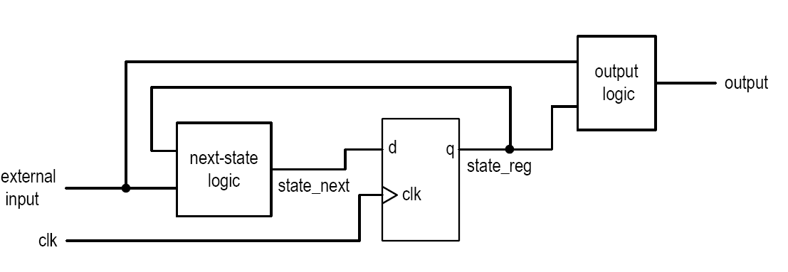
Synchronous Circuit (Chapter 8)
Basic block diagram
State register (memory elements)
Next-state logic (combinational circuit)
Output logic (combinational circuit)
Operation
At the rising edge of the clock, state_next sampled and stored into the register (and becomes the new value of state_reg
The next-state logic determines the new value (new state_next) and the output logic generates the output
At the rising edge of the clock, the new value of state_next sampled and stored into the register
Glitches have no effect as long as the state_next is stabled at the sampling edge

Slide 10
D Latch
process (c, d, q_latch) is
begin
if (c = ‘1’) then
q_latch <= d;
else
q_latch <= q_latch;
end if;
q <= q_latch;
end process;

Slide 11
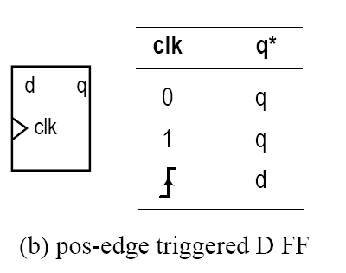
D Flip Flop
process (clk) is
begin
if (reset = ‘1’) then
q <= ‘0’;
elsif rising_edge(clk) then
q <= d;
end if;
end process;
process (clk) is
begin
if (reset = ‘1’) then
q <= ‘0’;
elsif falling_edge(clk) then
q <= d;
end if;
end process;
Note: You can use std_logic_vector for d and q.

Slide 12
Sequential Signal Assignment Statement

Slide 13
Simple Signal Assignment
Syntax
signal_name <= value_expression;
Syntax is identical to the simple concurrent signal assignment
Caution: Inside a process, a signal can be assigned multiple times, but only the last assignment takes effect
A signal can only be set in one process or combinational statement.
process (a, b, c, d) is
begin
y <= a or c;
y <= a and b;
y <= c and d; end process;
process (a, b, c, d) is
begin
y <= c and d; end process;
Equivalent
What would happen if the three statements were concurrent statements?

Slide 14
Variable Assignment Statement

Slide 15
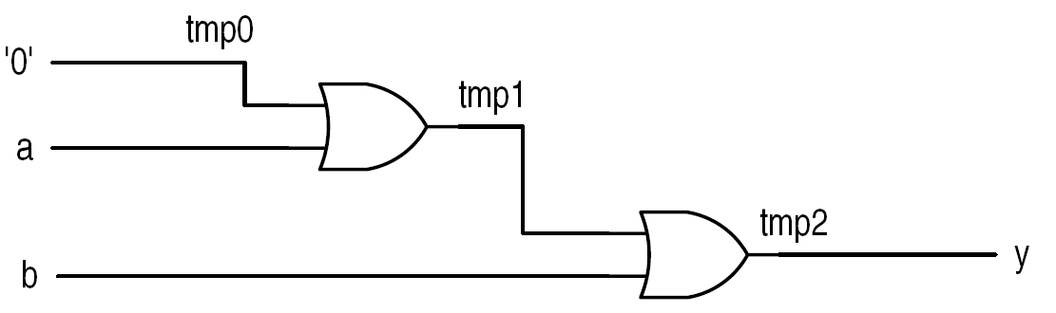
Variable Assignment Statement
Syntax
variable_name := value_expression;
Assignment takes effect immediately
No time dimension (i.e., no delay)
Behave like variables in C
Difficult to map to hardware (depending on context)
process (a, b, c) is
variable tmp : std_logic;
begin
tmp := ‘0';
tmp := tmp or a;
tmp := tmp or b;
y <= tmp; end process;

Slide 16
if Statement

Slide 17
if Statement
Syntax
Examples
Comparison to conditional signal assignment
Incomplete branch and incomplete signal assignment
Conceptual Implementation
if bool_expr_1 then
sequential_statements; elsif bool_expr_2 then
sequential_statements;
...
else
sequential_statements;
end if;

Slide 18
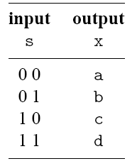
4-to-1 Mulitplexer
architecture if_arch of mux4 is
begin
process (a, b, c, d, s) is
begin
if (s = "00") then
x <= a;
elsif (s = "01") then
x <= b;
elsif (s = "10") then
x <= c;
else
x <= d;
end if;
end process;
end if_arch;

Slide 19
Comparison to Conditional Signal Assignment
Two statements are the same if there is only one output signal in if statement
if statement is more flexible
Sequential statements can be used in then, elsif and else branches:
Multiple statements
Nested if statements

Slide 20
Incomplete Branch and Incomplete Signal Assignment
According to VHDL definition:
Only the then branch is required; elsif and else branches are optional
Signals do not need to be assigned in all branch
When a signal is unassigned due to omission, it keeps the “previous value” (implying “memory” – latch/FF)
process (a, b) is
begin
if (a = b) then
eq <= ‘1';
end if;
end process;
process (a, b) is
begin
if (a = b) then
eq <= ‘1';
else
eq <= eq;
end if;
end process;
process (a, b) is
begin
if (a = b) then
eq <= ‘1';
else
eq <= ‘0';
end if;
end process;
Implies
Fix
Incomplete Branch

Slide 21
Incomplete Branch and Incomplete Signal Assignment
process (a, b) is
begin
if (a = b) then
lt <= lt;
eq <= eq;
gt <= '1';
elsif (a = b) then
lt <= lt;
eq <= '1';
gt <= gt;
else
lt <= '1';
eq <= eq;
gt <= gt;
end if;
end process;
process (a, b) is
begin
lt <= '0';
eq <= '0';
gt <= '0';
if (a = b) then
gt <= '1';
elsif (a = b) then
eq <= '1';
else
lt <= '1';
end if;
end process;
process (a, b) is
begin
if (a = b) then
gt <= '1';
elsif (a = b) then
eq <= '1';
else
lt <= '1';
end if;
end process;
Implies
Fix
Incomplete Signal Assignment

Slide 22
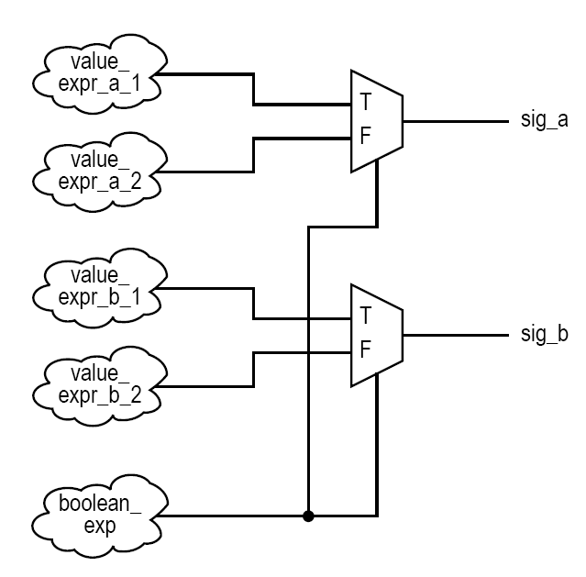
Conceptual Implementation
Same as conditional signal assignment statement if the if statement consists of
One output signal
One sequential signal assignment in each branch
Multiple sequential statements can be constructed recursively
if (boolean_expr) then
sig_a <= value_expr_a_1;
sig_b <= value_expr_b_1;
else
sig_a <= value_expr_a_2;
sig_b <= value_expr_b_2;
end if;

Slide 23
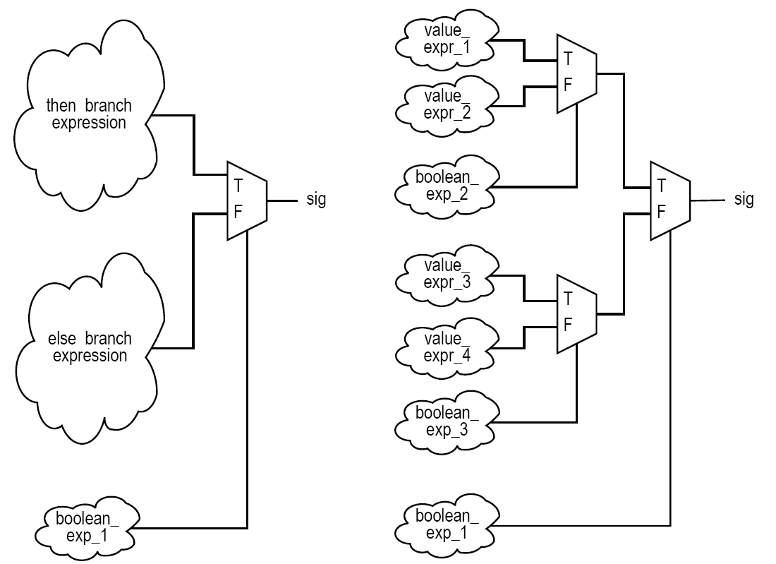
Conceptual Implementation
if (boolean_expr_1) then
if (boolean_expr_2) then
sig <= value_expr_1;
else
sig <= value_expr_2;
end if;
else
if (boolean_expr_3) then
sig <= value_expr_3;
else
sig <= value_expr_4;
end if;
end if;

Slide 24
case Statement

Slide 25
case Statement
Syntax
Examples
Comparison to selected signal assignment statement
Incomplete signal assignment
Conceptual Implementation
case case_expr is
when choice_1 =>
sequential_statements;
...
when choice_n =>
sequential_statements;
end case;

Slide 26
4-to-1 Multiplexer
architecture case_arch of mux4 is
begin
process (a, b, c, d, s) is
begin
case s is
when "00" =>
x <= a;
when "01" =>
x <= b;
when "10" =>
x <= c;
when others =>
x <= d;
end case;
end process;
end case_arch;

Slide 27
Comparison to Selected Signal Assignment
Two statements are the same if there is only one output signal in case statement
case statement is more flexible
Sequential statements can be used in choice branches
case sel_expr is
when choice_1 =>
sig <= value_expr_1;
when choice_2 =>
sig <= value_expr_2;
...
when choice_n =>
sig <= value_expr_n;
end case;
with sel_expr select
sig <= value_expr_1 when choice_1,
value_expr_2 when choice_2,
...
value_expr_n when choice_n;

Slide 28
Incomplete Signal Assignment
According to VHDL definition:
Signals do not need to be assigned in all choice branch
When a signal is unassigned, it keeps the “previous value” (implying “memory”)
Note: This is nearly identical to the issue with incomplete signal assignment for if statements. See that slide for description of problem and how to fix it.

Slide 29
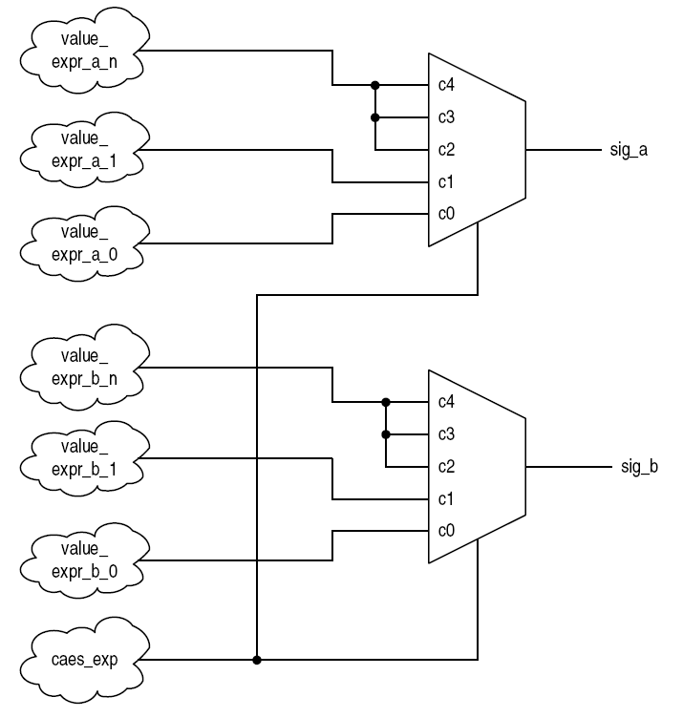
Conceptual Implementation
Same as selected signal assignment statement if the case statement consists of
One output signal
One sequential signal assignment in each branch
Multiple sequential statements can be constructed recursively
case case_exp is
when c0 =>
sig_a <= value_expr_a_0;
sig_b <= value_expr_b_0;
when c1 =>
sig_a <= value_expr_a_1;
sig_b <= value_expr_b_1;
when others =>
sig_a <= value_expr_a_n;
sig_b <= value_expr_b_n;
end case;

Slide 30
Simple for Loop Statement

Slide 31
Simple for Loop Statement
Syntax
VHDL provides a variety of loop constructs
Only a restricted form of loop can be synthesized
loop_range must be static
index assumes value of loop_range from left to right
Examples
Conceptual Implementation
for index in loop_range loop
sequential_statements;
end loop;

Slide 32
Reduced xor Example
library ieee;
use ieee.std_logic_1164.all;
entity reduced_xor_demo is
port(
a : in std_logic_vector(3 downto 0);
y : out std_logic
);
end reduced_xor_demo;
architecture demo_arch of reduced_sor_demo is
constant WIDTH : integer := 4;
signal tmp : std_logic_vector(WIDTH-1 downto 0);
begin
process (a, tmp) is
begin
tmp(0) <= a(0); -- Boundary bit
for i in 1 to (WIDTH-1) loop
tmp(i) <= a(i) xor tmp(i-1);
end loop;
end process;
y <= tmp(WIDTH-1);
end demo_arch;

Slide 33
Conceptual Implementation
“Unroll” the loop
for loop should be treated as “shorthand” for repetitive statements
Previous Example: reduced xor
tmp(0) <= a(0);
...
tmp(1) <= a(1) xor tmp(0);
tmp(2) <= a(2) xor tmp(1);
tmp(3) <= a(3) xor tmp(2); ...
y <= tmp(3);

Slide 34
Synthesis Guidelines

Slide 35
Synthesis of Sequential Statements
Concurrent statements
Modeled after hardware
Have clear, direct mapping to physical structures
Sequential statements
Intended to describe “behavior”
Flexible and versatile
Can be difficult to be realized in hardware
Can be easily abused
Think hardware
Designing hardware is not converting a C program to a VHDL program

Slide 36
Synthesis Guidelines: Sequential Statements
Variables should be used with care. A signal is generally preferred. A statement like n := n + 1; can cause great confusion for synthesis.
Except for the default value, avoid overriding a signal multiple times in a process.
Think of the if and case statements as routing structures rather than sequential control constructs.
An if statement infers a priority routing structure, and a larger number of elsif branches leads to a long cascading chain.
A case statement infers a multiplexing structure, and a large number of choices leads to a wide multiplexer.
Think of a for loop statement as a mechanism to describe the replicated structure.
Avoid “innovative” use of language constructs. We should be innovative about the hardware architecture, but not about the description of the architecture. Synthesis software may not be able to interpret the intention of the code.

Slide 37
Synthesis Guidelines: Combinational Circuits
For a combinational circuit, include all input signals in the sensitivity list to avoid unexpected behavior.
For a combinational circuit, include all branches of an if statement to avoid an unwanted latch.
For a combinational circuit, an output signal should be assigned in every branch of the if and case statements to avoid an unwanted latch.
For a combinational circuit, it is good practice to assign a default value to each signal at the beginning of the process.

Slide 38
Lesson Outline
VHDL process
Synchronous Circuit (Chapter 8)
Sequential Signal Assignment Statement
Variable Assignment Statement
if Statement
case Statement
Simple for Loop Statement

