Slide 1

ECE 484 - Advanced Digital Systems Design Lecture 6 – Writing VHDL Test Benches
HQ U.S. Air Force Academy
I n t e g r i t y - S e r v i c e - E x c e l l e n c e
Capt Michael Tanner Room 2F46A 333-6766
Notes:
Write on board:
ECE 315
Day 1 – Admin
Section Marcher
Introductions
Syllabus

Slide 2
Lesson Outline
Test Bench Overview
VHDL Tools: record, array, assert, wait
VHDL File I/O
and Gate Test Bench Examples

Slide 3
Test Bench Overview

Slide 4
Test Bench Overview
Simulate circuit behavior and verify functionality
Simulated therefore full VHDL language available – not just the synthensizeable subset
Basic test bench: view/verify waveforms
Simple to learn and implement
Tedious because it requires “man in the loop”
“Real World” test bench: automatic
More difficult to learn in implement
Completely automated test with result summary

Slide 5
Simulation Clock Generation
signal clk : std_logic := 'U';
constant clk_period : time := 20 ns;
...
process is
begin
clk <= '0';
wait for clk_period / 2;
clk <= '1';
wait for clk_period / 2;
end process;
signal clk : std_logic := ‘0';
constant clk_period : time := 20 ns;
...
clk <= not clk after clk_period / 2;

Slide 6
Self-Checking Testbench and2 gate
architecture sim of tb is
...
begin
dut: entity work.and2 port map(a, b, y);
process begin
a <= '0'; b <= '0'; wait for 10 ns;
assert y = '0' report "000 failed";
a <= '0'; b <= '1'; wait for 10 ns;
assert y = '0' report "001 failed";
...
end process;
end sim;
How do we handle multiple outputs?

Slide 7
Self-Checking Testbench DFF
architecture sim of tb is
signal clk : std_logic := ‘0';
constant clk_period : time := 20 ns;
signal d, q : std_logic := ‘U';;
begin
dut: entity work.dff port map(clk, d, q);
clk <= not clk after clk_period / 2;
process begin
wait for clk_period / 4;
d <= '0'; wait for clk_period;
assert q = '0' report "TV0 failed";
d <= '1'; wait for clk_period;
assert q = '1' report "TV1 failed";
end process;
end sim;

Slide 8
Verification of Large Designs

Slide 9
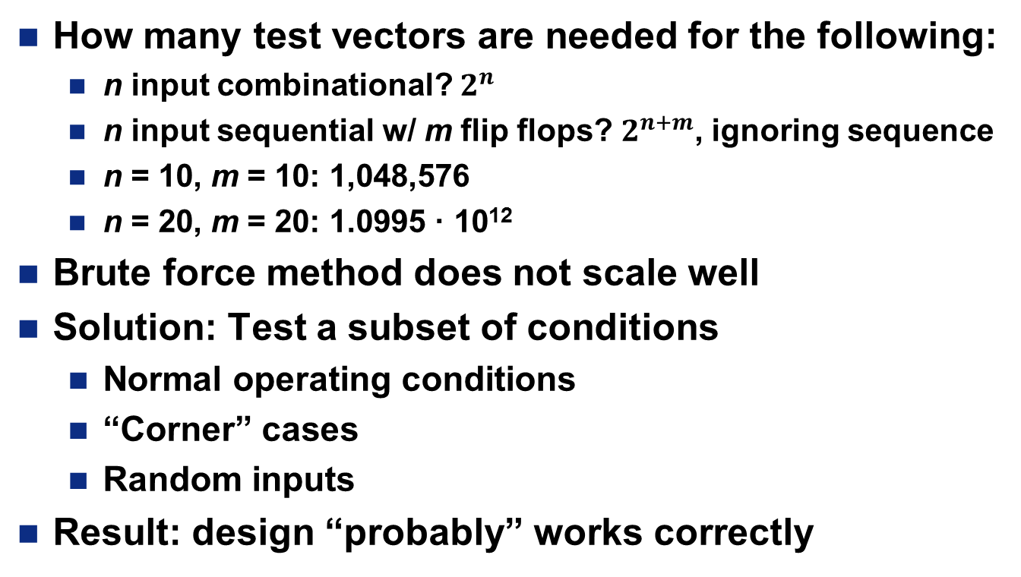
Verification of Large Designs
How many test vectors are needed for the following:
n input combinational? $2^{n}$
n input sequential w/ m flip flops? $2^{n+m}$, ignoring sequence
n = 10, m = 10: 1,048,576
n = 20, m = 20: 1.0995 · 10¹²
Brute force method does not scale well
Solution: Test a subset of conditions
Normal operating conditions
“Corner” cases
Random inputs
Result: design “probably” works correctly

Slide 10

Lab 1 Testbench Example
640 x 480 pixel image
Each pixel is 8-bits
Pixels generated in sequence
Over a period of more than (640*480)=307,200 clock cycles

Slide 11
VHDL Tools: record, array, assert, wait

Slide 12
VHDL record
A record is a collection of elements
Similar to a struct in C
Similar to an object with properties and no methods in Java
type my_record_type is record
field_1 : data_type;
field_2 : data_type;
...
field_n : data_type;
end record;
...
signal my_signal : my_record_type;
...
my_signal.field_1 <= “Hello World”;

Slide 13
VHDL array
Similar to arrays in C and Java
type my_array_type is array (index_type) of data_type;
type my_array_type is array (natural range <>) of std_logic;
constant my_array : my_array_type := (‘0’, ‘1’, ‘0’);
...
for i in my_array’range loop
out_1 <= my_array(i);
end loop;

Slide 14
VHDL assert
VHDL assert is used to check if actual value is the same as your expected value
Severity Levels: Failure, Error, Warning, Note
assert my_signal = expected_value
report “The String to output if the assertion fails”
severity severity_level;
assert my_signal = ‘0’
report “my_signal output was incorrect!”
severity error;

Slide 15
VHDL wait
VHDL wait can be used to block a process statement
wait;
wait for time;
wait until condition;
process
constant clk_period : time := 10 ms;
begin
clk <= ’0’;
wait for clk_period / 2;
clk <= ’1’;
wait for clk_period / 2;
end process;

Slide 16
VHDL File I/O

Slide 17
VHDL File I/O
All examples to this point have used a self-contained testbench file
Perhaps the test data is generated by another tool (e.g., image processing)
VHDL textio package allows us to process text files
text – represents a text file
line – represents a line from a text file
procedure file_open (file_f : text;
name : in string;
kind : in file_open_kind := read_mode);
procedure file_close (file_f : text);
function endfile (file_f : text) return boolean;
procedure readline (file_f : text;
l : inout line);
procedure read (l : text;
value : out type);

Slide 18
VHDL File I/O Example
use std.textio.all
...
process
file data : text;
variable sample : line;
variable a_var, b_var, y_expected : bit;
begin
file_open(data, "data_file.txt", read_mode);
while not endfile(data) loop
readline(data, sample);
read(sample, a_var);
read(sample, b_var);
read(sample, y_expected);
a <= to_stdulogic(a_var);
b <= to_stdulogic(b_var);
wait for clk_period;
assert y = to_stdulogic(y_expected)
report "y output is incorrect"
severity error;
end loop;
file_close(data);
wait;
end process;

Slide 19
and Gate Test Bench Examples

Slide 20
and Gate Test Bench Basic
type and_test_record is record
a : std_logic;
b : std_logic;
y : std_logic;
end record;
type and_test_array_type is array (natural range <>) of and_test_record;
constant and_test_array : and_test_array_type :=
(
-- a b y
(‘0’, ‘0’, ‘0’),
(‘0’, ‘1’, ‘0’),
(‘1’, ‘0’, ‘0’),
(‘1’, ‘1’, ‘1’)
);
...
one_digit: entity work.and2(behav)
port map (a => a, b => b, y => y);
...
for i in and_test_array’range loop
a <= and_test_array(i).a;
b <= and_test_array(i).b;
wait for 10 ns;
assert y = and_test_array(i).b
report “Test #” & to_string(i) & “Failed. (a, b, y, y_expected) - (” &
to_string(and_test_array(i).a) & “, ”
to_string(and_test_array(i).b) & “, ”
to_string(y) & “, ”
to_string(and_test_array(i).y) & “)”
severity error;
end loop;

Slide 21
and Gate Test Bench File I/O
type and_test_record is record
a : std_logic;
b : std_logic;
y : std_logic;
end record;
...
process
file data : text;
variable sample : line;
variable a_var, b_var, y_expected: and_test_record;
begin
file_open(data, “and_gate_test_vectors.txt", read_mode);
while not endfile(data) loop
readline(data, sample);
read(sample, a); a <= to_stdulogic(a_var);
read(sample, b); b <= to_stdulogic(b_var);
read(sample, y_expected);
wait for 10 ns;
assert y = and_test_array(i).b
report “Test #” & to_string(i) & “Failed. (a, b, y, y_expected) - (” &
to_string(a) & “, ”
to_string(b) & “, ”
to_string(y) & “, ”
to_string(y_expected) & “)”
severity error;
end loop;
file_close(data);
wait;
end process;

Slide 22
to_string Caveat
VHDL 2008 added File I/O and string operations for all data types (std_logic, bit, integer, etc.)
Xilinx still uses VHDL 1993 for its base libraries
You must download “additions” VHDL packages:
Add them to the “my_ieee” library (or whatever you want to call it)
Include/use package.all in both main entity and testbench

Slide 23
Lesson Outline
Test Bench Overview
VHDL Tools: record, array, assert, wait
VHDL File I/O
and Gate Test Bench Examples

