Slide 1

ECE 484 - Advanced Digital Systems Design Lecture 8 – Finite State Machines
HQ U.S. Air Force Academy
I n t e g r i t y - S e r v i c e - E x c e l l e n c e
Capt Michael Tanner Room 2F46A 333-6766
Notes:
Write on board:
ECE 315
Day 1 – Admin
Section Marcher
Introductions
Syllabus

Slide 2
Lesson Outline
Overview
FSM Representation
Timing and Performance of an FSM
Moore vs. Mealy
VHDL Description of a FSM
State Assignment
Moore Output Buffering

Slide 3
Overview

Slide 4
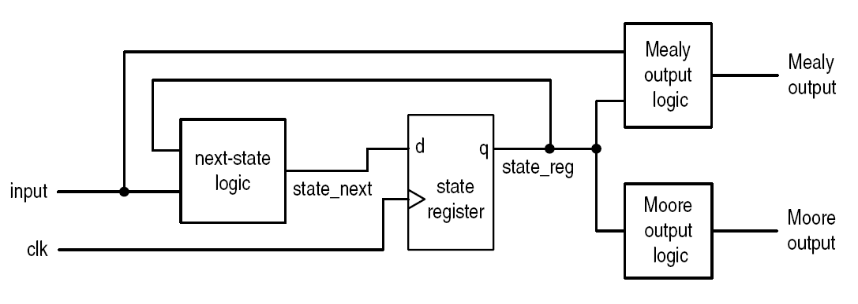
Overview
Contain custom logic in next-state logic
Used mainly used as a controller in a large system
Mealy vs. Moore output

Slide 5
FSM Representation

Slide 6
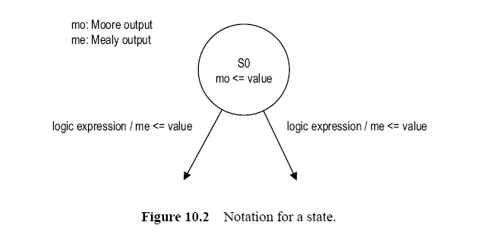
Representation of a FSM
State Diagram

Slide 7
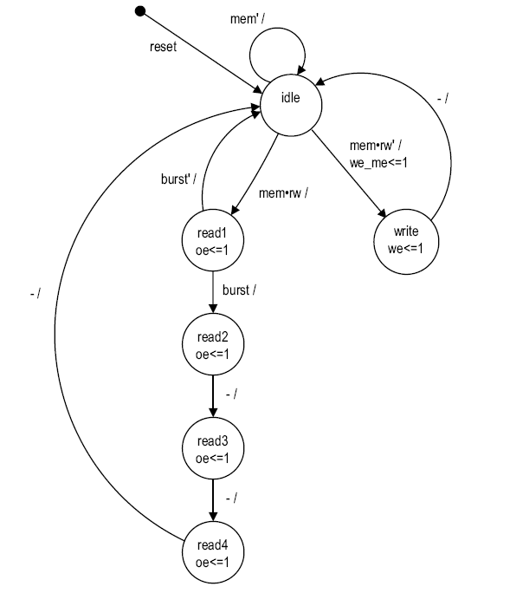
Memory Controller State Diagram

Slide 8
Timing and Performance of an FSM

Slide 9
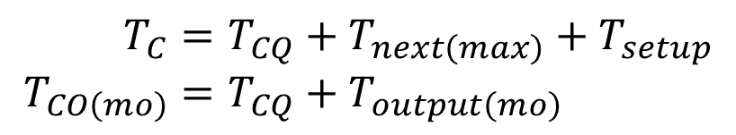
Timing and Performance of an FSM
Similar to a regular sequential circuit
$$T_{C}=T_{CQ}+T_{next\left(max\right)}+T_{setup} \\ T_{CO\left(mo\right)}=T_{CQ}+T_{output\left(mo\right)}$$

Slide 10
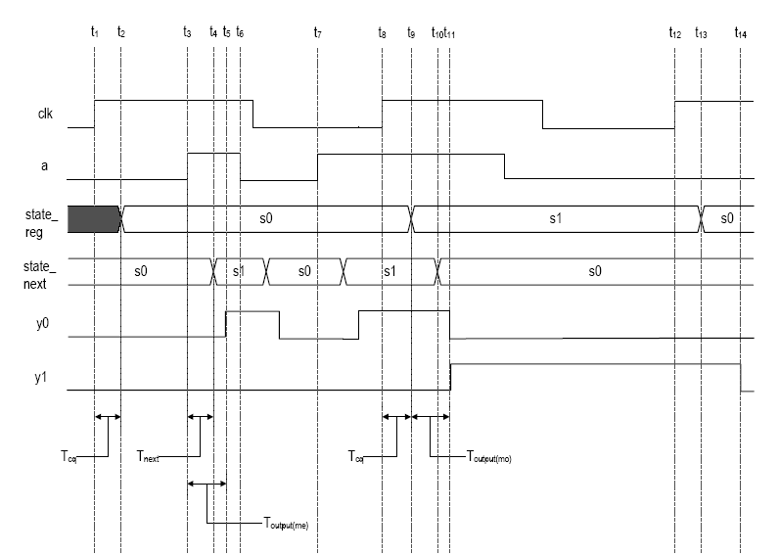

Timing and Performance of an FSM
$$T_{C}=T_{CQ}+T_{next\left(max\right)}+T_{setup} \\ T_{CO\left(mo\right)}=T_{CQ}+T_{output\left(mo\right)}$$

Slide 11
Moore vs. Mealy

Slide 12
Moore vs. Mealy
Moore machine: output is a function of state
Mealy machine: output function of state and output
From theoretical point of view, both machines have similar “computation capability”
Implication of FSM as a controller?

Slide 13
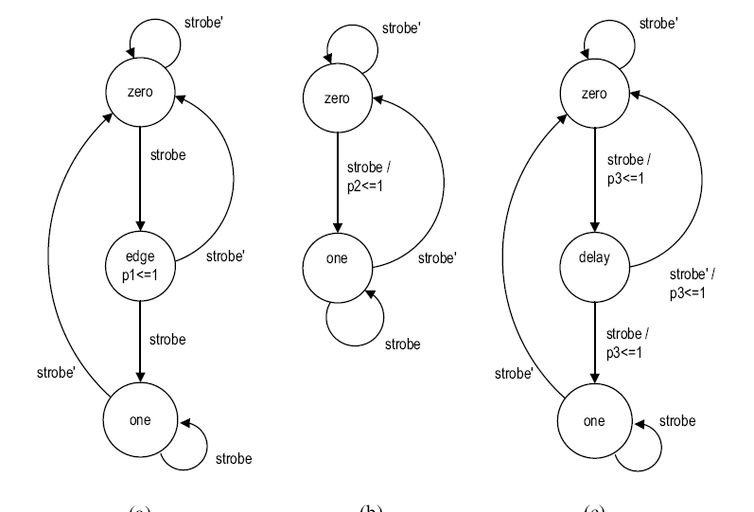
Example: Edge Detection Circuit
A circuit to detect the rising edge of a slow “strobe” input and generate a “short” (about 1-clock period) output pulse.

Slide 14
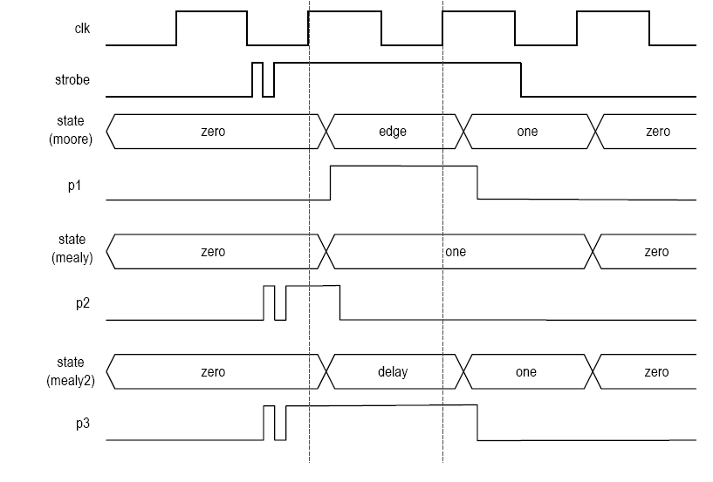
Example: Edge Detection Circuit
A circuit to detect the rising edge of a slow “strobe” input and generate a “short” (about 1-clock period) output pulse.

Slide 15
Moore vs. Mealy
Comparison
Mealy machine uses fewer states
Mealy machine responds faster
Mealy machine may be transparent to glitches
Which one is better?
Types of control signal
Edge sensitive
E.g., enable signal of counter
Both can be used but Mealy is faster
Level sensitive
E.g., write enable signal of SRAM
Moore is preferred

Slide 16
Moore vs. Mealy
Comparison
Mealy machine uses fewer states
Mealy machine responds faster
Mealy machine may be transparent to glitches (Bad!)
Which one is better?
Types of control signal
Edge sensitive
Example: enable signal of counter
Both can be used but Mealy is faster
Level sensitive
Example: write enable signal of SRAM
Moore is preferred

Slide 17
VHDL Description of a FSM

Slide 18
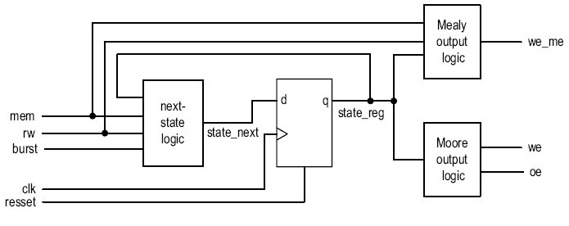
VHDL Description of a FSM
Follow the basic block diagram
Code the next-state/output logic according to the state diagram/ASM chart
Use enumeration data type for states
Can use Moore output buffering to prevent glitches

Slide 19

Example (See “memory_controller.vhd” Code Example)

Slide 20
State Assignment

Slide 21
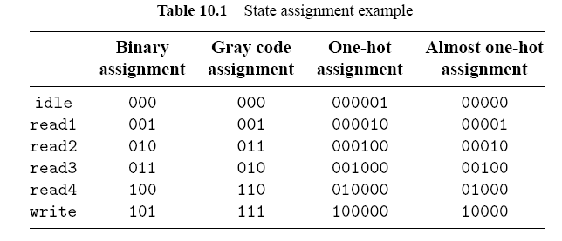
State Assignment
State assignment: assign binary representations to symbolic states
In a synchronous FSM
All assignments work
Good assignment reduce the complexity of next-state/output logic
Typical assignment – Binary, Gray, one-hot, almost one-hot

Slide 22
State Assignment: VHDL
Implicit: use user attributes enum_encoding
Explicit: use std_logic_vector for the register
type mc_state_type is (idle, write, read1, read2, read3, read4);
attribute enum_encoding : string;
attribute enum_encoding of mc_state_type :
type is "0000 0100 1000 1001 1010 1011";
constant idle : std_logic_vector(3 downto 0) := "0000";
constant write : std_logic_vector(3 downto 0) := "0100";
constant read1 : std_logic_vector(3 downto 0) := "1000";
constant read2 : std_logic_vector(3 downto 0) := "1001";
constant read3 : std_logic_vector(3 downto 0) := "1010";
constant read4 : std_logic_vector(3 downto 0) := "1011";
signal state_reg, state_next : std_logic_vector(3 downto 0);
...
if (reset = '1') then
state_reg <= idle;
else
state_reg <= idle;
end if;

Slide 23
Handling Unused States “Phantom States”
Many binary representations are not used
What happens if the FSM enters an unused state?
Ignore the condition
Safe (Fault-tolerant) FSM: go to an error state or return to the initial state.
Easy for the explicit state assignment
No portable code for the enumerated data type

Slide 24
Moore Output Buffering

Slide 25
Moore Output Buffering
FSM as control circuit
Sometimes fast, glitch-free signal is needed
An extra output buffer can be added, but introduce one-clock delay
Special schemes can be used for Moore output
Clever state assignment
Look-ahead output circuit
Potential problems of the Moore output logic:
Potential hazards introduce glitches
Increase the T_{co} delay (T_{co} = T_{cq} + T_{output})
Can we get control signals directly from the register?

Slide 26
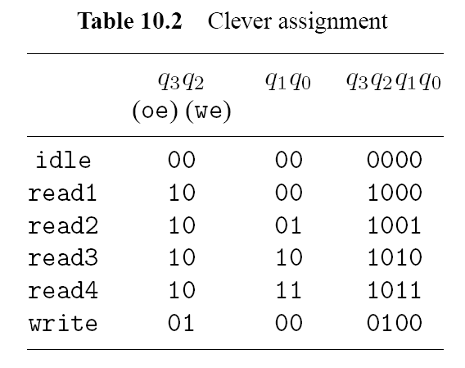
Clever State Assignment
Assigning state according to output signal patterns
Output can be obtained from register directly
Extra register bits may be needed
Must use explicit state assignment in VHDL code to access individual register bit
Difficult to revise and maintain

Slide 27
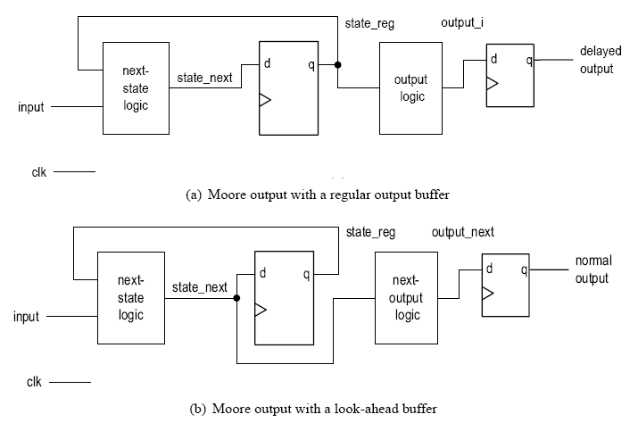
Look-Ahead Output Circuit
Output buffer introduces one-clock delay
The “next” value of Moore output can be obtained by using state_next signal
Buffer the next value cancel out the one-clock delay
More systematic and easier to revise and maintain

Slide 28
Lesson Outline
Overview
FSM Representation
Timing and Performance of an FSM
Moore vs. Mealy
VHDL Description of a FSM
State Assignment
Moore Output Buffering

