Slide 1

Eco Cup
Coffee Cup Project by Cupmakers team

Slide 2

Environmental Problem

Slide 3
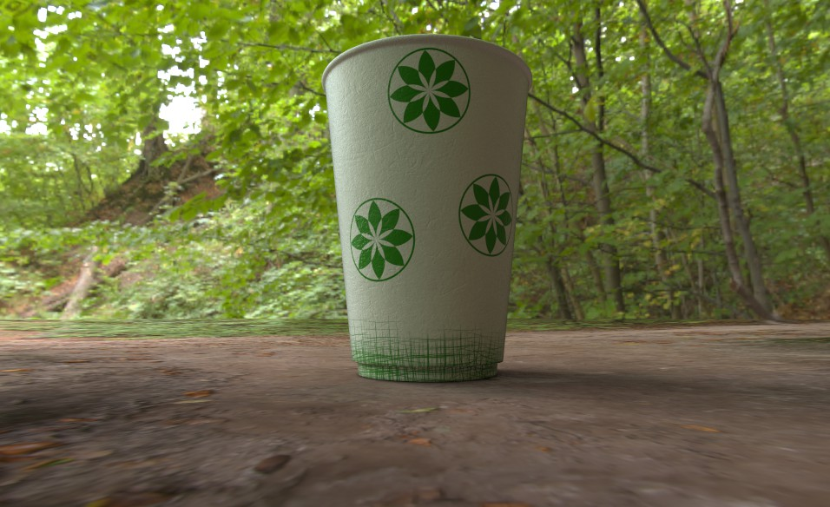
Prototype: ECO CUP

Slide 4


Slide 5
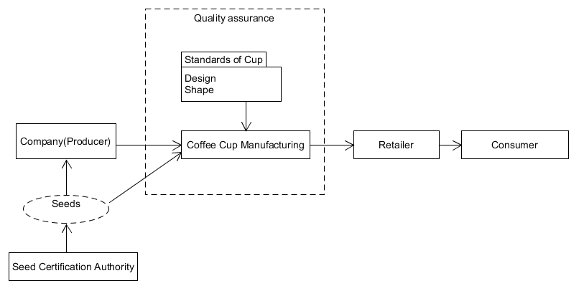
Industry Structure

Slide 6
Cupmakers.kz
STRENGTHS
Unique Design
Eco-friendly
Event-oriented
WEAKNESS
Low range of products
Expenditure on seeds
OPPORTUNITIES
Self-promotion product
USP (event organizers)
THREATS
Price damping (any company)
Equipment loss (damage)
Ignorance from Market

Slide 7
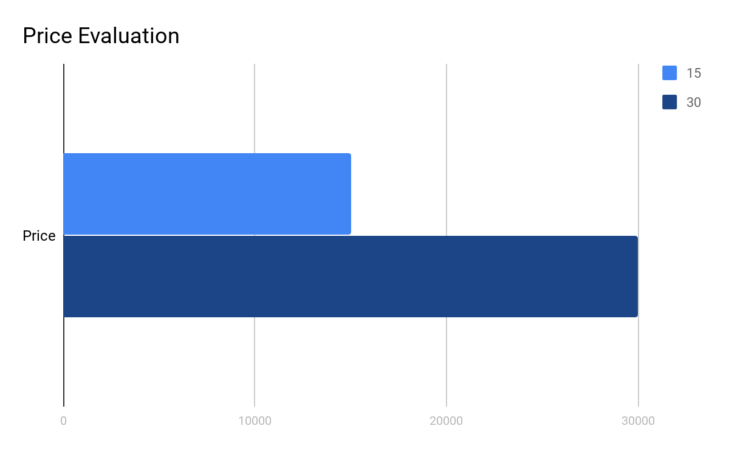
Costs
A manufactured cup with a seed costs an average of 15 to 30 tenge.

Slide 8
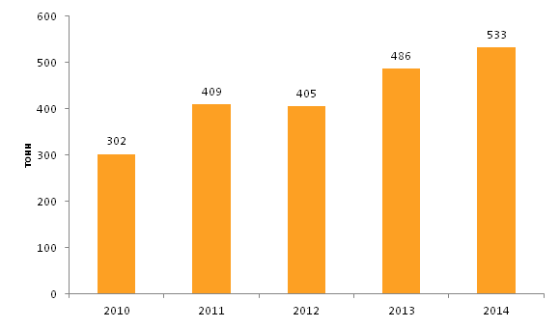
Coffee Import in Kazakhstan

Slide 9
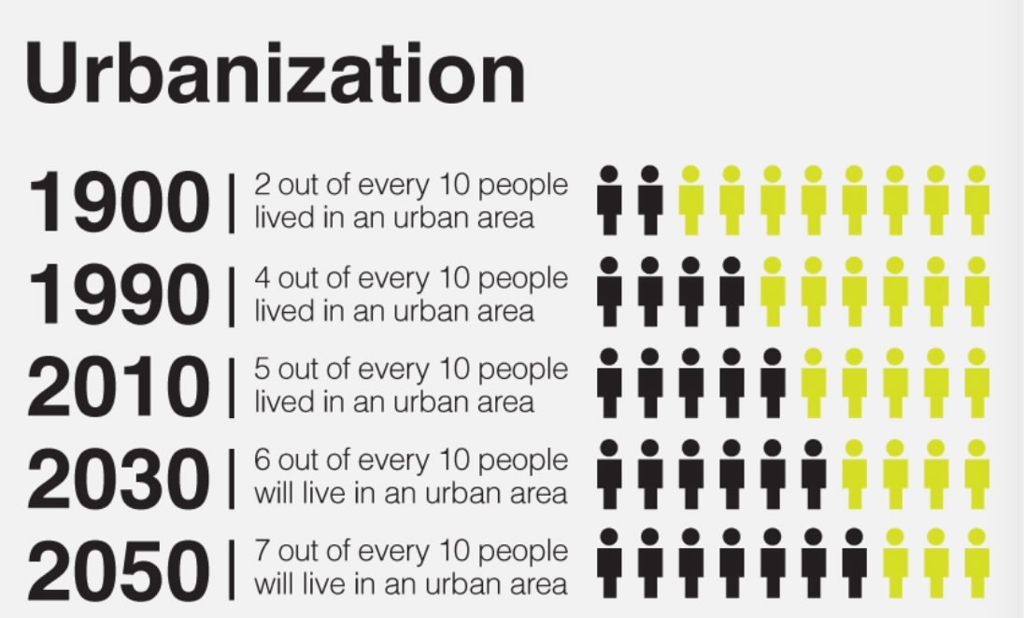
More than half of the world’s people will soon live in cities

Slide 10
Thank you for your attention!

