Slide 1
Predicting Loan Defaults for Smarter Lending
Alex Spence
DSC 630
11/17/2025

Slide 2
Introduction: Why This Matters
Problem: Loan defaults cost billions, linked to 2008 crisis
Goal: Predict defaults to reduce lender risk
Audience: Banks, fintechs, regulators
My family felt the 2008 crash—let’s prevent that for future generations!

Slide 3
Dataset Overview
Source: Kaggle (255,347 rows, 18 features)Key Features: CreditScore, Income, LoanAmount, DTIRatioDefault Rate: 15% (class imbalance)Text: “No missing data, ready for analysis!”

Slide 4
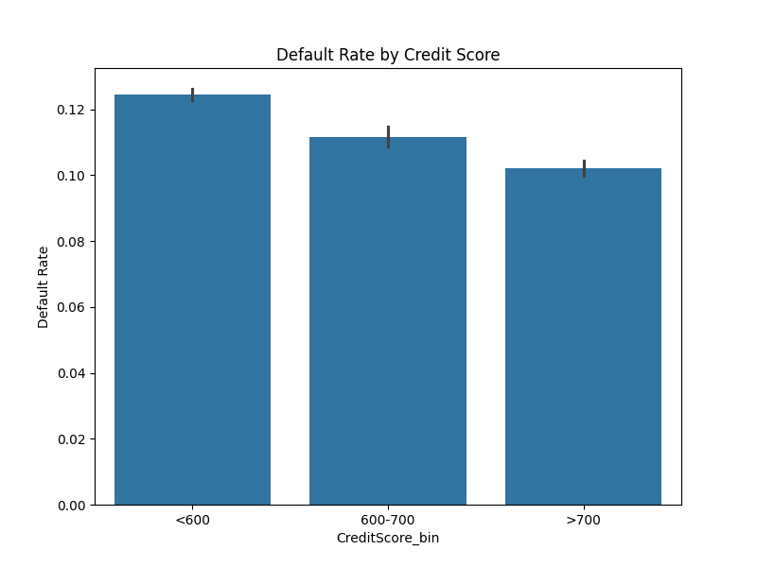
Data Exploration
Default Rate by Credit Score
12% default rate for CreditScore<600

Slide 5
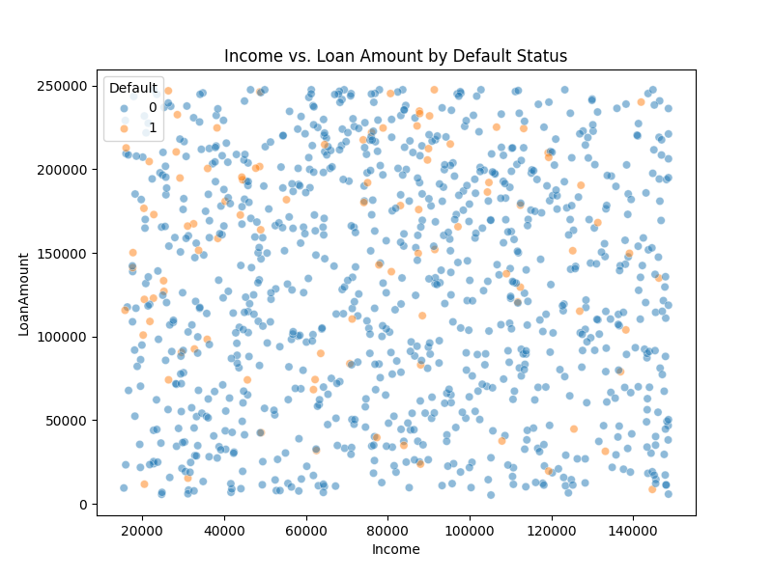
Data Exploration
Defaults cluster at high LoanAmount, low Income

Slide 6
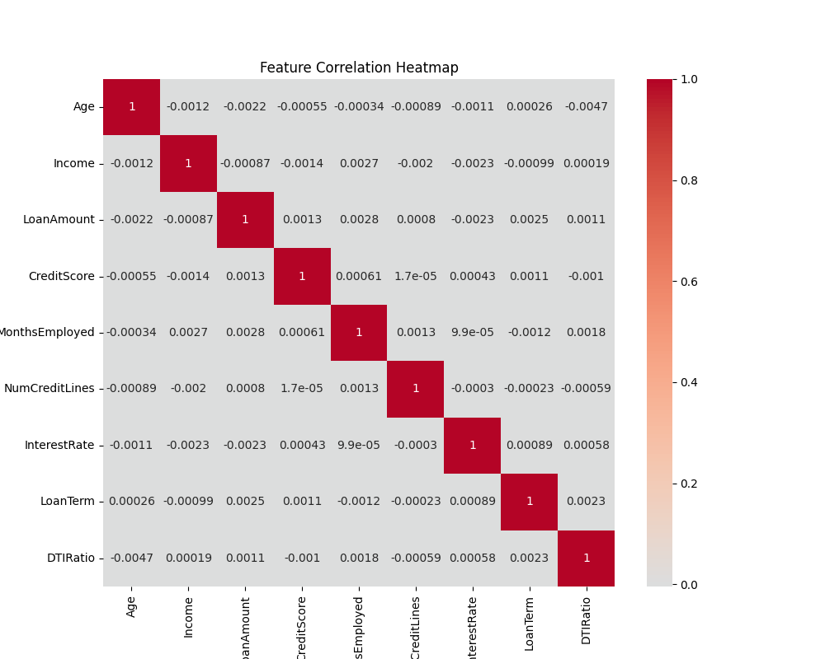
Data Preperation
Steps: Outlier capping, one-hot encoding, SMOTE, RFE
Dropped correlated features

Slide 7
Methods: Models and Evaluation
Logistic Regression, Random Forest, XGBoost
XGBoost used cost-sensitive learning for defaults

Slide 8
Methods: Models and Evaluation
Metrics: AUC-ROC, precision, recall, F1-score
Prioritized recall to catch defaults

Slide 9
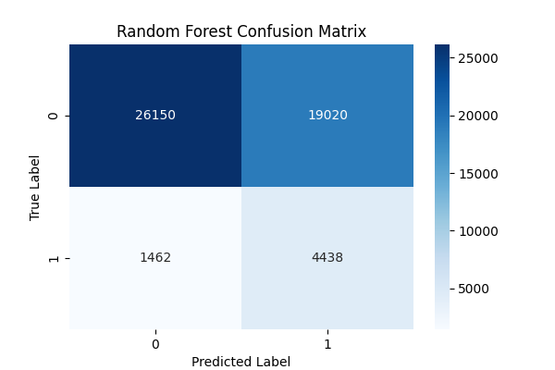
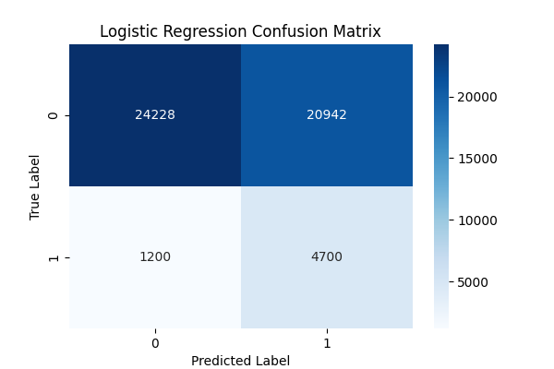
Results: Model Performance
Logistic Regression & Random Forest
Logistic: AUC-ROC 0.75, recall 0.80;
RF: recall 0.75

Slide 10
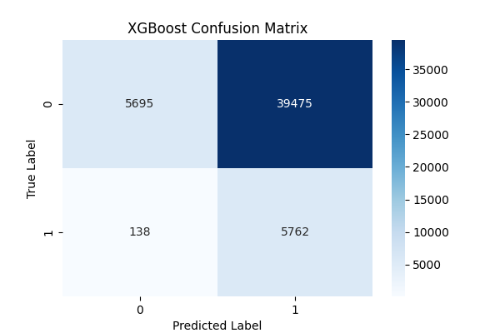
Results: Model Performance
XGBoost: recall 0.98, but precision 0.13

Slide 11
Conclusion
Near-perfect recall (0.98) but needs precision boost. Strong start for lender risk management!

