Slide 1
The Cost of Childcare: A Policy Crisis
Alex Spence
DSC 640 Project

Slide 2
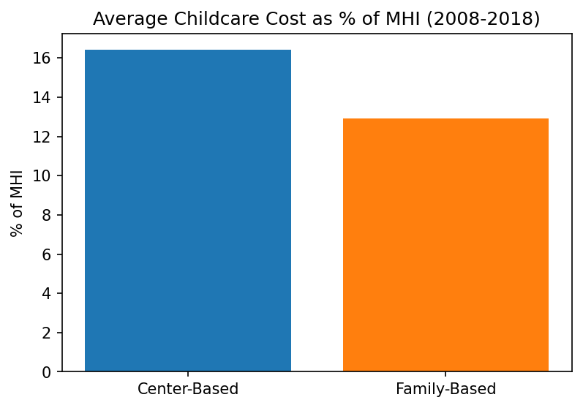
The Problem
Mean MCInfant (Median Center Based Childcare =$145.70/week
MFCCInfant (Median Family Based Childcare=$113.39/week (2008–2018).

Slide 3
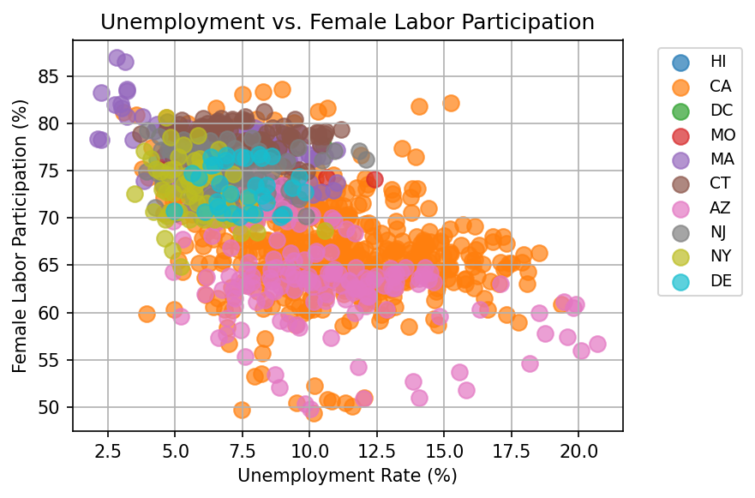
Economic Impact
Showing top 10 states for clarity – but trend is consistent across all states where the high cost is deterring women from the workforce

Slide 4
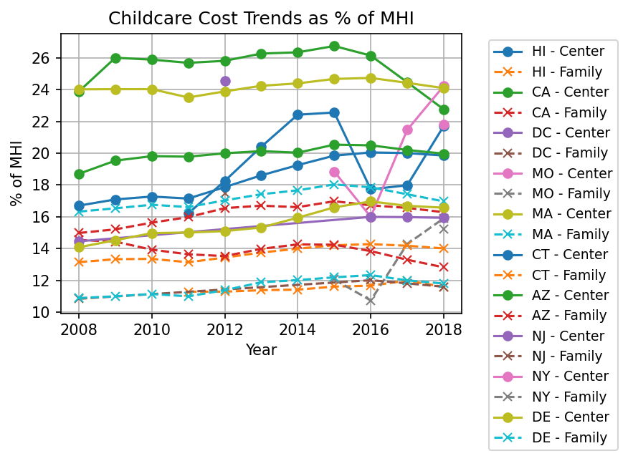
Regional Trends
Top 10 states by population – you see cost as a % of Median Household Income range from 10% to 26%
Costs crept up 5%-10% across state over the past decade

Slide 5
Call To Action
Subsidies can reduce costs, boost economies.
Could boost child tax credit or dependent care fsa limits.

Slide 6
Q&A
Questions?
Contact Alex Spence for more information or to get involved.
Data is nationaldatabaseofchildcareprices

