Slide 1

Predicting Telecom Customer Churn
Identifying Subscribers Likely to Leave and Why
Alex Spence
DSC 680 Project 3
Notes:
Hi everyone, my name is Alex Spence. This is my third and final project: Predicting Telecom Customer Churn – Identifying Subscribers Likely to Leave and Why. Today I'll cover the business problem, data, methods, results with key visuals, a practical tool, recommendations, and closing thoughts.

Slide 2
Business Problem
Churn = lost revenue & high acquisition costs (5–7× more expensive to replace)
Goal: Predict at-risk customers early → targeted retention (discounts, upgrades, support)
Research questions: Top drivers? Better than simple rules? Actionable insights?
Notes:
Churn is one of the biggest challenges in telecom. Losing a customer means losing recurring revenue, and replacing them costs 5 to 7 times more than keeping them. Retention teams want to know who's at risk so they can offer targeted incentives – like discounts, upgrades, or better support – before the customer switches. The research questions were: What are the strongest predictors? Can ML beat simple rules? And can the predictions be actionable for real teams?"

Slide 3
Data & Preparation
Dataset: Telco Customer Churn (Kaggle)
7,043 customers, 21 original features
Features: tenure, charges, contract type, services (internet/phone/streaming/security), demographics
Prep: Encoding, derived features (avg charge, service count), final shape ~7,043 × 45
Churn rate: ~26.5%
Notes:
I used the Telco Customer Churn dataset from Kaggle – 7,043 customers with 21 features. These include tenure, monthly and total charges, contract type, payment method, services like internet, phone, streaming, security, tech support, and demographics like gender, senior citizen status, partner, and dependents. After encoding categoricals, handling missing charges, and creating derived features like average charge and total services count, I had about 45 features and the same 7,043 rows. Churn rate was around 26.5% – so moderate imbalance that we had to handle

Slide 4
Methods
80/20 train/test split (manual balanced)
Baseline: Logistic regression
Main model: XGBoost (class weighting, CV tuning)
Evaluation: AUC-ROC, precision-recall, SHAP for interpretability
Notes:
I did an 80/20 train-test split with manual balancing to make sure both classes were in the train set. Logistic regression was the baseline. The main model was XGBoost – great for this kind of tabular data, with class weighting, cross-validation tuning, and early stopping. I used AUC-ROC as the primary metric, plus precision-recall for the minority class, and SHAP values for explainability – because knowing why someone is at risk is key for retention.

Slide 5
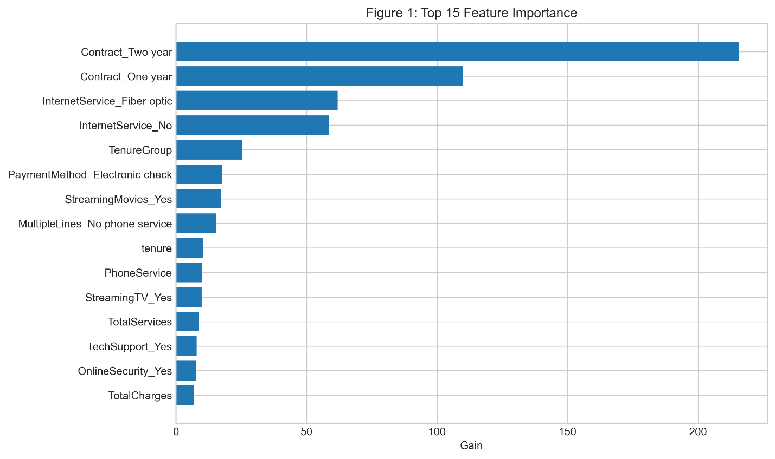
Results Overview
AUC-ROC: .845
Top drivers: Month-to-month contract, tenure, monthly charges, total services, tech support
Notes:
The XGBoost model achieved an AUC of .845 – solid performance for churn prediction. Here in Figure 1 are the top 15 features by importance. Month-to-month contract is by far the biggest driver, followed by tenure, monthly charges, total services used, and tech support. Short tenure and month-to-month contracts make churn much more likely.

Slide 6
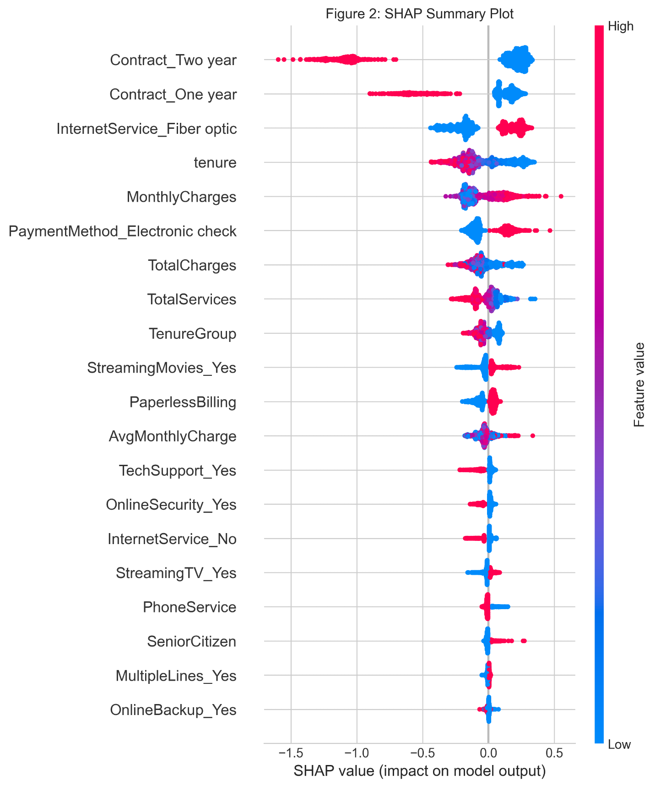
SHAP Insights
SHAP summary: Direction & magnitude of impact
High charges + month-to-month → high churn risk
Long tenure + bundled services → lower risk
Notes:
Figure 2 is the SHAP summary plot. It shows not just importance but direction: red means higher values increase churn risk, blue decreases it. Month-to-month contracts and high monthly charges strongly push risk up, while longer tenure and more bundled services pull it down. This gives clear, actionable insights for retention strategies

Slide 7
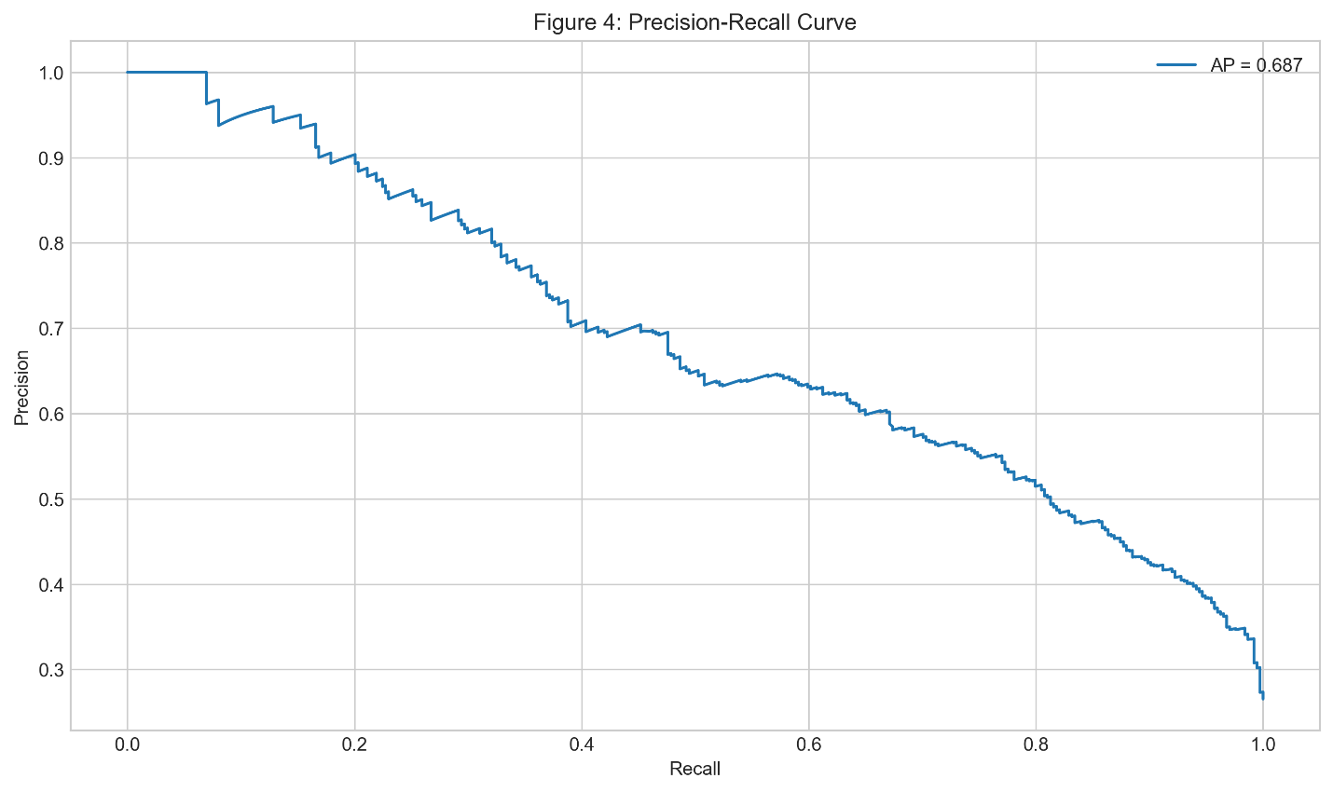
Model Quality
Precision-recall curve: Good balance for minority class
Usable threshold: ~30–40% risk (captures most churners without too many false positives)
Notes:
Figure 4 is the precision-recall curve. With 26% churn, precision is important – we don't want to waste offers on too many loyal customers. At a threshold that captures about 75% of actual churners, precision stays reasonable, making it practical for targeted campaigns.

Slide 8
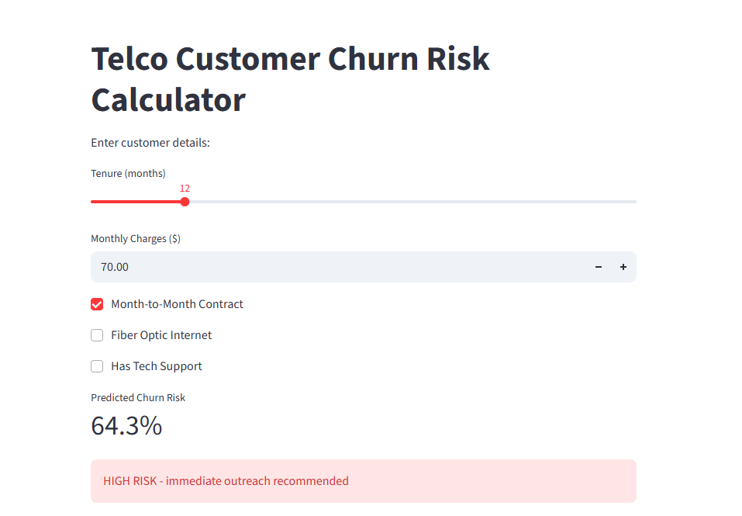
Practical Demo
Streamlit dashboard: Input tenure, charges, contract, internet, tech support → get risk % + alert
Use case: Real-time check in CRM or retention team tool
Notes:
"To make this usable, I built a Streamlit dashboard – Figure 5 is a screenshot. You input tenure, monthly charges, whether it's month-to-month, fiber internet, and tech support status. It gives an instant churn risk percentage and a color-coded alert – high risk in red, moderate in yellow, low in green. This could easily be added to a CRM tool for quick checks by retention staff."

Slide 9
Recommendations & Ethics
Target month-to-month + high-charge customers with discounts/long-term offers
Bundle services (security/streaming/tech support) to reduce risk
Monitor short-tenure customers
Ethics: Similar performance across gender/senior status; human review always required
Notes:
Prioritize month-to-month customers with high charges and few services for retention offers like discounts or bundles. Add value-added services like tech support or security to reduce risk. Monitor short-tenure customers closely.
On ethics: Performance was similar across gender and senior citizen groups. Minor differences by payment method were noted. The model is support only – human review always required. No automated decisions.

Slide 10
Closing
Key takeaway: Good predictions + clear explanations = actionable retention strategies
Next: Validate on real data, add support ticket trends
Thank you!
Notes:
To wrap up: We can predict churn well with standard data, and the model highlights preventable drivers like month-to-month contracts and high standalone pricing. The biggest lesson: Interpretability turns a good model into a useful business tool. Next steps would be testing on real telecom data and adding signals like recent support tickets. Thank you so much for watchin

