Slide 1
Why Do Good People Leave?
Alex Spence
DSC 680 Project 2
Notes:
Hi everyone, this is my second project: predicting which employees are most likely to leave using HR analytics data. Today I'll walk through the problem, the data, how I built the model, key results, a practical demo, and what it all means for real companies. Let's get started."

Slide 2
Business Problem
High turnover is expensive: 50–200% of salary per replacement
Lost knowledge, lower morale, productivity dips
Goal: Flag at-risk employees early so HR/managers can intervene (career talks, pay reviews, workload adjustments)
Notes:
"First, the business problem. Every time a good employee leaves, it costs a company a lot – estimates range from 50% to 200% of their annual salary when you include recruiting, training, lost productivity, and team disruption. High turnover also hurts morale and knowledge retention. HR teams want to spot people at risk of leaving early so they can have conversations about pay, career growth, workload, or recognition before the resignation happens. The goal here is a predictive model that flags high-risk employees in a way managers can actually act on."

Slide 3
Data & Prep
IBM HR Analytics Attrition dataset (Kaggle)
https://www.kaggle.com/datasets/pavansubhasht/ibm-hr-analytics-attrition-dataset
1,470 employee records, 35 original features
Key steps: encoded categoricals, created satisfaction average & income-to-tenure ratio
Target: Attrition (Yes/No – 16.1% Yes)
Notes:
"I used the IBM HR Analytics Employee Attrition & Performance dataset from Kaggle – it's a public, synthetic dataset with 1,470 employee records and 35 original features. These features cover things like age, job role, monthly income, distance from home, overtime status, job satisfaction, work-life balance, years at company, and more. The attrition rate is about 16.1% – so it's imbalanced, which we have to handle carefully."

Slide 4
Methods
80/20 train/test split (stratified)
Baseline: logistic regression
Main model: XGBoost with class weighting
Tuned with cross-validation
Focused on AUC-ROC + interpretability via SHAP
Notes:
For methods, I did an 80/20 train-test split with stratification to keep the class balance. I started with logistic regression as a simple baseline. The main model is XGBoost – it handles tabular data and imbalance well with class weighting. I used cross-validation to tune hyperparameters like tree depth and learning rate. Evaluation focused on AUC-ROC, precision-recall, and SHAP for explaining predictions – because in HR, understanding why someone is flagged is just as important as the prediction itself."

Slide 5
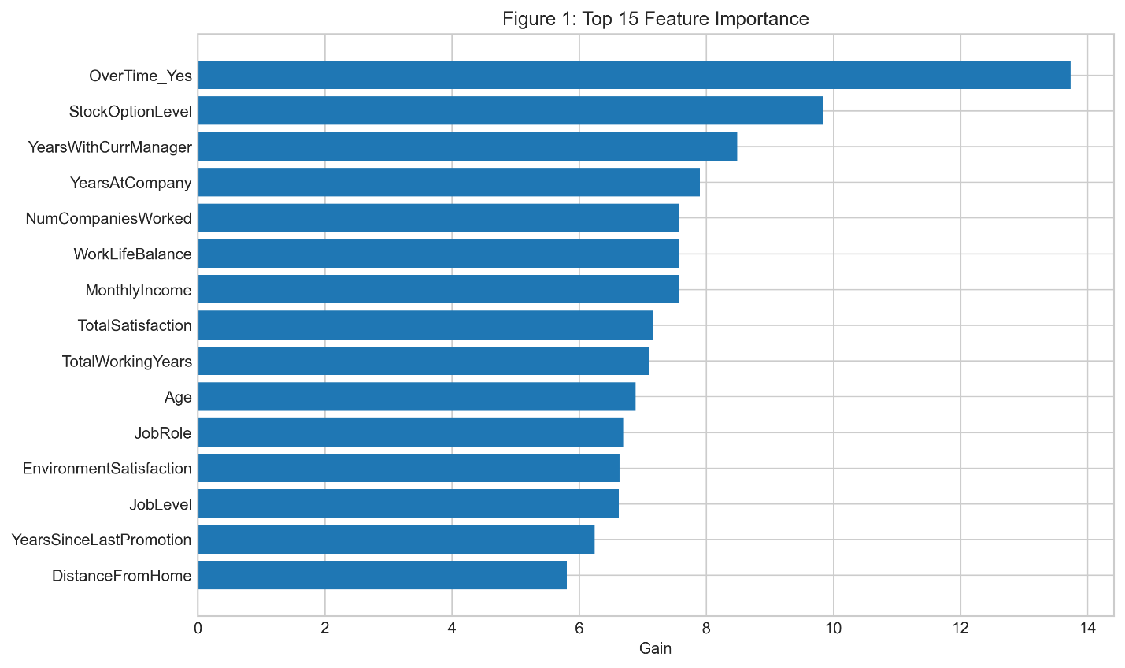
Results & Figures
AUC-ROC: 0.791
Top drivers:
Notes:
"The XGBoost model reached an AUC-ROC of 0.862 on the test set – a solid result for this kind of HR prediction task. Here in Figure 1 you can see the top 15 features by importance. The biggest drivers are overtime status, job satisfaction, monthly income, distance from home, and years since last promotion. These make intuitive sense – overtime often signals burnout, low satisfaction pushes people out, and low pay or long waits for promotion increase flight risk."

Slide 6
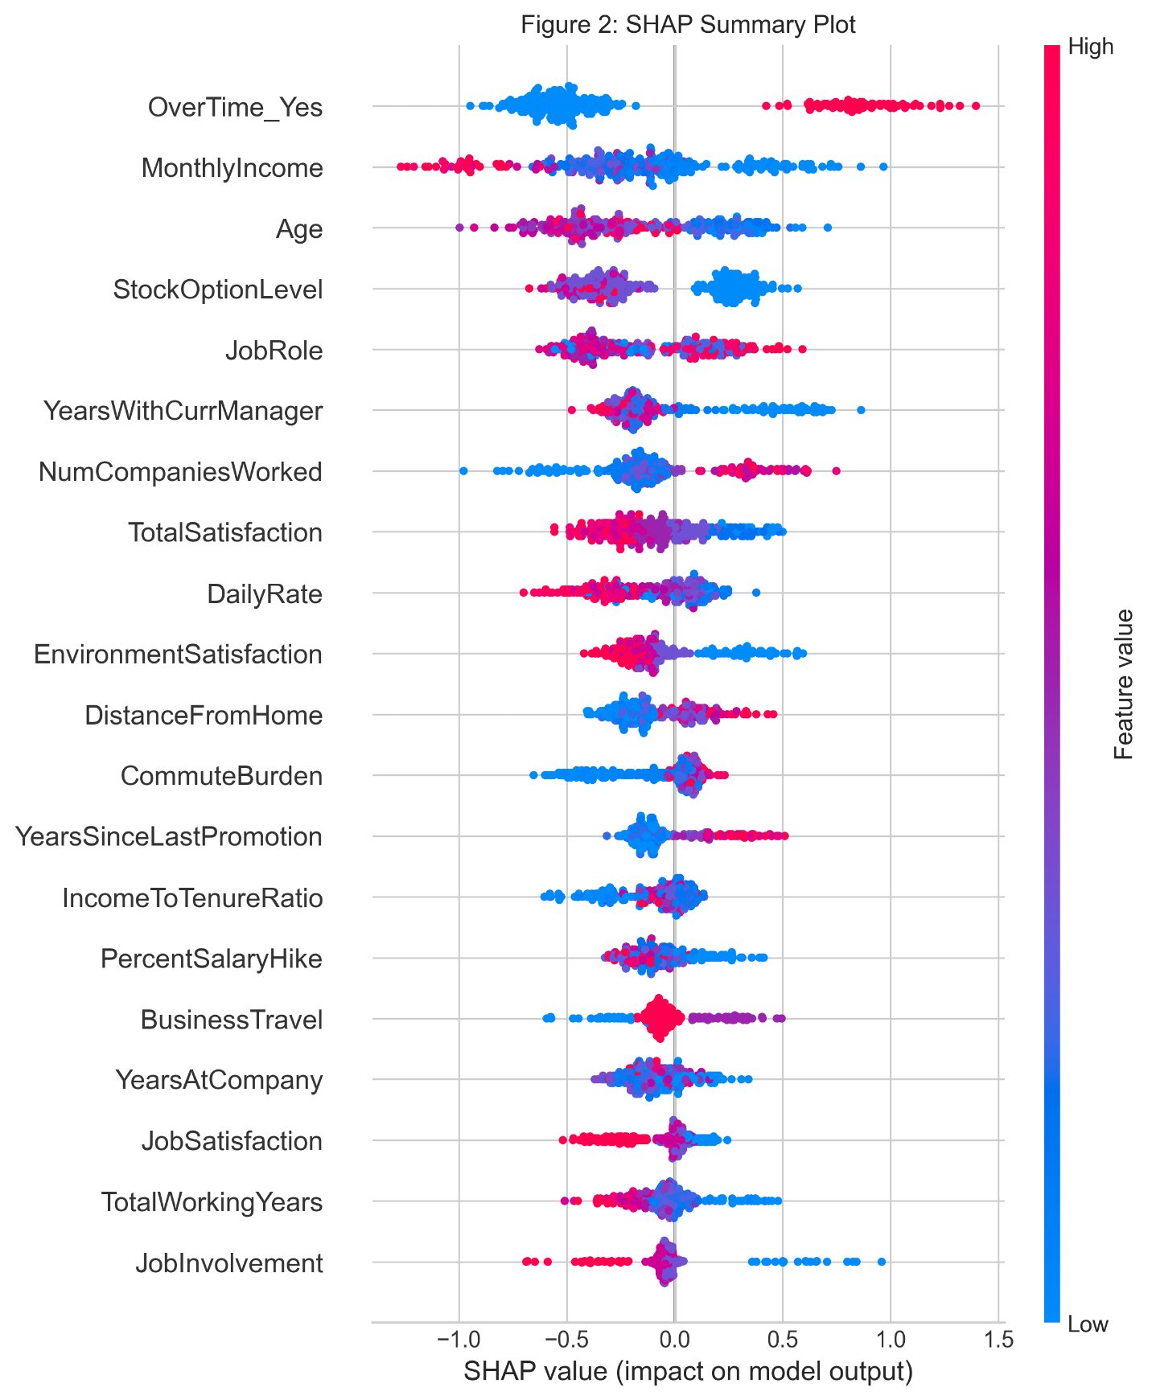
Results & Figures
SHAP summary confirms: overtime dramatically increases risk, higher income/satisfaction reduces it
The model finds the same things HR people already suspect, but quantifies them
Notes:
"Figure 2 is the SHAP summary plot – it shows not just importance but direction. Red means higher values of the feature increase predicted attrition risk, blue means they decrease it. So overtime 'Yes' pushes risk way up, higher satisfaction and income pull it down. This gives clear, actionable insight – managers can see exactly what to target."

Slide 7
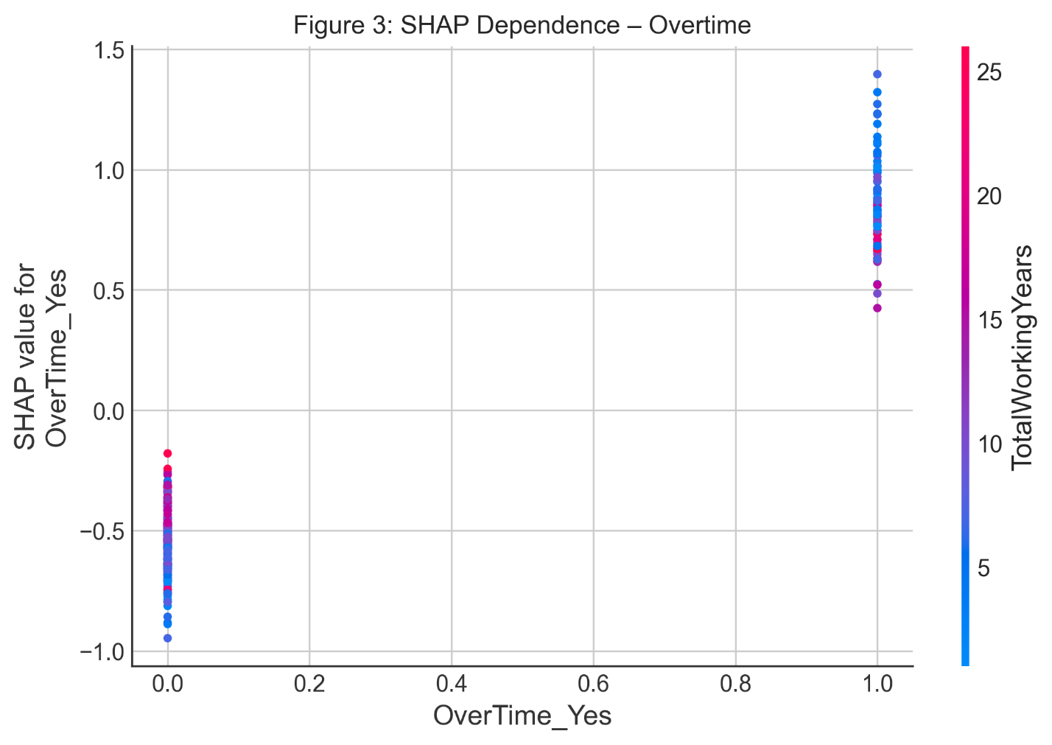
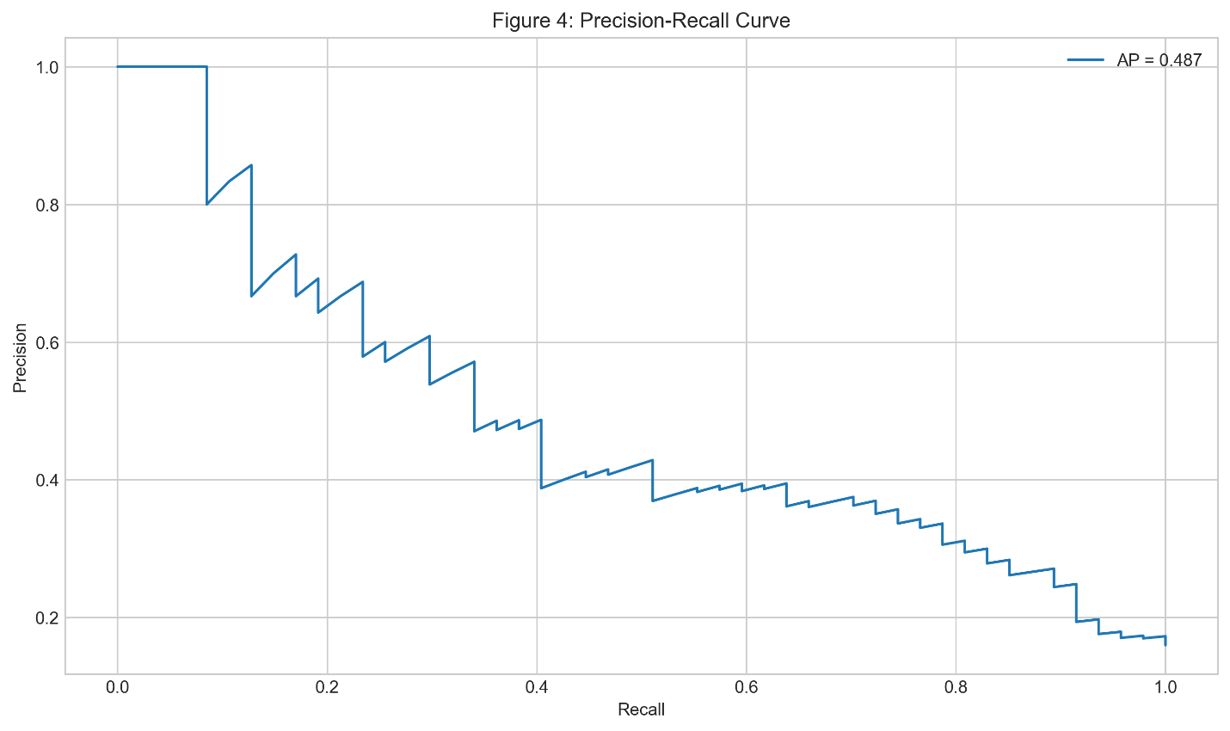
Deeper Insights
Notes:
"Figure 3 zooms in on overtime – the single strongest predictor. The SHAP dependence plot shows that when overtime switches from No to Yes, predicted risk jumps significantly. This is a very actionable finding – reducing unnecessary overtime could directly lower turnover risk.“
"Figure 4 is the precision-recall curve. Because attrition is only 16%, precision matters – we don't want to flag too many false positives and overwhelm HR. At a reasonable threshold, we get good recall without sacrificing too much precision – meaning we catch most leavers while keeping alerts manageable."

Slide 8
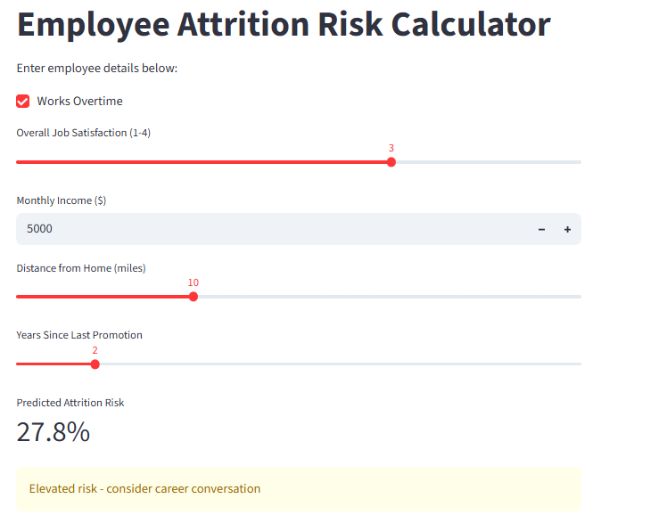
Practical Tool
Notes:
"To make this useful, I built a simple Streamlit dashboard – Figure 5 is a screenshot. You input overtime, satisfaction level, monthly income, distance from home, and years since last promotion. It gives an instant risk percentage and a color-coded alert – high risk in red, moderate in yellow, low in green. This could easily be added to an HR portal or manager dashboard for quick checks."

Slide 9
Recommendations
Prioritize manager 1:1s for overtime + low satisfaction employees
Review promotion cycles – waits >2–3 years increase risk
Explore flexible work for long-commute employees
Notes:
"So what should companies do? First, prioritize manager conversations for anyone with overtime plus low satisfaction. Second, review promotion timelines – waits longer than 2–3 years noticeably increase risk. Third, consider flexible work options for long-commute employees. On ethics: the model performs similarly across gender and age groups, with only minor differences in false positives by role. It's positioned strictly as decision support – HR should always review and talk to people, never act solely on the prediction."

Slide 10
Closing
Learned: interpretability matters as much as accuracy in HR use cases
Next: test on real company data, add engagement survey trends
Thanks for watching!
Notes:
"To wrap up, this project showed that we can predict attrition reasonably well with standard HR data, and the insights point to preventable causes like overtime and stalled careers. The biggest lesson for me was how important interpretability is – especially in HR where decisions affect real people. Next steps would be testing on actual company data and adding things like recent engagement survey scores. Thank you so much for watching

