Slide 1

Tensorflow

Slide 2
Agenda
Tensorflow Introduction
Conferences
XLA
  just-in-time (JIT)
  ahead-of-time (AOT)
JIT and AOT examples

Slide 3
Tensorflow
TensorFlow™ is an open source software library for numerical computation using data flow graphs. Nodes in the graph represent mathematical operations, while the graph edges represent the multidimensional data arrays (tensors) communicated between them.

Slide 4
Tensors
A tensor consists of a set of primitive values shaped into an array of any number of dimensions.
3 # a rank 0 tensor; this is a scalar with shape []
[1., 2., 3.] # a rank 1 tensor; this is a vector with shape [3]
[[1., 2., 3.], [4., 5., 6.]] # a rank 2 tensor; a matrix with shape [2, 3]
[[[1., 2., 3.]], [[7., 8., 9.]]] # a rank 3 tensor with shape [2, 1, 3]

Slide 5
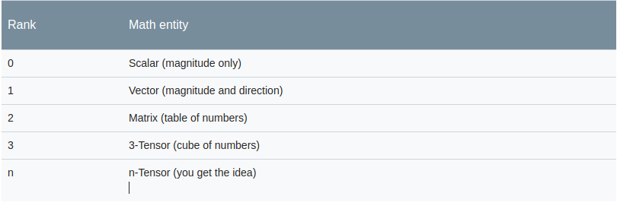
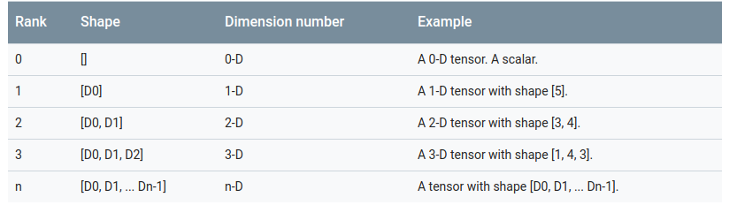
Rank and Shape

Slide 6
Constants
Constants Variables have a value that does not change during runtime.
node1 = tf.constant(3.0, dtype=tf.float32)
node2 = tf.constant(4.0) # also tf.float32 implicitly
print(node1, node2)

Slide 7
Placeholders
A graph can be parameterized to accept external inputs, known as placeholders. A placeholder is a promise to provide a value later.
a = tf.placeholder(tf.float32)
b = tf.placeholder(tf.float32)
adder_node = a + b # + provides a shortcut for tf.add(a, b)
print(sess.run(adder_node, {a: 3, b: 4.5}))
print(sess.run(adder_node, {a: [1, 3], b: [2, 4]}))

Slide 8
Variables
To make the model trainable, we need to be able to modify the graph to get new outputs with the same input. Variables allow us to add trainable parameters to a graph.
W = tf.Variable([.3], dtype=tf.float32)
b = tf.Variable([-.3], dtype=tf.float32)
x = tf.placeholder(tf.float32)
linear_model = W * x + b
sess = tf.Session()
print(sess.run(linear_model, {x: [1, 2, 3, 4]}))

Slide 9
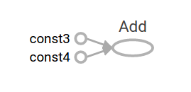
Computational Graph
A computational graph is a series of TensorFlow operations arranged into a graph of nodes
node1 = tf.constant(3.0, dtype=tf.float32)
node2 = tf.constant(4.0) # also tf.float32 implicitly
node3 = tf.add(node1, node2)
sess = tf.Session()
print("sess.run(node3):", sess.run(node3))
//Print result: sess.run(node3): 7.0

Slide 10
Session
A session encapsulates the control and state of the TensorFlow runtime.
# Create a default in-process session.
with tf.Session() as sess:
# ...
# Create a remote session.
with tf.Session("grpc://example.org:2222"):
# ...

Slide 11
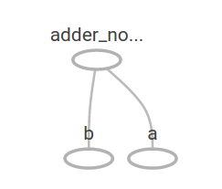
Computational Graph
a = tf.placeholder(tf.float32)
b = tf.placeholder(tf.float32)
adder_node = a + b # + provides a shortcut for tf.add(a, b)
sess = tf.Session()
print(sess.run(adder_node, {a: 3, b: 4.5}))
print(sess.run(adder_node, {a: [1, 3], b: [2, 4]}))
//print results:
7.5
[ 3. 7.]

Slide 12
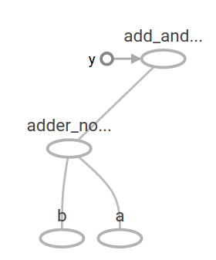
Computational Graph
a = tf.placeholder(tf.float32)
b = tf.placeholder(tf.float32)
adder_node = a + b # + provides a shortcut for tf.add(a, b)
add_and_triple = adder_node * 3.
sess = tf.Session()
print(sess.run(add_and_triple, {a: 3, b: 4.5}))
//print result:
22.5

Slide 13
Device Placement
EXEMPLO 1: -- variable
with tf.device("/gpu:1"):
v = tf.get_variable("v", [1])
"/cpu:0": The CPU of your machine.
"/gpu:0": The GPU of your machine, if you have one.
"/gpu:1": The second GPU of your machine, etc.
EXEMPLO 2: -- computation
with tf.device("/device:CPU:0"):
# Operations created in this context will be pinned to the CPU.
img = tf.decode_jpeg(tf.read_file("img.jpg"))
with tf.device("/device:GPU:0"):
# Operations created in this context will be pinned to the GPU.
result = tf.matmul(weights, img)

Slide 14
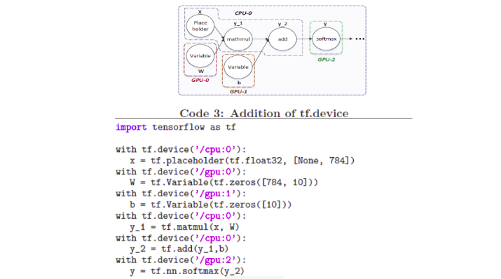
Device Placement

Slide 15
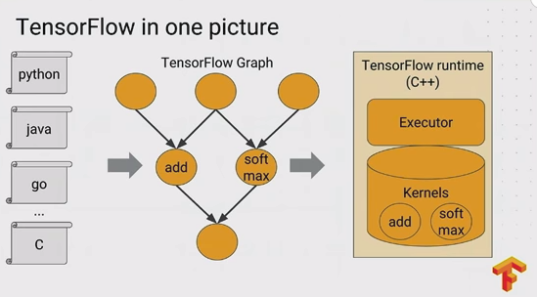
TensorFlow runtime

Slide 16
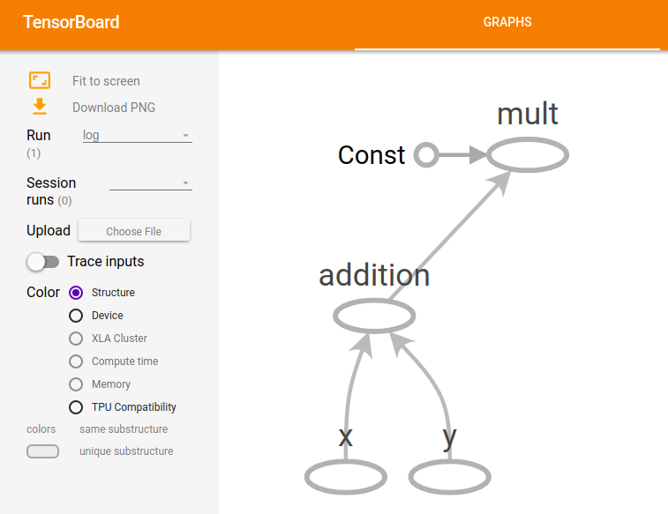
tensorboard

Slide 17

Conferences

Slide 18
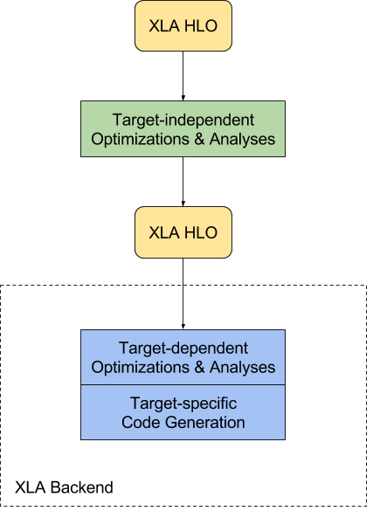
XLA
XLA (Accelerated Linear Algebra) is a domain-specific compiler for linear algebra that optimizes TensorFlow computations.
***OPTS**
Improve execution speed
Improve memory usage
Reduce reliance on custom Ops
Reduce mobile footprint.
Improve portability
https://goo.gl/rAsyHB

Slide 19
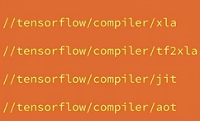
XLA

Slide 20
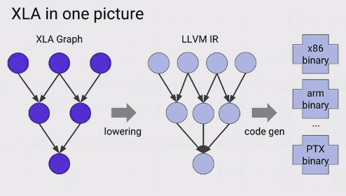
//tensorflow/compiler/xla
In general, XLA module is responsible to convert a given XLA Graph into binary by first lowering it into an LLVM IR, and after compiling the LLVM IR to given binary of a specific architecture (e.g. x86).

Slide 21
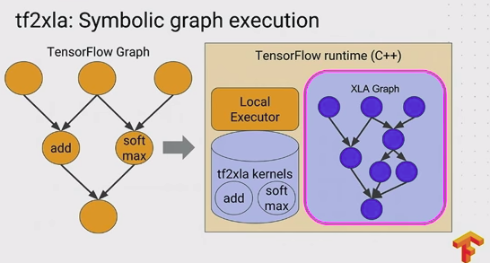
//tensorflow/compiler/tfa2xla
The tfa2xla module is responsible to convert an TFG into an XLA Graph. The example below convert the entire TFG into a XLA Graph (a common case when using AOT).

Slide 22
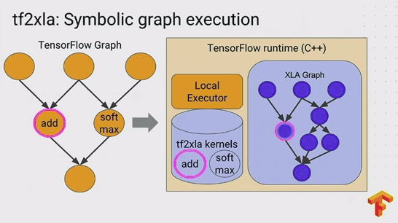
//tensorflow/compiler/tfa2xla
Each node of the TFG is converted into an XLA Graph’s node. Observe that the TFG add node is converted into an XLA add node.

Slide 23
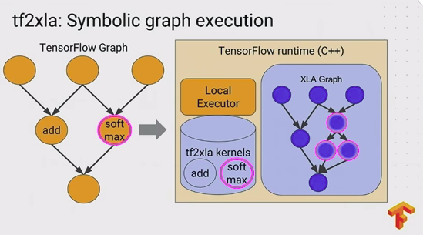
//tensorflow/compiler/tfa2xla
The TFG soft max node is converted into three XLA node.

Slide 24
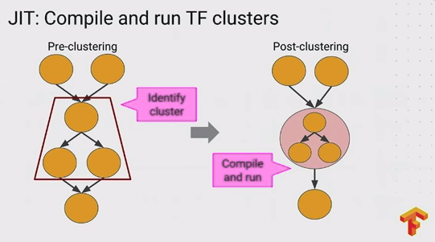
//tensorflow/compiler/jit

Slide 25
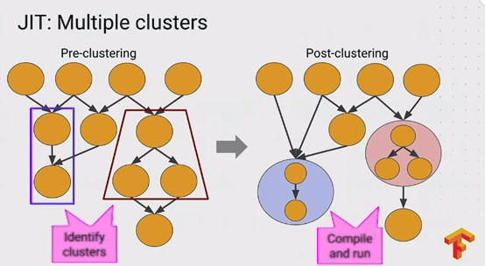
//tensorflow/compiler/jit

Slide 26
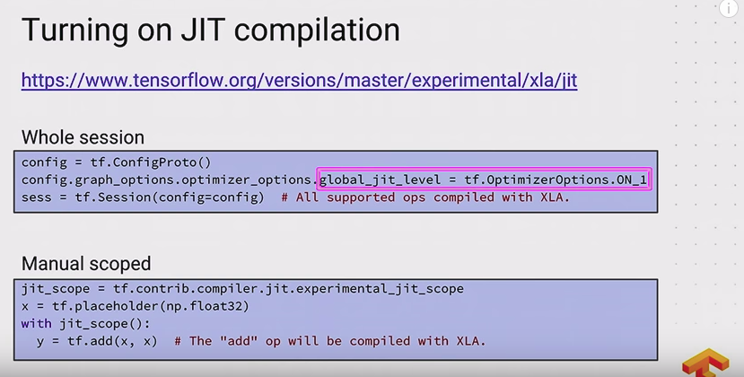
//tensorflow/compiler/jit

Slide 27
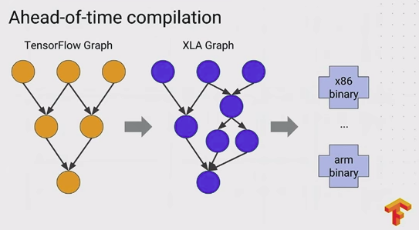
//tensorflow/compiler/aot

Slide 28
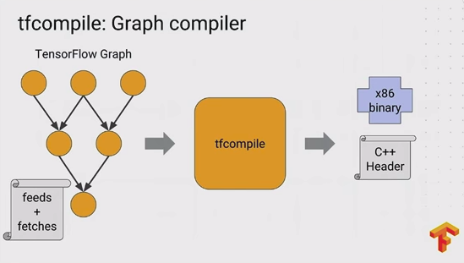
//tensorflow/compiler/aot

Slide 29
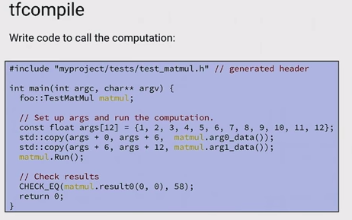
//tensorflow/compiler/aot

Slide 30
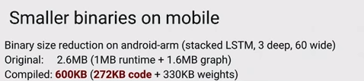
//tensorflow/compiler/aot

Slide 31
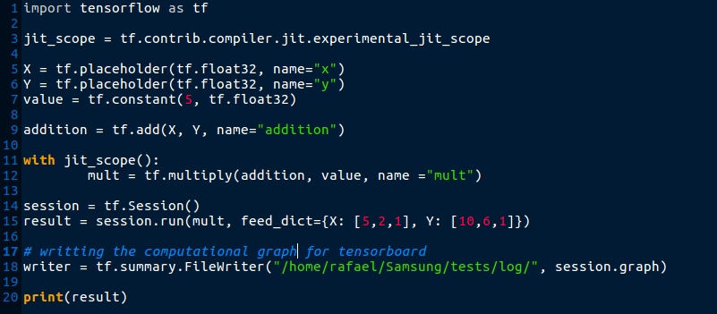
Example JIT
Print --> [ 75. 40. 10.]

Slide 32
tensorboard

Slide 33
Example of Protobuf
node {
name: "addition"
op: "Add"
input: "X"
input: "Y"
device: “CPU:0”
attr {
key: "T"
value {
type: DT_FLOAT
}
}
}

Slide 34
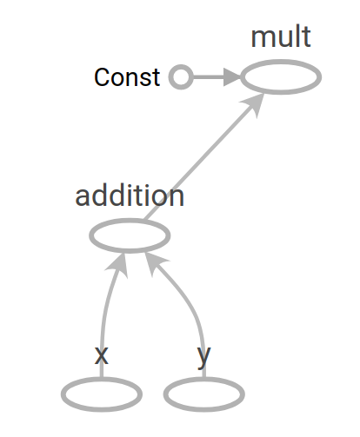
Execution -- python example.py
Y = _Arg[T=DT_FLOAT, index=1, CPU:0"]() is dead: 0
[10. 6. 1.]

Slide 35
Execution -- python example.py
X = _Arg[T=DT_FLOAT, index=0, CPU:0"]() is dead: 0
[5. 2. 1.]
[10. 6. 1.]

Slide 36
Execution -- python example.py
Const = Const[dtype=DT_FLOAT, value=Tensor<type: float shape: [] values: 5>, CPU:0"]() is dead: 0
5.
[5. 2. 1.]
[10. 6. 1.]

Slide 37
Execution -- python example.py
addition = Add[T=DT_FLOAT, CPU:0"](X,Y) is dead: 0
5.
[15. 8. 2.]
[5. 2. 1.]
[10. 6. 1.]

Slide 38
Execution -- python example.py
[XLA] mult = multiply[Targs=[DT_FLOAT, DT_FLOAT], Tresults=[DT_FLOAT], function=funcMult, _device="CPU:0"](addition, Const) is dead: 0
5.
[15. 8. 2.]
[15. 8. 2.]
[5. 2. 1.]
[10. 6. 1.]

Slide 39
XLA compilation
XlaCompilationCache::Compile XLA JIT compilation cache
  Signature: funcMult ,float[3],float[]
  num_inputs = 2
    0: dtype=float present=1 shape=[3]
    1: dtype=float present=1 shape=[]
  num_outputs = 1
    0: dtype=1
Compilation cache miss for the signature above!!

Slide 40
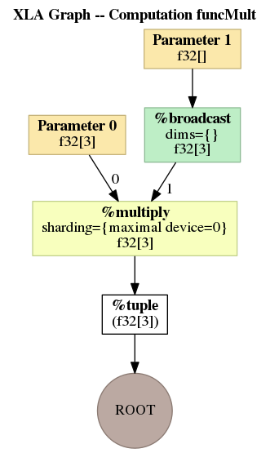
XLA Graph

Slide 41
XLA compilation

Slide 42
HLO IR
HloModule funcMult:
ENTRY %cluster_0[_XlaCompiledKernel=true,_XlaNumConstantArgs=0,_XlaNumResourceArgs=0].v4 (arg0: f32[3], arg1: f32[]) -> (f32[3]) {
%arg0 = f32[3]{0} parameter(0)
%arg1 = f32[] parameter(1)
%broadcast = f32[3]{0} broadcast(f32[] %arg1), dimensions={}
%multiply = f32[3]{0} multiply(f32[3]{0} %arg0, f32[3]{0} %broadcast), sharding={maximal device=0} # metadata=op_type: "Mul" op_name: "mult"
ROOT %tuple = (f32[3]{0}) tuple(f32[3]{0} %multiply)
}

Slide 43
XLA compilation

Slide 44
XLA compilation -- OPT
HLO pass pipeline CPU
HLO pass CallInliner
HLO pass convolution-canonicalization
HLO pass simplification
HLO pass batchnorm_rewriter
HLO pass algsimp
HLO pass tuple-simplifier
HLO pass dce
HLO pass reshape-mover
HLO pass constant_folding
HLO pass transpose-folding
HLO pass cse
HLO pass fusion
HLO pass layout-assignment
HLO pass algsimp
HLO pass cse
HLO pass cpu-parallel-task-assigner
HLO pass dce
HLO pass copy-insertion
HLO pass dce
HLO pass flatten-call-graph

Slide 45
XLA compilation

Slide 46
HLO IR
HloModule funcMult:
ENTRY %cluster_0[_XlaCompiledKernel=true,_XlaNumConstantArgs=0,_XlaNumResourceArgs=0].v4 (arg0: f32[3], arg1: f32[]) -> (f32[3]) {
%arg0 = f32[3]{0} parameter(0)
%arg1 = f32[] parameter(1)
%fusion = f32[3]{0} fusion:kLoop(f32[3]{0} %arg0, f32[] %arg1), calls=%fused_computation # metadata=op_type: "Mul" op_name: "mult"
%fused_computation (arg0.param_0: f32[3], arg1.param_1: f32[]) -> f32[3] {
%arg0.param_0 = f32[3]{0} parameter(0)
%arg1.param_1 = f32[] parameter(1)
%broadcast.1 = f32[3]{no layout} broadcast(f32[] %arg1.param_1), dimensions={}
ROOT %multiply.1 = f32[3]{0} multiply(f32[3]{0} %arg0.param_0, f32[3]{no layout} %broadcast.1), sharding={maximal device=0} # metadata=op_type: "Mul" op_name: "mult"
}
ROOT %tuple = (f32[3]{0}) tuple(f32[3]{0} %fusion)
}

Slide 47
XLA compilation

Slide 48
XLA compilation --LLVM IR
; ModuleID = '__compute_module'
source_filename = "__compute_module"
target datalayout = "e-m:e-i64:64-f80:128-n8:16:32:64-S128"
target triple = "x86_64-unknown-linux_gnu"
define void @multFunc(i8* align 8 dereferenceable(8) %retval, i8* noalias %run_options, i8** noalias %params, i8** noalias %temps, i64* noalias %prof_counters) #0 {
entry:
%fusion.invar_address.dim.0 = alloca i64
%0 = getelementptr inbounds i8*, i8** %params, i64 0
%arg0.untyped = load i8*, i8** %0, !invariant.load !0, !dereferenceable !1, !align !2
%1 = bitcast i8* %arg0.untyped to [3 x float]*
%2 = getelementptr inbounds i8*, i8** %params, i64 1
%arg1.untyped = load i8*, i8** %2, !invariant.load !0, !dereferenceable !3, !align !2
%3 = bitcast i8* %arg1.untyped to float*
%4 = getelementptr inbounds i8*, i8** %temps, i64 0
%5 = load i8*, i8** %4, !invariant.load !0, !dereferenceable !1, !align !2
%fusion = bitcast i8* %5 to [3 x float]*
store i64 0, i64* %fusion.invar_address.dim.0
br label %fusion.loop_header.dim.0
fusion.loop_header.dim.0: ; preds = %fusion.loop_body.dim.0, %entry
%fusion.indvar.dim.0 = load i64, i64* %fusion.invar_address.dim.0
%6 = icmp uge i64 %fusion.indvar.dim.0, 3
br i1 %6, label %fusion.loop_exit.dim.0, label %fusion.loop_body.dim.0
fusion.loop_body.dim.0: ; preds = %fusion.loop_header.dim.0
%7 = getelementptr inbounds [3 x float], [3 x float]* %1, i64 0, i64 %fusion.indvar.dim.0
%8 = load float, float* %7, !invariant.load !0, !noalias !4
%9 = load float, float* %3, !invariant.load !0, !noalias !4
%10 = fmul fast float %8, %9
%11 = getelementptr inbounds [3 x float], [3 x float]* %fusion, i64 0, i64 %fusion.indvar.dim.0
store float %10, float* %11, !alias.scope !4, !noalias !7
%invar.inc = add nuw nsw i64 %fusion.indvar.dim.0, 1
store i64 %invar.inc, i64* %fusion.invar_address.dim.0
br label %fusion.loop_header.dim.0
fusion.loop_exit.dim.0: ; preds = %fusion.loop_header.dim.0
%tuple = bitcast i8* %retval to [1 x i8*]*
%12 = getelementptr inbounds [1 x i8*], [1 x i8*]* %tuple, i64 0, i64 0
%13 = bitcast [3 x float]* %fusion to i8*
store i8* %13, i8** %12, !alias.scope !7, !noalias !4
%prof_counter.computation = getelementptr i64, i64* %prof_counters, i64 0
ret void
}

Slide 49
XLA compilation -- x86_64
0x00000000 mov rax, qword ptr [rdx]
0x00000003 mov rdx, qword ptr [rdx + 8]
0x00000007 mov rcx, qword ptr [rcx]
0x0000000a vmovss xmm0, dword ptr [rdx]
0x0000000e vmulss xmm1, xmm0, dword ptr [rax]
0x00000012 vmovss dword ptr [rcx], xmm1
0x00000016 vmulss xmm1, xmm0, dword ptr [rax + 4]
0x0000001b vmovss dword ptr [rcx + 4], xmm1
0x00000020 vmulss xmm0, xmm0, dword ptr [rax + 8]
0x00000025 vmovss dword ptr [rcx + 8], xmm0
0x0000002a mov qword ptr [rdi], rcx
0x0000002d ret

Slide 50
Execution -- python example.py
[XLA] mult = multiply[Targs=[DT_FLOAT, DT_FLOAT], Tresults=[DT_FLOAT], function=funcMult, _device="CPU:0"](addition, Const) is dead: 0
5.
[ 75. 40. 10.]
funcMult found
[15. 8. 2.]
[5. 2. 1.]
[10. 6. 1.]

Slide 51
Execution -- python example.py
retval(mult)
[ 75. 40. 10.]
5.
[ 75. 40. 10.]
[15. 8. 2.]
[5. 2. 1.]
[10. 6. 1.]

Slide 52
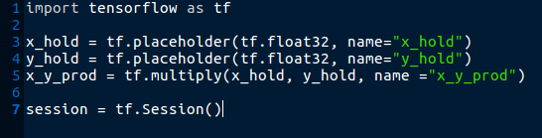
Example AOT

Slide 53
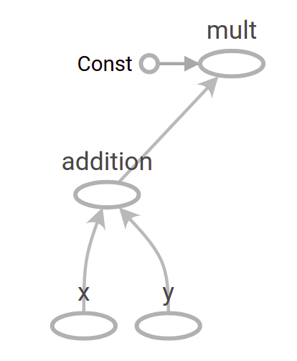
TensorFlow Graph
It is necessary to create the protobuf from the TensorFlow Graph
tfmatmul.pb

Slide 54
Feeds and Fetches
feed {
id { node_name: "x_hold" }
shape {
dim { size: 2 }
dim { size: 3 }
}
}
feed {
id { node_name: "y_hold" }
shape {
dim { size: 3 }
dim { size: 2 }
}
}
fetch {
id { node_name: "x_y_prod" }
}
tfmatmul.config.pbtxt

Slide 55
Invoke tfcompile
load("//third_party/tensorflow/compiler/aot:tfcompile.bzl", "tf_library")
# Use the tf_library macro to compile your graph into executable code.
tf_library(
name = "tfmatmul",
cpp_class = "foo::bar::MatMulComp",
graph = "tfmatmul.pb",
config = "tfmatmul.config.pbtxt",
)
Invoke the tfcompile passing this script as parameter

Slide 56
tfcompile OPT
tfcompile makes use of XLA optimizations by converting the protobuf into HLO IR.

Slide 57
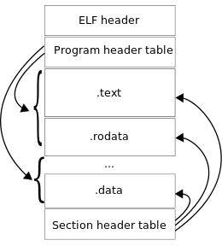
tfcompile results (header and binary)
namespace foo {
namespace bar {
class MatMulComp {
public:
enum class AllocMode {
ARGS_RESULTS_AND_TEMPS, // Allocate arg, result and temp buffers
RESULTS_AND_TEMPS_ONLY, // Only allocate result and temp buffers
};
MatMulComp(AllocMode mode = AllocMode::ARGS_RESULTS_AND_TEMPS);
~MatMulComp();
bool Run();
void** args();
void set_arg0_data(float* data);
float* arg0_data();
float& arg0(size_t dim0, size_t dim1);
void set_arg1_data(float* data);
float* arg1_data();
float& arg1(size_t dim0, size_t dim1);
void** results();
float* result0_data();
float& result0(size_t dim0, size_t dim1);
};
} // end namespace bar
} // end namespace foo
tfcompile has as result one header file and one binary (e.g. x86).

Slide 58
Using the header and binary files
#define EIGEN_USE_THREADS
#define EIGEN_USE_CUSTOM_THREAD_POOL
#include <iostream>
#include "third_party/eigen3/unsupported/Eigen/CXX11/Tensor"
#include "tensorflow/compiler/aot/tests/test_graph_tfmatmul.h" // generated
int main(int argc, char** argv) {
Eigen::ThreadPool tp(2); // Size the thread pool as appropriate.
Eigen::ThreadPoolDevice device(&tp, tp.NumThreads());
foo::bar::MatMulComp matmul;
matmul.set_thread_pool(&device);
// Set up args and run the computation.
const float args[12] = {1, 2, 3, 4, 5, 6, 7, 8, 9, 10, 11, 12};
std::copy(args + 0, args + 6, matmul.arg0_data());
std::copy(args + 6, args + 12, matmul.arg1_data());
matmul.Run();
// Check result
if (matmul.result0(0, 0) == 58) {
std::cout << "Success" << std::endl;
} else {
std::cout << "Failed. Expected value 58 at 0,0. Got:"
<< matmul.result0(0, 0) << std::endl;
}
return 0;
}
Compile the code linking the binary generated by
tfcompile and execute.

