Slide 1
Retinal image segmentation

Slide 2
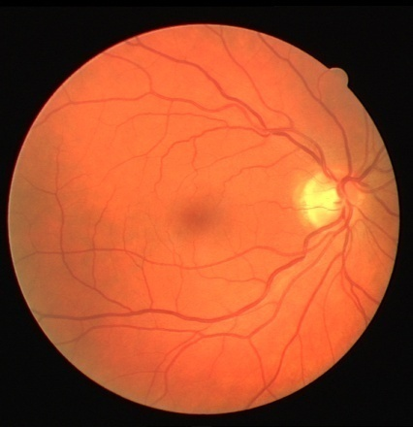
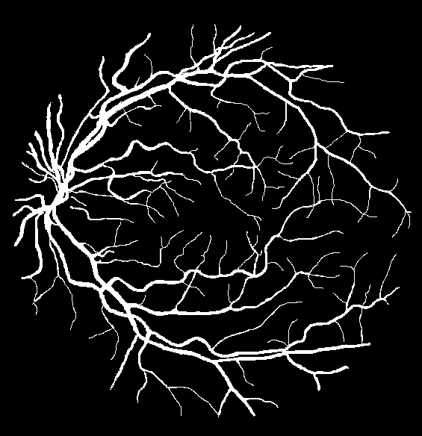
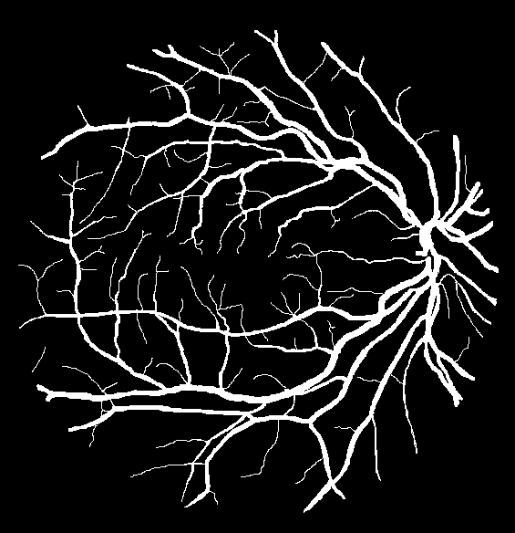
The problem
Retina Image
?
Manually extracted
Vessels
(Ground Truth)

Slide 3
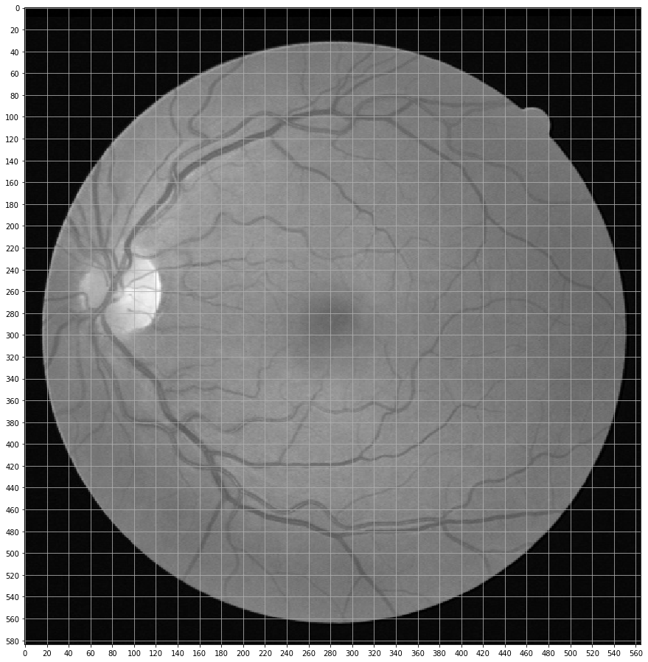
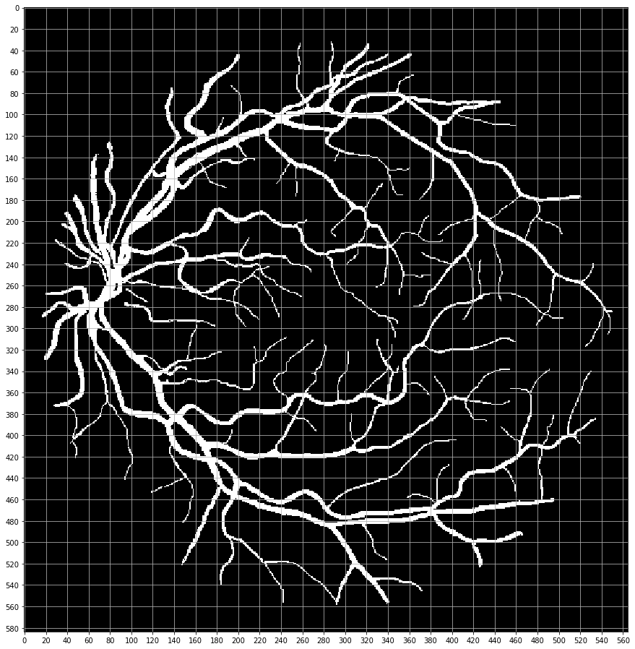
Data Pre_Processing
Convert to gray scale and sampling
0
0
1
0
0.007843 | 0.007843 | 0.007843 | 0.007843

Slide 4
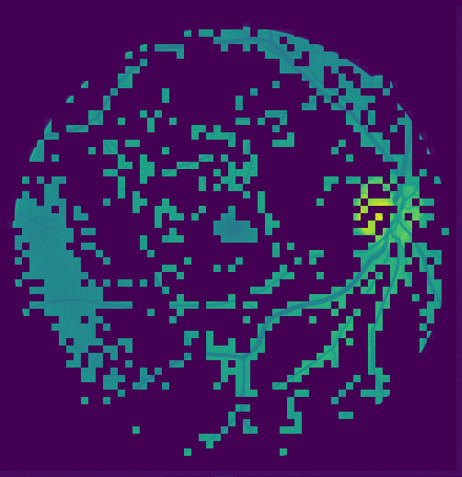
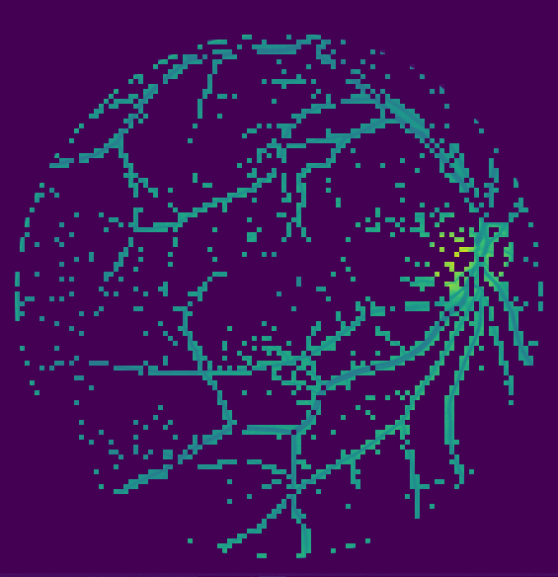
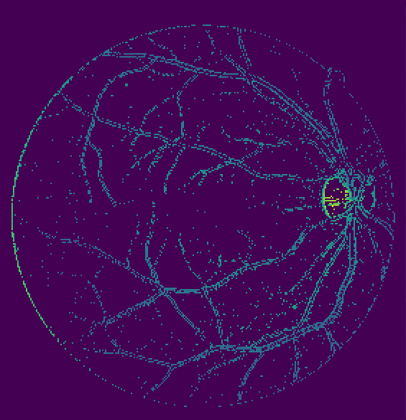
Feature matrix
P1 | P2 | P3 | p4 | Class
1.151778 | 1.10134 | 1.175307 | 1.161288 | -1
1.047569 | 0.990985 | 1.13438 | 1.078331 | 1
Grid size ?
9
5
2

Slide 5
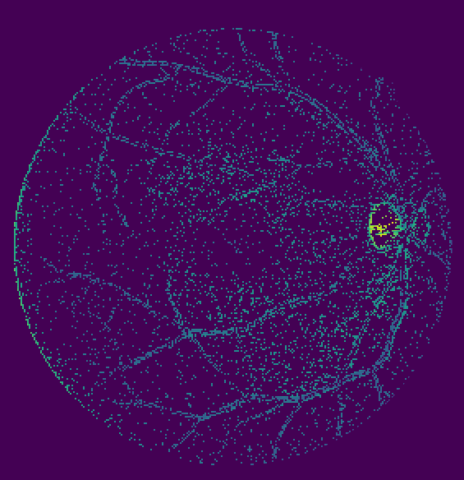
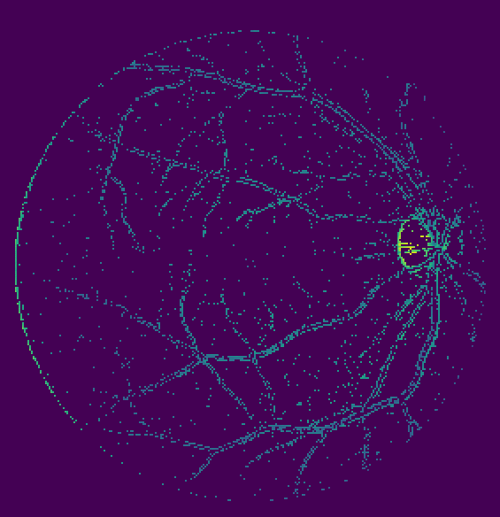
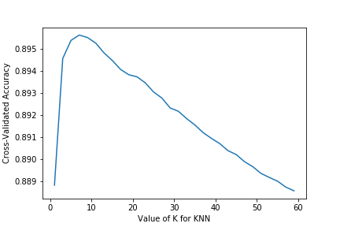
KNN
Cross validation : 10 fold .
Accuracy : 89.56 % .
Tuning and Output

Slide 6
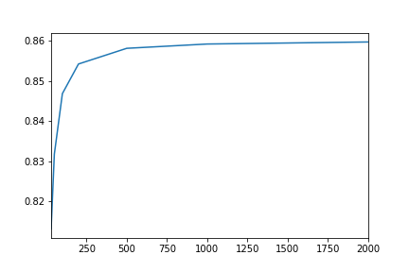
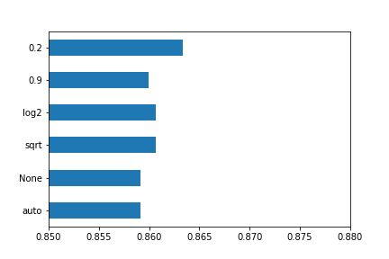
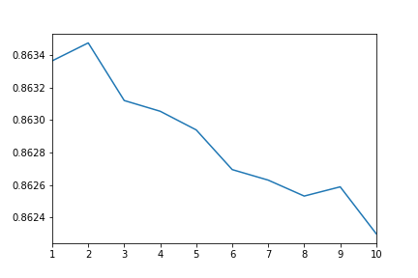
Random forest
Cross validation : 10 fold .
Accuracy : 89.60 % .
Tuning and Output
N_Estimators
Max_Features
Min_Samples_Leaf

Slide 7
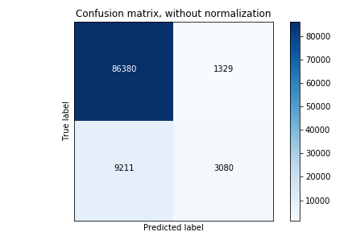
Confusion Matrix
KNN
Random Forest
True Positives :Bottom right square shows number of correctly predicted vessel pixels .
True Negatives: Upper left square shows number of correctly predicted non vessel pixels.
False Positives: Upper right, incorrectly predicted that pixels are vessels.
False Negatives :Bottom left, incorrectly predicted that pixels are not vessels.

Slide 8
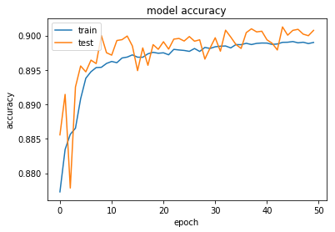
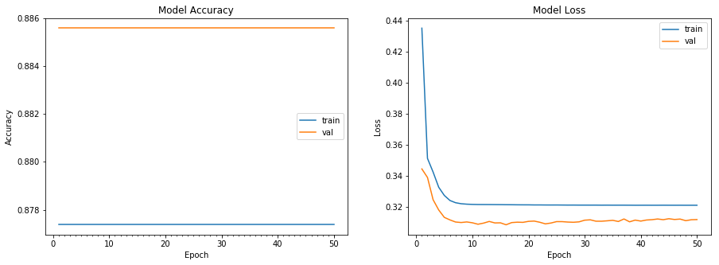
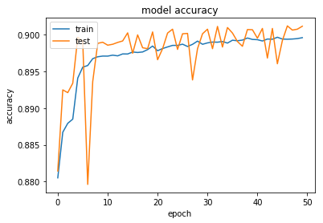
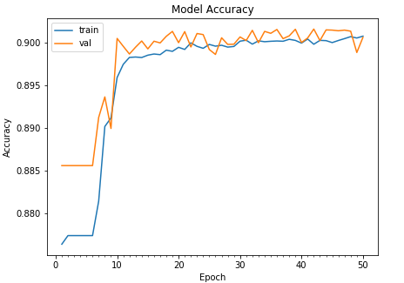
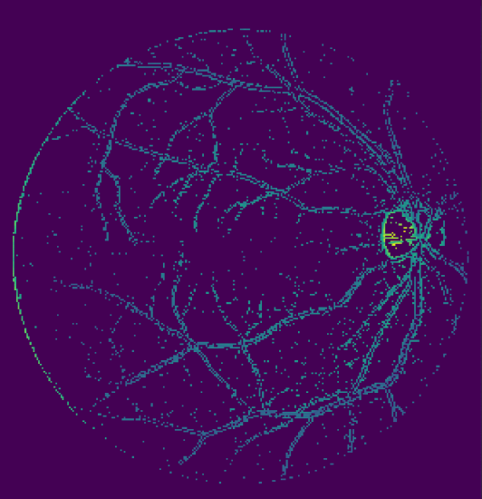
Fully connected NN
10-1000-1 > 89.97%
NN structure :
4-2-1 > 87.82%
16-1000-100-1000-1 > 90.12%
10-1000-50-50-50-50-1 > 90.0%

Slide 9
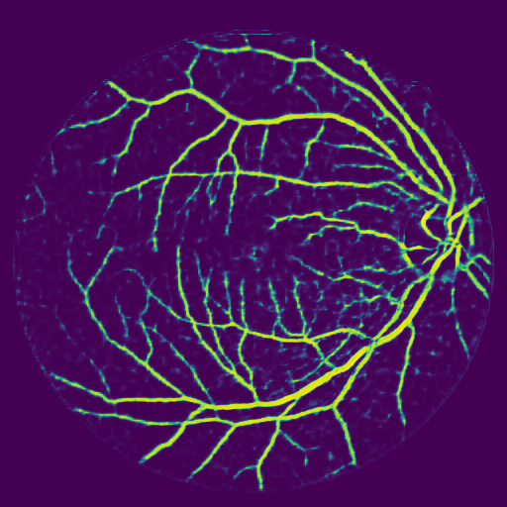
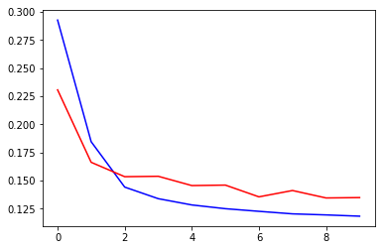
convolutional neural network
CNN structure :
The result :
8 convolutional layer
8 | 16 | 32 | 32 | 32 | 24 | 16 | 64
1 output layer
1

Slide 10
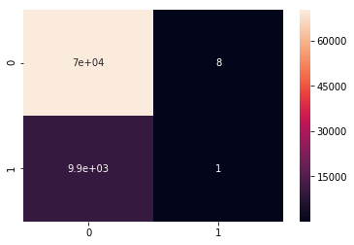
Manually created Algorithms
Logistic regression.
Neural network :
1 input layer, 1 hidden network,1 output layer

