Slide 1

Credit card marketing improvement project
Team 6:
Alex, Louis & Borja

Slide 2
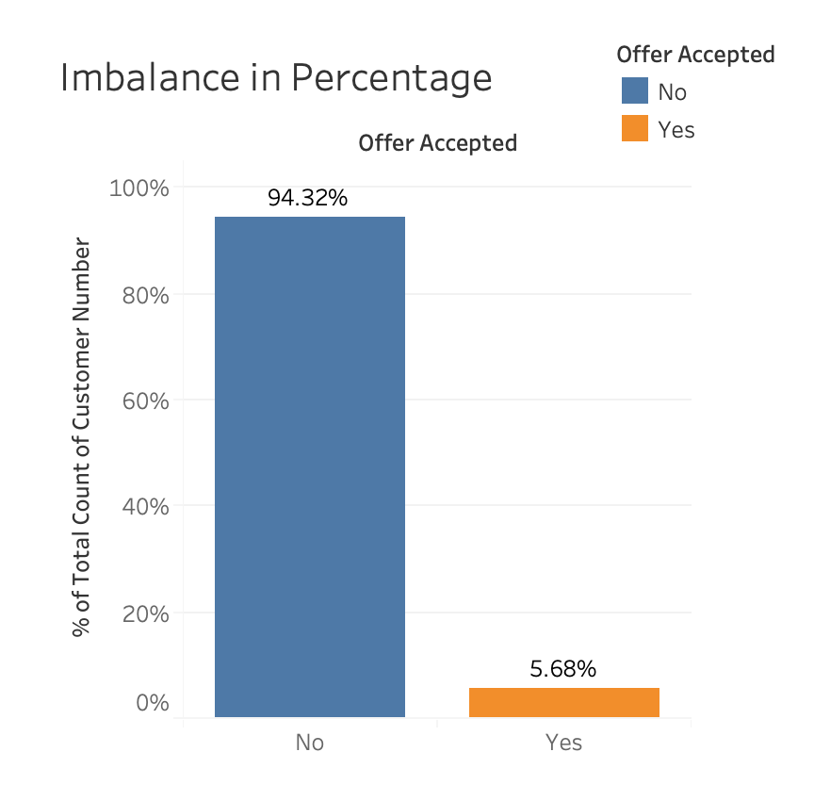
Credit card offer acceptance
As we can see on the graph, most customers did not accept the offer
Let’s discuss how the bank can increase the percentage of accepted offers in the following slides

Slide 3
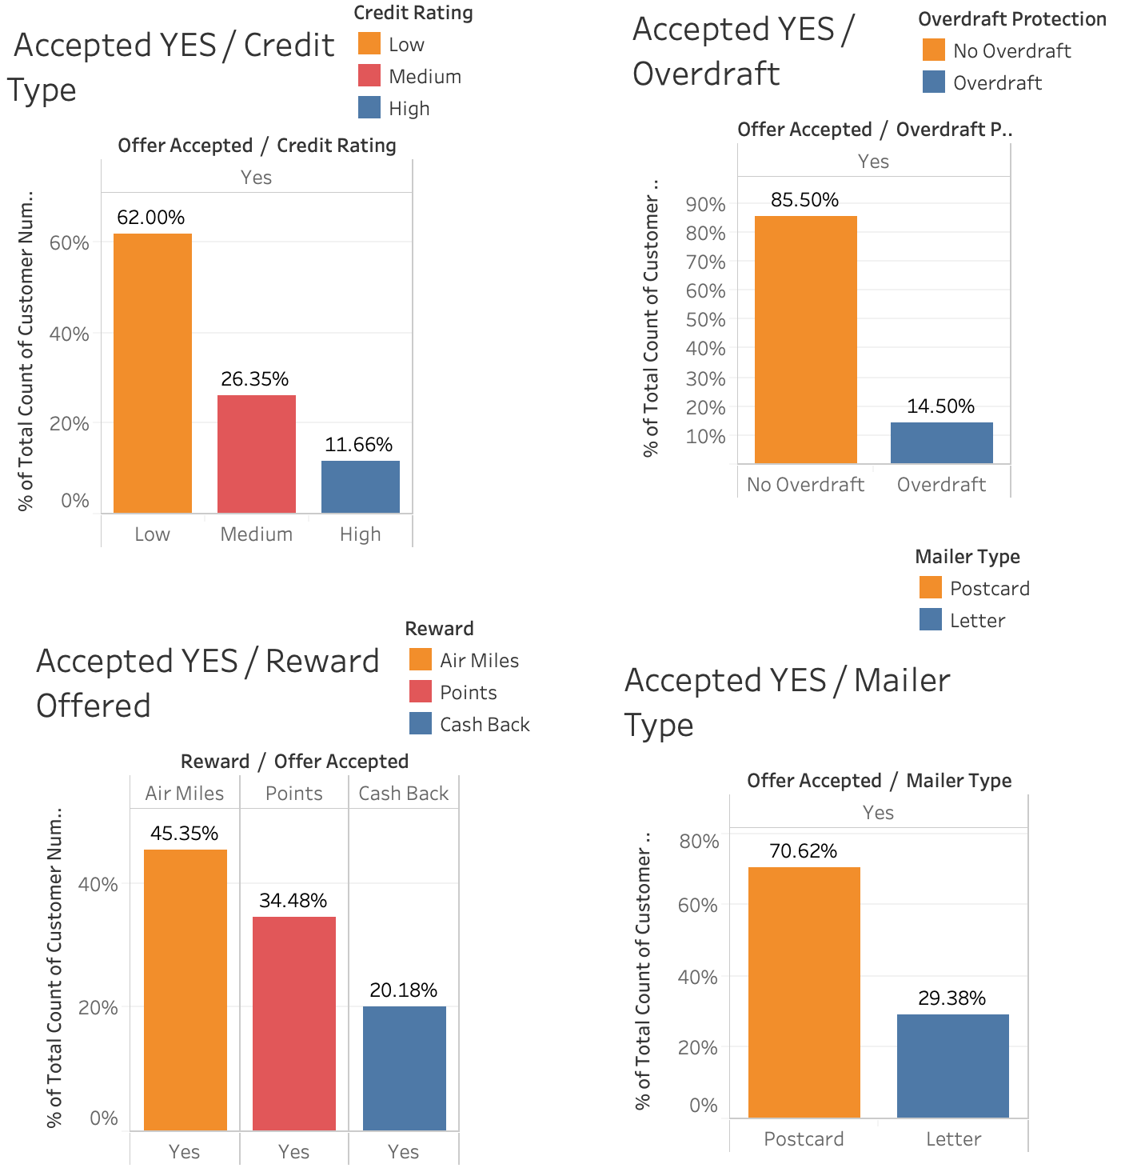
Data exploration
Characteristics of customers who accepted the offer:
Low credit rating
No overdraft protection
Air Miles offer
Received postcard from the campaign
In order to increase the acceptance rate, the bank should focus on customers with these characteristics

Slide 4
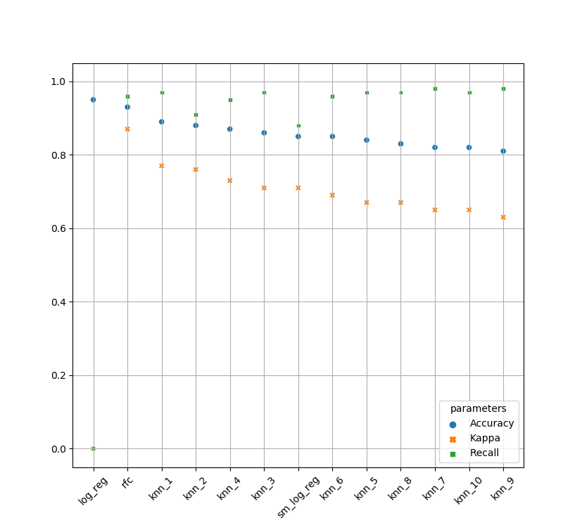
Data pre-processing, processing and modelling
Data processing
Feature selection: VIF > 5
Correlation between balance and quarterly balances
Data transformation didn’t improve results
Few customers had large balances
Train / test split
80% train / 20% test produced the best results
Model selection
We decided to go with the Random Forest model due to Accuracy, Kappa and Recall(0) scores.
Recall(0): 0.96 for our model captures most potential customers

Slide 5
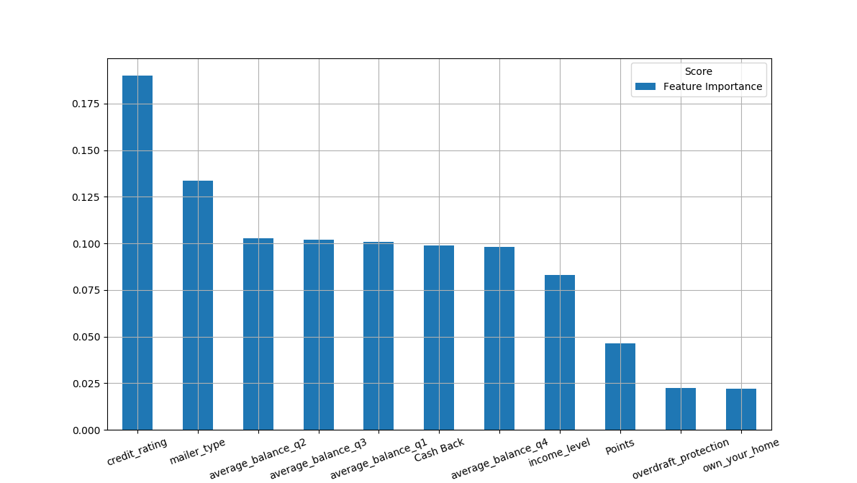
Feature importance
Credit rating is the most important feature. This is inline with our expectation derived from data exploration.
Mailer type also play a key role during the decision process of the client.

Slide 6
Actionable insights and future next steps
Target customers who:
have a low credit rating
don’t have overdraft protection
Engage in a strategic partnership with airlines to credit cards that have Air Miles rewards
Target customers using postcards
Future next steps:
Explore how can we turn customers that did not accept the offer into ‘yes’ customer ?

Slide 7
Thank you!

