Slide 1


Slide 2
“Go is an attempt to combine the ease of programming of an interpreted, dynamically typed language with the efficiency and safety of a statically typed, compiled language.”
https://golang.org/doc/faq

Slide 3
Inhalt
Slice
Vererbung durch Komposition
Reflection
Garbage Collection
Multiple Return Values (anderes Team?)
Concurrency (anderes Team?)
Fazit

Slide 4
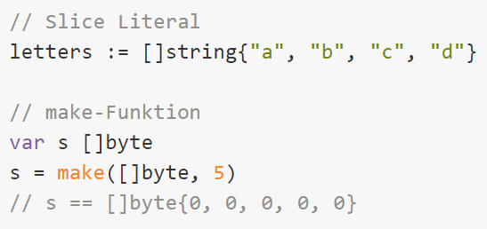
Slice

Slide 5
Multiple Return Values

Slide 6
Komposition mit Mixins (Inheritance)

Slide 7
Reflection

Slide 8
Fazit Team

Slide 9
Fazit Alex

Slide 10
Fazit Fabian

