Slide 1
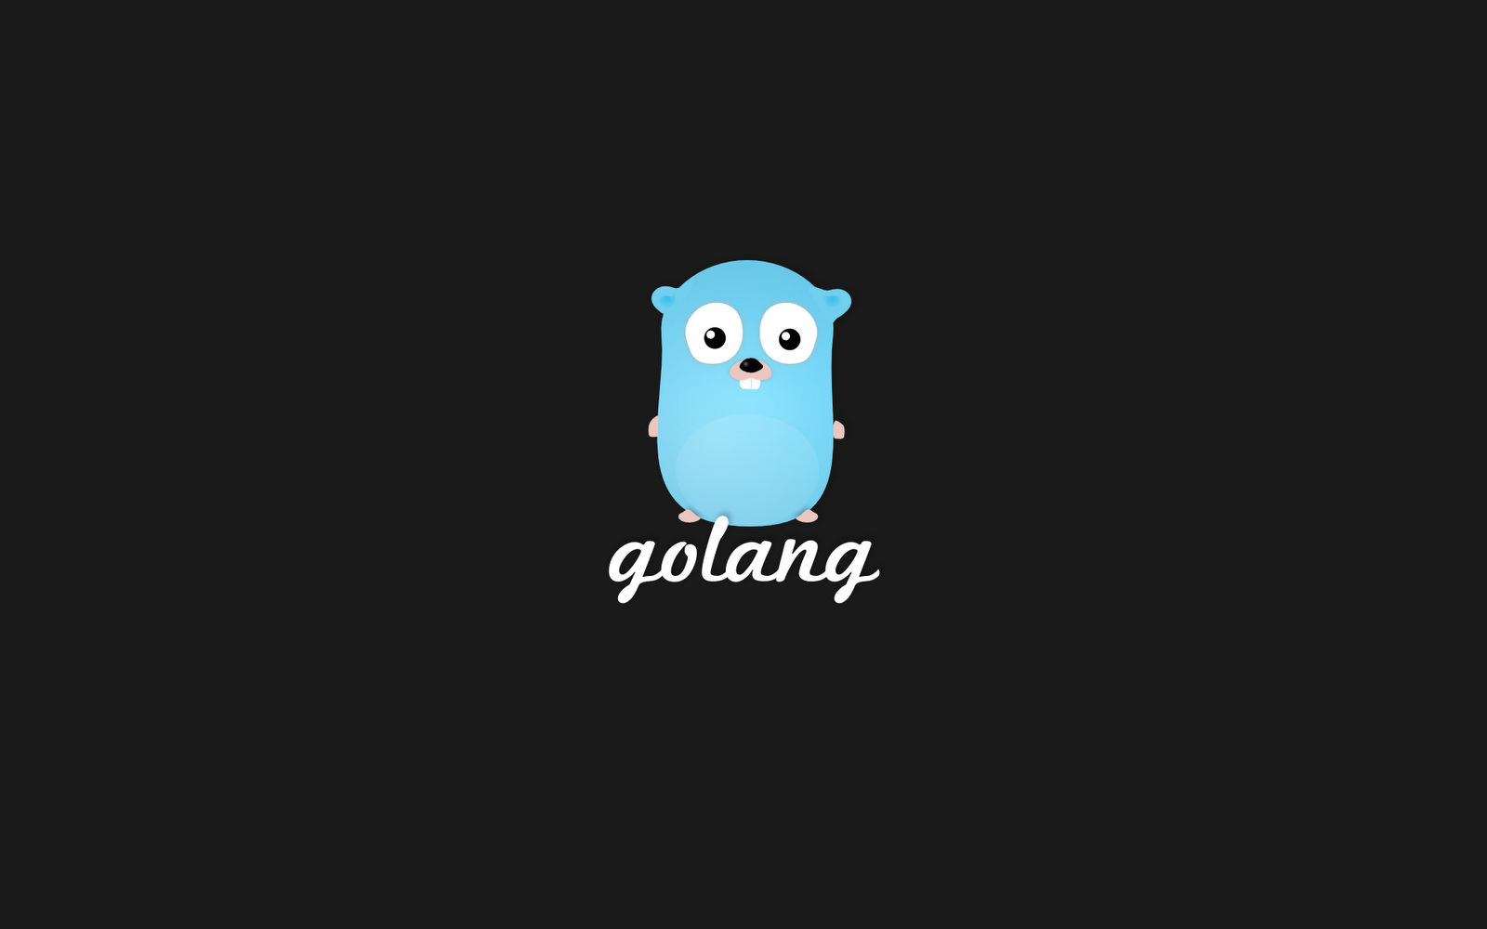

Slide 2
System Programmierung
Cli
webservice
“Go is an attempt to combine the ease of programming of an interpreted, dynamically typed language with the efficiency and safety of a statically typed, compiled language.”
https://golang.org/doc/faq

Slide 3
Warum und wofür
Docker
Golang.org

Slide 4
Inhalt
Slice
Vererbung durch Komposition
Reflection (Wollen wir nicht präsentieren)
Garbage Collection (go runtime
Multiple Return Values (anderes Team?)
Concurrency (anderes Team?)
Fazit

Slide 5
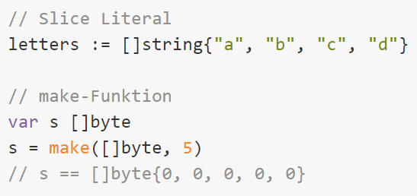
Slice

Slide 6
Multiple Return Values

Slide 7
Komposition mit Mixins (Inheritance)

Slide 8
Reflection

Slide 9
Fazit Team

Slide 10
Fazit Alex

Slide 11
Fazit Fabian

