Slide 1

Edison workshop
Alex Tereschenko <alext.mkrs@gmail.com>
This work is licensed under the Creative Commons Attribution 4.0 International License. To view a copy of this license, visit http://creativecommons.org/licenses/by/4.0/
*Other names and brands may be claimed as the property of others.

Slide 2
What's Edison
Intel(r) Edison* Compute Module is a System on Module (SOM), fully-featured computer on a 25mm x 35.5mm board
You use it with either off-the-shelf or custom designed expansion boards
It is certified for Wi-Fi and Bluetooth in 68 countries, making it easier to create commercial products/prototypes with the Module as a core
*Other names and brands may be claimed as the property of others.

Slide 3
Compute Module HW specs
CPU: 2x500MHz 32-bit Atom™ cores with SSE support
MCU: 1x100MHz 32-bit Quark™ core
RAM: 1GB 2-channel LPDDR3
Flash: 4GB eMMC
Wireless: dual-band WiFi 802.11 a/b/g/n with onboard antenna, BT 4.0 (including Low Energy)
Connectivity/buses: SD controller, 2xUART, 2xI2C, 1xSPI, 1xI2S, 12xGPIO (4xPWM), 1xUSB 2.0 OTG, 2x Clock output (32 KHz, 19.2 MHz)
See more details in Hardware Guides, URLs are on the Links slide

Slide 4
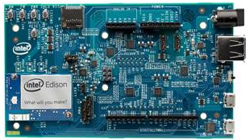
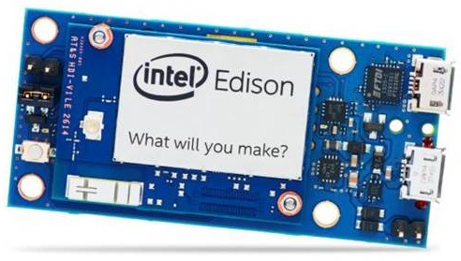
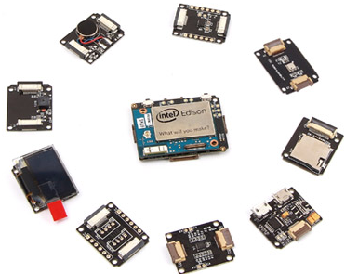
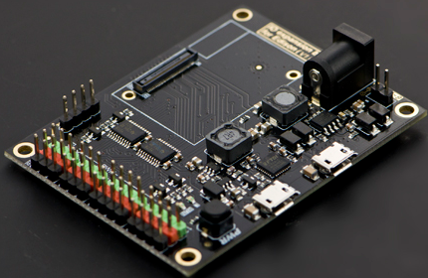
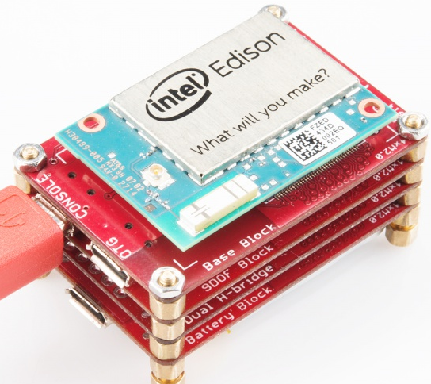
Expansion boards
Intel(r) Edison Kit for Arduino*
Intel(r) Edison Breakout Board Kit
SparkFun Blocks for Edison
Xadow Wearable Kit
DFRobot IO Expansion Shield
+ more, just search
*Other names and brands may be claimed as the property of others.

Slide 5
Software environment
Main OS: Linux-based, Yocto Poky 1.7.2 (kernel 3.10.17)
  There's an unofficial package repo supported by yours truly, see instructions at http://alextgalileo.altervista.org/edison-package-repo-configuration-instructions.html
MCU: Viper* RTOS kernel
*Other names and brands may be claimed as the property of others.

Slide 6





Programming Edison
Intel(r) XDK IoT Edition (JavaScript/Node.js)
Eclipse (C/C++/Java)
Arduino IDE
Wyliodrin
Vi ☺ (C/C++/Java/Python/JS – via mraa & upm)
MCU is programmed with Eclipse-based MCU SDK using C

Slide 7
Hands-on

Slide 8
Workshop project
Weather station
Getting data from temperature and light sensors
Displaying data on an LCD screen
Presenting data through a web interface
A simple example for you to get the hang of Edison

Slide 9
Environment setup/prework
Install PuTTY (or your favorite terminal emulator)
Install WinSCP
Install Edison drivers from https://software.intel.com/en-us/iot/hardware/edison/downloads (look for “Windows Standalone Driver”)
Connect Grove Temperature Sensor module to a Base Shield connector A0, Grove Light module to A1, Grove LCD to any connector marked “I2C”
Connect Edison's microUSB port marked J16 (the middle one) to your computer. Edison should power on and boot and you should see Virtual COM and RNDIS devices created in Device Manager.
Make sure your computer has an address from 192.168.2.x/24 subnet range assigned to the virtual RNDIS adapter. If it doesn't just configure using standard means or ask the instructor :)

Slide 10
Implementation
We'll use MRAA library through UPM modules
We'll use Python and directly edit files on the device using your preferred text editor and WinSCP
All sources and slides themselves are available at https://github.com/alext-mkrs/edison-workshop

Slide 11
Implementation – contd.
Login to your Edison using PuTTY, username is “root”, password is empty. Connect using WinSCP as well – that way you can edit files on the board by just double-clicking them in WinSCP.
Look into the /home/root/edison-workshop/code directory, run the run.py script to see how it works. Open your browser and go to http://192.168.2.15:5000 , that should be the address and the port for our app running on Edison
Create a new directory and start creating your own version, or just go an modify the existing sources to see how it works
If you want to pursue your own project – go ahead and feel free to use other sensors available

Slide 12
Things to try further
Get Bluetooth-enabled sensors and access them using PyBlueZ
Draw nice charts using something like http://www.highcharts.com/demo/combo-meteogram
Upload data to the cloud for further analysis and data preservation, e.g. http://enableiot.com or Xively or whatever else.

Slide 13
Links
Edison home page: http://www.intel.com/content/www/us/en/do-it-yourself/edison.html
Edison main downloads page: https://software.intel.com/en-us/iot/hardware/edison/downloads
Edison Compute Module hardware Guide: http://www.intel.com/support/edison/sb/CS-035274.htm
Edison Kit for Arduino Hardware Guide: http://www.intel.com/support/edison/sb/CS-035275.htm
Edison Mini-breakout Board Hardware Guide: http://www.intel.com/support/edison/sb/CS-035252.htm
Mraa library: https://github.com/intel-iot-devkit/mraa
UPM: https://github.com/intel-iot-devkit/upm

