Slide 1


GrabSchool “Bus” Service for the Modern Era
Proposed by:
Swee Meng
Alex Tan
Michael Leow Younes Saadi

Slide 2
Objectives
To identify the relation between schools and traffic in KL
To propose an approach which will be called GrabSchool, that will provide safe and reliable alternative to send kids to school.
To measure the efficiency of GrabSchool

Slide 3
Traffic Data in Kuala Lumpur?
Is there a correlation between schools and traffic in KL?
Notes:
Congestion ..

Slide 4
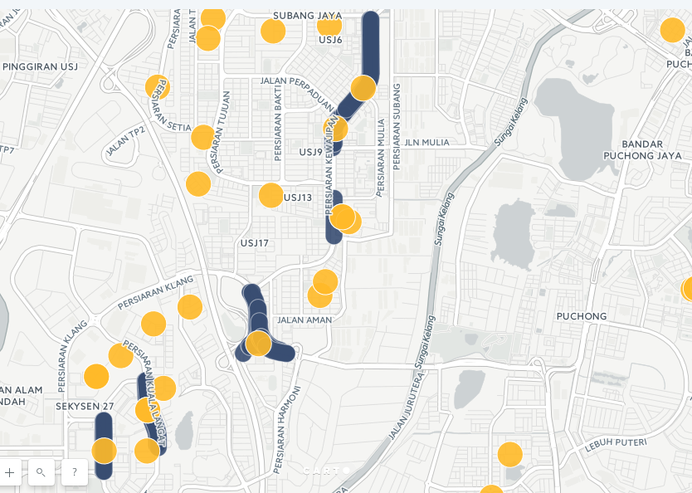

Slide 5
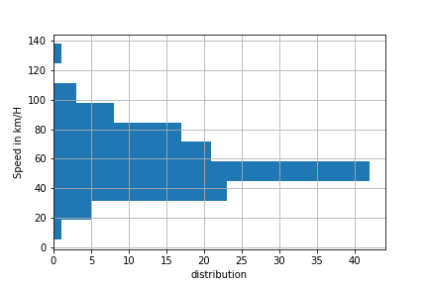
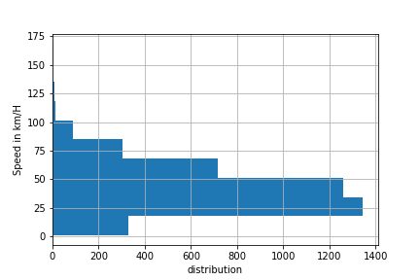
Sample at Morning Session
Notes:
Mod – 5am – 55,
Mod – 7 am – 46,

Slide 6
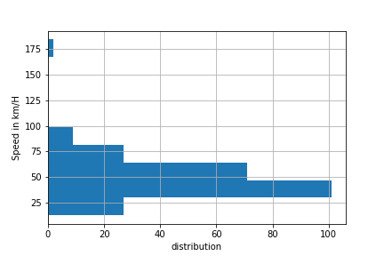
Control Sample (Evening + Morning)
Notes:
Global 7: M

Slide 7
Solution
- Offer parents a trusted platform to send their children to schools
- Multiple drivers are interviewed
- Car-pooling to schools for kids
- Teachers can verify the driver’s identity and track the drivers position
- Additional revenue for drivers to send children to extracurricular activities
- Save money for transportation

Slide 8
Resources
https://sweemeng.carto.com/builder/014ea7e6-1c13-11e7-acf4-0ef24382571b/
https://github.com/alextanhongpin/mytraffichack-school-data

Slide 9
Thanks

