Slide 1
How to organise your work more efficiently?
Project Management
Team Work
Efficincy
Results
Allowing for feedback
?AGILE??

Slide 2
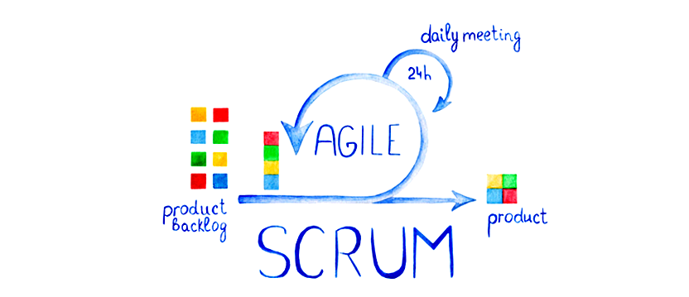
SCRUM

Slide 3
SCRUM
Agile Proj. Management framework: allows for feedback and continuous improvements + potential demo product at every stage.
Allows for: Transparency, inspection, adaptation

Slide 4
TEAM
Prod. Owner sets goals
SCRUM Master: point of contact for blockages
Team Members (commit to objs)
5 Values:
Commitment
Courage
Focus
Openness
Respect

Slide 5
Process
SPRINT(2 wks): proj is split into different stages
SPRINT PLANNING: team selects which items to work on (prod. Owner doesn't interefere)
DAILY STAND-UP (15mins):
  What did you do yesterday?
  What are you working on today?
  Any blockages?
SPRINT DEMO: features are shown to stakeholders
Sprint RETROSPECTIVE:
  What worked well?
  What did NOT work well?
  What should be improved?
Sprint Product is incremented into the Final Product

