Slide 1
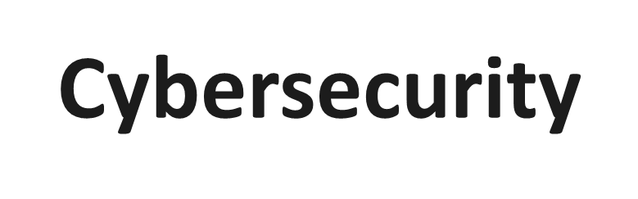
What is cybersecurity?
Cyberattacks
Principles
Tips

Slide 2

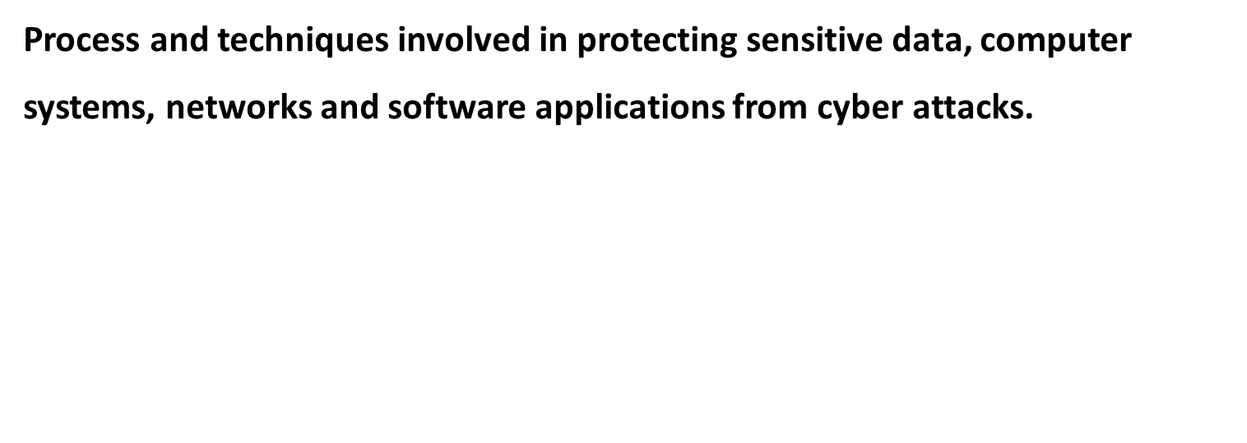

Slide 3




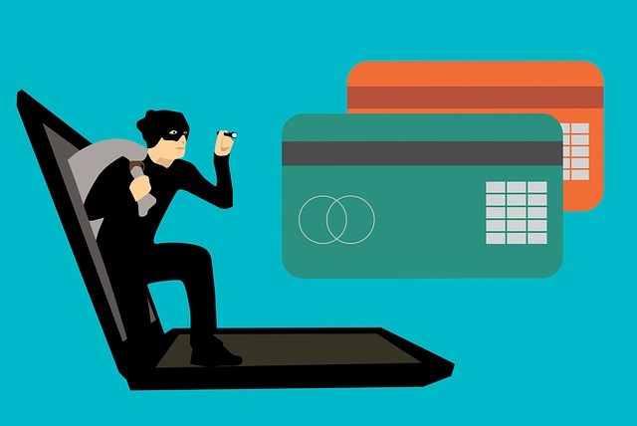
Botnet Attacks
access the network and injects malware to disrupt its working
Ransomware
Program that encrypts the files on the target system.
Common Cyber
Attacks
Social Engineering Attacks:
gathers sensitive info: tricks you by attractive ads and ask you to feed personal and bank account details. All the info is cloned and used for financial frauds.
Phishing
Spam emails imitating to be from legitimate source, aims to steal sensitive data

Slide 4
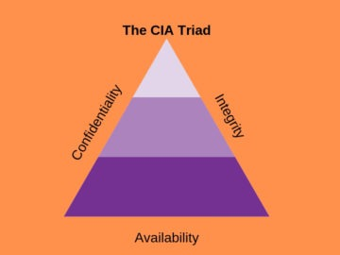
Principles
Confidentiality: rules that limit the access of information
Integrity: ensure data is consistent, accurate and trustworthy
Availability: all necessary components (ardware, software, networks, devices and security equipment) are maintained and upgraded.

Slide 5

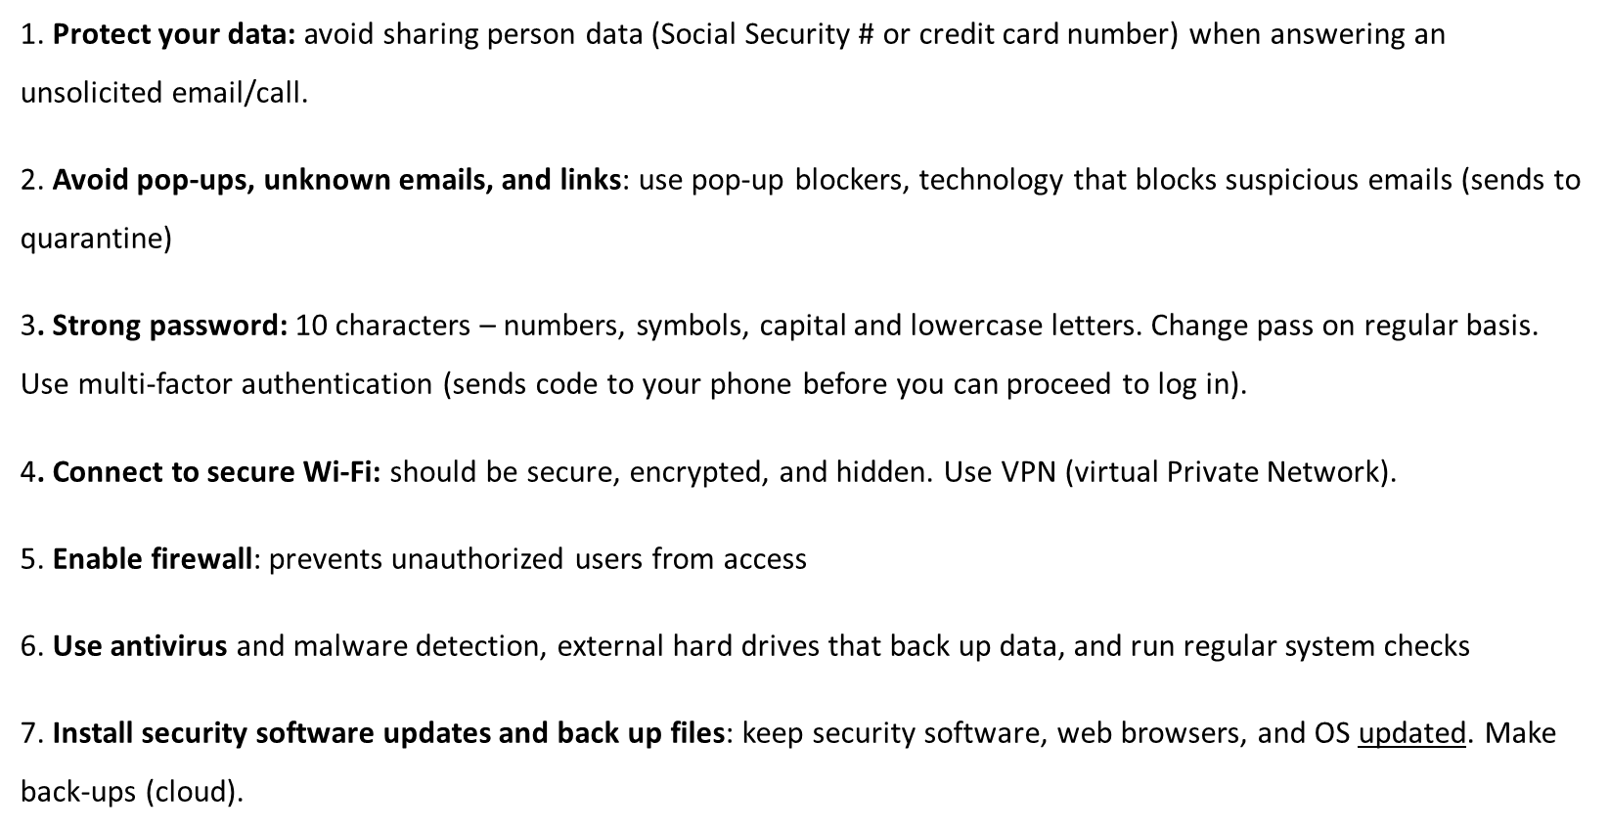
CyberSecurity Best Practices

