Slide 1

Web Components
Alexander Romanenko
Developer for The Steele Group

Slide 2






Slide 3
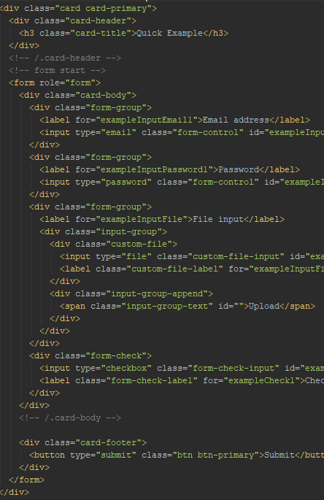
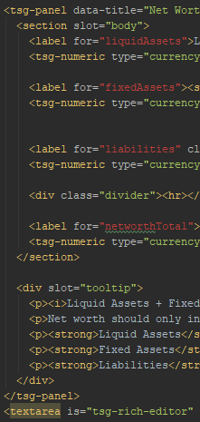

Slide 4


Tag attributes
Selectors
DOM node hierarchy
Events
Templates
(ES 6 classes)

Slide 5
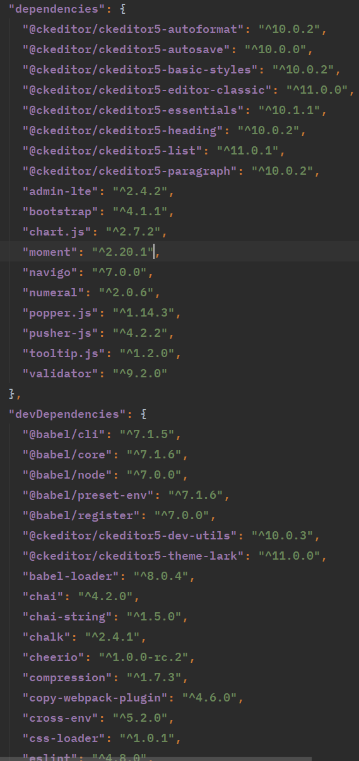
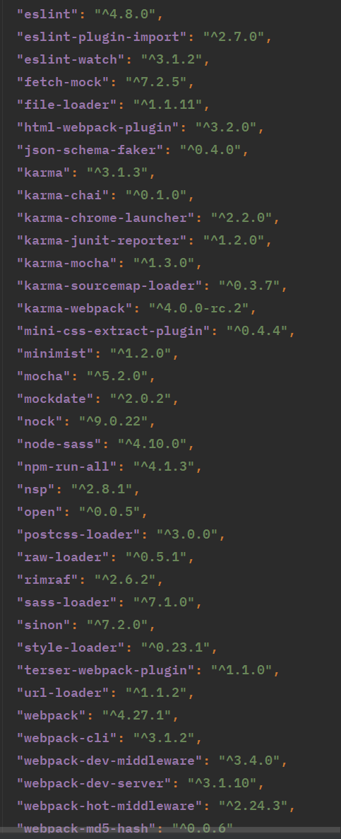
Notes:
Show running JS functions against component.

Slide 6
Resources
https://developers.google.com/web/fundamentals/web-components/customelements (https://bit.ly/2y4XfYj)
https://www.chromestatus.com/features/schedule
https://chrome.google.com/webstore/detail/css-used/cdopjfddjlonogibjahpnmjpoangjfff

Slide 7
Challenge
Validation of components adding up to a 100%
Formatted numeric field.
Accept required total as attribute

