Slide 1

Customer Segmentation for Promotional Campaign Strategy

Slide 2
Cleaning
EDA
MODEL - CLUSTERING
RESULTS

Slide 3
Cleaning Process
Dropped columns that had the same information across the board
Dropped Nan values
Got rid of irregular registrations in the Marital Status column
Dropped outliers found in the Income column
Processed categorical values in order to make them usable in the model
Processed registrations that contained dates to make them usable in the model

Slide 4
Exploratory Data Analysis
Insights
The Amount of money spent on different product categories is highly correlated to the annual Income of the customer

Slide 5
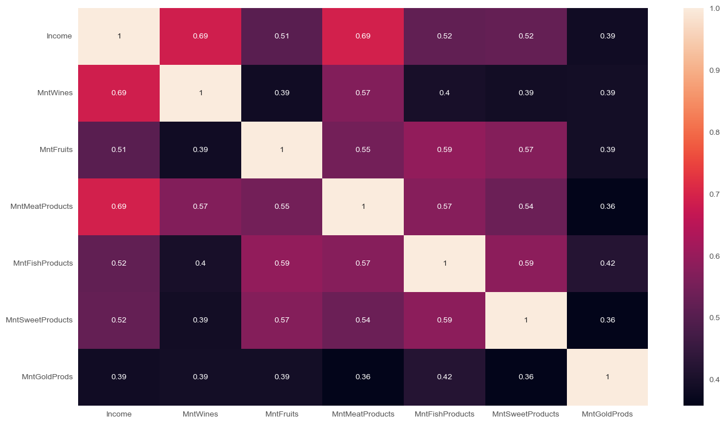
Correlation Heatmap

Slide 6
Clustering using K-means
Two Clustering Paths
Silhouette score: a metric used to measure how well-defined the clusters are.
High silhouette score = Good Low silhouette score = Bad
After Scaling our data
Without Scaling our data

Slide 7
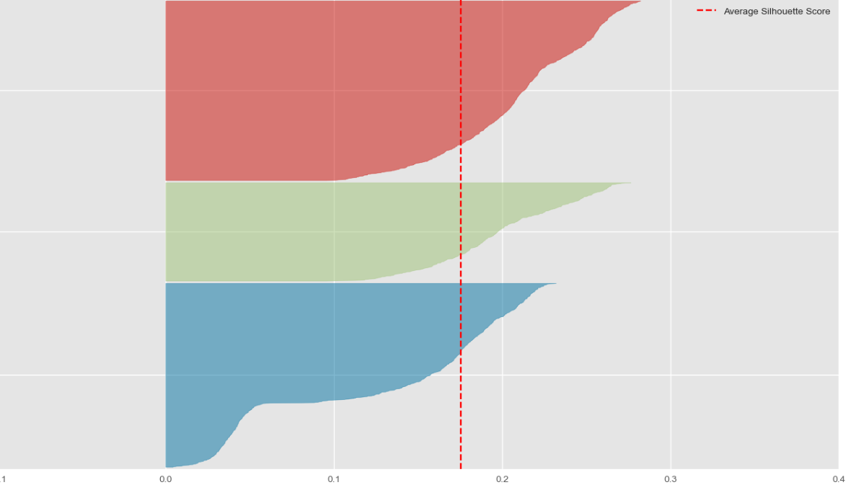
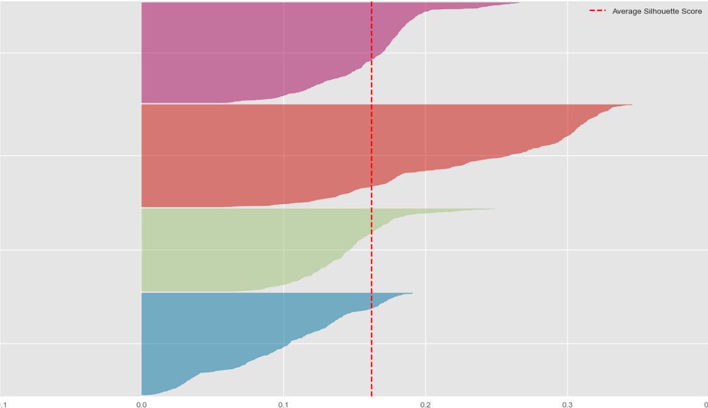
Clustering on Scaled data
Clusters = 3 Clusters = 4
Silhouette score : 0.014 (low) Silhouette score : 0.02 (low)

Slide 8

Clustering on Scaled data does not create meaningful results
Scaling on this dataset

Slide 9
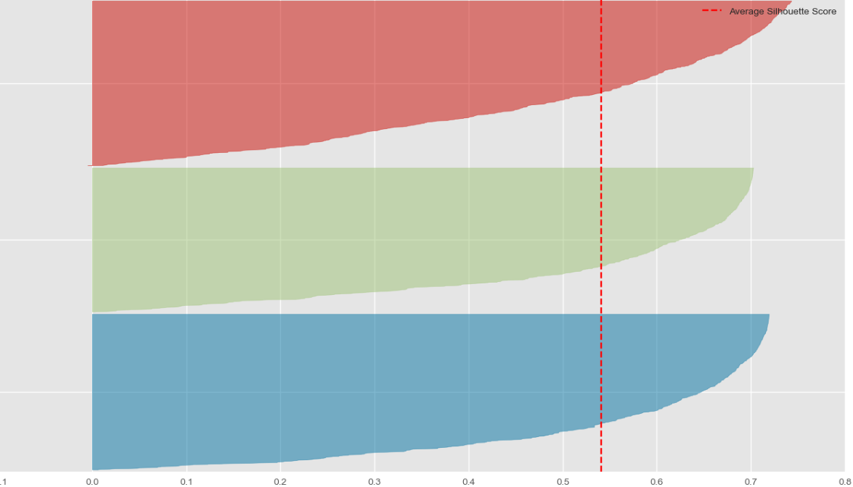
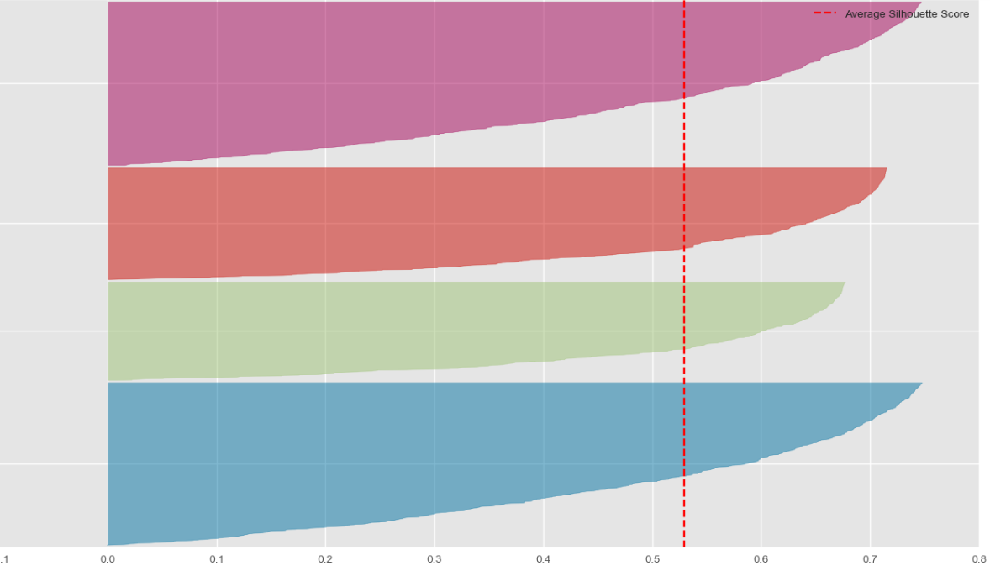
2. Clustering Without Scaling
Clusters = 3 Clusters = 4
Silhouette score : 0.54 (high) Silhouette score: 0.52 (high)

Slide 10

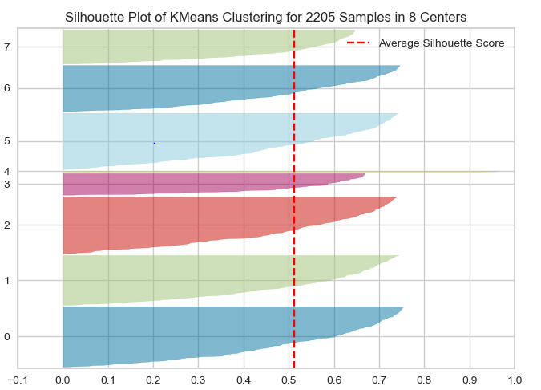

Choosing Number of Clusters
Any choice between 2-6 clusters is acceptable.
More than 7 clusters creates imbalances
that we do not want

Slide 11
Explaining Customer Clusters
The algorithm splits customers into different clusters based on their income
Customers with Higher income spent more but buy similar amounts of products.
This means that they tend to make more expensive purchases
Customers with Higher income buy less products on discounts

Slide 12
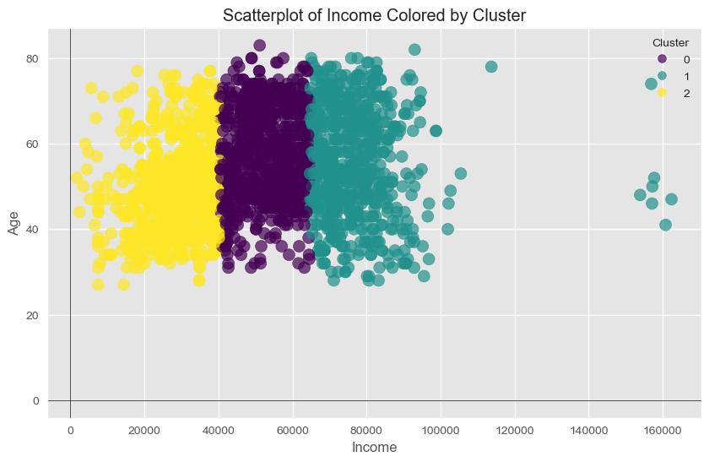

Slide 13
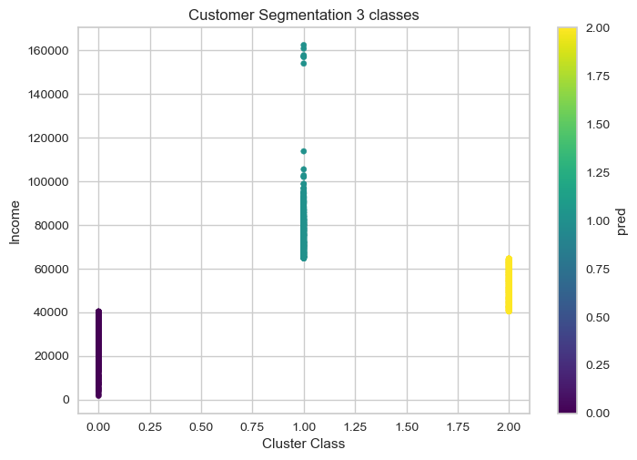

Slide 14
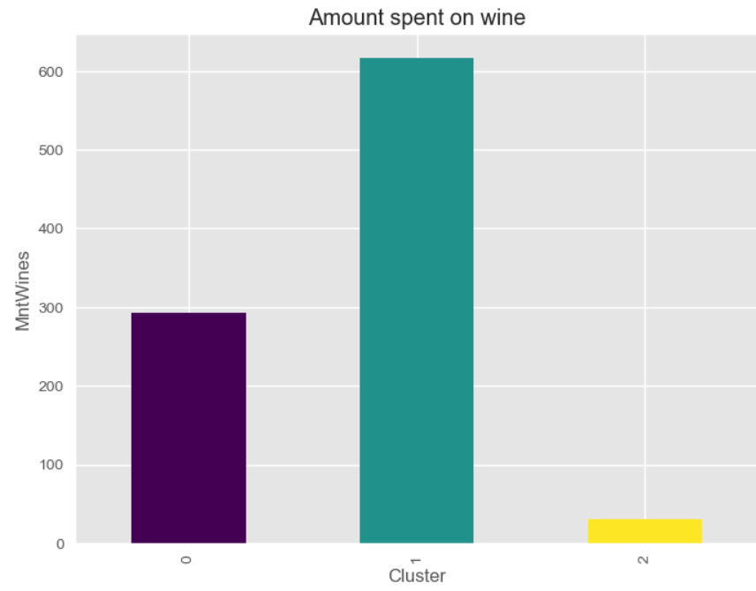
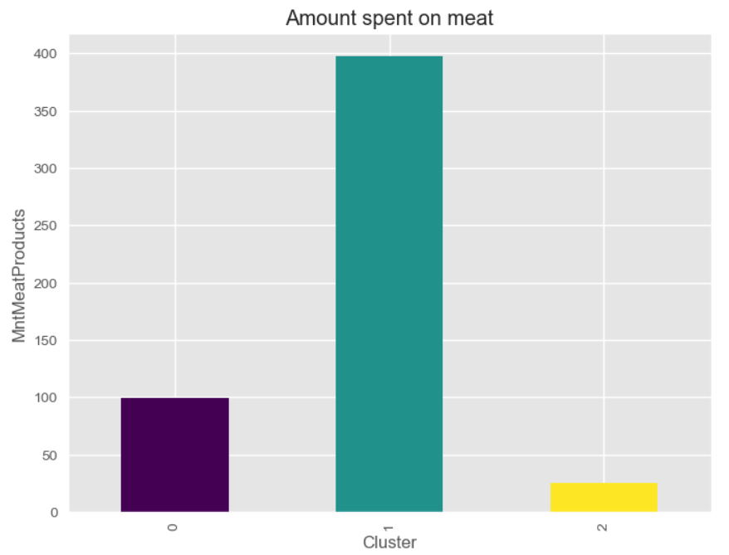
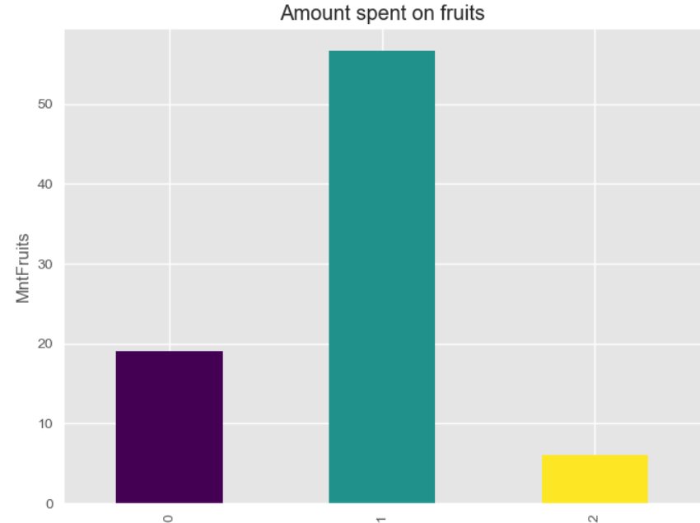
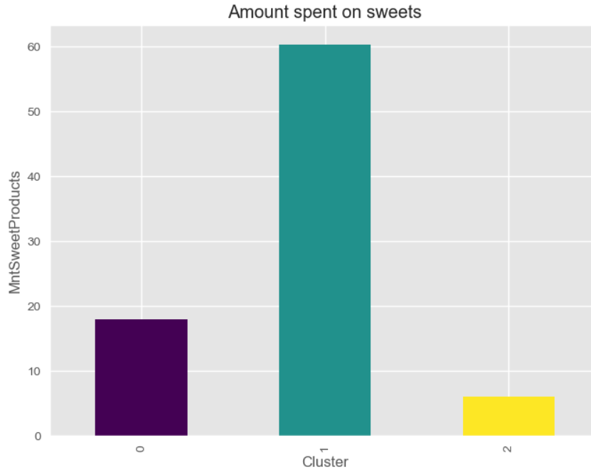

Slide 15
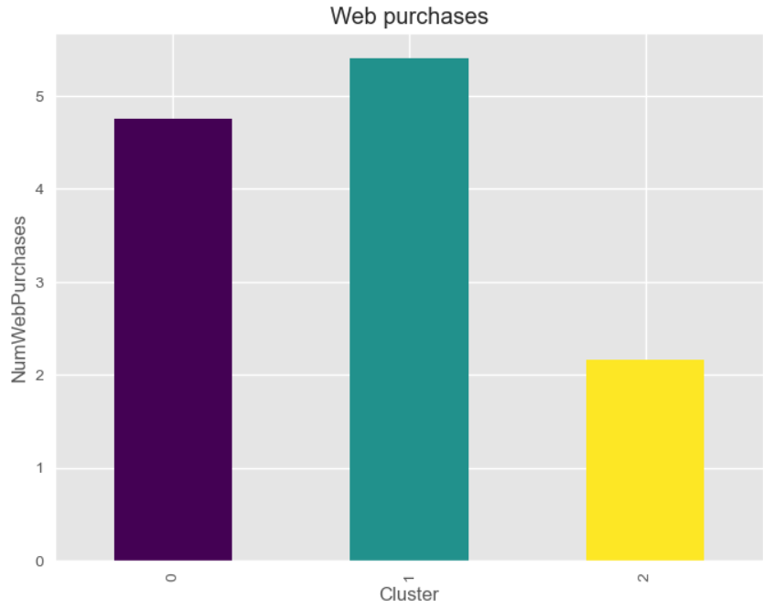
Customers with Higher income spent more but make similar amount of purchases

Slide 16
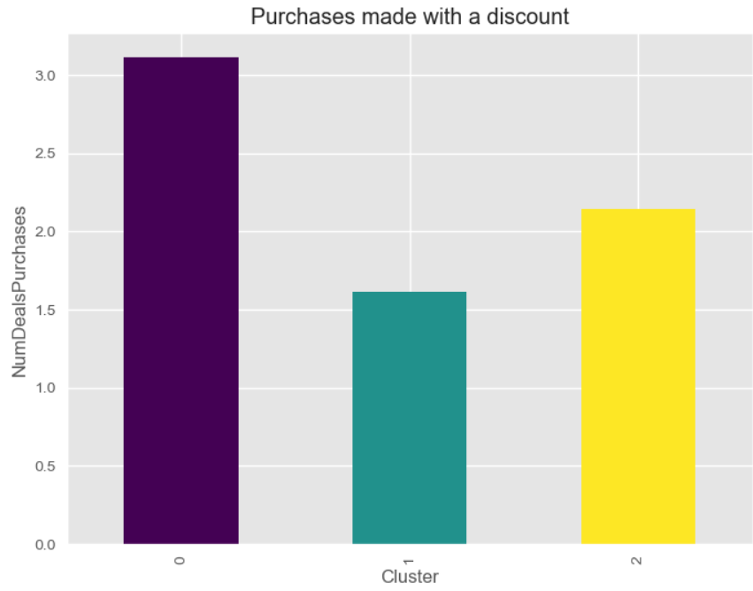
Customers with higher income do not take into consideration discounts

Slide 17
Closing Thoughts
The number of clusters should be decided according to the number of different promotional campaigns the store is willing to run, and they should not exceed 6
To lessen the impact of customer income in the clustering process we will need more data on the purchasing behavior of each customer (e.g. type of products bought, purchasing frequency)

Slide 18
Thank You

