Slide 1
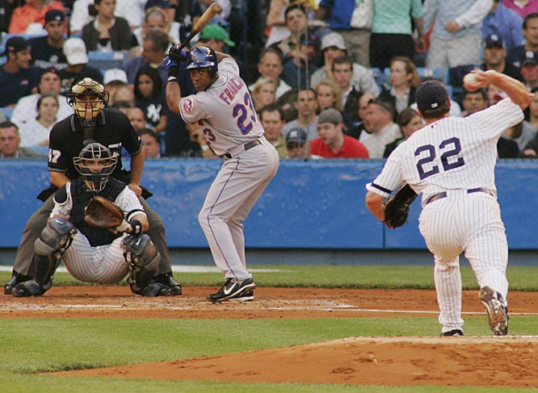
Batter-pitcher matchups
Analyzing matchups at the pitch level and not the player level

Slide 2
Motivation
“The manager is choosing to pinch hit with player A here. He has had great success against this pitcher, batting .300 (3-10) in his career.”
“Now the other manager is countering with another reliever. He has had had much more success against this hitter, holding him to a .200 (2-10) career batting average.”
How much does this one hit difference actually tell us? Probably not a lot.
If specific pitcher batter matchups don’t happen frequently enough to get the required sample sizes, how can they make decisions about who to use?

Slide 3
Our Idea
While individual matchups don’t happen that often, the hitter has probably faced pitchers who throw similar types of pitches much more often.
Maybe seeing how a hitter does against that pitcher type can provide more accurate information about what the actual chance of success would be.
Our goal is to develop a system that based on the current hitter/pitcher, to recommend which pinch hitter or reliever a coach should use from the players on his roster based on how the hitter has fared against pitchers of similar type.

Slide 4
The Data
Since 2006, a system called pitch f/x has been keeping track of every pitch thrown in the major leagues.
Pitch f/x tracks the velocity, pitch type, horizontal and vertical break, as well as several other factors for each pitch.
The data can be pulled directly from the MLB database using an R package, and then turned into a collection of csv files.
One year’s worth of data is about 500,000 pitches.

Slide 5
The Method
Based on all of these pitch attributes, we can classify “similar” pitchers together (i.e. pitchers that throw the same pitch types at the same speeds)
To do this, we will do a clustering analysis on the data to group pitcher types together.
Once we have pitcher clusters, we will be able to see if a hitter’s overall performance against the cluster is predictive for individual cases in the cluster.
We are looking at clustering methods that can use mixed categorical and continuous variables

Slide 6
Tools
Hadoop: used to aggregate each pitch to pitchers, with the value being a vector of characteristics of the pitchers. Then, Hadoop will be used to run the clustering.
Mahout: a machine learning tool on top of Hadoop. This would make it easier, but we believe there are educational advantages to building our own implementation of the clustering algorithm on Hadoop.
Neo4j: a graph database that will allow us to build a recommendation engine on top of it, using Cypher or Gremlin as a traversal language.
Java or Python: Have not decided yet on a language implementation yet, but Java would be easier to use with Hadoop.

Slide 7
Implementation
A simple web-page to access the graph database:
Input : Current bench/bullpen, Opposite Player, Hitter or Pitcher
Output: Recommendation of player to put on the field
Given our past project, we could use Django again, however maybe too complex for this simple application
Java-based Play framework / Micro Web Framework Spark if Using Java

