Slide 1
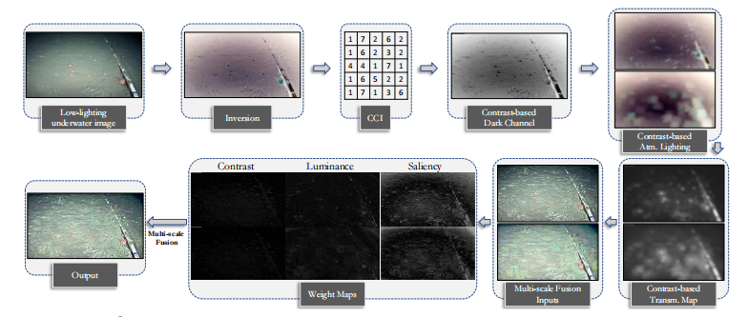
Underwater Image Quality Enhancement by using L2UWE Framework

Slide 2
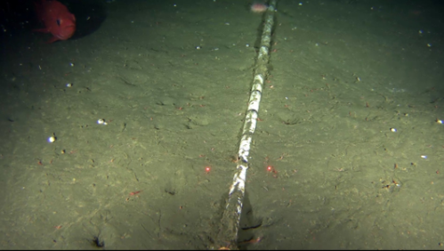
Background and Conflict
Underwater image quality has dark region, low contrast, and hazy appearance due to
underwater non-uniform lighting
water absorption and scattering

Slide 3
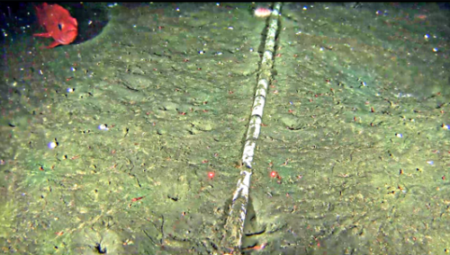
Proposed Solution
L2UWE Framework - outperforms the compared methods
Dark channel prior-based dehazing of single images
Contrast-Guided approach for the enhancement of low-light images
Multi-scale fusion for image enhancement

Slide 4

Formation of Hazy Image
Goal of dehazing is to find the haze-free image(J) by determining A(estimation of the global atmospheric lighting) and t(transmission map)
Given I(hazy image) and how to find A and t?
Dark Channel Prior(DCP)
Hazy Image
Airlight
Direct Attenuation

Slide 5

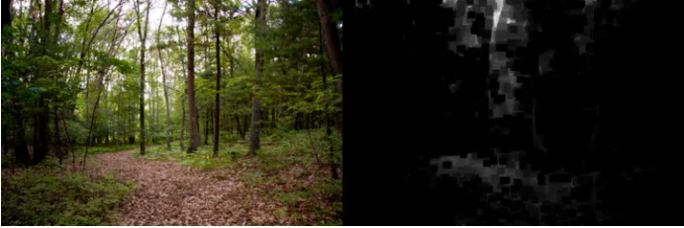
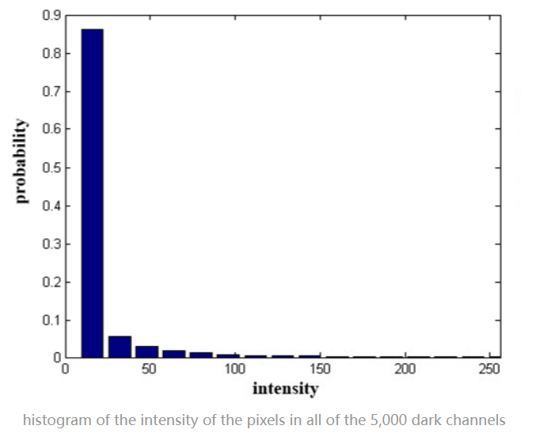
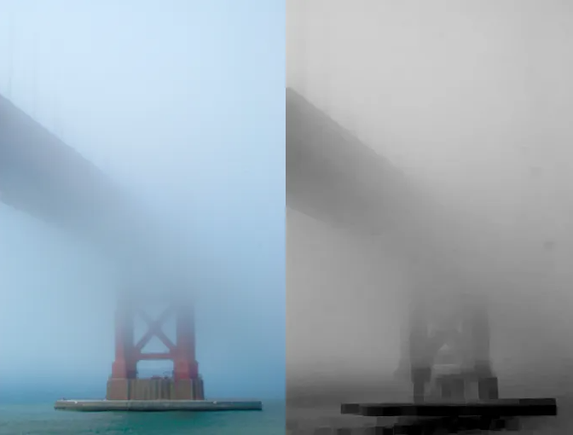

Single Image Haze Removal Using Dark Channel Prior
No Haze
It is introduced by He et al 2011
Original Image(left) and Dark Channel(right)
With Haze
Original Image(left) and Dark Channel(right)
Image resource: MIT-Adobe-5K

Slide 6

Atmospheric Light Intensity
Ancuti et al observed that a single global value might not properly represent the illumination of low-light scenes, thus proposing the estimation of local atmospheric light intensities A inside patches Ψ following Equation
A single three-dimensional global atmospheric lighting vector A (c ∈ {R, G, B}) can be inferred by looking at the 0.1% or 0.2% brightest pixels in the dark channel (which represent the most haze-opaque regions from input)

Slide 7


Transmission Map
DCP is used to derive the transmission map t
Haze-less Image by simple conversion
Detail procedure can be found from He’s article
Note: the Atmospheric light intensity used in the equation will be replaced by local value

Slide 8

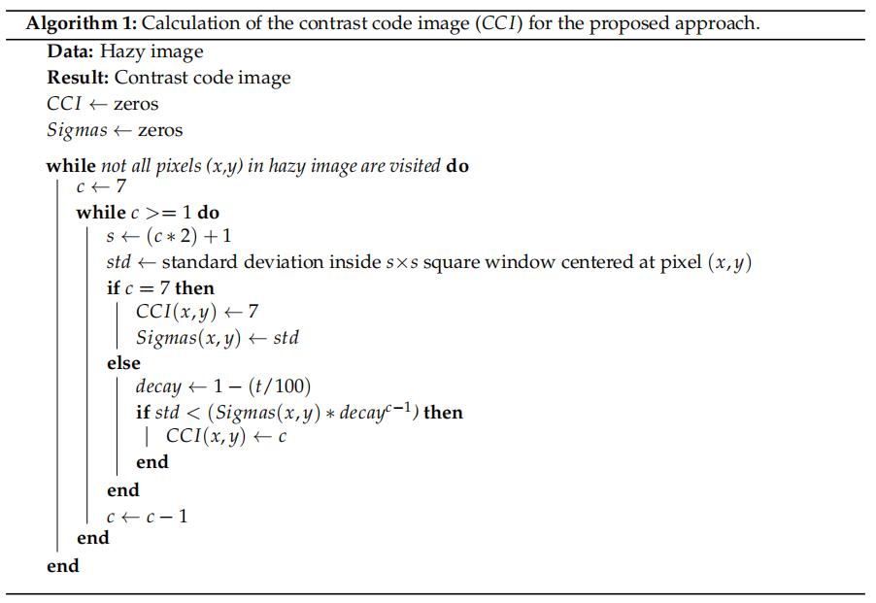
Contrast Code Image(CCI)
Using single sized patch throughout the image will have the following issues:
Small patch sizes would result in oversaturation of the radiance from the recovered scene (non-natural colors)
Large patch sizes better estimate and eliminate haze, but since they consider that the transmission profile (i.e., amount of light that reaches a camera) is constant inside patch Ω, undesired halos might appear around intensity discontinuities
a single patch size is typically not optimal for images of varying scales
CCI calculation will provide a dynamic patch size according to the local standard deviation
resource: Tunai Porto Marques, Alexandra Branzan Albu, and Maia Hoeberechts. A contrast-guided approach for the enhancement of low-lighting underwater images

Slide 9


Contrast Code Image(CCI)
the relationship between CCI code c and the size of the lighting square patch Υ used in our local atmospheric lighting model calculation
In the proposed approach, we select m as 5 and 30
Smaller local patch size: captures the finer details of the original image
Larger local patch size: create brighter models
In order to get the final image, we need to combine two processed image by using multi-scale fusion method

Slide 10




Multi-scale fusion for image enhancement
We will calculate the three weight maps of atmospheric light intensity with different patch size
Luminance(visibility)
Chromaticity(saturation)
Saliency(degree of conspicuousness)
Combining Process
for each normalized weight map, a Gaussian pyramid is computed
the mixing between the Laplacian inputs and Gaussian normalized weights is performed at each level independently to combine the weight maps

Slide 11
Recommended Procedure:
1. Calculating CCI according to local standard deviation
2. Finding the contrast-based dark channel
3. Obtaining two Atmospheric light image with different patch sizes
4. Calculating two transmission maps
5. Obtaining two haze-less images
6. Calculating weight maps and combine two images by using multi-scale fusion approach

Slide 12
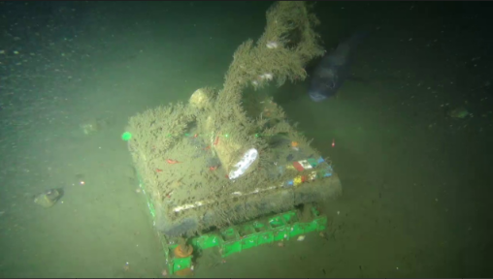
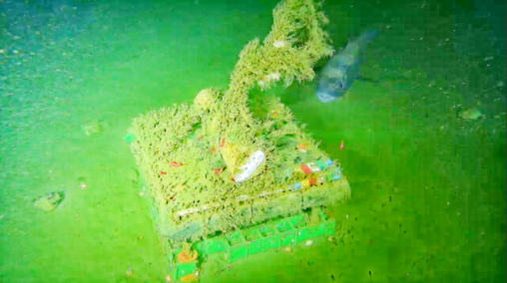
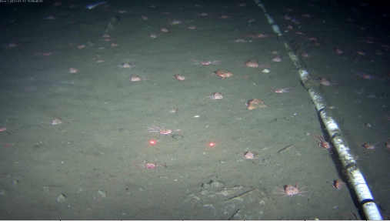
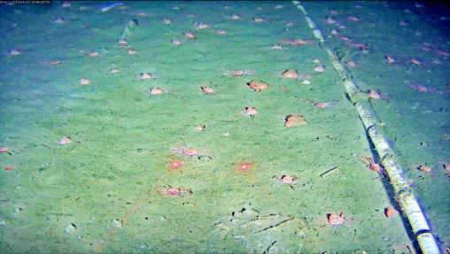
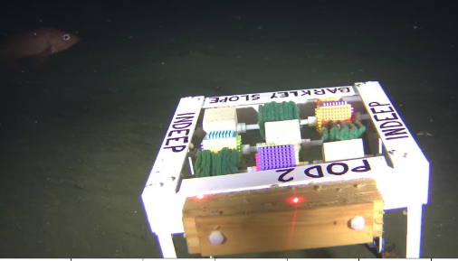
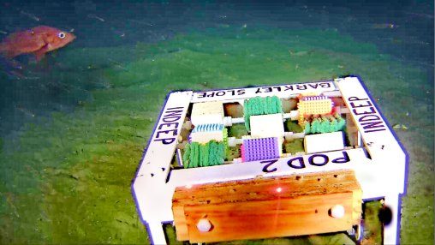
Final Result
Before
After

Slide 13
References
[1] T. P. Marques and A. B. Albu, “L^2UWE: A framework for the efficient enhancement of low-light underwater images using local contrast and multi- scale fusion,” arXiv.org, 05-Nov-2020. [Online]. Available: https://arxiv.org/abs/2005.13736. [Accessed: 10-Feb-2023].
[2] T. Porto Marques, A. Branzan Albu, and M. Hoeberechts, “A contrast-guided approach for the enhancement of low-lighting underwater images,” Journal of imaging, 01-Oct-2019. [Online]. Available: https://www.ncbi.nlm.nih.gov/pmc/articles/PMC8321153/. [Accessed: 10-Mar-2023].
[3] “Ocean Dark,” Home. [Online]. Available: https://sites.google.com/view/oceandark/home. [Accessed: 1-Mar-2023].
[4] A. C. O. A. C; “Single image dehazing by multi-scale fusion,” IEEE transactions on image processing : a publication of the IEEE Signal Processing Society. [Online]. Available: https://pubmed.ncbi.nlm.nih.gov/23674449/. [Accessed: 04-Apr-2023].
[5]“Single Image Haze Removal Using Dark Channel prior | IEEE journals ...” [Online]. Available: https://ieeexplore.ieee.org/abstract/document/5567108/. [Accessed: 05-Apr-2023].

Slide 14
Thank you & Questions

