Slide 1
Regression Testing Webapp
Project Group 13: Alex Tobias, James Duin

Slide 2
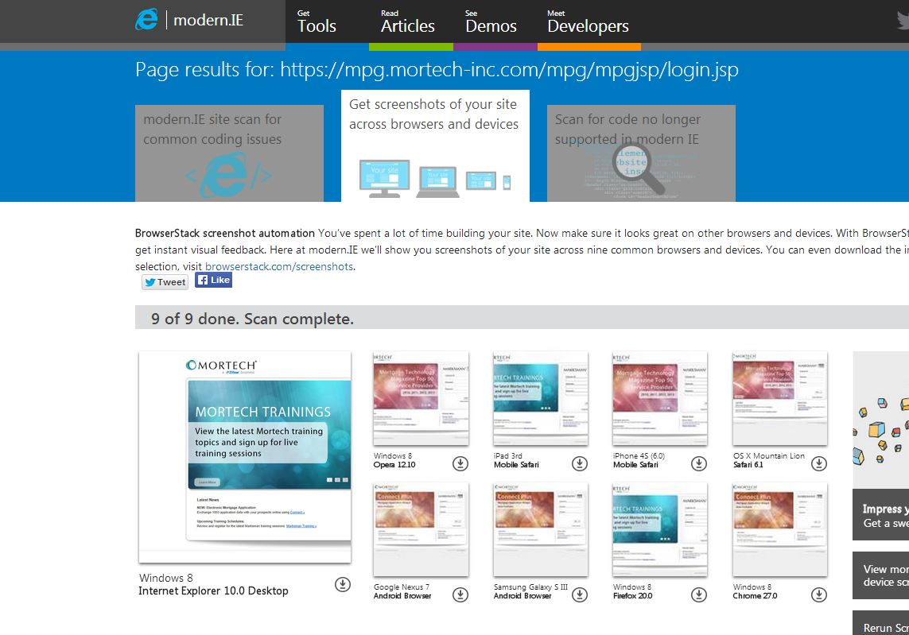
Demand for cross browser/os testing tools

Slide 3
Architecture Overview
-Java Webapp, Mysql Database
-VirtualBox, 6 Virtual Machines
-Jenkins
-Sahi

Slide 4
Gen. Requirements Phase 1
- Users can save scripts on the scripts page.
- Users can save a test schedule for a single script on IE9/Win7. (no test suites yet).
- The system executes the saved test schedule on the IE9/Win7 Virtual Machine and posts results for each script to the reports page.

Slide 5
Gen. Requirements Phase 2
- User can upload and save multiple scripts and group them into multiple test suites.
- User can save test schedules for each test suite.
- 6 supported VM’s. IE9 Win7, IE8 XP, IE10 Win7, IE11 Win7, IE10 Win8, IE11 Win8.
- Supports Running Test Suites on a specific Browser/VM combination, live or dev environment, hour of the day weekly schedule, scripts can be assigned to multiple test suites.
-Does not support test suites overlapping in schedule, only one test schedule per test suite.

Slide 6
Java WebApp
-Developed in Eclipse
-java and jdbc to connect to database
-jsp pages with javascript and jQuery
WebApp

Slide 7
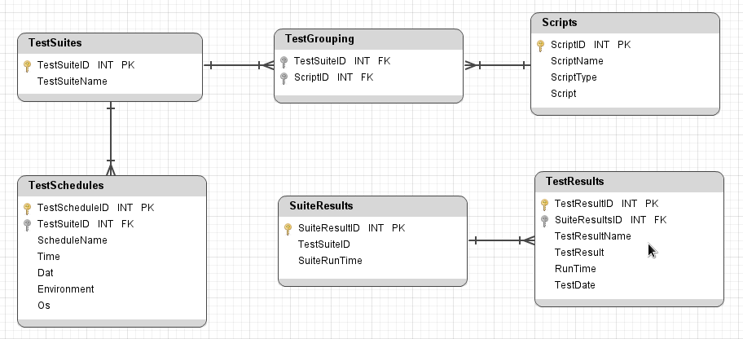
MySql Database

Slide 8
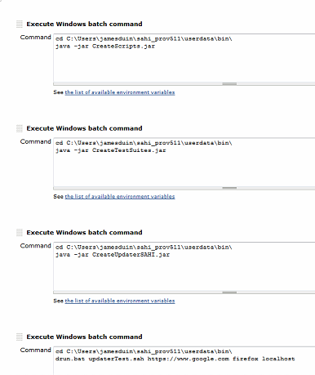
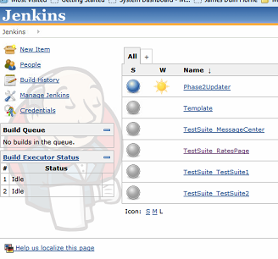
Jenkins

Slide 9
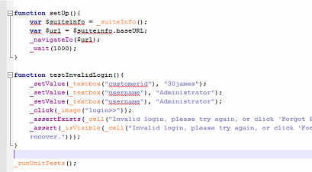
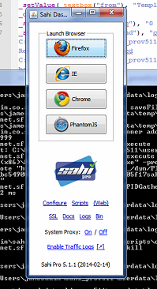
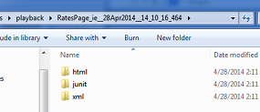
Sahi

Slide 10
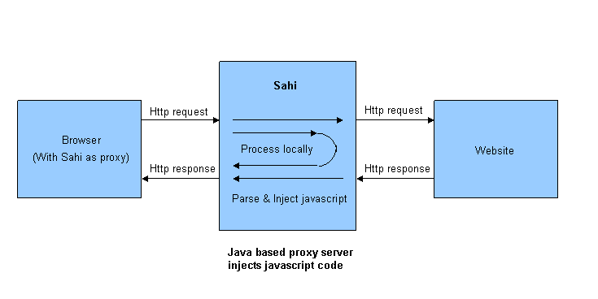
Sahi

Slide 11
Problems along the way
- Network settings between the VMs with different operating systems and the host PC
- Database structure
- Updating Jenkins
- Resolving Conflicts in run time
-Configuring servlets to jsp pages

Slide 12
Questions?

