Slide 1
Masterwork presentation
Tóth Alex
04.2023.

Slide 2
The structure of the website
The http://test-automation-blog.greenfox.academy/ is a simple Blog website
It has a few page which are these
Home page
Login page
Register page
Account page – it has four small menus aswell
Logout page
And a page of each blog post

Slide 3
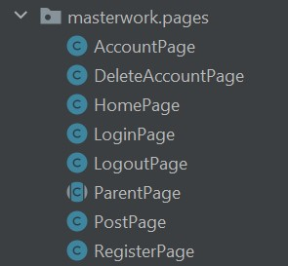
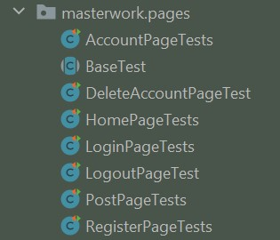
The structure of the masterwork
The structure of the masterwork is following the base structure of the website, in addition it has a ParentPage and a DeleteAccountPage which is one of the Account Page’s submenus
Page objects structure
Test cases structure

Slide 4
Account page
AccountPage object
The AccountPage object has one different method beside the basic getters and setters and the simple click on links. It called update and used to update an existing user’s first name, last name, and e-mail address.
AccountPage test cases
The AccountPage has one test case which is used for assert if we can update a logged in user’s first name, last name, and e-mail address.

Slide 5
Delete account page
DeleteAccountPage object
The DeleteAccountPage object has one different method beside the basic getters and setters and the simple clicks on links. It called delete and used to delete an existing user completely.
DeleteAccountPage test cases
The DeleteAccountPage has one test case which is used for assert if we can delete an existing user completely.

Slide 6
Home page
HomePage object
Beside the default getters and setters and the simple clicks on links, the HomePage class has three methods implemented. Firstly, it has an open method, secondly it has a paginate method, and last but not least it has a list blog post titles method.
HomePage test cases
The HomePage has two different test cases. The first one is checks if the listed blog post titles are equal to the actual titles, and the second one is a simple pagination test.

Slide 7
Login page
LoginPage object
The LoginPage class has only one special method implemented which is the login method.
LoginPage test cases
The LoginPage has two different parametrized test. Both of them revieve data to login from a csv file, the first one get valid username and password but the second get invalid ones.

Slide 8
Logout page
The LogoutPage is one of the simplest page of the website. It has only one method implemented which is a simple click on the logout submit button, and has only one test case which asserts if a logged in user can log out successfully.

Slide 9
Post page
PostPage object
PostPage is a bigger page which has three special method: one for write a comment as a logged in user, one for write a comment as a guest and one for save a blog post’s content into a .txt file.
PostPage test cases
PostPage test cases are used to check if the three mentioned method work properly.

Slide 10
Register page
RegisterPage object
The RegisterPage has one complex method which called registry.
RegisterPage test cases
The RegisterPage test cases are working similarly to the LoginPage test cases. It also has two different parametrized test case, one is for cover a succeful registration and one is for cover an unsuccessful one.

