Slide 1
Sampling Distributions
MATH 2300
Chapter 7

Slide 2
Sample Means
Suppose you sample from a population 10 times.
You record the following sample means:
Why aren’t the values all the same?

Slide 3
The Population
The entire group of individuals about which we want to get information.
Often, it is too time-consuming or expensive to obtain data for the entire population.
How do we get around these constraints?

Slide 4
The Sample
Part of the population from which we actually collect information
We use this information to draw conclusions about the population.
We call this process inference.

Slide 5
How do we describe samples?
First, we collect raw data.
The actual measurements or observations.
We consolidate or summarize the raw data to describe the various characteristics of the sample.
These numerical summaries are called statistics.

Slide 6
How do we describe populations?
We use our statistics to make estimates about the characteristics of the population.
The characteristics of a population are called parameters.
The value that a parameter takes is almost always unknown.

Slide 7
Summary
Parameters | Statistics
Describe Populations | Describe Samples
Fixed Values for a Given Population | Changes from Sample to Sample
Value Unknown in Practice | Value is Calculated for a Given Sample

Slide 8
A Population Distribution
For a given variable, this is the distribution of values the variable can take among all the individuals in the population.
IMPORTANT:
Describes the individuals in the population.

Slide 9
A Sampling Distribution
The distribution of values taken by a statistic in all possible samples of the same size from the same population.
IMPORTANT:
Describes a statistic calculated from samples from a given population.

Slide 10
Random Sampling Error
The deviation between the statistic and the parameter.
Caused by chance in selecting a random sample.
Margin of error includes only random sampling error.
NOT errors associated with choosing bad samples.

Slide 11
Developing a Sampling Distribution
Assume there is a population …
Population size n = 4
Measurement of interest is age of individuals
Values: 18, 20, 22, 24 (years)
C
D
A
B

Slide 12
Consider All Possible Samples of Size n = 2
16 Sample Means
16 possible samples (sampling with replacement)

Slide 13
Displaying the Sampling Distribution
16 Sample Means
Sample Means Distribution
_
P(X)
.3
.2
.1
0
_
18 19 20 21 22 23 24
X

Slide 14
Population Distribution vs. Sampling Distribution
Population
Sample Means Distribution
n = 2
_
P(X)
P(X)
.3
.3
.2
.2
.1
.1
0
0
_
18 20 22 24
A B C D
X
18 19 20 21 22 23 24
X

Slide 15
The Law of Large Numbers
A sample is drawn at random from any population with mean μ.
As the number of observations goes up, the sample mean tends to get closer to the population mean μ.

Slide 16
Example: Class of 20 Students
Suppose there are 20 people in a class and you are interested in the average height of the class.
The heights (in inches):
72 64 75 63 62 61 68 76 59 73
67 66 65 64 60 65 70 56 71 62
The average height is 65.95 in.

Slide 17
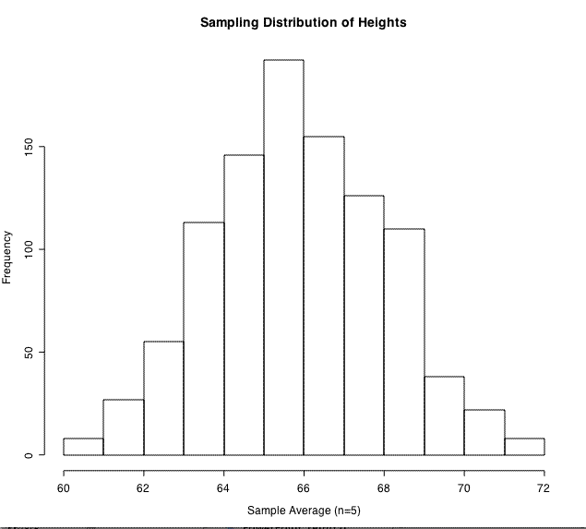
Example: n = 5

Slide 18
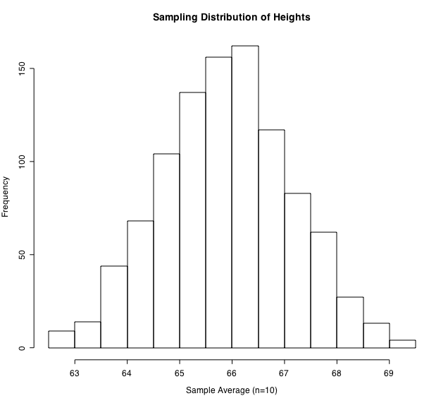
Example: n = 10

Slide 19
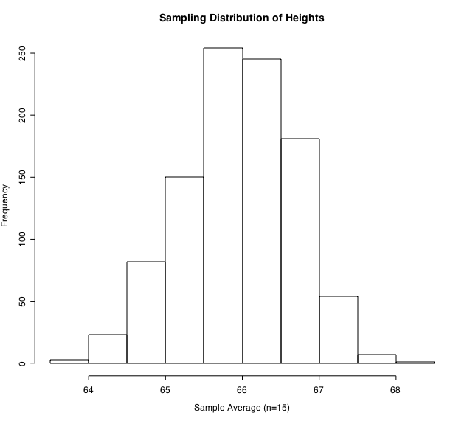
Example: n = 15

Slide 20
What the Law of Large Numbers Tells Us
It tells us that our estimate of the population mean will get better and better as we take bigger and bigger samples.
This means the variability (or spread) of the sample mean decreases as n increases.
However, there are some cautions regarding misusing it.

Slide 21
Applying the LLN to Probabilities
A process is repeated through many trials.
Proportion of times event A occurs will be close to the probability P(A).
The larger the number of trials the closer the proportion should be to P(A).

Slide 22
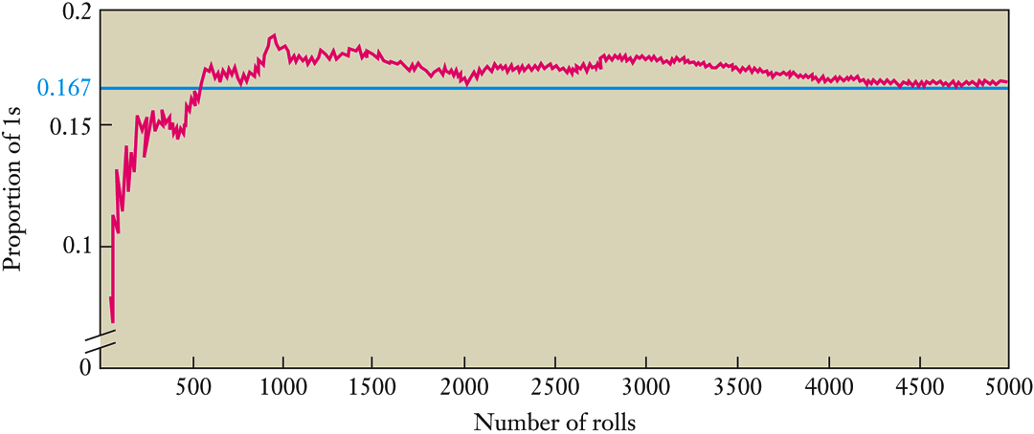
Example: Rolling a Die

Slide 23
Caution: Football Example
A quarterback has a career pass completion ratio of 0.60.
In today’s game, he has so far thrown 10 passes and only completed 2 of them.
The commentator says, “He’s bound to complete the next few by the law of averages!”
Faulty logic!
Notes:
In order to get back to completing 60% of his passes, the QB will need to complete ALL of his next 10 passes or 16 of his next 20. This means he would have to perform well ABOVE his normal level.
In addition, one game is SHORT term…the law of large numbers deals with the LONG term.

Slide 24
Sampling Distribution of a Mean
A SRS of n observations is taken from a large population with a mean μ and a standard deviation σ.
The sampling distribution of the sample mean has the same mean:
The standard deviation is

Slide 25
Example: Sodium Measurements
Standard deviation of sodium content 10 mg.
Measure 3 times and the mean of these 3 measurements is recorded.
What is the standard deviation of the mean result?
How many measurements are needed to get a standard deviation of the mean equal to 5?

Slide 26
Sampling Distribution of a Mean
If the distribution of the population is N(μ, σ)
Then the sample mean of n independent observations has the distribution:

Slide 27
Graphical Depiction
Distribution of
n larger
n larger
n larger
n
μ

Slide 28
The Central Limit Theorem
the sampling distribution becomes almost normal regardless of shape of population
As sample size gets large enough…

Slide 29
The Central Limit Theorem
A SRS of n observations taken from a population with mean μ and standard deviation σ
Regardless of the population’s distribution the distribution of the sample mean will be approximately normal (provided the sample size is sufficiently large).
The larger the sample size, the better the approximation to the normal distribution.

Slide 30
Simulating 500 Rolls of n Dice

Slide 31
Simulating 500 Rolls of n Dice

Slide 32
Simulating 500 Rolls of n Dice

Slide 33
Simulating 500 Rolls of n Dice

Slide 34
Z-Score for Distribution of the Mean
where: = Sample mean
= Population mean
= Population standard deviation n = Sample size

Slide 35
Example Calculation
What is the probability that a sample of 100 automobile insurance claim files will yield an average claim of $4,527.77 or less if the average claim for the population is $4,560 with standard deviation of $600?
P(Z < -0.54) = 0.2946

Slide 36
Example: ACT Exam
Scores on the ACT exam are distributed N(18.6, 5.9)
What is the probability that a single student scores 21 or higher?
What is the probability that the mean score of 50 students is 21 or higher?

Slide 37
Summary
Means of random samples are less variable than individual observations.
Means of random samples are more Normal than individual observations.

