Slide 1
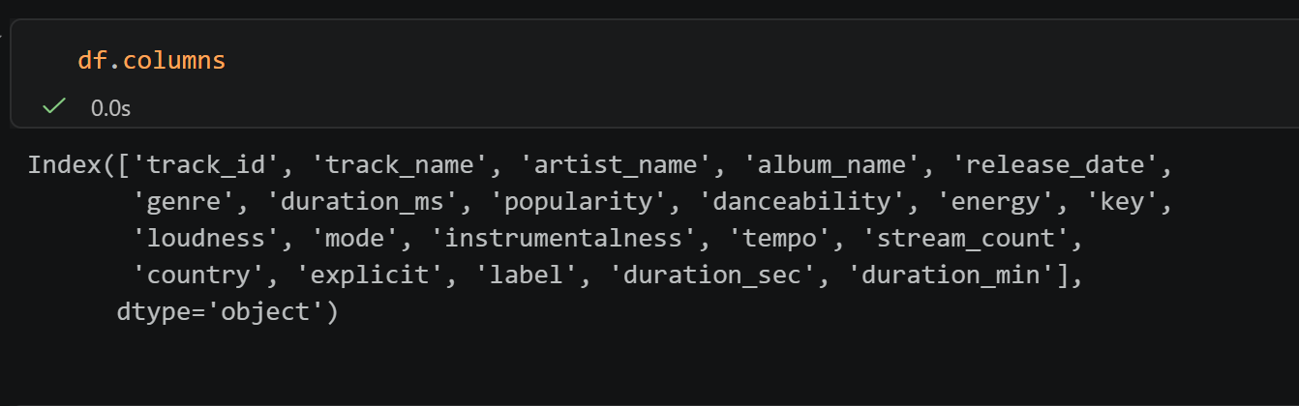
About this file
This file contains synthetic but realistic Spotify-style music data spanning 2015–2025, covering a wide range of audio features, popularity metrics, streaming statistics, and metadata.
Balanced distribution across genres, years, and popularity levels
Safe public use — fully synthetic, no copyrighted content
Spotify Music Analytics Dataset (2015–2025)

Slide 2
Contents
Duration vs Stream Count
Stream Count Distribution by Genre (Log Scale)
Stream Popularity (log scale)
Stream Count vs Distribution by Genre (Log Scale)
Change of Genre Danceability Over Time

Slide 3
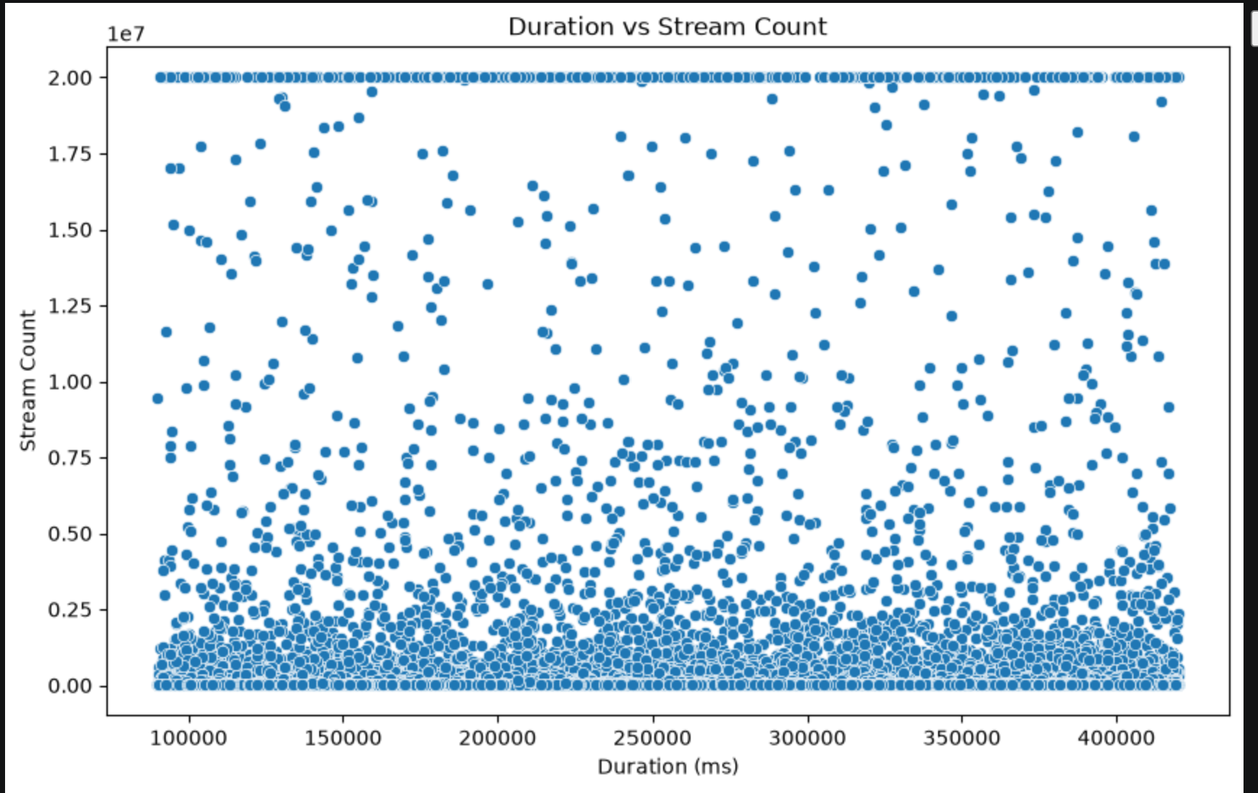
Duration vs Stream Count

Slide 4
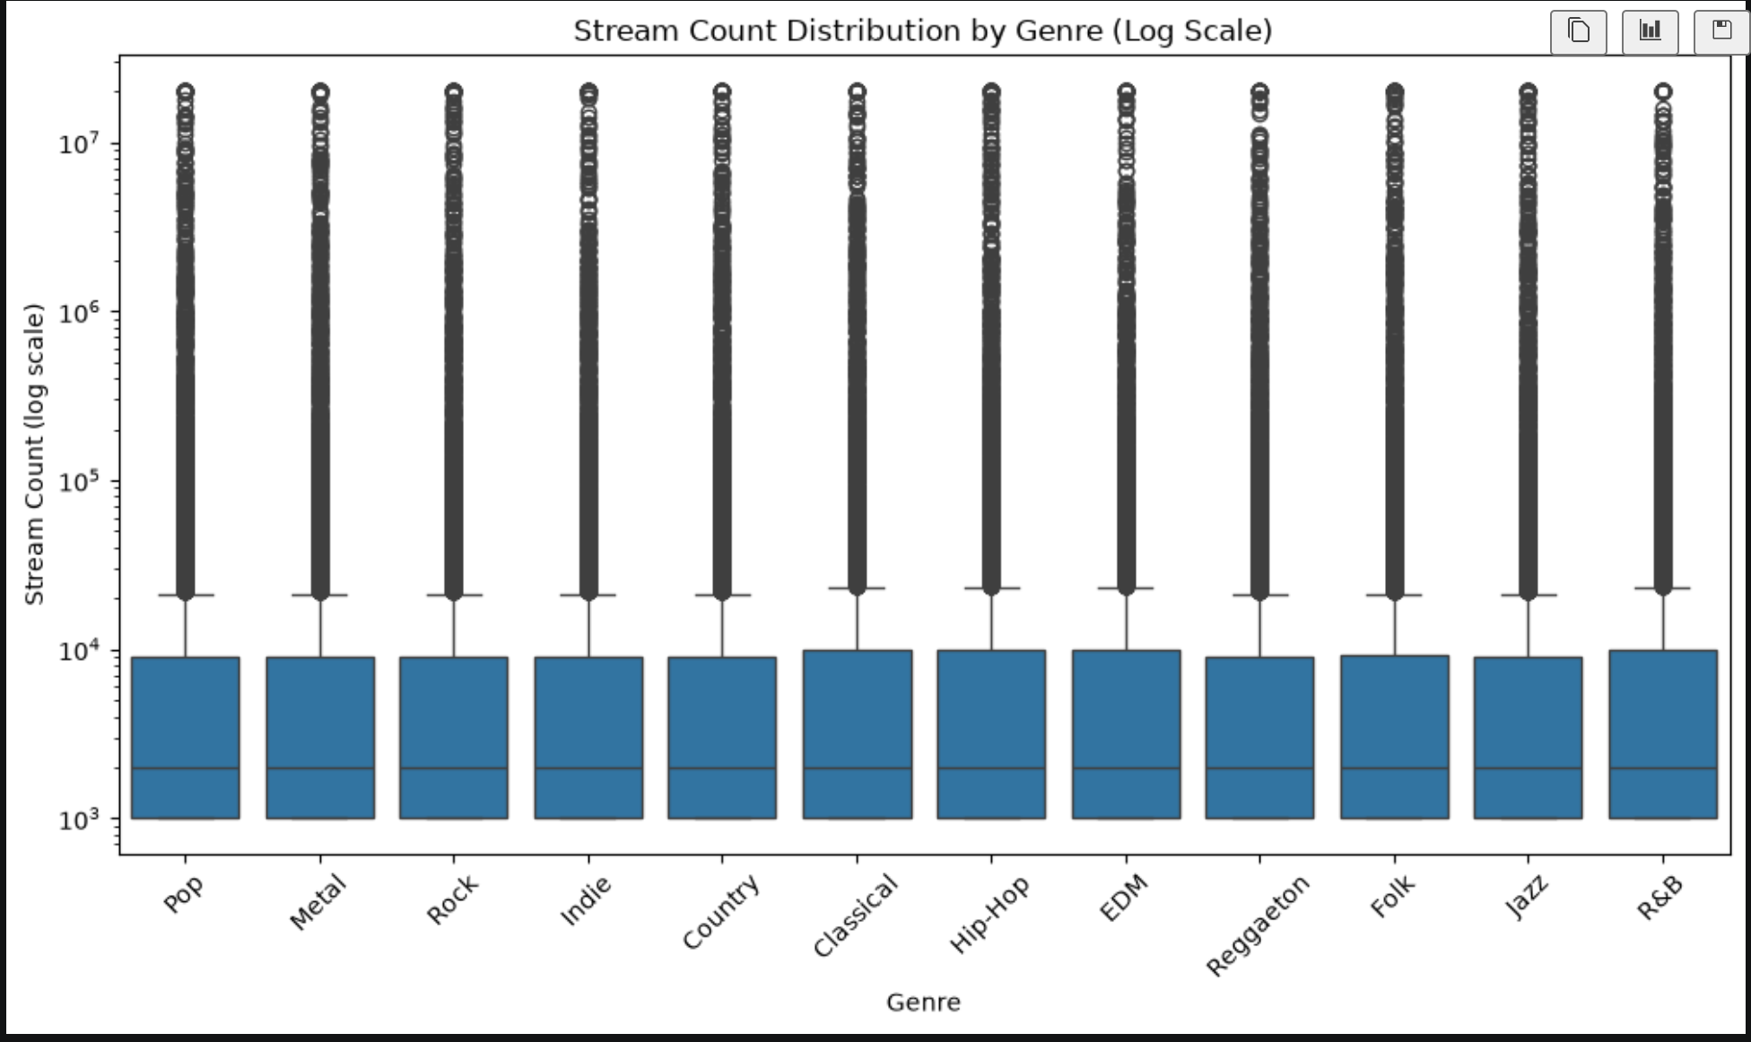
Stream Count Distribution by Genre (Log Scale)
Data are equally distributed across Genre and Stream count

Slide 5
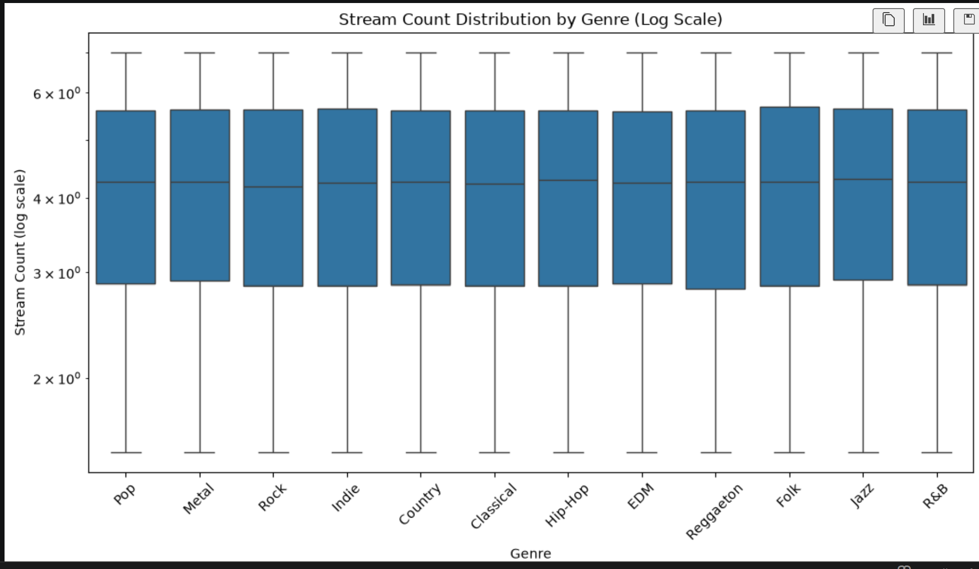
Stream Count Distribution by Genre (Log Scale)

Slide 6
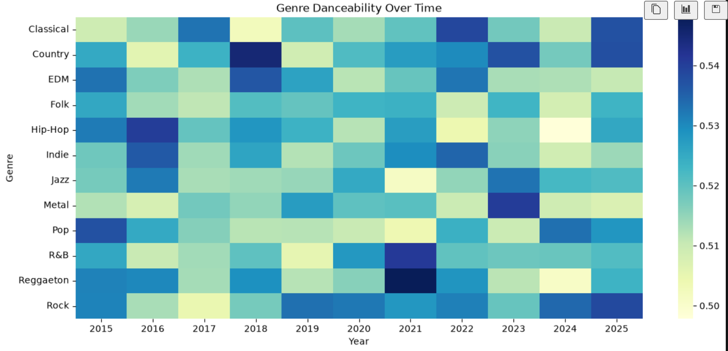
Genre Danceability Over Time
Rock records was valued more danceable from 2019 to 2025

Slide 7
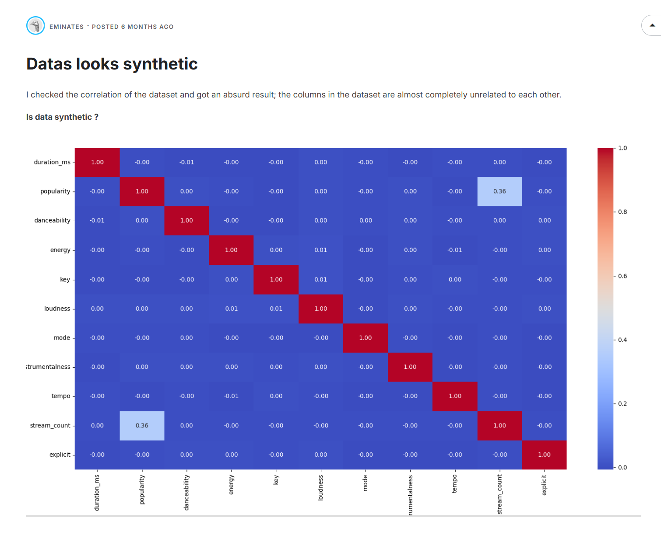
User Comments

Slide 8
Summing up
Data is synthetic and evenly distributed around categories
Features behave independently
No meaningful relationships between music attributes
Weak signal realism
The data cannot be used for meaningful analysis.

