Slide 1



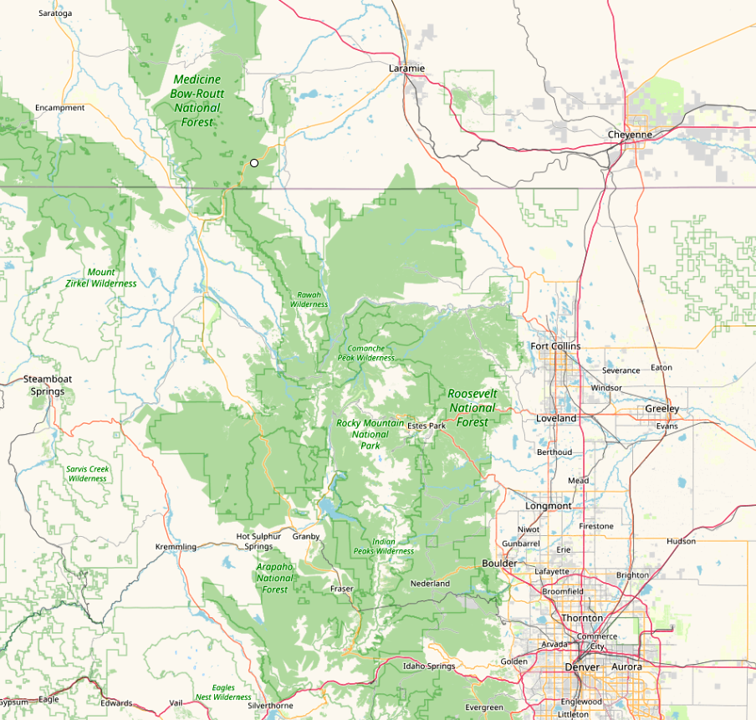
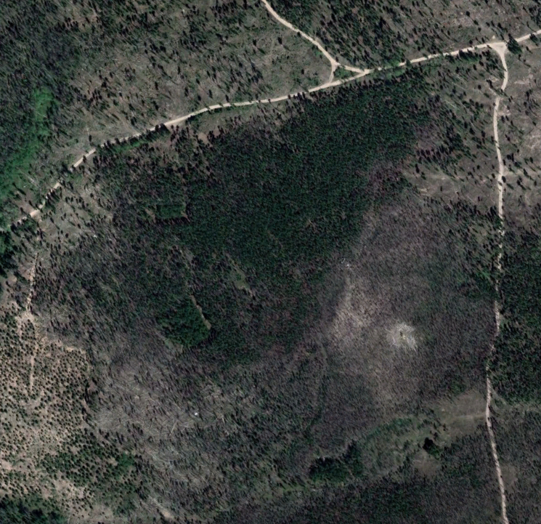

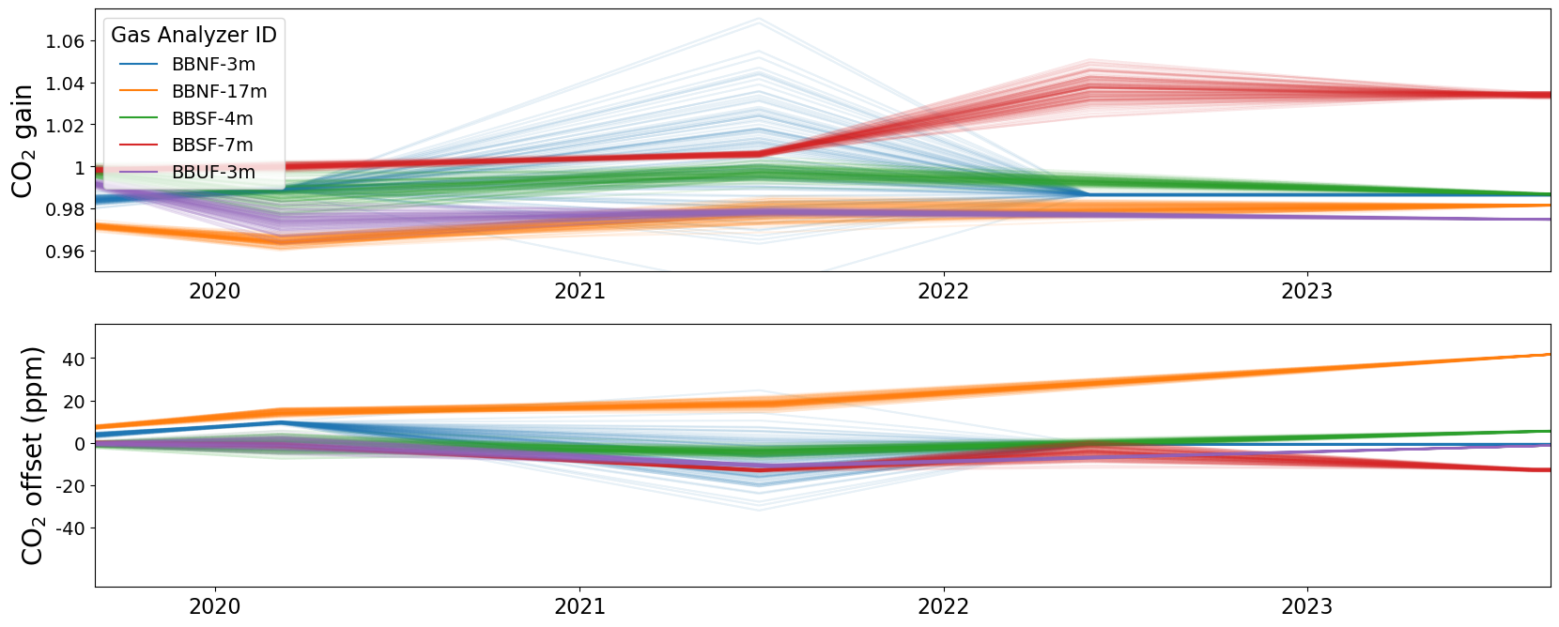
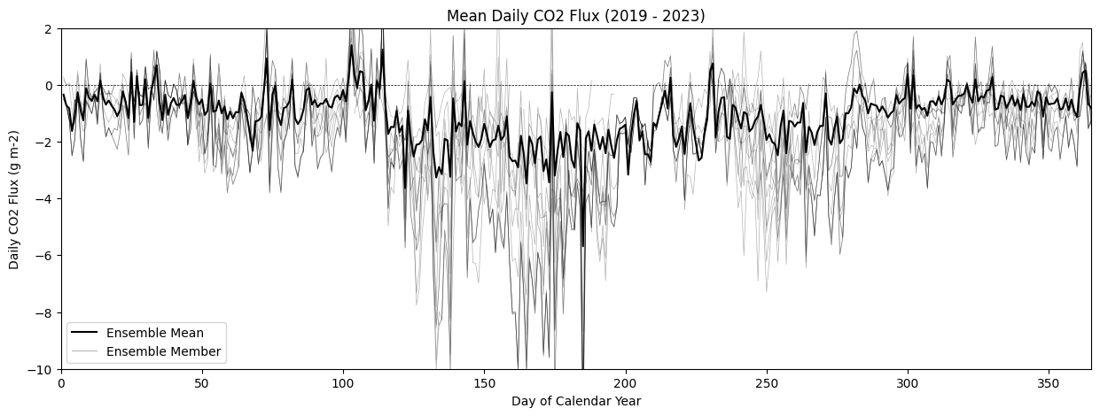
A High-Throughput Workflow for Exploring Eddy Covariance Data Processing Using EddyPro
Alex S. Fox¹, Liudmila Mainzer², Brent E Ewers¹, John M Frank³, Collin Dixon⁴, Tera Swaby⁴
¹University of Wyoming, Dept. of Botany, Laramie, WY, ²University of Wyoming, Advanced Research Computing Center, Laramie, WY,
³USDA Forest Service, Rocky Mountain Research Station, Fort Collins, CO, ⁴University of Wyoming, Laramie, WY
contact: afox18@uwyo.edu
Background
Eddy covariance (EC) measurements are highly prone to bias and uncertainty. Hands-on management of EC data processing is necessary to make it suitable for scientific inference.
EC data processing is computationally intensive.
Optimizing EC data processing settings for a single dataset may need multiple processing runs, and each time must be inspected and processing methods must be tuned. This is very time consuming.
Site operators would benefit from a workflow to expedite the data exploration process.
Workflow Demonstration: Sensitivity of CO₂ Flux to Gas Analyzer Field Calibrations
The field calibrations performed on infrared gas analyzers used in EC systems are subject to bias and random error (Fig. 3). We used our workflow this calibration error at the US-CPk Ameriflux by performing a sensitivity analysis of surface carbon flux measurements to random error in the gas analyzer calibration coefficients (Fig. 4).
Openstreetmap, 2023
US-CPk
Wyoming
Colorado
200m
Image: Maxar Technologies, 2023
High-Throughput Workflow
We developed a semi-automated, scalable, and maintainable workflow – developed in Python and built upon EddyPro^{1,2} (a widely used data EC data processing software tool). This workflow is designed to improve the quality of flux data by accelerating data processing, facilitating data exploration, aiding in human decision-making, and accommodating new and future advances in high-frequency EC data processing.
Our EddyProConfigEditor python module³ forms the backbone of our workflow. It enables users to automatically edit .eddypro INI configuration using a python script without relying on the EddyPro GUI. Additionally, our python module can set up .eddypro files for parallel processing, by splitting up single files for processing long time intervals into multiple smaller files representing shorter time intervals.
BB-NF 3m
BB-NF 17m
EddyproConfigEditor python module Github page
BB-SF 4m
Fig 2: Map of the US-CPk Ameriflux site used in this demonstration, with gas analyzers labelled. The site sits in a snow-dominated lodgepole pine forest in the Snowy Range mountains of SE Wyoming.⁴ In 2008, the site experienced a mountain pine beetle outbreak. In 2018, the Badger Creek fire burned over 86km² of surrounding forest.
BB-SF 7m
BB-SF 7m
Fig. 3: Timewise linear interpolation of calibration coefficients for each gas analyzer over time at US-CPk. Top: Gain coefficient for CO₂ concentration measurements. Bottom: Offset coefficient for CO₂ concentration measurements. Each line represents a possible set of calibration coefficients for a particular gas analyzer.
Random Uncertainty in Gas Analyzer gain and offset Coefficients at US-CPk
Figure 1: Diagrams of workflows for exploring data processing methods and parameters in Eddypro. Top: A typical EddyPro workflow requires human intervention after every step, and processing runs can take multiple hours to complete. Bottom: Our high-throughput workflow using our EddyproConfigEditor python module requires less human intervention and is designed to be run in parallel, reducing processing times by 10-100 depending on the computing hardware available.
Typical workflow
Repeat N times
Create new Eddypro project
Run pilot, ensure everything runs without errors
Change processing settings, generate a new configuration file
Run an entire year of data
Interpret results
Eddypro GUI
~1hr
Eddypro Engine
~1hr
Eddypro GUI
~5min
Eddypro Engine
~8hr
Python, R
~1hr
Higher throughput workflow
Run an entire year of data in parallel
Fig. 4: CO₂ flux from the BB-NF 17m gas analyzer, averaged for each day of the year across 5 years of data for 17 ensemble members. Thin lines represent individual runs computed from a single set of calibration coefficients. The thick line represents the mean of all runs.
Note: this data has not been subject to any post-processing. Additionally, apparent CO₂ uptake in the wintertime is due to self-heating of the gas analyzer, which has not been fully corrected yet.
Eddypro Engine
~2hr
Eddypro Engine
~2hr
Create Eddypro Project
Run pilot, ensure everything runs without errors
Change processing settings, generate multiple new configuration files
Split configuration file up by time for parallel processing
Eddypro Engine
~2hr
Split configuration file up by time for parallel processing
…
Split configuration file up by time for parallel processing
Interpret outputs
Python
0min
Python
0min
Python, R
~3hr
Eddypro GUI
~1hr
Eddypro Engine
~1hr
Python
~15min
Python
0min
Run an entire year of data in parallel
Eddypro Engine
~2hr
Eddypro Engine
~2hr
Eddypro Engine
~2hr
Conclusions and Further Work
Our new workflow and python module speed up computation and reduce human decision-making in EC data preprocessing using methods accessible to most site operators.
Our workflow enabled us to explore years of historical high-frequency data form the US-CPk Ameriflux site and discover new possible sources of error.
We will release a more user-friendly and distributable version of our pipeline in Spring 2024.
1. LI-COR Biosciences - Impacting Lives Through Science.
https://www.licor.com/env/products/eddy_covariance/eddypro
2. EddyPro-Engine. https://github.com/LI-COR/eddypro-engine
(2023).
3. EddyProConfigEditor.
https://github.com/EwersLabUWyo/EddyProConfigEditor/
(2023)
4. Site Info for US-CPk- AmeriFlux.
https://ameriflux.lbl.gov/sites/siteinfo/US-CPk.
Contact: afox18@uwyo.edu

