Slide 1
Aristotle University of Thessaloniki
Department of Informatics
Twitter Stream Mining: An analysis of basic techniques
Pardalidou Christina UID: 690
Tsiliggiris Alexandros
Karapostolakis Sotiris

Slide 2
Contents
Introduction
Event Detection
Sentiment Analysis
Geo-Location
Conclusions
References

Slide 3
Introduction
World Wide Web → Dynamic Information Resource
Social Networks
Opinion Expression
Broadcasting News
Communication
Twitter is the most popular micro-blogging service
Monitoring and analysing → Significant Information
Users can be instantly informed about event/news
Companies use Twitter for advertising and promotion reasons or build reputation; analysing users’ sentiment.

Slide 4
Introduction
Twitter is not only endless database of short messages →
Event Detection
Quick Information Delivery
Optimal query retrieval in search engines
User-Generated-Content(UGC) has led many companies to Sentiment Analysis.
Reasons for Sentiment Analysis
Better proposals from recommendation systems
Sites for creation of summaries from people’s reviews
Companies

Slide 5
Introduction
Strong connection between Event Detection and Location
Users are not only individuals, but part of user groups
Geo-Location Prediction
User-located news
Regional Advertisement
Main problem: Only 1% of tweets are geo-tagged.

Slide 6
Event Detection
Goal: Extract an event by analysing tweets
Why it isn’t simple
  Large data stream
  Must be processed online
  Noise
    Tweets about music, movies, etc.

Slide 7
A detection approach
Based on the idea that:
  Users tweet about a particular event
  Events are reported in real time
Online algorithms must be used
  To capture the “pulse of the moment”

Slide 8
Difference from newswire
News reporters are not known
  They appear randomly (random users)
News reporters must be identified

Slide 9
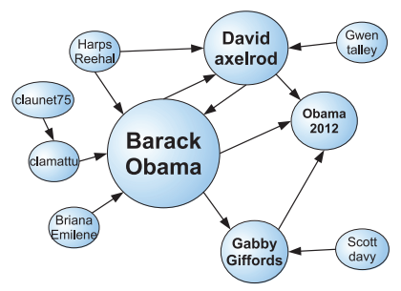
Identifying users
Users with a high amount of followers
  Usually post news
  Are influential in the network

Slide 10
Approaches: Identifying news tweets
By training a Naive Bayes classifier
  Tweets from influential users are usually news
Term frequency and sorting
Online clustering
Living organism

Slide 11
Sentiment Analysis
Sentiment Analysis (SA) can be defined as a process that automates mining of attitudes, opinions, views and emotions from text, speech, tweets and database sources through Natural Language Processing (NLP). Sentiment analysis involves classifying opinions in text into categories like "positive" or "negative" or "neutral".
Twitter Sentiment Analysis (TSA) tackles the problem of analyzing the messages posted on Twitter in terms of the sentiments they express. Twitter is a novel domain for SA and very challenging.

Slide 12
Sentiment Analysis
In the literature, SA has been applied at three different levels: document, sentence, and entity levels.
SA at the document level aims to identify the sentiment polarity expressed in the whole document.
SA at the sentence level aims to classify each sentence as positive or negative.
SA at the entity level detects the sentiment polarity of a specific entity/target of a particular object.
For the task of TSA there is no fundamental difference between document and sentence level. In case of tweets, SA can be applied on two levels: message/sentence and entity levels.

Slide 13
Sentiment Analysis
Four different classes can be identified in the literature of TSA:
Machine Learning
Lexicon-Based
Hybrid (Machine Learning & Lexicon-Based)
Graph-Based

Slide 14
Machine Learning
The majority of the proposed methods that deal with TSA employs a classifier from the field of machine learning that is trained on various features of tweets. Some of the most applied classifiers are:
Naive Bayes (NB)
Maximum Entropy (MaxEnt)
Support Vector Machines (SVM)
Logistic Regression (LR)
Random Forest (RF)
Conditional Random Field (CRF)

Slide 15
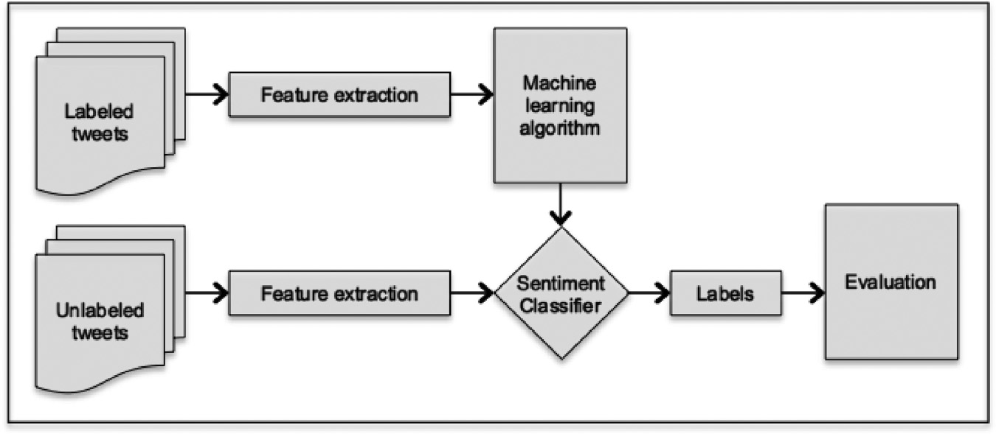
Machine Learning
Image. Typical process for sentiment classification.

Slide 16
Machine Learning
Bakliwal et al. 2012 employed an SVM classifier trained on 11 features to address TSA. They employed different pre-processing techniques one by one in order to measure their effectiveness. Spelling correction, stemming, and stop-words removal managed to increase the accuracy of the classifier. Two different datasets were used to evaluate their approach (Stanford and Mejaj). The best results were achieved by the combination of NLP and Twitter-specific features.

Slide 17
Lexicon-Based
Lexicon-based methods leverage lists of words annotated by polarity or polarity score to determine the overall opinion score of a given text. The main advantage of these methods is that they do not require training data. Lexicon-based are less explored in TSA compared to machine-learning methods. The main reason is the uniqueness of the text on Twitter that not only contains a large number of textual peculiarities and colloquial expressions (e.g yolo, gr8) but also has a dynamic nature with new expressions and hashtags emerging from time to time.

Slide 18
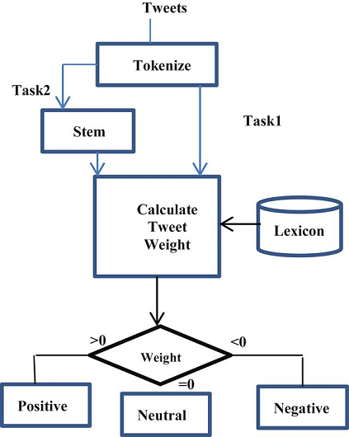
Lexicon-Based
Image. An example of the architecture of a framework of lexicon-based sentiment analysis.

Slide 19
Lexicon-Based
Ortega et al. 2013 proposed a three-step technique for TSA. Pre-processing was performed in the first step and polarity detection in the second step. In the last step, they performed rule-based classification. Polarity detection and rule-based classification were based on WordNet and SentiWordNet. Their approach managed to achieve good results when evaluated on the SemEval-2013 dataset. However, the authors did not compare their method with existing techniques to prove its effectiveness.

Slide 20
Hybrid
An interesting hybrid method was presented by Ghiassi et al. 2013, who combined dynamic artificial neural network with n-gram. Emoticons and tweets that contained the word love or hate or their synonyms were used as features to build the two classifiers: SVM and a Dynamic Architecture for Artificial Neural Networks (DAN2). The proposed approach was tested on a collection of tweets crawled using the subject Justin Bieber. The results showed that DAN2 managed to outperform SVM.

Slide 21
Graph-Based
Although machine-learning methods achieve a great performance on TSA, they require a large number of annotated data. Label propagation is a method that can reduce the demand of the annotated data. For this reason, a number of researchers utilized the Twitter social graph under the assumption that people influence one another. Label propagation is a semi-supervised method in which labels are distributed to nodes using the connection graphs.

Slide 22
Graph-Based
Some of the first to apply a label propagation method for TSA were Speriosu et al. 2011. Their proposed method leveraged the Twitter follower graph under the assumption that people influence one another. Users, tweets, unigrams, bigrams, hashtags, and emoticons were used as nodes for the construction of the graph. The proposed label propagation method outperformed a lexicon-based approach and a MaxEnt classifier.

Slide 23
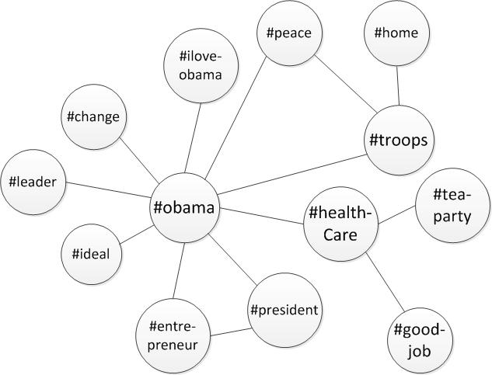
Graph-Based
Image. An example of a Hashtag Graph Model

Slide 24
Geolocation
Geolocation at Different Granularities
→ Prediction at city-level
→ 1,524,522 tweets from 9551 users
→ Google’s geocoding API, Twitter’s rest API and Twitter’s streaming API
Content-based statistical classifiers
Word Classifier
Hashtag Classifier
Place Classifier
Weka’s Naive Bayes Multimonial as learning algorithm.

Slide 25
Geolocation
Content-based heuristics classifiers
Local Place Heuristic Classifier
Visit Place Heuristic Classifier
Ensemble of Location Classifiers
→ Classification Strength for a user is the inverse of the number of matching locations in the matching location distribution.
→ Classification Strength of a classifier for a particular instance is used as the weight of that classifier in the ensemble (for classifying that instance) and the location with the highest rank by weighted linear combination is returned as the result.

Slide 26
Geolocation
Comparison of the state-of-the-art techniques
Users to dispose highly-precised locations. Building of a probabilistic model representing the likelihood of observing a relationship between two users given the geographic distance between them(Facebook).
The technique is a tree regression model that predicts the actual distance between the users. However, as the size of the network grows, computing the regression model on all pairs of located user dominates the run-time.
Proposal of several extensions to the [1] model based on strategies for weighting which of a user’s friends are likely to be most predictive of their location.

Slide 27
Geolocation
Infer geolocation by taking into account the influence of both users and of locations, capturing the intuition that some users are more informative for predicting the locations of the neighbors.
User may have more than one home location from which they posts. Relationships between users and locations are modeled with a supervised extension to Latent Dirichlet Allocation.
SVM with 3 features: (1) the cities of a user’s friends, relative to the city’s respective number of Twitter users, (2) the number of closed triads in a user’s social network residing in the same city, and (3) the number of reciprocal following relationships a user has per city.

Slide 28
Geolocation
A user, their location is inferred by taking the most frequently seen location among their social network.
Extension of the idea of location inference as label propagation by interpreting location labels spatially. Locations are inferred using an iterative, multi-pass procedure. during one pass, the location of each user is assigned as the geometric median of the locations of all the user’s neighbors, with ground-truth data providing the locations for the first pass.
Extension of above method to take into account edge weights in the social network and to limit the propagation of noisy locations.

Slide 29
Geolocation
Evaluation criteria
Accuracy of a post’s location.
Accuracy of a user’s all posts location.
Maximizing the posts whose location is able to be inferred.
→ AUC, Post Coverage and Median-Max.
Experiments
→ Cross Validation, Self-Reported locations and Temporal Decay

Slide 30
Geolocation
Using self-reported locations as ground truth yields far fewer ground truth locations than reported in earlier studies and even in the best configuration for matching these locations to coordinates, systems trained on self-reported locations suffer a large drop in accuracy, with the Median-Max error doubling for all but the lowest- performing systems.
According to, Geoinference methods that predict locations of future posts, it is concluded that while accuracy rates only decrease slightly, Post Coverage was estimated to drop by half after a four month period.

Slide 31
Conclusions
lalala

Slide 32
Conclusions
lalala

Slide 33
References
lalala

Slide 34
References
lalala

